Slide 1
Low level tasks for Digital Humanities

Slide 2
CEDAR project
Textual criticism
Comparing manuscripts to establish the original text

Slide 3
Image to text alignment
Aligns the text elements to the corresponding spatial locations on a document image.
Text elements can be words or letters.
Rafi Cohen, Irina Rabaev, Jihad El-Sana and Klara Kedem
ICDAR, 2015

Slide 4
Image to image alignment
Aligns the spatial locations of text elements on a document image to the corresponding spatial locations text elements on another document image.
Boraq Madi, Ahmad Droby, Jihad El-Sana
IJDAR, 2022
Majeed Kassis, Jumana Nassour, Jihad El-Sana
ICDAR, 2017

Slide 5
Low level tasks
Mentioned tools requires some low-level tasks to be executed prior to their execution.
Page segmentation
Line segmentation
Word segmentation
Letter segmentation
Pixel segmentation (binarization)

Slide 6
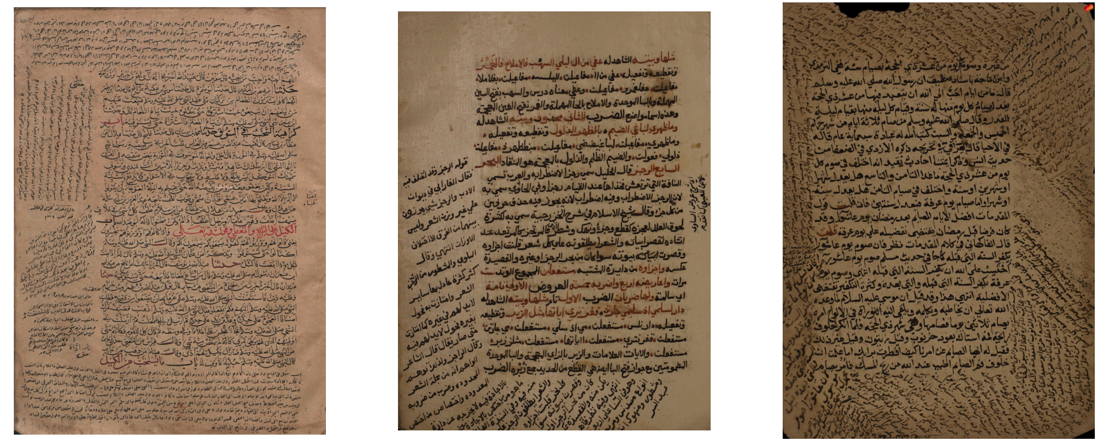
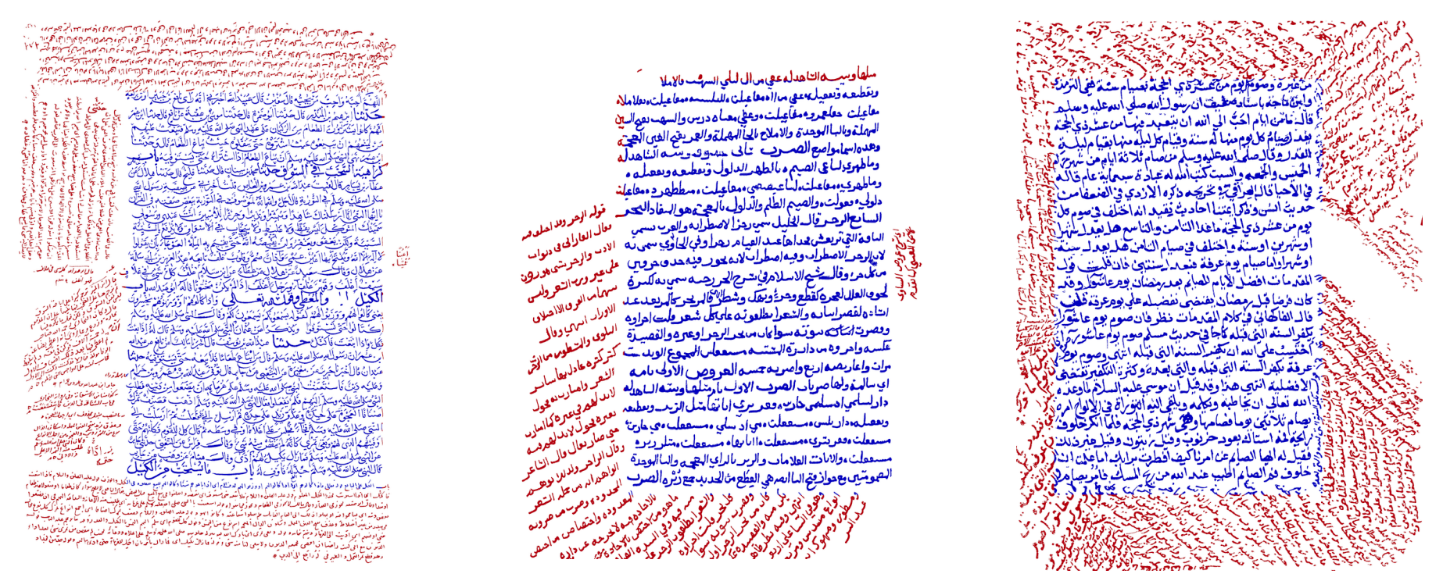
Page segmentation
Berat Kurar, Jihad El-Sana
ASAR, 2016

Slide 7
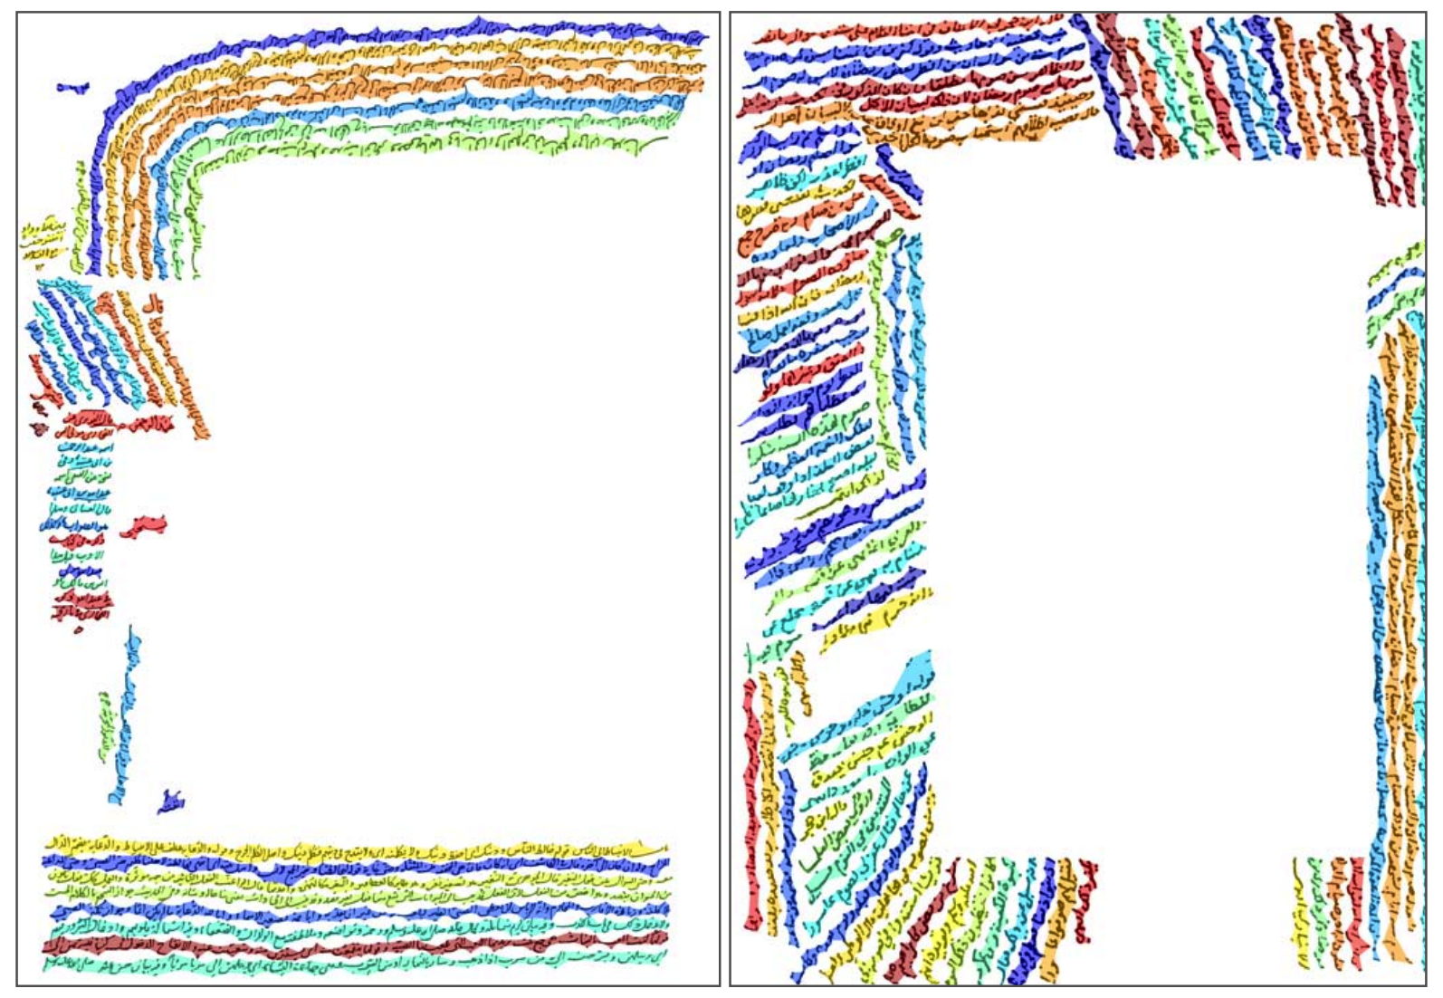
Line segmentation
Berat Kurar, Rafi Cohen, Irina Rabaev, Jihad El-Sana
ASAR, 2019

Slide 8
Word segmentation
Berat Kurar, Irina Rabaev, Jihad El-Sana
ICDAR, 2019

Slide 9
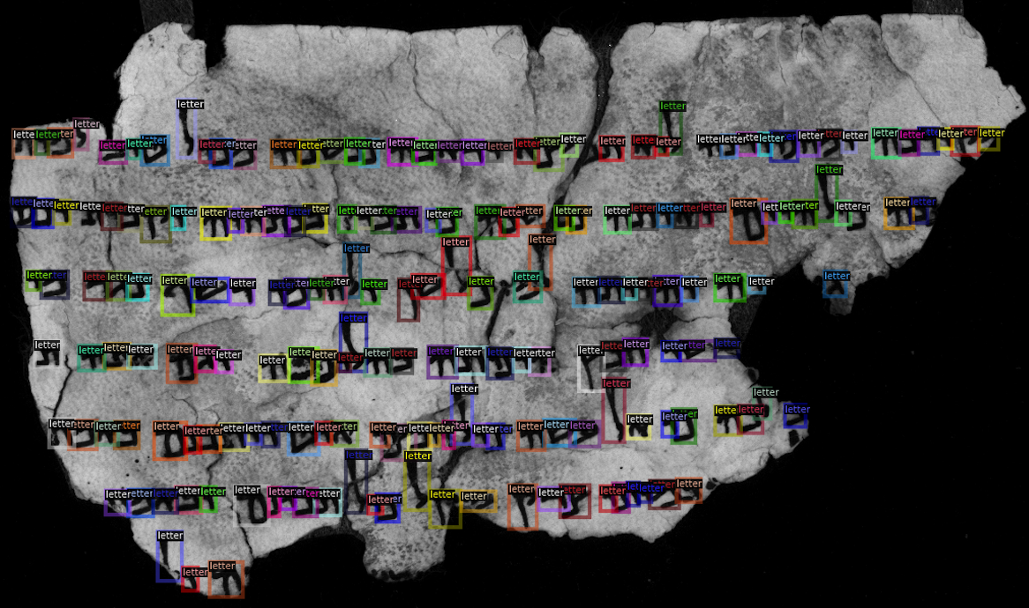
Object detection challenge

Slide 10
Letter segmentation (Object detection)

Slide 11
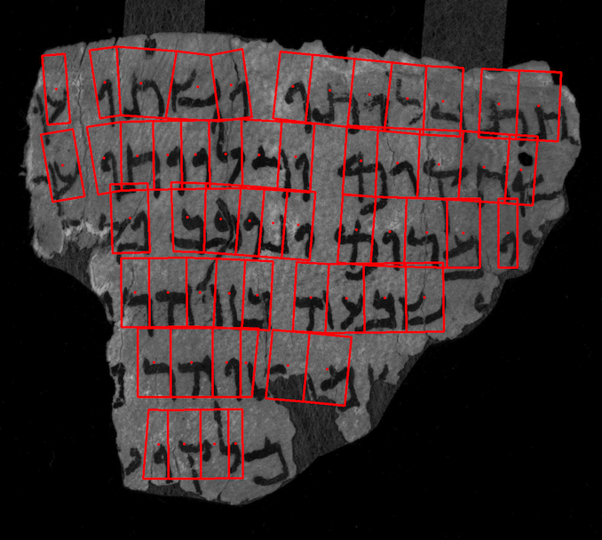
Letter segmentation (Kraken = RNN + CTC loss)
Benjamin Kiessling
DH, 2019

Slide 12
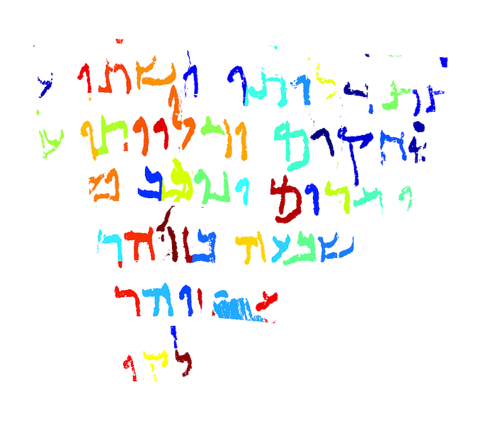
Pixel segmentation (Binarization)
Berat Kurar, Ahmad Droby, Irina Rabaev, Reem Alasam, Borak Madi, Jihad El-Sana
ICPPR, 2021

Slide 13
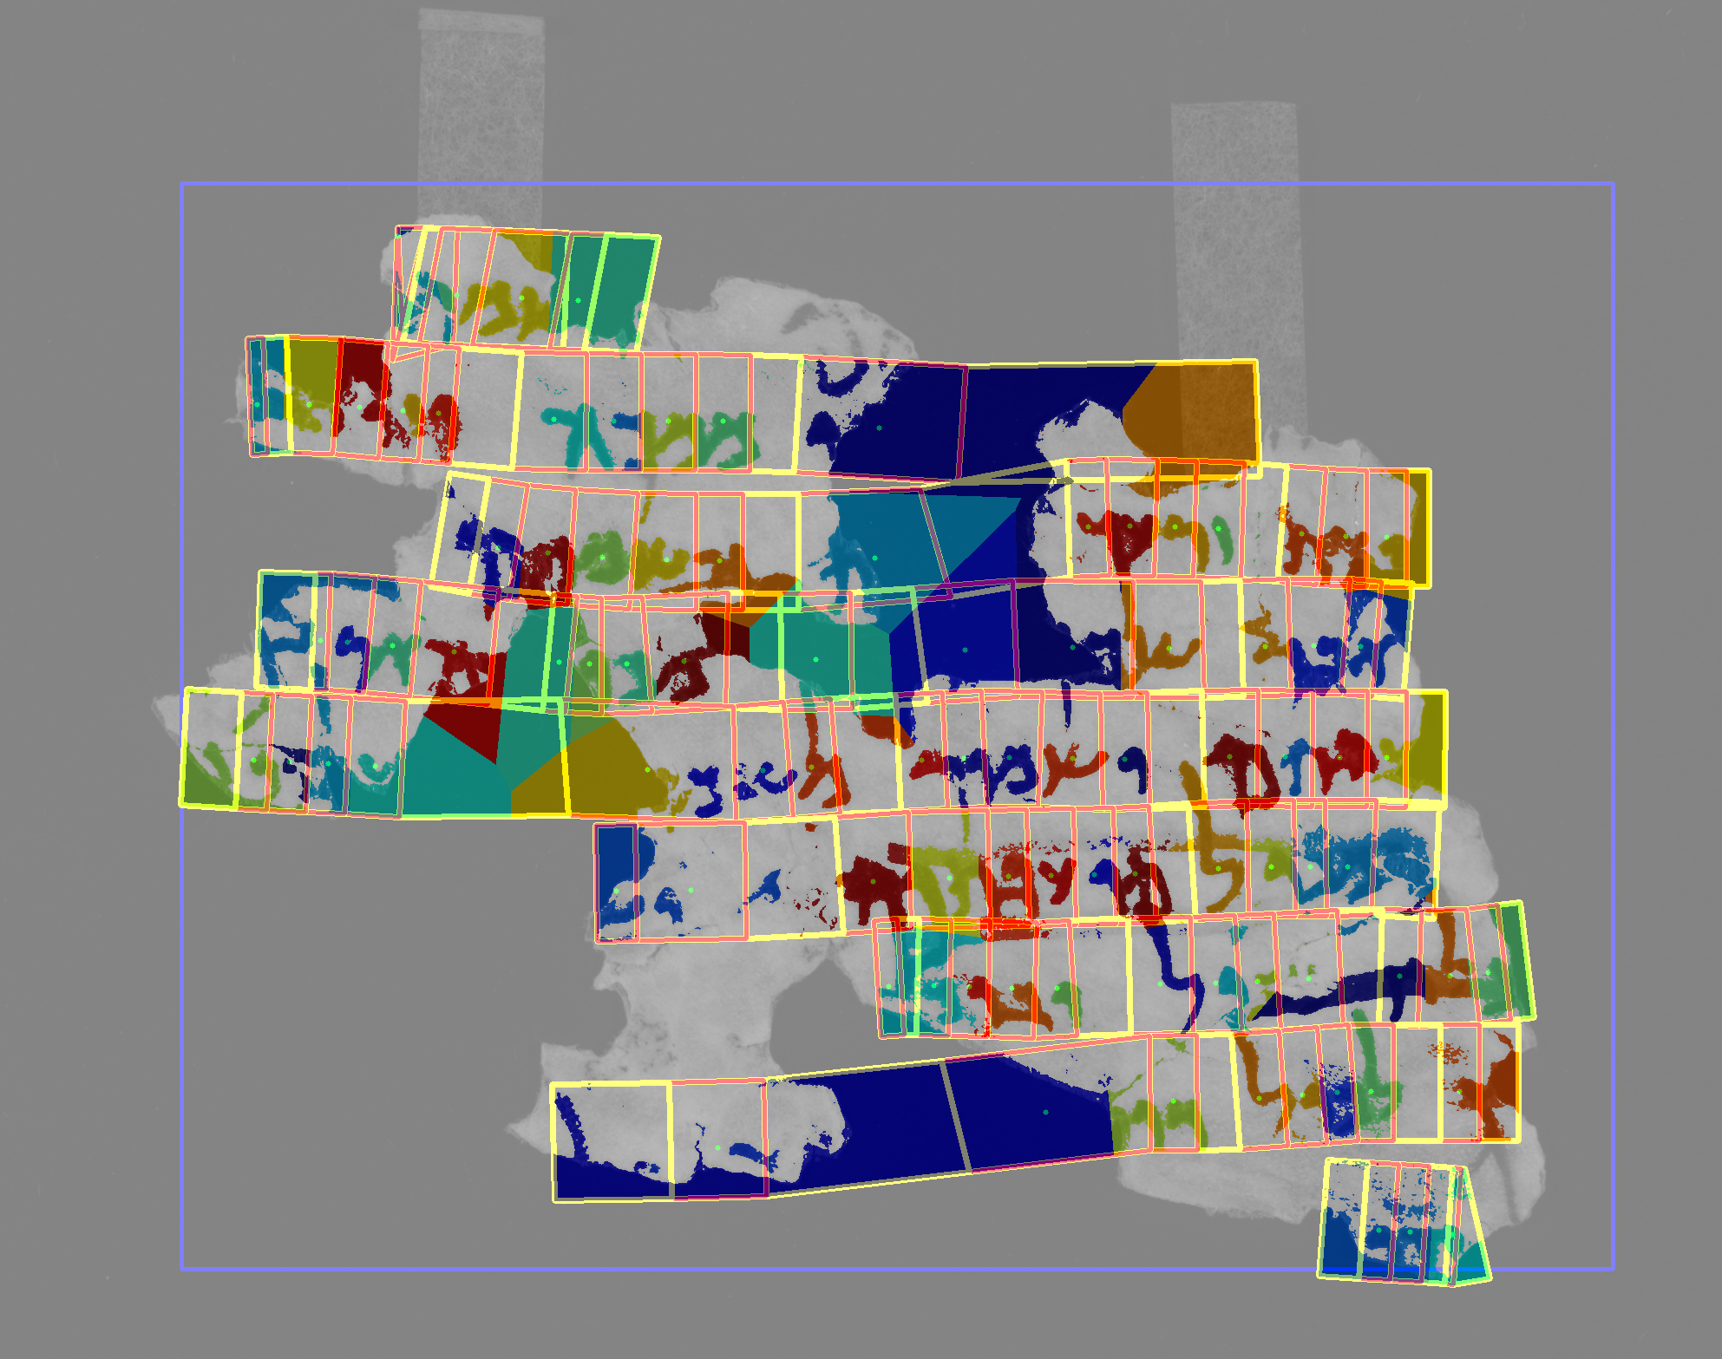
Kraken challenge
Berat Kurar, Ahmad Droby, Irina Rabaev, Reem Alasam, Borak Madi, Jihad El-Sana
ICPR, 2021

Slide 14
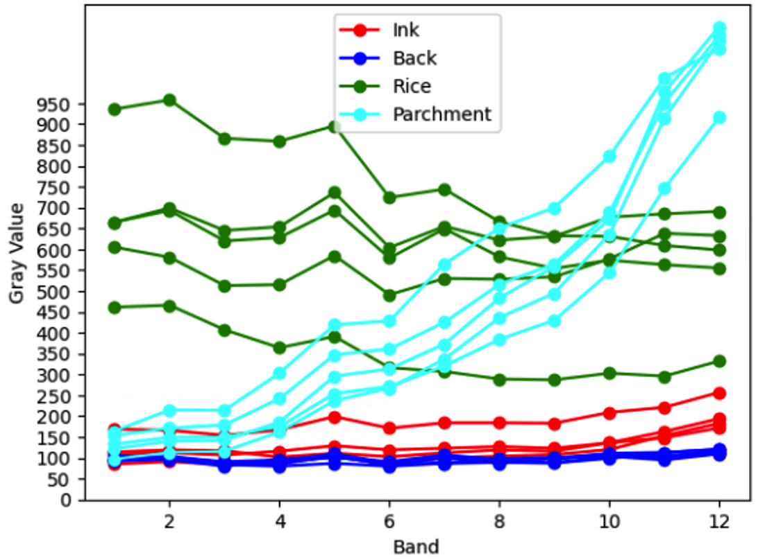
Multispectral segmentation
Gray value trend of pixels across multispectral bands

Slide 15
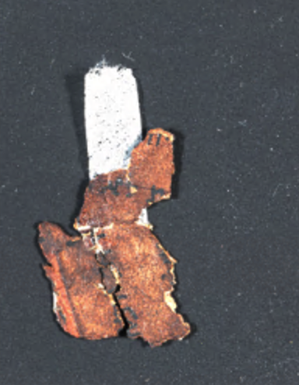
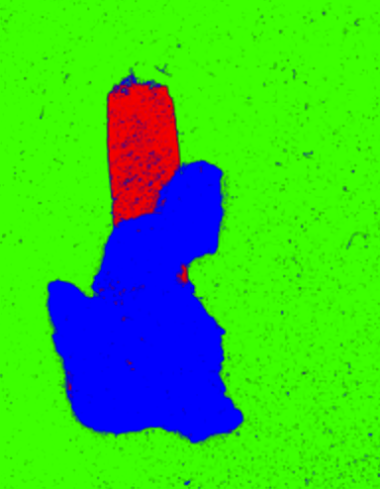
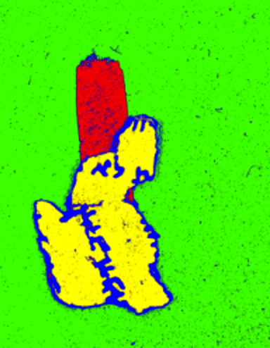
Multispectral segmentation
Notes:
Color, infrared, otsu, MS parchment, MS holes and shadows, MS letters

Slide 16
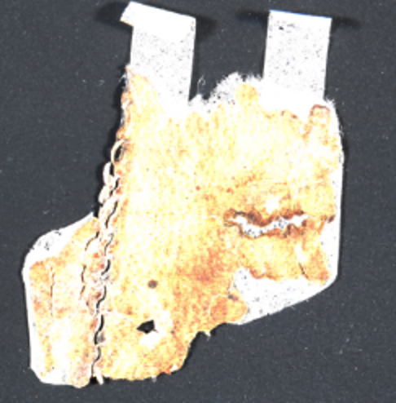
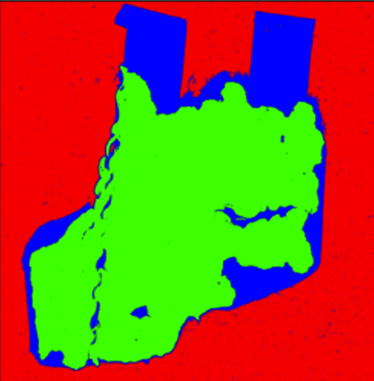
Multispectral segmentation
Notes:
Color, infrared, otsu, MS parchment, MS holes and shadows

Slide 17
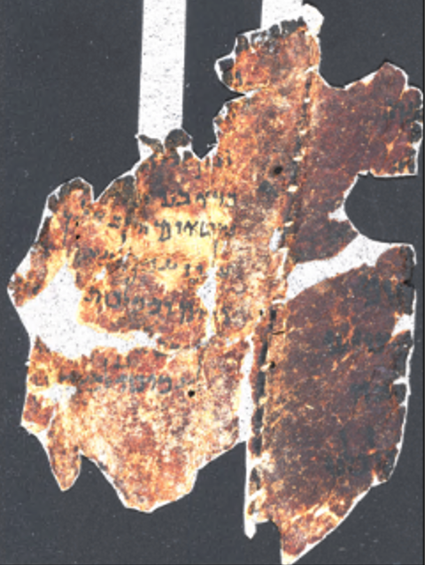
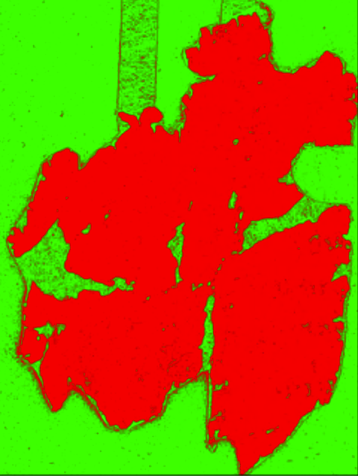
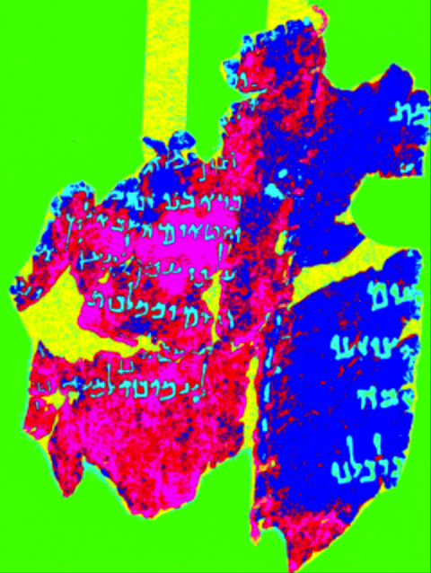
Multispectral segmentation
Notes:
Color, infrared, otsu, MS parchment, MS holes and shadows, MS letters

Slide 18
Accurately detected and recognized letters are crucial:
Transcription alignment
Paleography

Slide 19
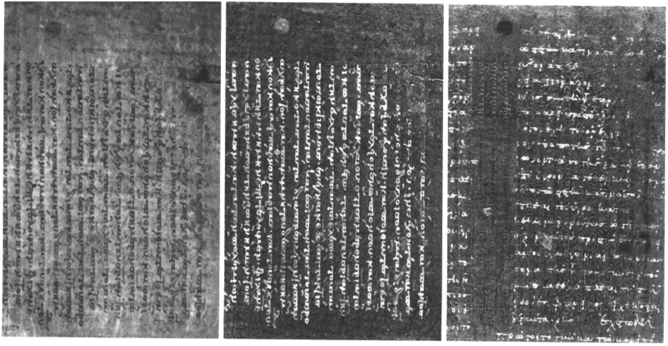
Multispectral segmentation challenge
R.L. Easton; K.T. Knox; W.A. Christens-Barry
AIPR, 2003

Slide 20
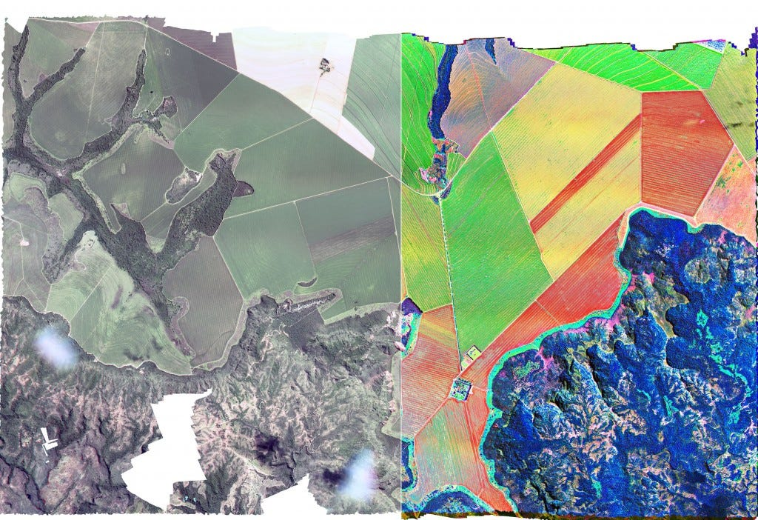
Multispectral segmentation challenge
https://medium.com/remote-sensing-in-agriculture
2016

Slide 21
Digital Hebrew Paleography: Script Types and Modes Ahmad Droby, Irina Rabaev, Daria Vasyutinsky, Berat Kurar Barakat, and Jihad El Sana 2022 Journal of Imaging, MDPI
Hard and Soft Labeling for Hebrew Paleography: A Case Study Ahmad Droby, Daria Vasyutinsky, Irina Rabaev, Berat Kurar Barakat, and Jihad El Sana (DAS) 2022 IAPR International Workshop on Document Analysis System
Is a deep learning algorithm effective for the classification of medieval Hebrew scripts? Daria Vasyutinsky, Irina Rabaev, Ahmad Droby, Berat Kurar Barakat, and Jihad El Sana 2022 #DHJewish - Jewish Studies in the Digital Age
VML-HP: Hebrew paleography dataset Ahmad Droby, Berat Kurar Barakat, Irina Rabaev, Daria Vasyutinsky, and Jihad El Sana (ICDAR) 2021 International Conference on Document Analysis and Recognition
SmartScript: a Web-Based System for Classification of Medieval Hebrew Scripts Daria Vasyutinsky, Irina Rabaev, Ahmad Droby, Berat Kurar Barakat, and Jihad El Sana 2021 The ACH Conference
Deep learning for palaeographic analysis of medieval Hebrew manuscripts: a DH team collaboration experience Daria Vasyutinsky, Irina Rabaev, Berat Kurar Barakat, Ahmad Droby, and Jihad El Sana 2020 Twin Talks: Understanding and Facilitating Collaboration in Digital Humanities

