Slide 1
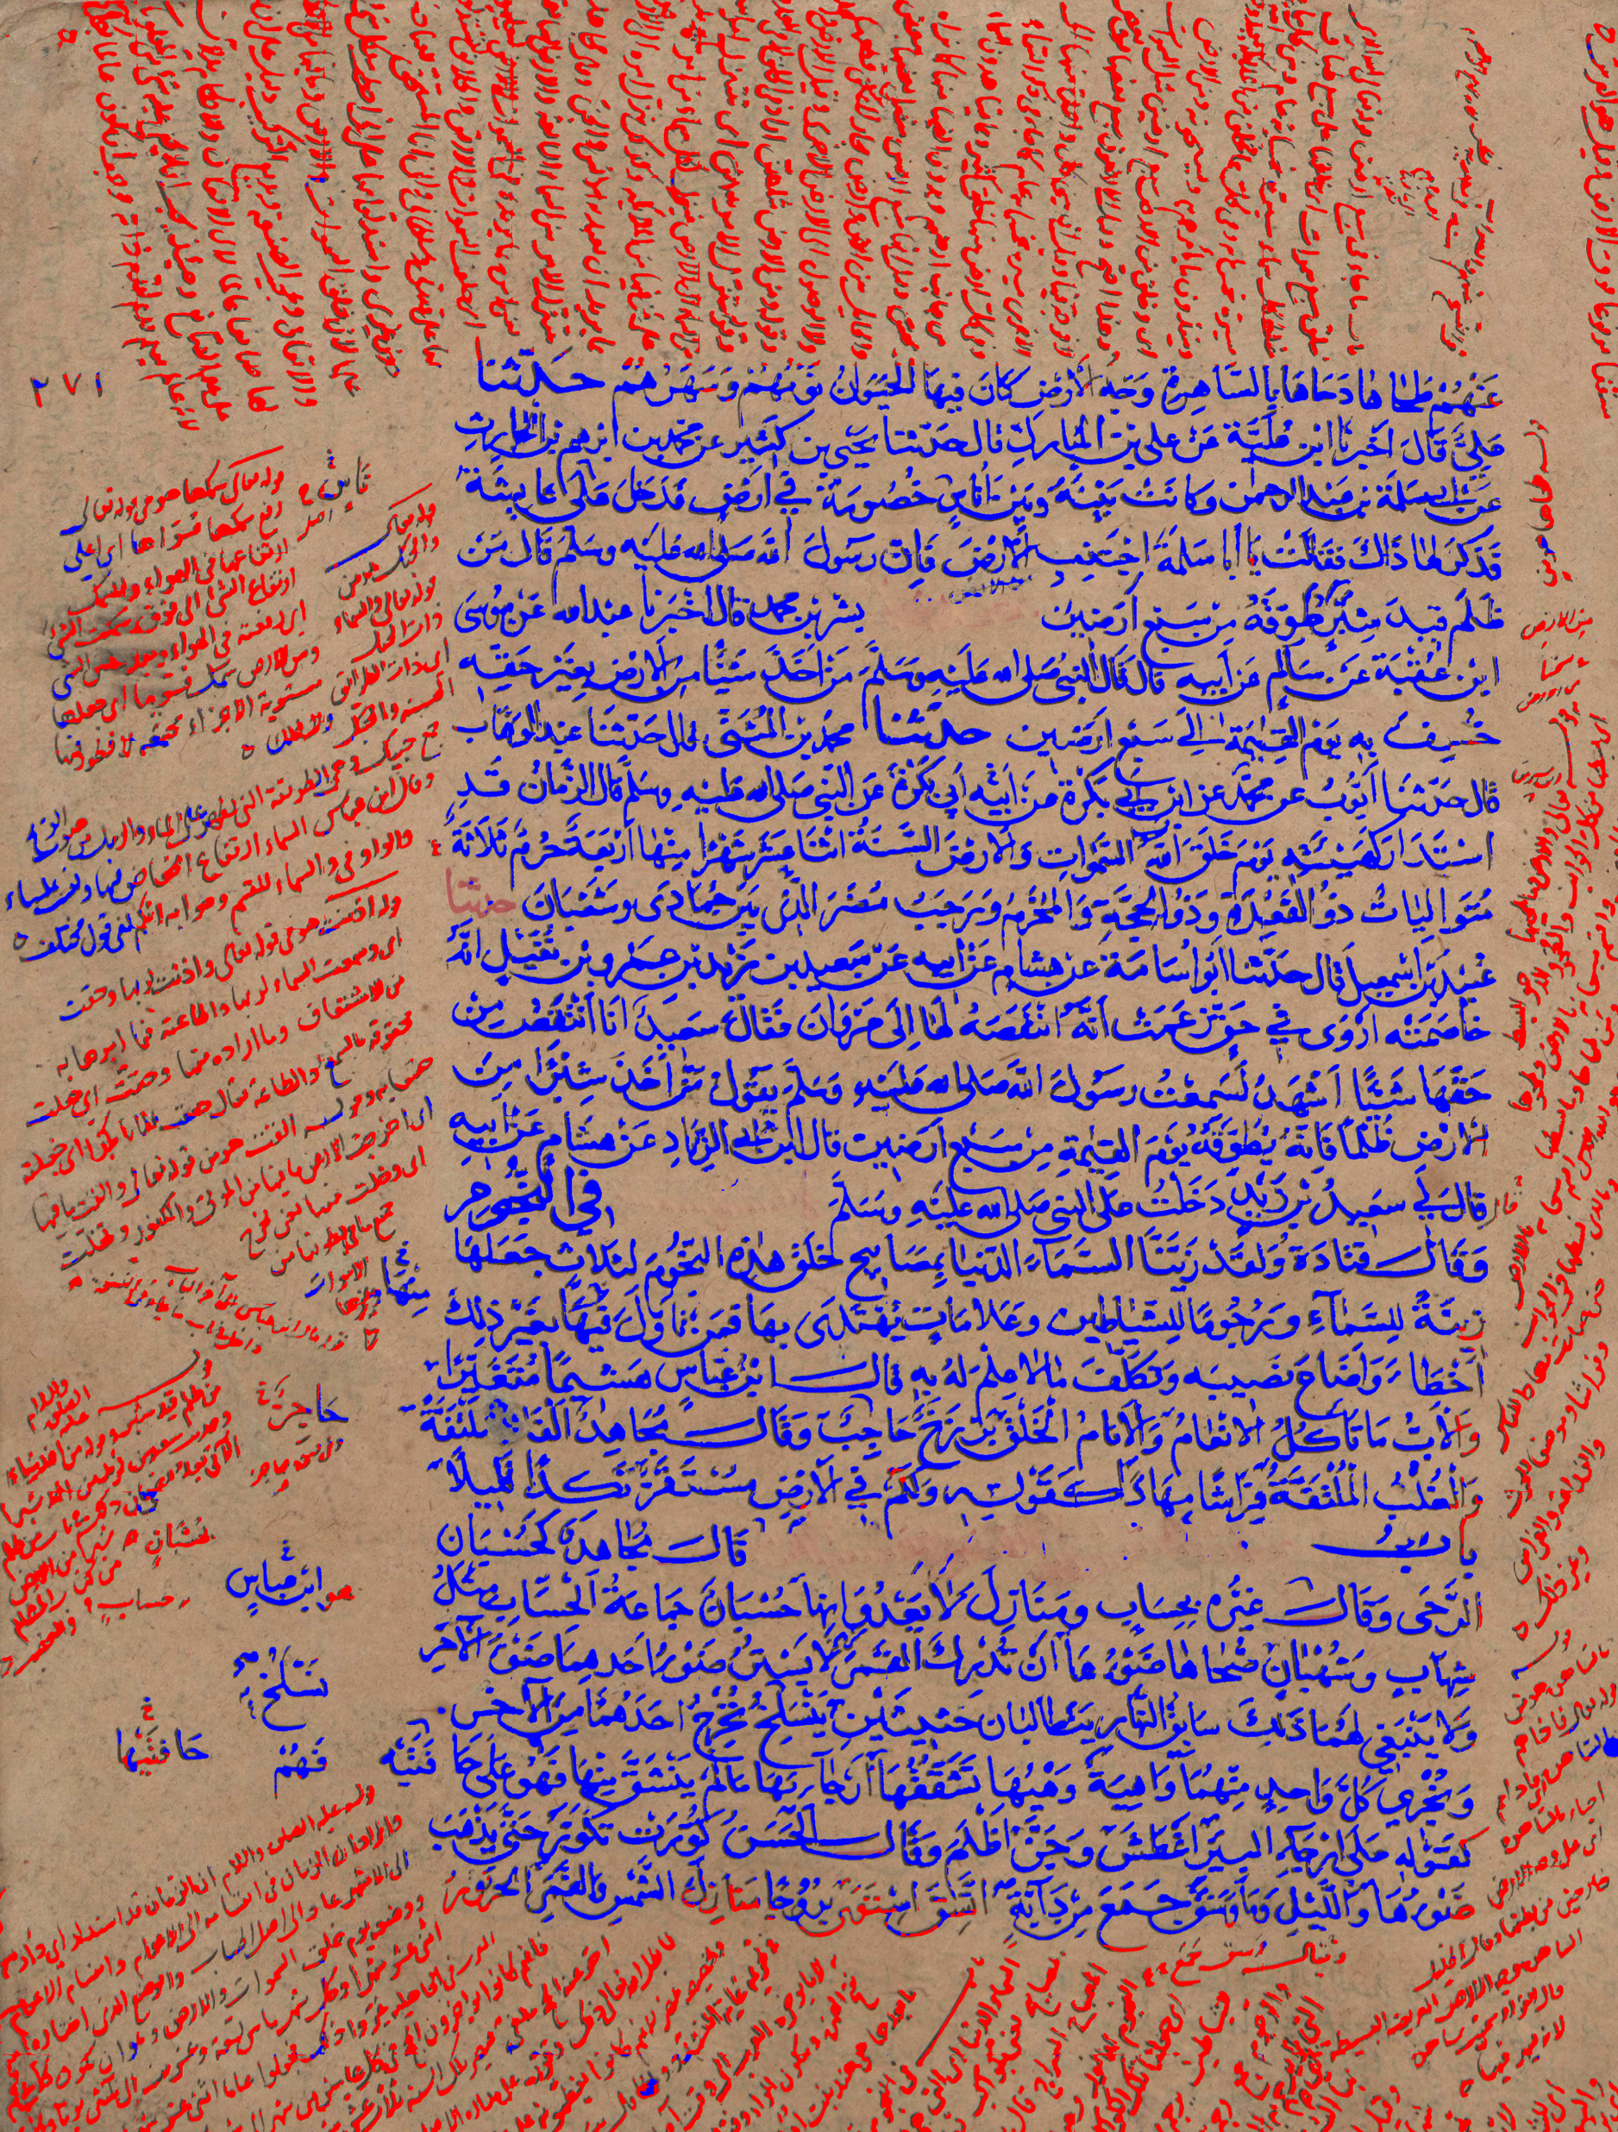
A recent method for document image layout analysis
Berat Kurar Barakat
Courtesy Leipzig University
Notes:
Hi, I am Berat.
Formerly a bachelor student from Bethlehem University.
And currently a pHD student of Jihad.
We research how to use deep learning methods for historical document image processing.
So I am going to present you a deep learning based method for document image layout analysis which we have used for publishing a paper and participating two international competitions in 2018.

Slide 2
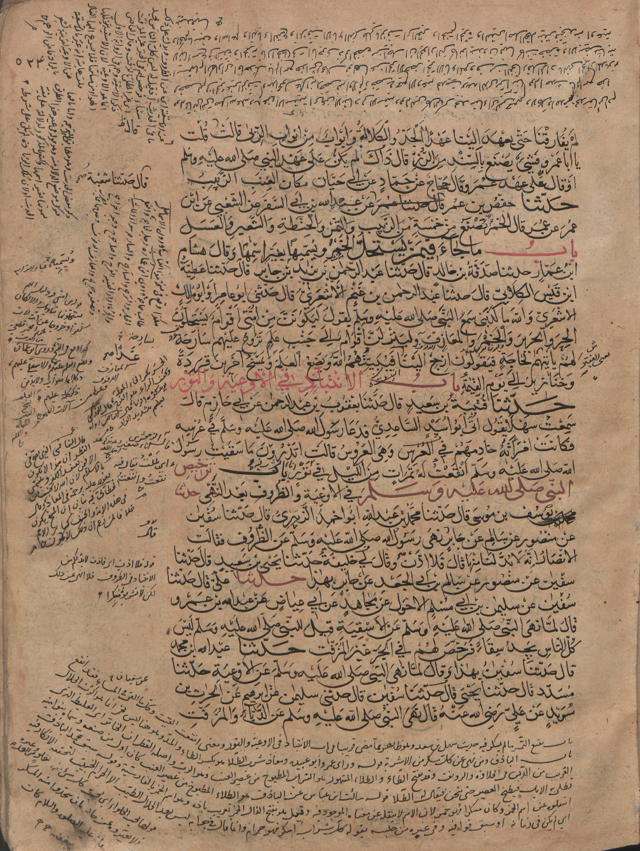
Problem definition
Side text
Main text
Notes:
Page layout analysis is an important pre-processing step for the other document image processing algorithms.
Given a document image, we first need to segment it into homogeneous regions and then classify these regions.
For example in one of our problems we have to segment and classify the regions as main text and side text.

Slide 3
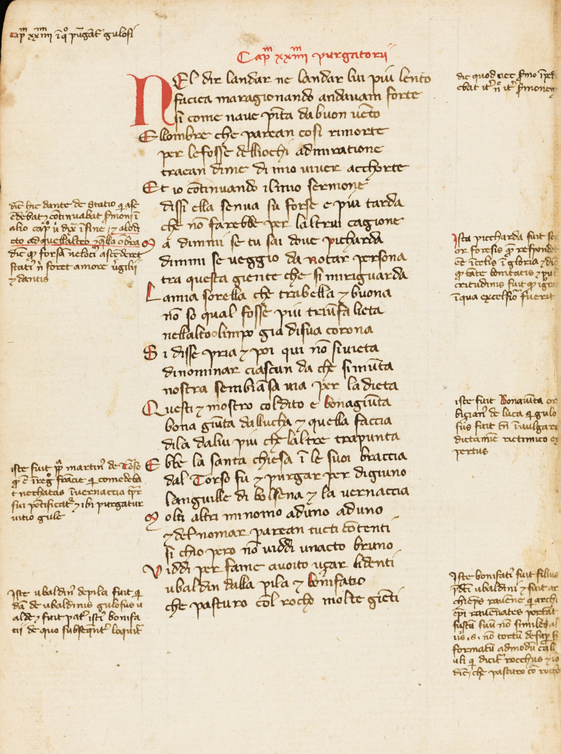
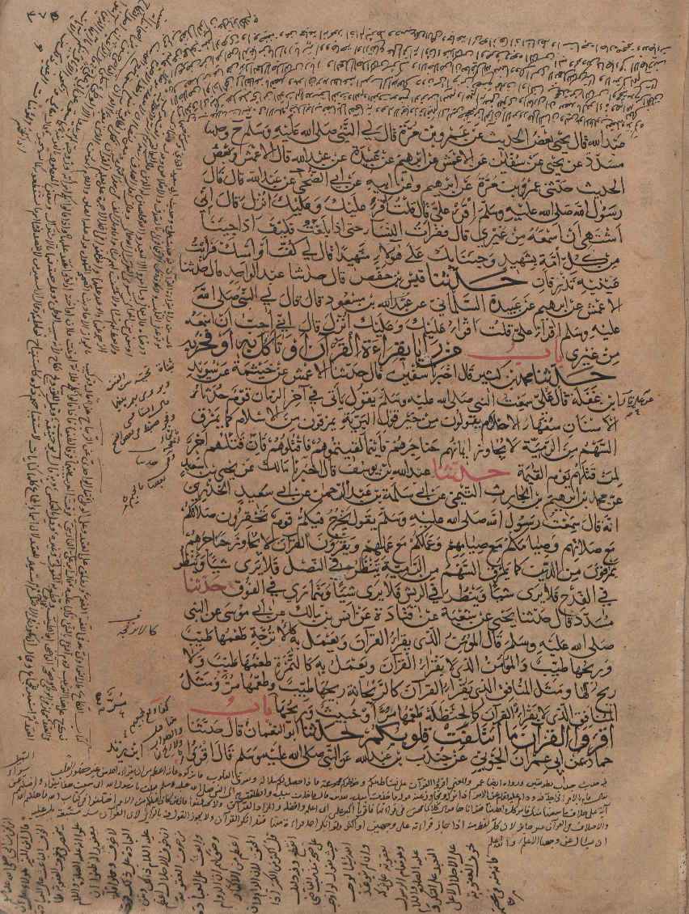
Contribution
- Simple layout
- Low degradation
- Complex layout
- High degradation
Notes:
For page layout analysis problem we've proposed a deep learning based method.
It can work on document images with complex layout and relatively higher degradation levels.
In addition this method can reach satisfactory results without any pre processing or post processing.

Slide 4
Related work
Bukhari et al, 2012
Complex layout
Multilayer Perceptron (MLP)
Connected component classification
Context features ---> Redundant computation
        Enormous time
Binarized ---> Potential errors
        Additional time
Post processing ---> Dataset specific parameters
        Additional time
Notes:
Previously Bukhari et al worked on complex layout document images.
They used multilayer perceptron to classify connected components according to their context features which in turn leads to redundant computation and enormous time.
Input is binarized and can introduce potential errors when used highly degraded documents.
Also output is processed using dataset specific parameters.

Slide 5
Related work
Simistra et al, 2016
Simple layout
Deep learning
Pixel classification
Context features ---> Redundant computation
        Enormous time
Pre training ---> Additional time
Notes:
Recently Simistra et al worked on simple layout document images.
They used deep learning to classify pixels according to their context features which in turn leads to redundant computation and enormous time in addition to the time needed for their pre training phase.

Slide 6
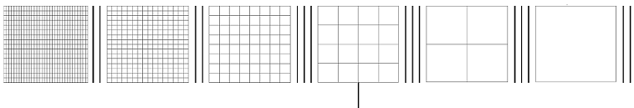
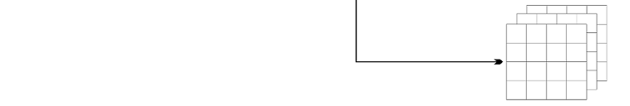
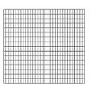
Method
Qualitative results
Qualitative results
Fully Convolutional Network (FCN)
VGG-16
image
conv1
pool1
conv2
pool2
conv3
pool3
conv4
pool4
conv5
pool5
conv6-7
m
n
Encoder
8 x upsampled
Prediction (FCN8)
4x conv7
2x pool4
pool3
m
n
Decoder
J. Long, E. Shelhamer, and T. Darrell, “Fully convolutional networks for semantic segmentation”, 2015
Notes:
And our method is based on fully convolutional networks.
A fully convolutional network learns to extract features and classify them simultaneously.
The input is an image patch.
Then we have convolutional blocks.
Each block consists of convolutional layers and a maxpooling layer.
First five blocks follow the design of VGG 16 network.
Then there are two additional convolutional layers 6 and 7
This part is called encoder part of the FCN.
Encoder downsamples input image by max pooling layers.
Then, decoder upsamples the downsampled outputs to input image size using transpose convolution.
Result is a tensor of m by n by number of classes. This tensor contains a class label for each corresponding pixel of the input.

Slide 7
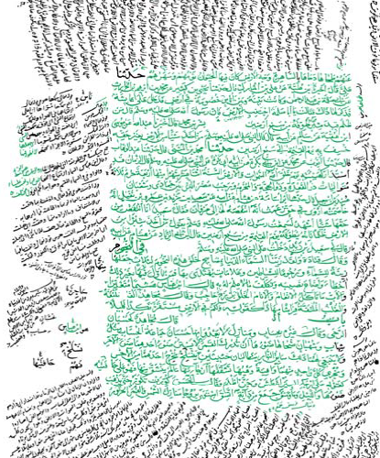
Paper results
Our method
Bukhari et al
Courtesy Leipzig University
Notes:
These are qualitative results from our paper work compared with Bukhari et al.
Most important difference is that our input is not binarized.

Slide 8
Paper results
F1 measure on test set
 | Main text | Side text
Our method | 0.95 | 0.80
Bukhari et al | 0.95 | 0.95
Notes:
And these are quantitative results from our paper work.
Our method performs as good as Bukhari et al in main text classification and they outperform us in side text classification

Slide 9
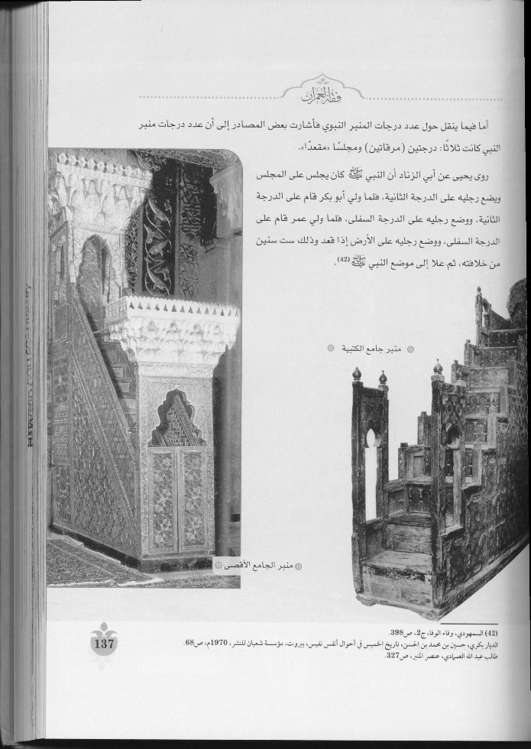

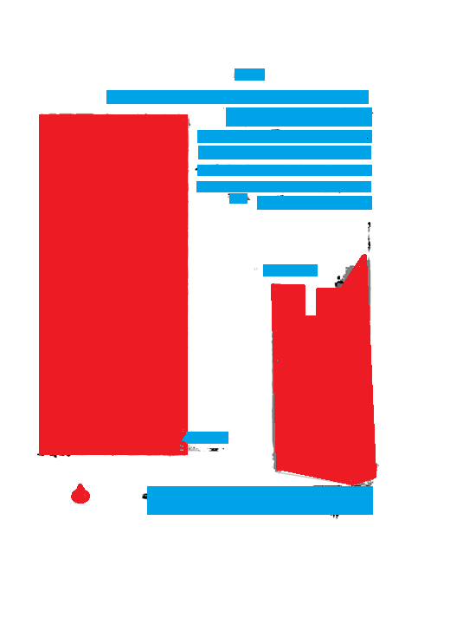
Competition results
ASAR 2018 Page layout analysis competition
Input
Prediction
Postprocessed
Notes:
Using FCN method we also participated ASAR 2018 Page layout analysis competition.
Here we can see an example input from this competition and its FCN prediction. In this competition we used a post processing step which further refines our results.

Slide 10
Competition results
ASAR 2018 Page layout analysis competition
 | Pixel F1 | Block F1
FCN | 0.86 | 0.92
RFAAD | 0.64 | 0.79
AdaTh | 0.84 | 0.84
Notes:
Here are the quantitive results from ASAR 2018 competition. We got the first place in page segmentation classification track in comparison to other two competitor algorithms.

Slide 11
Competition results
ICFHR 2018 Arabic scientific manuscript layout analysis competition
Input
Postprocessed prediction
Notes:
Using FCN method we also participated ICFHR2018 Arabic scientific manuscript layout analysis competition..
Here we can see an example input from this competition and its FCN prediction with post processing.

Slide 12
Competition results
ICFHR 2018 Arabic scientific manuscript layout analysis competition
Notes:
Here are the quantitive results from ICFHR 2018 competition. Again we got the first place in page segmentation and classification track in comparison to other four competitor algorithms.

Slide 14
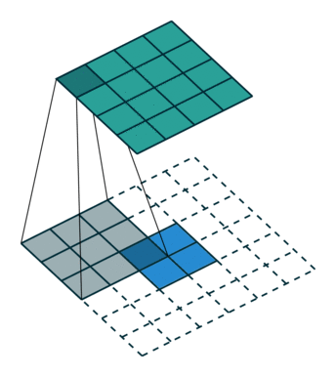
Transpose convolution
Transpose convolution
Notes:
Transpose convolution

