Slide 1
Deep Learning for Historical Document Image Processing
Doctoral Research Proposal
Candidate: Berat Barakat Supervisor: Jihad El-Sana
16/06/2018
Notes:
Hi, I am Berat.
I am going to present my doctoral research proposal with the title …

Slide 2
Contents
  Introduction
    Significance
    Hypothesis
  Literature review
    Page layout analysis
    Text line segmentation
    Text alignment
  Initial results
  Research plan
  Conclusion
Notes:
At first I will introduce goal and significance of the research and set our hypothesis.
Later I will review the literature.
Then I will present our initial results
And lastly I will talk about our research plan and conclude

Slide 3
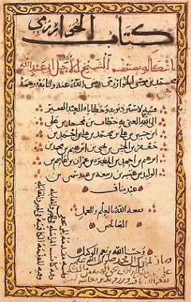
introduction

Slide 4




Goal of the research
Deep learning
Page layout
analysis
Textline
segmentation
Text
alignment
Notes:
The goal of this research is application of deep learning algorithms for page layout analysis, text line segmentation and text alignment of Arabic and Hebrew historical document images.

Slide 5
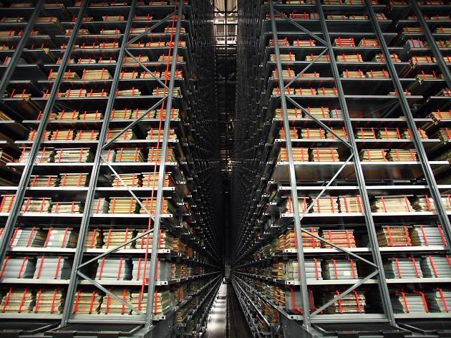
Significance of the work
So far British Library digitized over 30 million documents
Retrieved from
https://www.bl.uk/digitisation-services
Notes:
Historical documents are being digitized plentifully for preservation and dissemination.
But digital documents further need to be transcribed for easy explorability.
Hence there is a significant need for reliable historical document image processing algorithms.

Slide 6
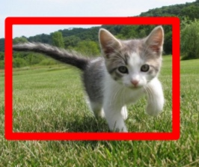





Significance of the work
Object
recognition
Deep
learning
Voice
recognition
Drug
discovery
Notes:
On the other hand, deep learning has improved state-of-the-art in image recognition, voice recognition, drug discovery.

Slide 7
Hypothesis
Page layout
analysis
Deep
learning
Textline
segmentation
Text
alignment
Notes:
Therefore we hypothesize that deep learning can leverage the complexity of historical documents and improve the performance of page layout analysis, text line segmentation and text alignment algorithms
Here we have the challenge That deep learning algorithms are successful but their effective training requires much labeled data.
We have much data but limited labeled data. Therefore we have to seek remedies for this challenge during our experiments

Slide 8
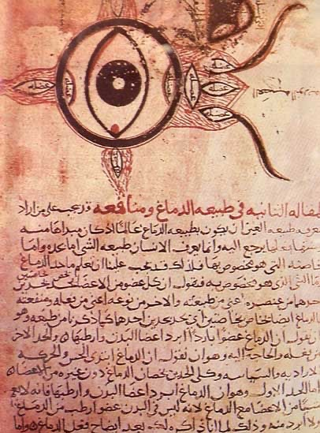
Literature review
Notes:
Before I start the literature review I would like to note that most primitive works were on printed documents, and I will talk about some of them as well.

Slide 9
Page layout analysis literature
Top-down methods
Wong et al., 1982
Akiyama and Hagita, 1990
Antanacopoulus and Apostolos, 1998
Bottom-up methods
Garz et al., 2011
Journet et al., 2008
Mehri et al., 2013
Mehri et al., 2014
Bukhari et al., 2012
Asi et al., 2014
Wei et al., 2013
Chen et al., 2014
Wei et al., 2014
Chen et al., 2015
Wei et al., 2015
Chen et al., 2017
Notes:
Page layout analysis consists of page segmentation and region classification.
Page segmentation segments a document image into homogeneous regions.
Region classification classifies these regions into classes such as text, graphic and picture.
Page segmentation algorithms work in either top-down or bottom-up manner.
Top-down methods segment a whole page into regions.
Bottom-up methods aggregate elements into regions.
Where elements can be pixels, connected components or patches.

Slide 10
top-down methods
Notes:
Top-down methods are applicable to binary and printed documents with manhattan layout.

Slide 11
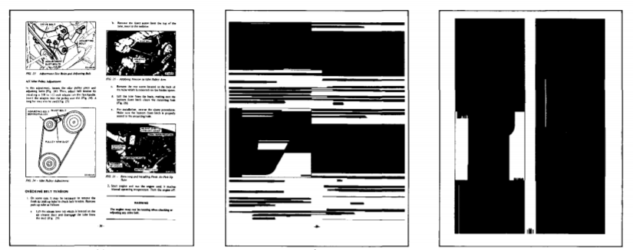
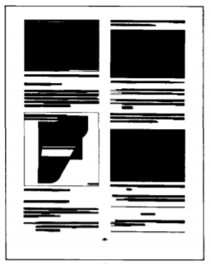
Wong et al., 1982
Smearing
Input document
Horizontal RLSA
Vertical RLSA
Horizontal RLSA
Λ
Vertical RLSA
Notes:
For example in this work, smearing was used for page segmentation.
Smearing links together the neighboring pixels that are separated by less than a threshold number of pixels.
Smearing was applied in horizontal and vertical direction. Then the outputs were combined using logical and operation to produce the final segmented regions. The regions were then classified according to region features such as total number of black pixels, horizontal black-white transitions and height of the region. This method has a high computational cost of pixel-wise operations with further problem of choosing the appropriate threshold.

Slide 12
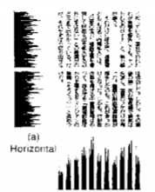
Akiyama and Hagita, 1990
Projection profile
Horizontal PP
Vertical PP
Notes:
In this work, projection profile was used for page segmentation.
A projection profile is obtained counting the number of black pixels along a given direction.
PP was applied recursively to divide document into smaller regions.

Slide 13
Bottom-up methods
Notes:
Bottom-up methods are the methods based on clustering or classification.
They are applicable to color or gray documents with unconstrained layouts

Slide 14
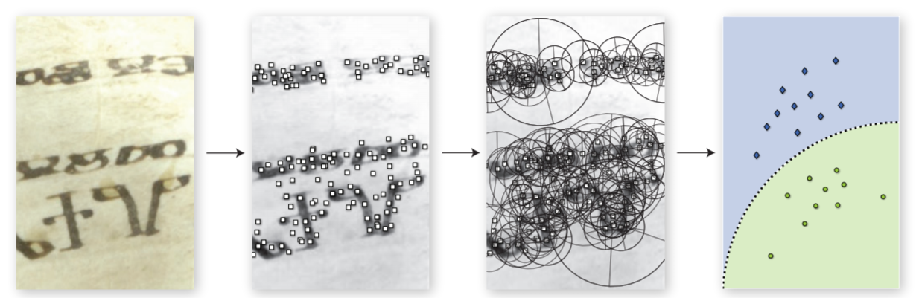
Garz et al., 2011
Point of interest classification
Input
Interest points
by DoG
SIFT
descriptors
SVM classification
Notes:
In this work, first interest points were computed by DoG.
DoG represents discriminative character parts such as junctions, arcs or endings.
Then for every interest point a SIFT descriptor was computed.
Finally the descriptors were classified by SVM into initials, headings and text areas.
SIFT descriptor is invariant to scale, rotation and illumination so the method is robust to various script sizes, orientations and background intensities.

Slide 15
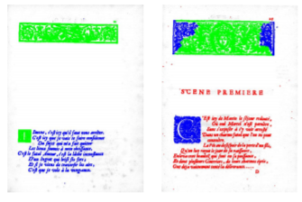
Journet et al., 2008, Mehri et al., 2013,Mehri et al., 2014
Pixel clustering using texture features
Texture features by:
Gabor filters
Grey level co-occurence matrix
Auto correlation matrix
Pixels clustered by texture features
Notes:
In these 3 works texture features were used for page segmentation.
Texture is a low level feature that describes coarseness and regularity.
Texture features can be extracted using autocorrelation function, Grey Level Co-occurrence Matrix (GLCM), Gabor filters.
These works clustered the pixels according to their texture features to form the segmented regions.

Slide 16
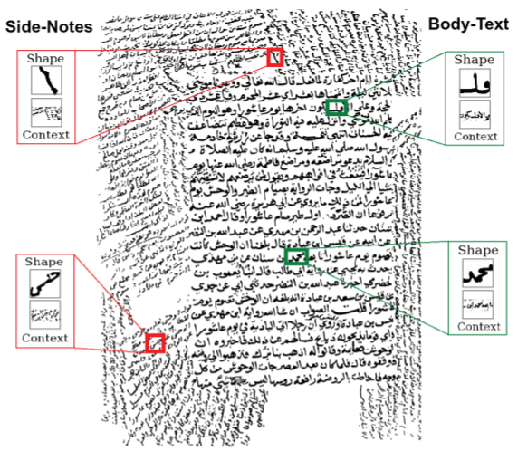
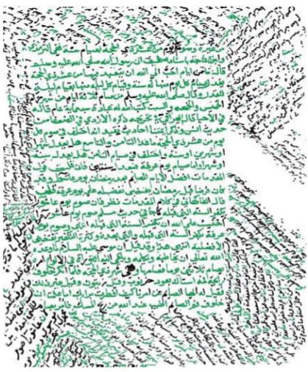
Bukhari et al., 2012
Connected component classification using shape and context features
Input
Pixels classified by MLP
Notes:
In this work shape and context features of connected components were used for page segmentation.
These features are normalized height, foreground area, orientation and neigbourhood information of the connected components.
This work classified the connected components according to their shape and context features using MLP into maintext or sidetext classes.

Slide 17
Wei et al., 2013
Pixel classification using color features with SVM, GMM and MLP
Chen et al., 2014
Pixel classification using color and texture features with SVM
Wei et al., 2014
Pixel classification using color and texture features by feature selection algorithm
Chen et al., 2015
Pixel classification using convolutional auto-encoder features with SVM
Notes:
There are plenty of works that formulates page segmentation as pixel classification.
Their difference is type of the features or classifiers.
Main problem of these methods is high computational cost of pixel wise operations in addition to redundant context feature calculations.

Slide 18
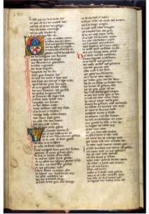

Chen et al., 2017
Pixel classification with CNN
Input
Pixels classified by CNN
Notes:
The recent work in the time of this proposal was also based on pixel classification but using CNN.
To speed up pixel wise operations they first generated superpixels.
A superpixel is an image patch which contains the pixels belong to the same object.
They only classified the center pixel of each superpixel and rest pixels in that superpixel were assigned to the same class.

Slide 19
Text line segmentation literature
Projection methods
Ha et al., 1995
Manmatha et al., 1999
Arivazgahan et al., 2007
Bar-Yosef et al., 2009
Ouwayed et al., 2012
Smearing methods
Kwan et al., 1982
Shi et al., 2004
Alaei et al., 2011
Grouping methods
Bukhari et al., 2009
Saabni et al., 2014
Moyyset et al., 2015
Li et al. 2016
Pastor et al., 2016
Notes:
Text line segmentation is locating each text line in a text region.
The solutions fall in three categories: projection methods, smearing methods and grouping methods.

Slide 20
Projection methods
Notes:
Projection methods use projection profiles in horizontal axis to determine the gaps between the text lines.

Slide 21
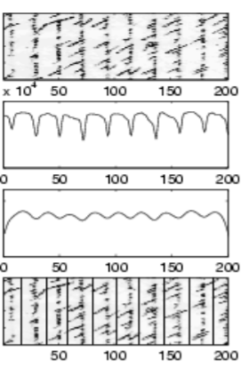
Ha et al., 1995, Manmatha et al., 1998
Projection profile
Input
PP
Smoothed
PP
Segmented
lines
Notes:
Here the first work used plain projection profile on binary documents whereas the second work extended projection profile to grey images by smoothing them with a Gaussian filter to eliminate the false max and mins.
But this method is not robust skew variation.

Slide 22
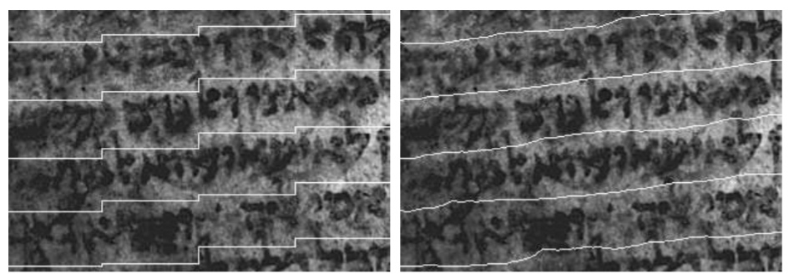
Arivazgahan et al., 2007, BarYosef et al., 2009
Projection profile
Piecewise local PP
Adaptive local PP
Notes:
Therefore Arivazgahan et al. proposed piece wise local projection profiles for skewed lines.
However their segmentation results in a stair case appearance.
As a solution Yosef et al. proposed adaptive local projection profile that adapts to skew of each text line as it progresses. They applied projection profile stripe by stripe. At each stripe first they calculated the orientation of the text lines then applied projection profile in the skew direction.

Slide 23
Smearing methods
Notes:
Smearing links together the neighboring pixels that are separated by less than a threshold number of pixels.
In the smeared image bounding boxes of the connected components are the extracted text lines.

Slide 24
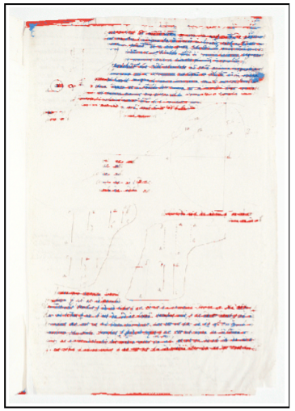
Shi et al., 2004
Smearing background pixels
Extracted text lines
superimposed on manuscript
Notes:
Smearing method fails on documents with touching text lines.
Therefore this work smeared background pixels.
But if the threshold is too big then it may erase the text areas.
So for every background pixel they store the number of skipped foreground pixels.
Then they binarize the resulting matrix using a pre-set threshold to get the final segmentation.
This method breaks the touching lines but is not robust with skewed lines.

Slide 25
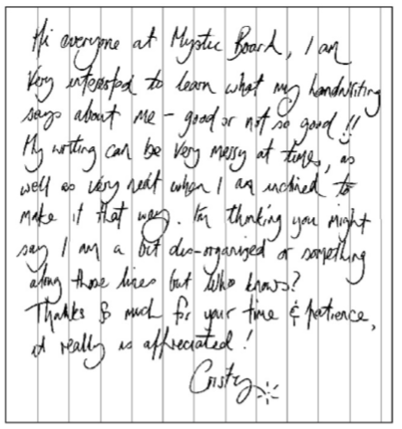
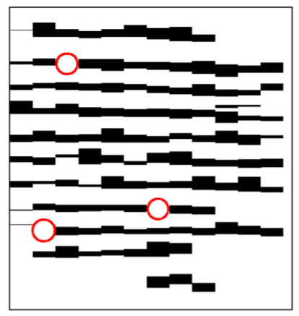
Alaei et al., 2011
Strip wise smearing
Striped input
Striped smearing
Notes:
On the contrary this work smeared the foreground pixels in a strip wise fashion that preserves the skew of each text line.

Slide 26
Grouping methods
Notes:
Grouping method aggregates pixels or connected components in a bottom up strategy.

Slide 27
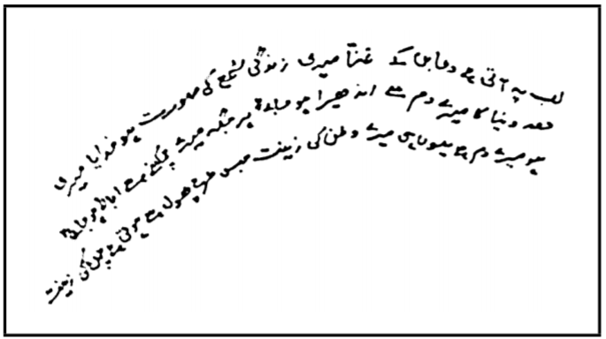
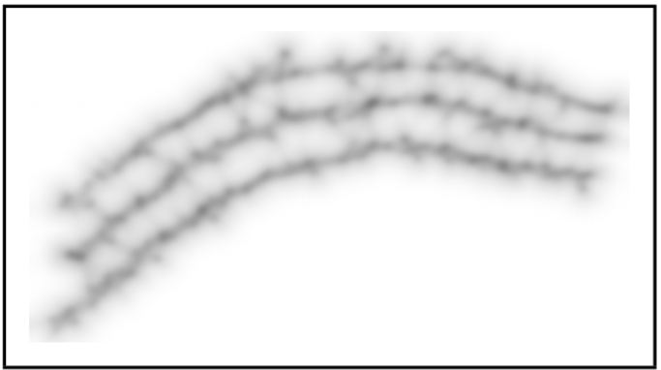
Bukhari et al., 2009
Line enhancement using multi oriented anisotropic Gaussian
Input with curved lines
Multi oriented anisotropic
Gaussian enhancement
Notes:
Bukhari et al. smoothed text lines with multi-oriented anisotropic Gaussian filter.
Then they found edges over the smoothed image and adapted active contours over the edges to perform text line segmentation. Their method is robust with skewed and curved text lines but fails in case of biased average character height.

Slide 28
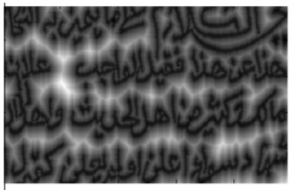
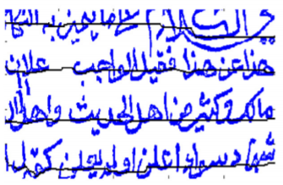
Saabni et al., 2014
Seam carving
Signed distance transform
Seams with
minimal energy cost
Notes:
Saabni et al. constructed an energy map on binary images using Signed Distance Transform (SDT).
SDT assigns negative values to pixels lying inside components and positive values to those lying outside components.
Then using this energy map with seam carving method they found the medial seams that pass through the text lines.

Slide 29

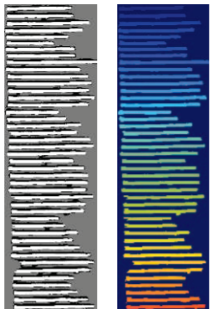

Pastor et al., 2016
Pixel classification using CNN and watershed algorithm
Main body area
Input
CNN
Watershed
Notes:
In this work, they masked main body area of the text lines and trained a CNN to classify every pixel as main body area or not.
Result is a classification score map for all the pixels. This score map is refined using watershed algorithm to separate touching text lines.

Slide 30
Text alignment literature
Image to text methods
Tomai et al., 2002
Kornfield et al., 2004
Leydier et al., 2014
Rabaev et al., 2015
Image to image methods
Asi et al., 2011
Kassis et al., 2017
Notes:
Alignment is identifying similar regions on given data streams.
There two categories
Image to text alignment and image to image alignment.

Slide 31
Image to text methods

Slide 32
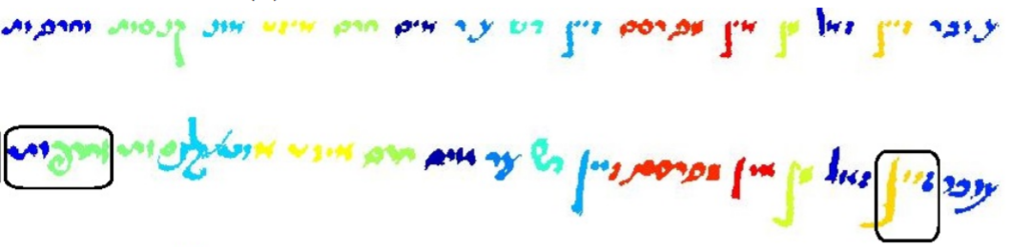
Rabaev et al., 2015
Energy minimization between synthetic and original lines
Synthetic line
Original line
Notes:
Rabaev et al. formulated alignment as energy minimization problem between original text line image and synthetic text line image.
A transcript line contains words and an image line contains connected components.
The goal is to assign each connected component to a word.
Such that components assigned to a word has maximum visual similarity to that word
And components in a word are spatially close to each other.

Slide 33
Image to image methods

Slide 34
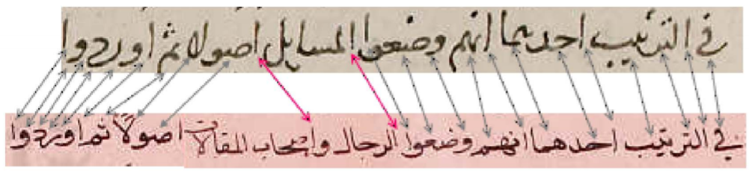
Kassis et al., 2017
Compare two word images using Siamese CNN
Original line in book 1
Original line in book 2
Notes:
Kassis et al. aligned the subwords using Hungarian algorithm with the similarity measurement from the siamese network.
Hungarian algorithm assigns the subwords from two books in a way to maximize the total similarity.

Slide 35
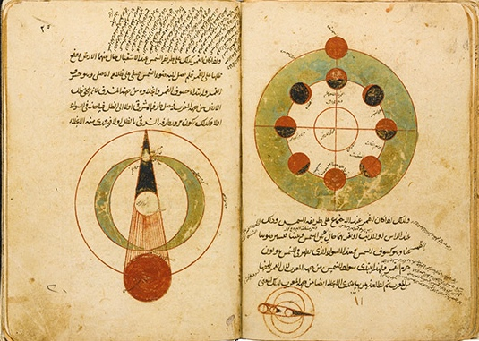
Initial results

Slide 36
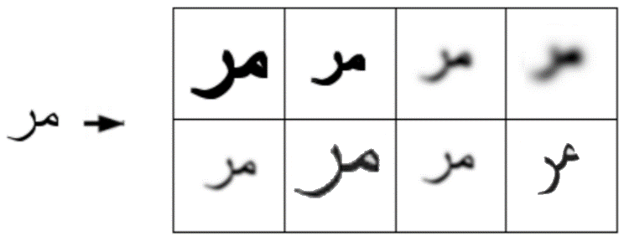
1- Experiment study on utilizing CNN to recognize historical Arabic handwritten text
ASAR 2017
Tasks carried out:
Generating degraded printed words
    Rotating
    Blurring
    Filtering
    Zooming
Degraded printed text in Naskh font
Notes:
First work has the title …
My task was to generate Arabic subwords in Naskh font and degrade them by rotating, blurring, filtering and zooming.

Slide 37
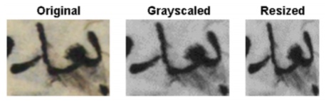
2- Synthesising versus Augmentation for Arabic Word Recognition with CNN
ASAR 2018
Tasks carried out:
Preprocessing
Augmentation
Training CNN
Evaluation
Preprocessing
Notes:
Second work has the title …
My first task was in preprocessing.
We greyscale and resize the input images into fixed size.

Slide 38
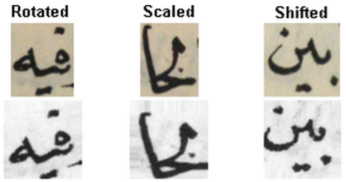
2- Synthesising versus Augmentation for Arabic Word Recognition with CNN
ASAR 2018
Tasks carried out:
Preprocessing
Augmentation
Training CNN
Evaluation
Augmentation
Notes:
Second task was to augment the train set samples by rotating, scaling and shifting as shown in the figure

Slide 39
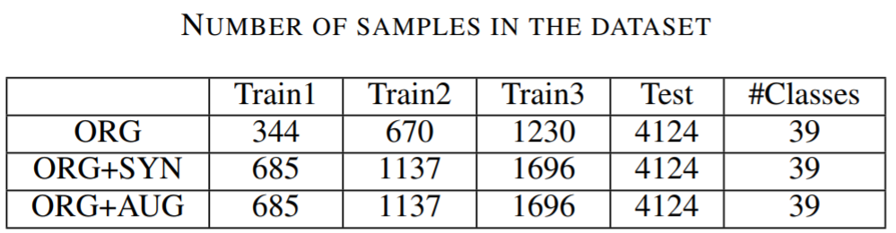
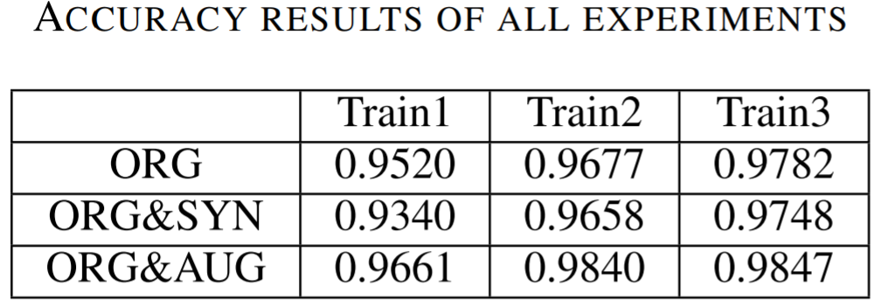
2- Synthesising versus Augmentation for Arabic Word Recognition with CNN
ASAR 2018
Tasks carried out:
Preprocessing
Augmentation
Training CNN
Evaluation
Notes:
Third task was training CNN and evaluating the results
We created 3 training sets.
First set contains only original samples
Second set contains original and synthesized samples
Third set contains original and augmented samples.
For each type of set we gradually increased number of samples as we can see in the horizontal direction of the first table.
Then we trained a Lenet like CNN.
Second table shows the accuracy values.
Comparing the results horizontally shows that larger train set leads to better results.
Comparing the results vertically shows that augmentation leads to the best results.

Slide 40
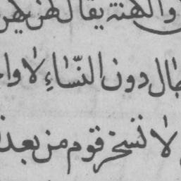
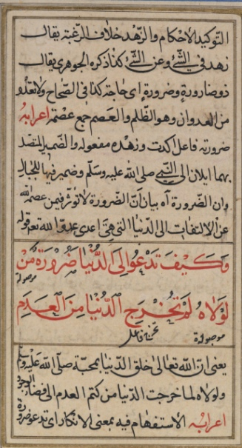
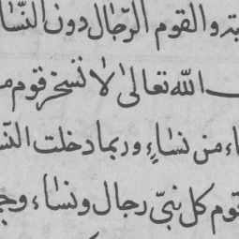





3- Case Study: Fine Writing Style Classification Using Siamese Neural Network
ASAR 2018
$$150 ×150$$
Tasks carried out:
Data preparation
$$120 ×120$$
$$75 ×75$$
$$40 ×40$$
$$150 ×150$$
$$150 ×150$$
3 lines
4 lines
Notes:
Third work has the title …
In this work we showed the writing style variation throughout a book using Siamese CNN.
My task was in data preparation.
In data preparation we detected main text regions using color differences of decorations and sizes of page margins.
Then we cropped patches from the extracted main text regions.
We created patches in 4 different sizes, then getting the best result with 150 by 150 size we decreased the resolution and created patches of 150 by 150 with around 4 text lines and eventually reach the best results with these patches.

Slide 41
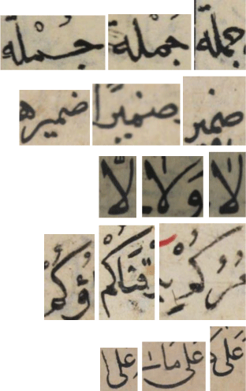
4- Word Spotting Using Convolutional Siamese Network
DAS 2018
Tasks carried out:
Data preparation
Training siamese CNN
Evaluation
Inter-book variation
In-book variation
Notes:
Fourth work has the title …
Spotting words from a possibly large range of vocabulary is challenging because we don’t have many positive samples per class.
And this method can spot
1. Words with varying writing styles and backgrounds as shown in the figure
2. As well as out of vocabulary words

Slide 42
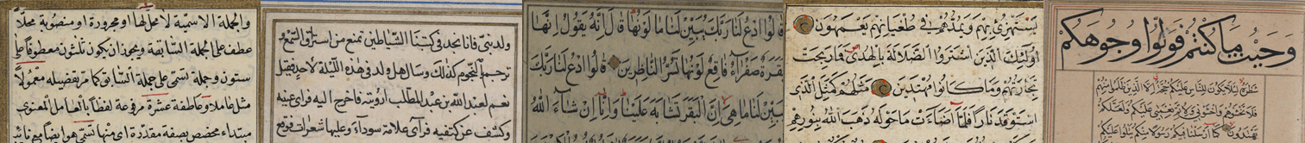
4- Word Spotting Using Convolutional Siamese Network
DAS 2018
Tasks carried out:
Data preparation
Training siamese CNN
Evaluation
Book 1
Book 2
Book 3
Book 4
Book 5
Train
Test
Test
Test
Test
Test
Notes:
My first task was in data preparation.
Dataset contains 5 books.
We based our training on the first book but evaluated the best model on all the 5 books.
We split the first book into training, validation and testing parts in class level.
So we ensured that test set is completely OOV.

Slide 43
4- Word Spotting Using Convolutional Siamese Network
DAS 2018
Tasks carried out:
Data preparation
Training siamese CNN
Evaluation
Book# | mAP | P@1 | P@2 | P@3 | #Queries | #Labels | #OOV
Book1 | 0.91 | 1.0 | 1.0 | 1.0 | 2100 | 21 | 21
Book2 | 0.75 | 1.0 | 1.0 | 1.0 | 2100 | 21 | 14
Book3 | 0.82 | 1.0 | 1.0 | 0.98 | 2100 | 21 | 16
Book4 | 0.75 | 1.0 | 1.0 | 0.98 | 2100 | 21 | 15
Book5 | 0.80 | 0.95 | 0.95 | 0.95 | 2100 | 21 | 16
All | 0.62 | 0.95 | 0.95 | 0.93 | 10500 | 58 | 47
Contrastive loss
Notes:
Second task was training Siamese network.
We trained it with contrastive loss.
Contrastive loss pulls the similar points together, pushes the different points apart.
Table shows the mAP and P@k values of the model trained on 500 words from first book and tested on all the 5 books.
So it shows that as the number of classes increases performance decreases. But method can spot OOV words and words with varying styles

Slide 44
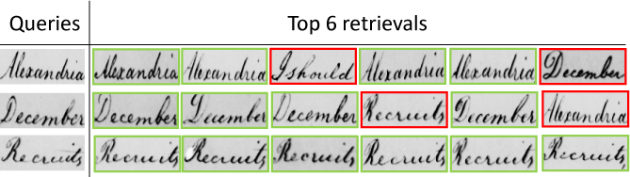
4- Word Spotting Using Convolutional Siamese Network
DAS 2018
Tasks carried out:
Data preparation
Training siamese CNN
Evaluation
Notes:
Here are some qualitative results from George Washington dataset.
Quantitative results in this dataset set was below the state of the art.

Slide 45
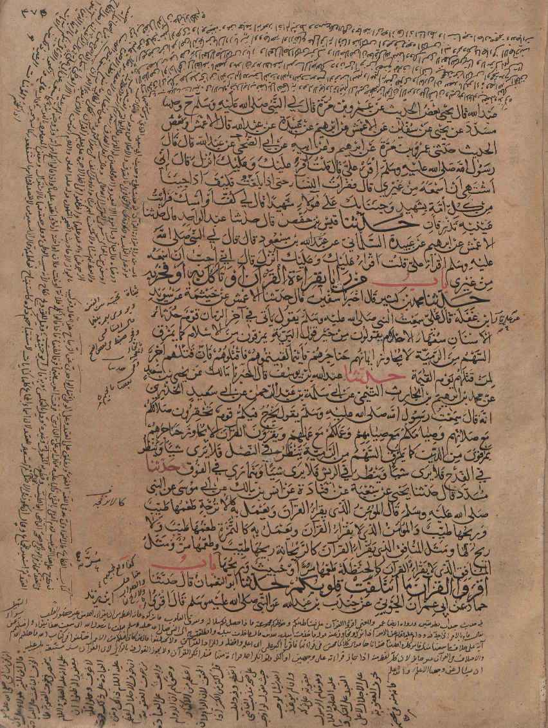
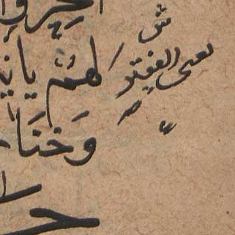
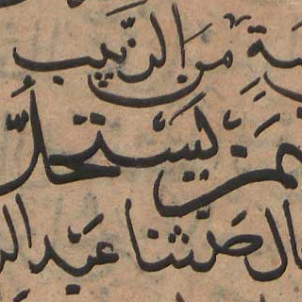

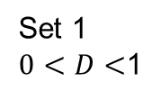
5- Binarization Free Layout Analysis for Arabic Historical Documents Using Fully Convolutional Networks
ASAR 2018
Set 1
$0<D<$1
Tasks carried out:
Data preparation
Training FCN
Evaluation
Set 2
$$D>0.83$$
Notes:
Fifth work has the title …
In this work we used FCN to segment grey document images.
My first task was in data preparation.
We created two training sets.
Set1 contains randomly cropped 100.000 patches
Set2 contains randomly cropped 100.000 patches with density grater than 0.83

Slide 46
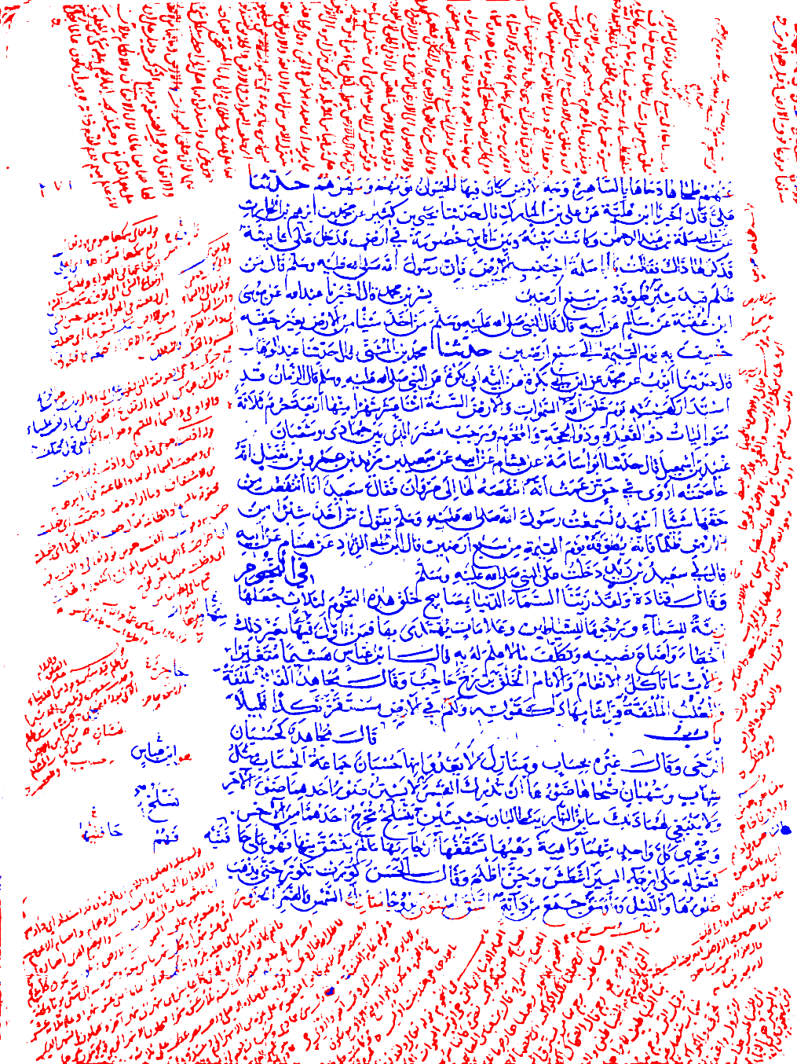
5- Binarization Free Layout Analysis for Arabic Historical Documents Using Fully Convolutional Networks
ASAR 2018
Tasks carried out:
Data preparation
Training FCN
Evaluation
 | Main text | Side text
Set 1 | 0.90 | 0.68
Set 2 | 0.95 | 0.80
Bukhari et al | 0.95 | 0.95
F1 measure on test set
A segmented page
Notes:
Left table shows F1 measures
We compared the results with Bukhari et al
Further training in set 2 improved the results but still did not outperform Bukhari et al.
In the right we can see an example qualitative result.

Slide 47
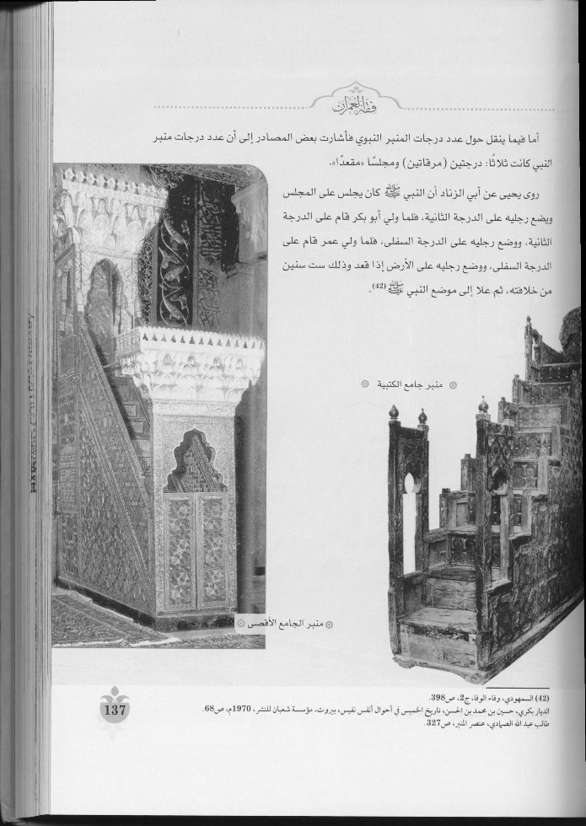
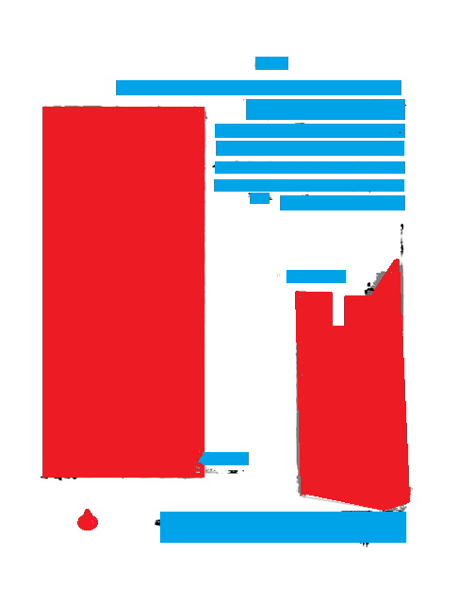
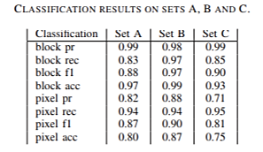
6- Page Layout Analysis Competition
ASAR 2018 (1st place in classification challenge)
Tasks carried out:
Training FCN
Evaluation
Input
Output
Notes:
Sixth work is participating a competition on page layout analysis.
We got the first place in the classification challenge.
My task was training the FCN and evaluating the results.
Left table shows the quantitative results and right figure shows a qualitative result.

Slide 48
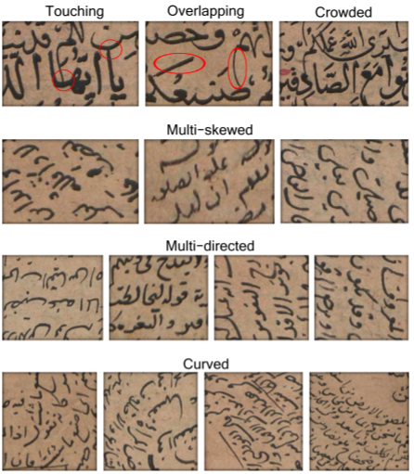
7- Text Line Segmentation for Challenging Handwritten Document Images using Fully Convolutional Network
ICFHR 2018
Tasks carried out:
Data preparation
Training FCN
Code of new metric
Evaluation
Notes:
Seventh work has the title …
In this work we defined what a challenging handwritten document contains as shown in the figure.
It contain various writing styles with inconsistent font types and font sizes through multiskewed, multi-directed and curved text lines.
And we published a dataset of challenging handwritten documents.
It contains 30 pages from two different manuscripts.

Slide 49
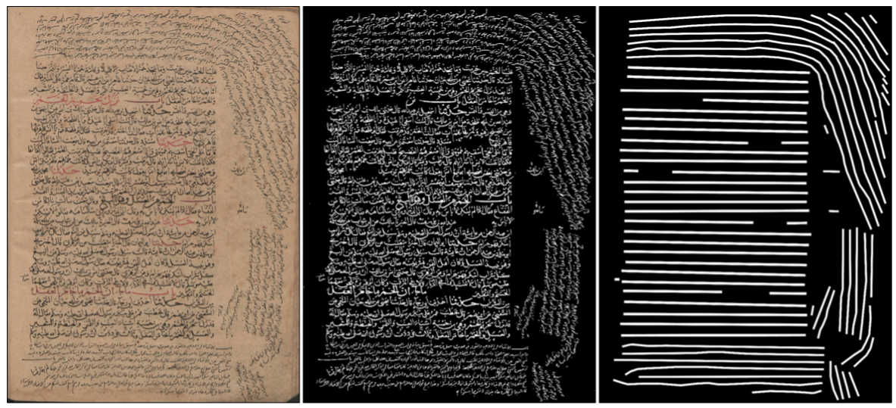
7- Text Line Segmentation for Challenging Handwritten Document Images using Fully Convolutional Network
ICFHR 2018
Tasks carried out:
Data preparation
Training FCN
Code of new metric
Evaluation
Original
Binarized
Ground truth
Notes:
In data preparation we binarized and inverted the images.
Then we manually annotated the line masks on the document images.

Slide 50
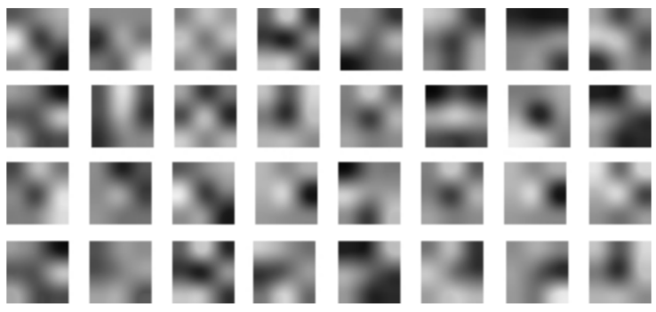
7- Text Line Segmentation for Challenging Handwritten Document Images using Fully Convolutional Network
ICFHR 2018
Tasks carried out:
Data preparation
Training FCN
Code of new metric
Evaluation
Visualization of the filters in the first convolutional layer
Notes:
Entire training took around 9 days. Visualization of the first layer filters shows that network learned and filters converged.

Slide 51
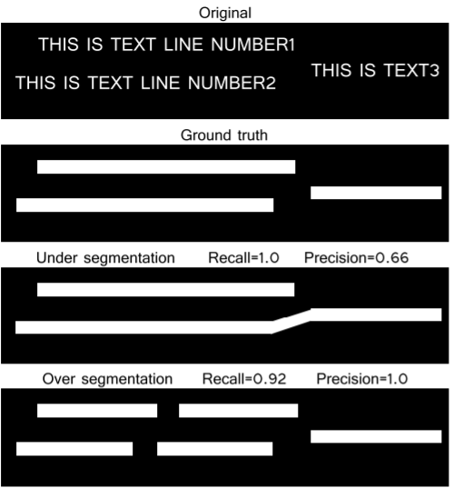
7- Text Line Segmentation for Challenging Handwritten Document Images using Fully Convolutional Network
ICFHR 2018
Tasks carried out:
Data preparation
Training FCN
Code of new metric
Evaluation
Notes:
We also presented a new evaluation metric.
The idea is if algorithm labels all components of a line with the same label then it extracts this line without errors.
But if it labels a line with multiple labels then it oversegments
And if it labels a part of its components then it undersegments.
So the new metric penalizes under segmentation by its precision value and over segmentation by its recall value.

Slide 52
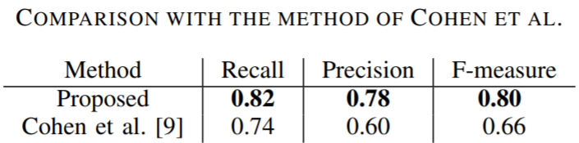
7- Text Line Segmentation for Challenging Handwritten Document Images using Fully Convolutional Network
ICFHR 2018
Tasks carried out:
Data preparation
Training FCN
Code of new metric
Evaluation
Notes:
We compared the results with the work of Cohen et al.
Their method is based on using multi oriented anisotropic Gaussian filter.
Their low precision value shows that their algorithm tends to over segment.
Probably it is because the biased average character height.

Slide 53
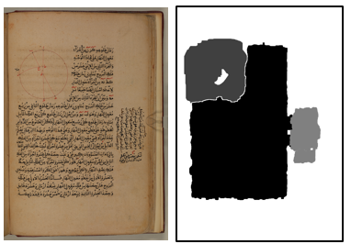
8- Competition on Page Layout Analysis of Historical Arabic Scientific Manuscripts
ICFHR 2018 (Results to be announced)
Tasks carried out:
Training FCN
Postprocessing
Notes:
Eighth work is participating another competition on page layout analysis.
Our method is based on FCN.
Figure shows an example page segmented into main text, side text and image regions.

Slide 54

9- Competition on Text Line Segmentation of Historical Arabic Scientific Manuscripts
ICFHR 2018 (Results to be announced)
Tasks carried out:
Preprocessing
Run Cohen et al.’s code
Postprocessing
Notes:
In the same competition we also participated on text line segmentation challenge.
We used Cohen et al.’s algorithm based on anisotropic Gaussian filter.
Figure shows an example main text area segmented into text lines.

Slide 55
10- Using Scale-Space Anisotropic Smoothing for Text Line Extraction in Historical Documents
IJDAR (submitted)
Tasks carried out:
Ground truth
Generate outputs using different parameters
Code of new metric
Evaluation
Notes:
Tenth work has the title …
In this work my tasks were to annotate the ground truth, to generate outputs using different parameters, implementing a new evaluation metric and evaluation of 38 pages using this new metric.

Slide 56

Future works

Slide 57









Page layout analysis using Siamese CNN
Tasks carried out:
Data preparation
Training siamese CNN
Back
Main
Side
Notes:
We plan to make page layout analysis using Siamese network.
My tasks were data preparation and training the network.
We created patches of background, main text and side text areas.
Then we trained a Siamese network to measure the similarity of two patches.
It can predict the similarity of patches in the test set with an accuracy of 90 percent.
We plan to use this similarity metric to cluster patches of a page into regions.
In this work main advantage is that we can label the pages coarsely instead of pixel level

Slide 58
Unsupervised learning for word spotting
Tasks carried out:
Unsupervised training
Website for human performance evaluation
Are these in correct order?
YES
Are these in correct order?
NO
Notes:
In another work we plan unsupervised learning for word spotting
My first task was unsupervised training.
We trained a Siamese network that can guess spatial order of two patches from an unlabeled word.
Here the idea is that, for network to answer this question it has to be recognizing the contents of these patches.

Slide 59
Unsupervised learning for word spotting
Tasks carried out:
Unsupervised training
Website for human performance evaluation
Visualization of the filters in the first convolutional layer
Notes:
Here is the visualization of the first layer filters
It shows that network learned and filters converged.
It can predict the spatial order of patches in the test set with an accuracy of 90 percent.

Slide 60

Unsupervised learning for word spotting
Tasks carried out:
Unsupervised training
Website for human performance evaluation
Web portal for testing humans
Notes:
Whereas in our initial measurements through a web portal for human performance is around 70 percent accuracy.

Slide 61

Restoration of occluded characters
Tasks carried out:
Problem is defined as segmentation using shape priors
Seek to solve using
    FCN
Hebrew characters occluded by Arabic characters
Notes:
Our current plan is to restore occluded characters using deep learning.
This problem is defined as segmentation using shape priors.
So we seek to solve it using FCN

Slide 62

Text alignment using subwords generated by GAN
Label
Generated images
Plan to:
Generate subwords using conditional GAN
Align generated sentence image with original sentence image
0
1
2
3
4
5
6
Notes:
Another plan is to generate subwords using a conditional gan and align generated sentence image with original sentence image

Slide 63
Unsupervised transcription
Plan to:
Cluster subwords
Assign class probabilities to subwords using an OCR
Label the clusters using the class probabilities of subwords and Hungarian algorithm
Retrain OCR
Notes:
Last plan is to transcribe a book in unsupervised manner.

Slide 64
Conclusion
Deep learning has been successfully used for historical document image processing
    Page layout analysis
    Text line segmentation
Plan to use deep learning
    Text alignment
    Unsupervised methods

