Slide 1
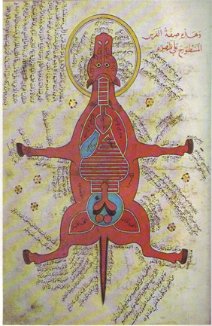
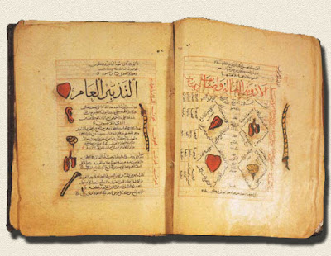
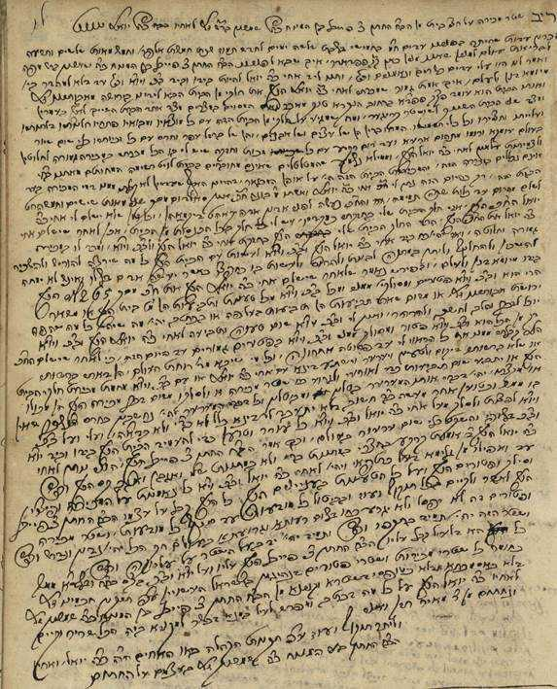
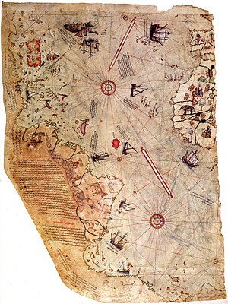
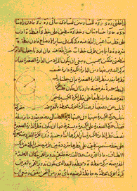
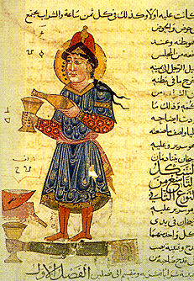
Historical document image analysis
Visual Media Lab
VML
Notes:
Hi,
This Berat, from Visual Media Laboratory, under supervision of Jihad El-Sana.
We do work on historical document image analysis.
Our target is to help humanities scientists in exploring the content of historical document images.

Slide 2
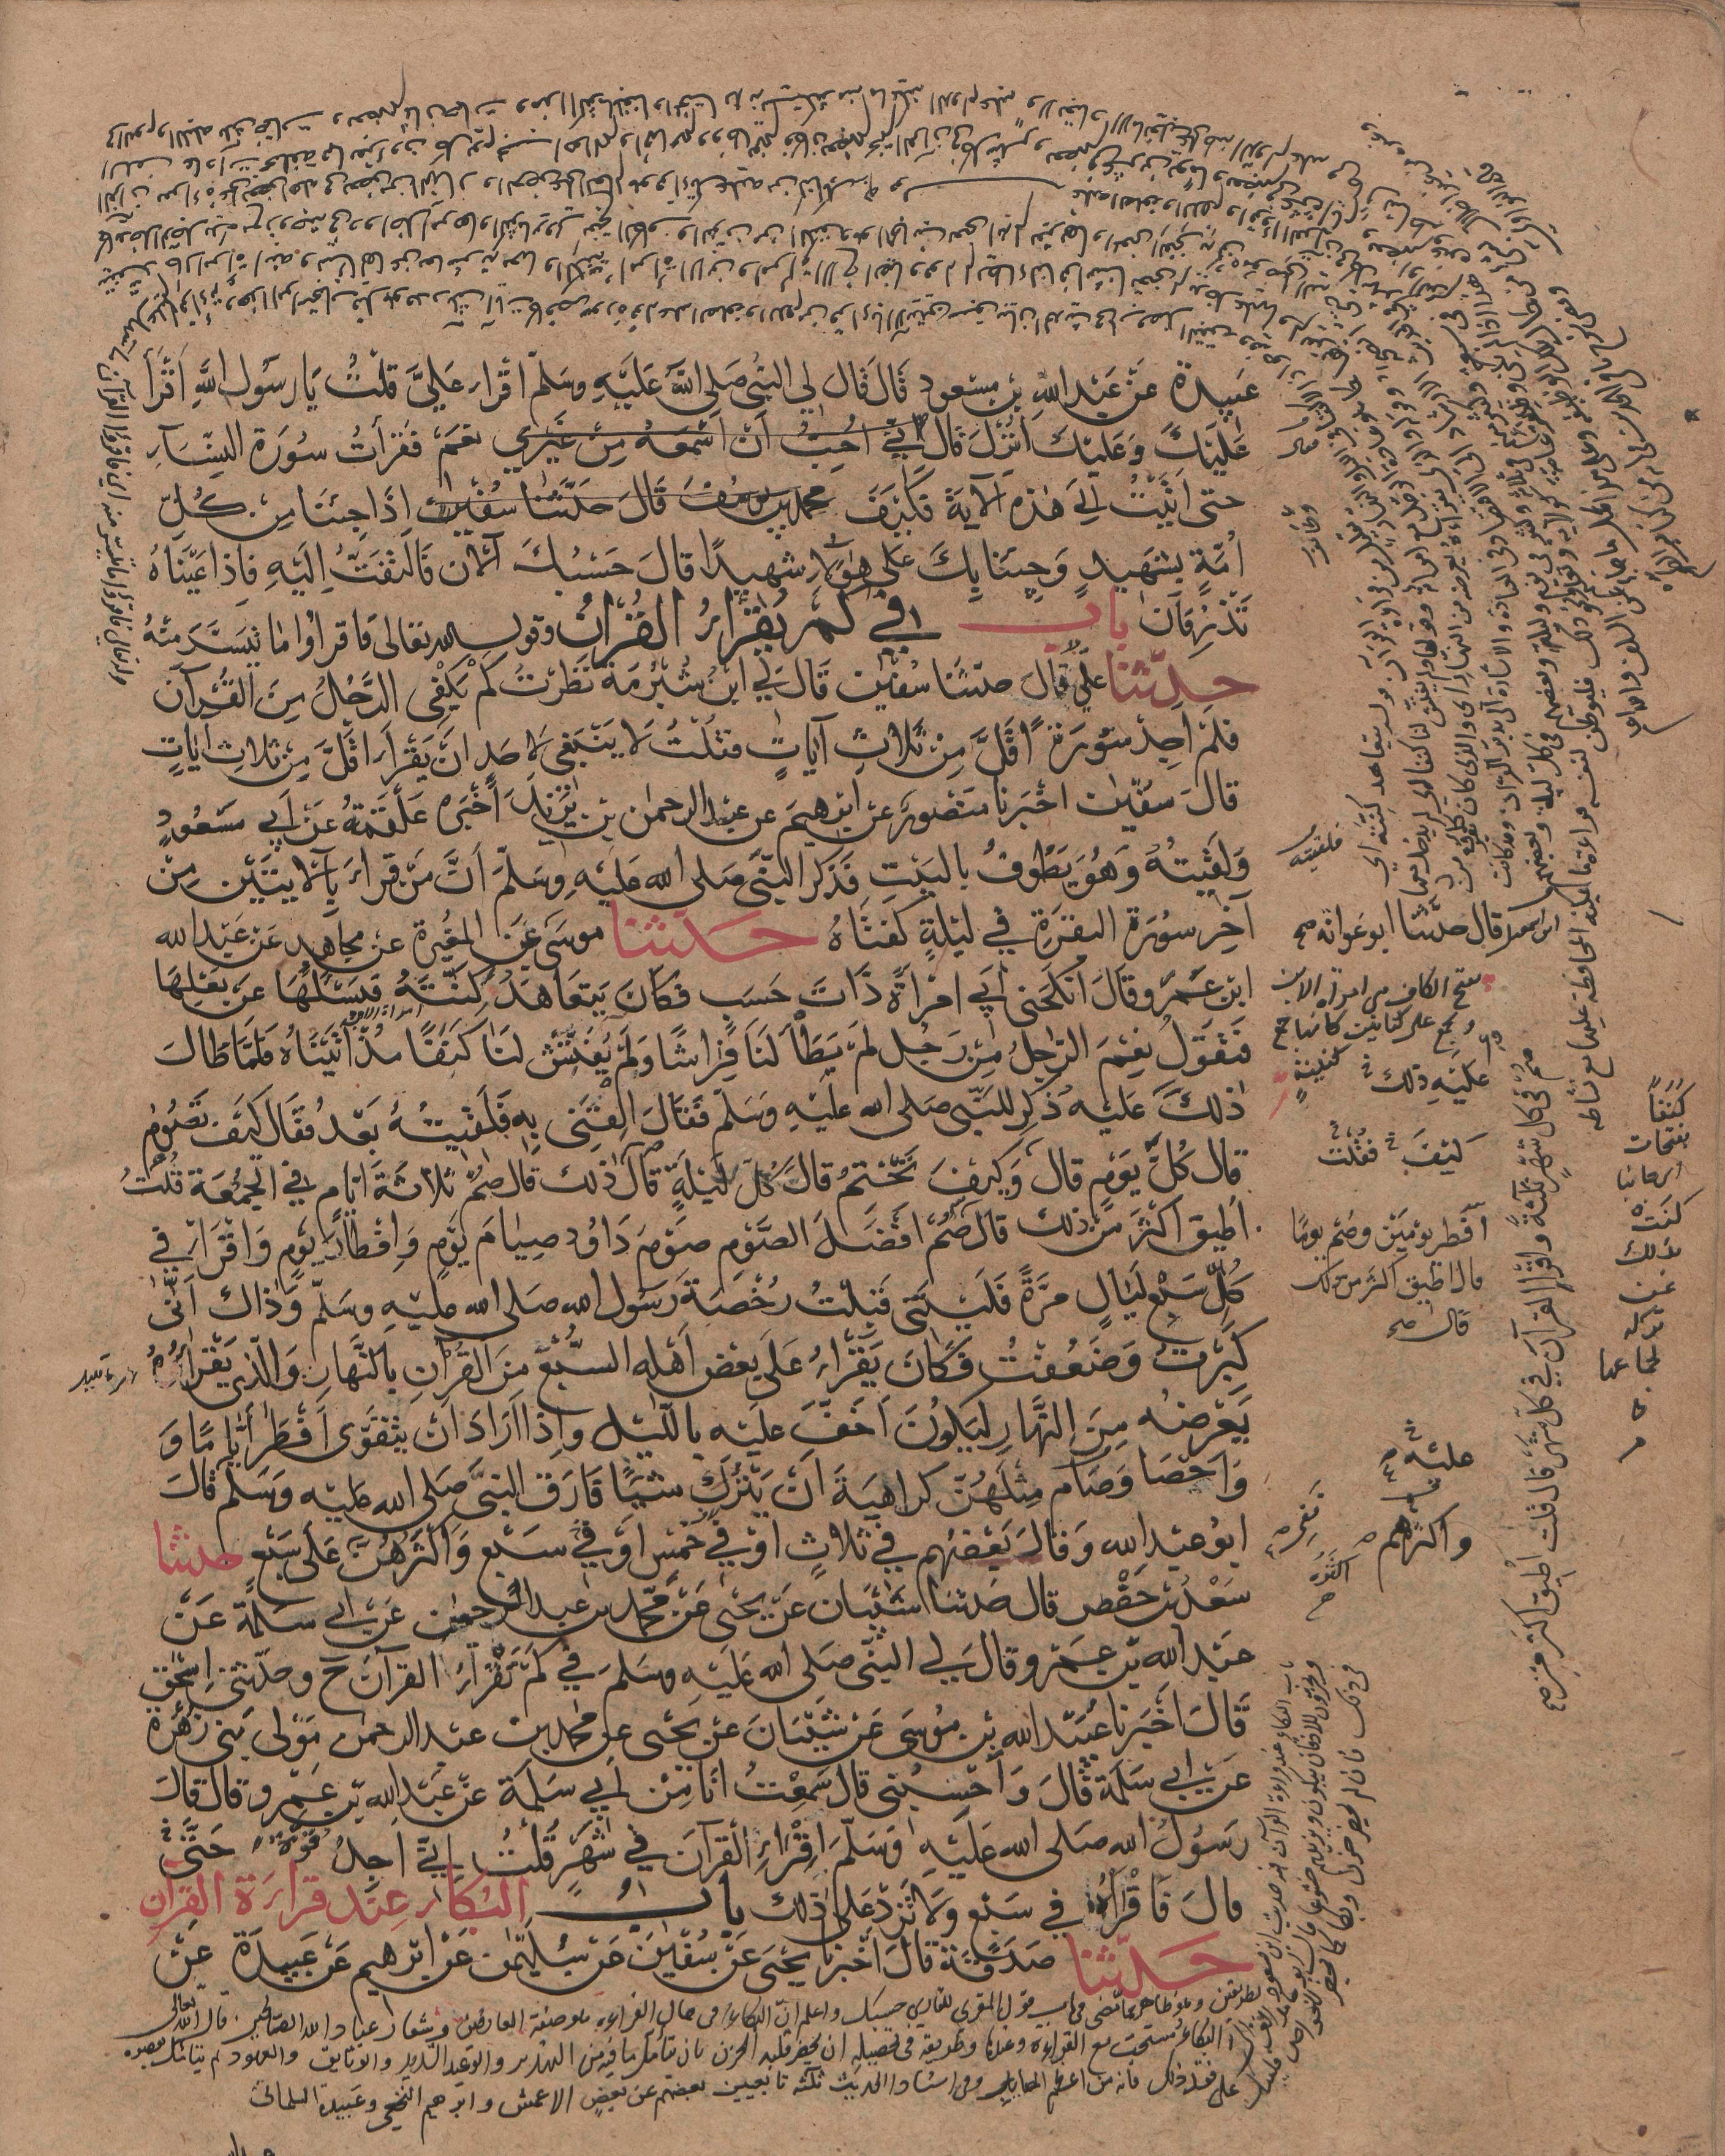
Noise reduction
Binarization
Notes:
To do this, we use algorithms to reduce the noise and binarize the document.

Slide 3
Layout analysis
Notes:
We use algorithms to segment the document image into homogeneous text regions and classify these regions.

Slide 4
Text line segmentation
for main text
Notes:
Then we use algorithms to segment the text lines of main text region.

Slide 5
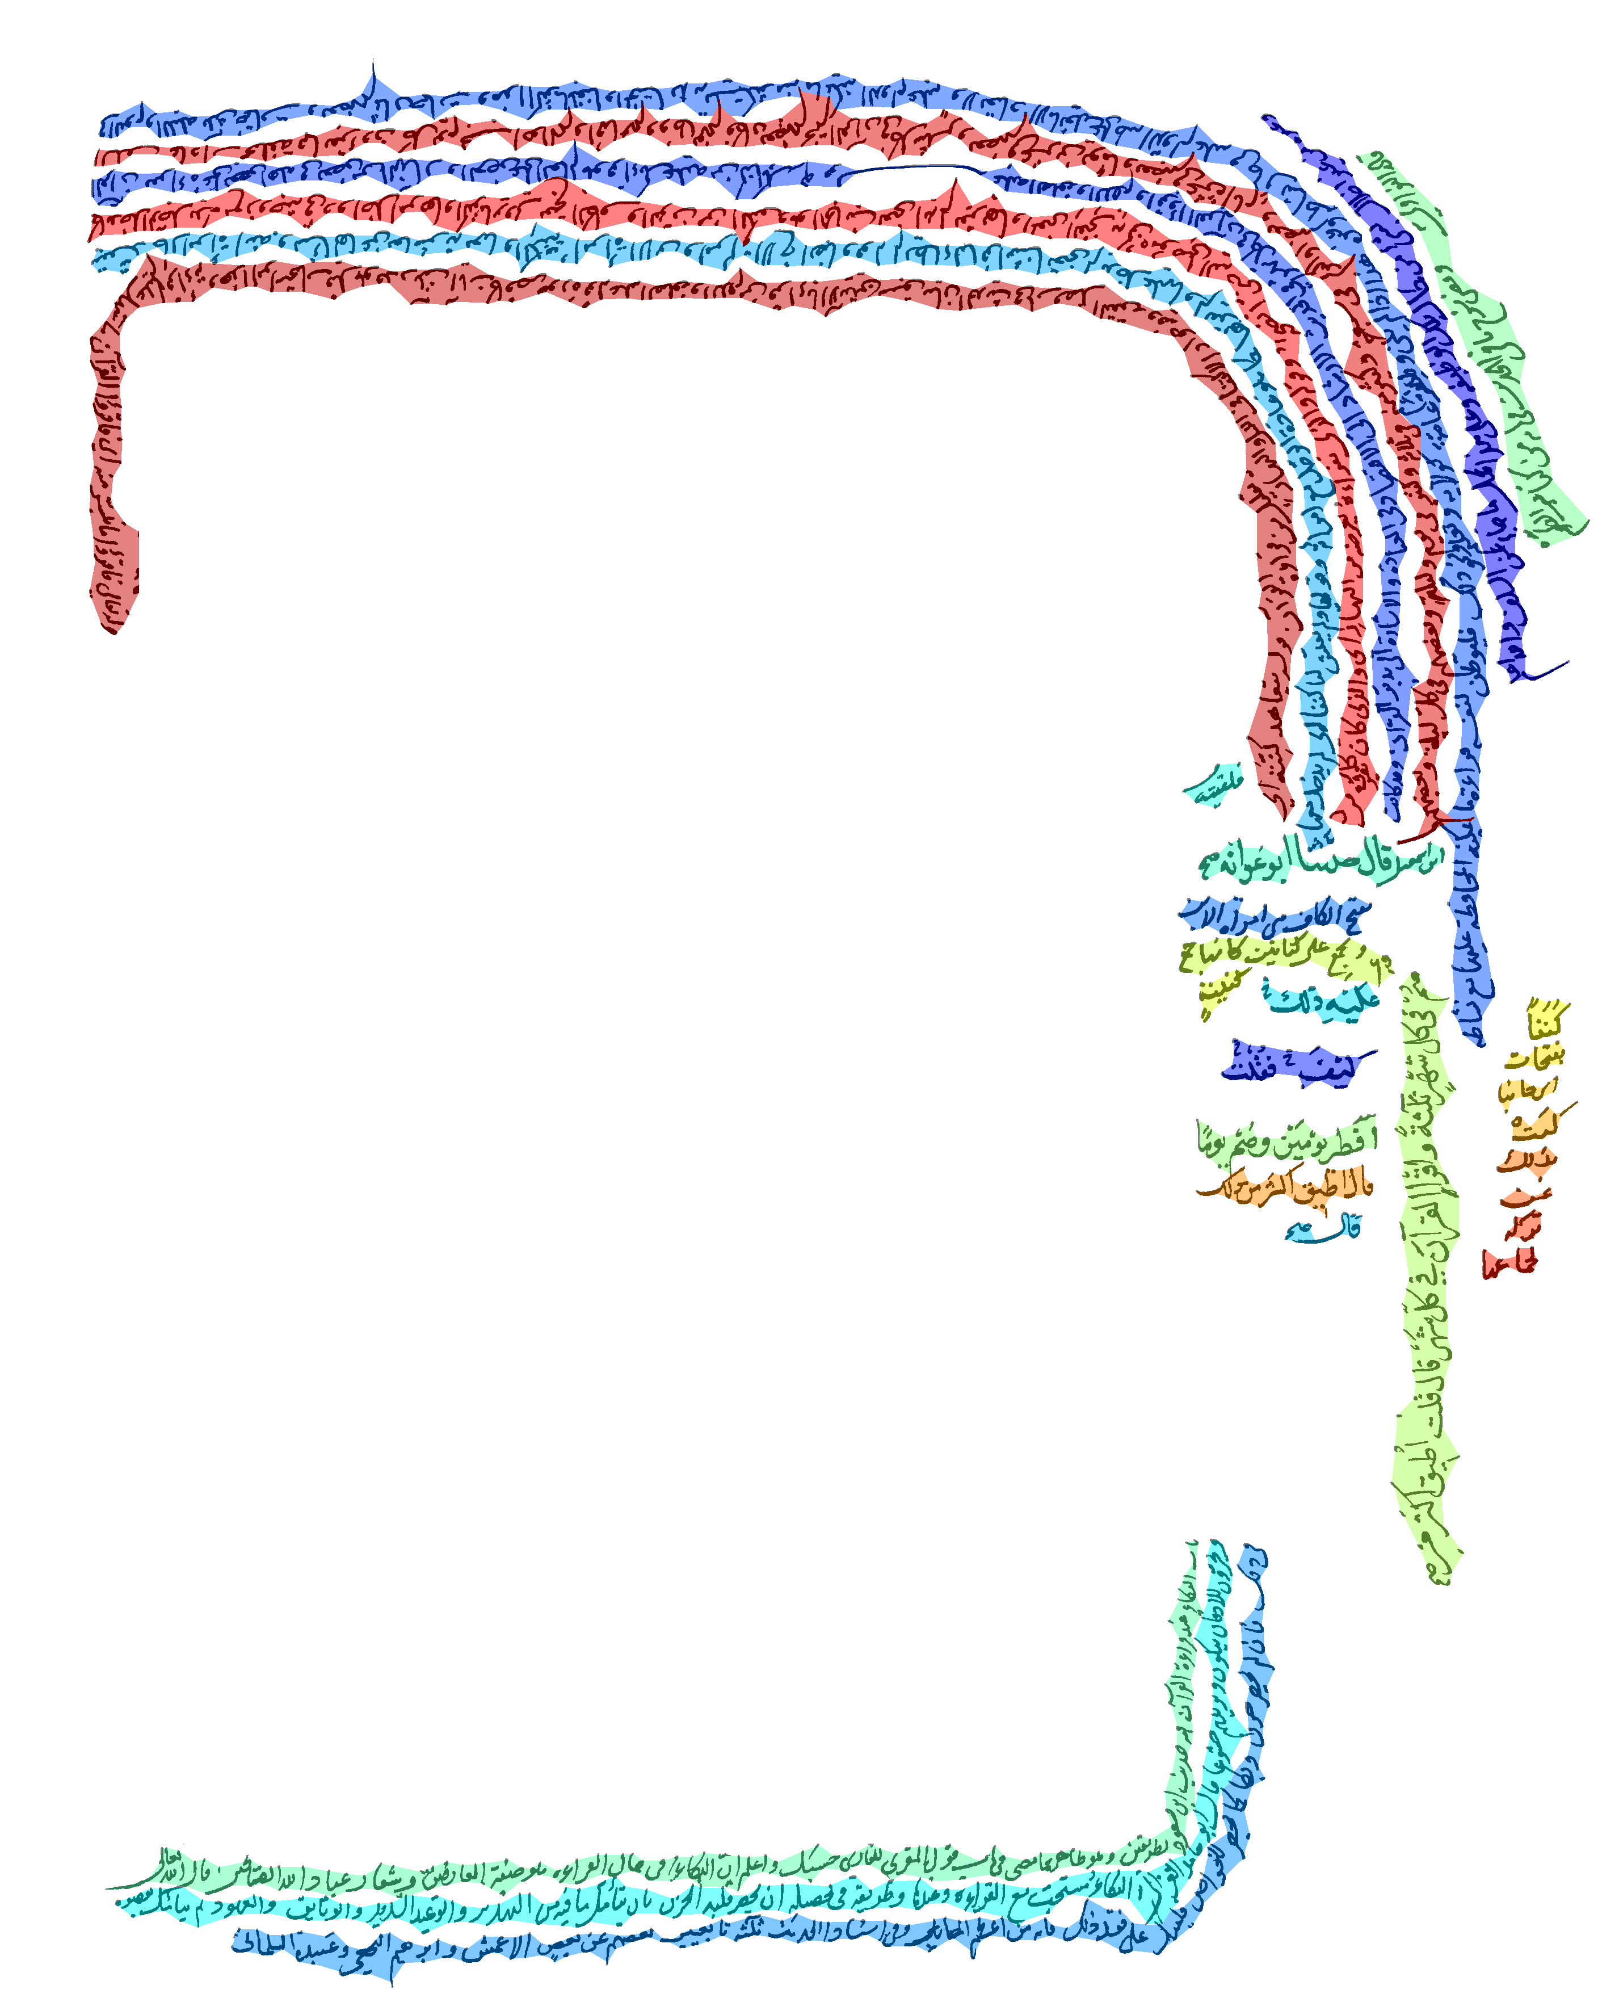
Text line segmentation
side text
Notes:
And to segment the text lines of side note region.

Slide 6
Query word searching
Notes:
On the outputs of these pre processing stages we can search a query word in the historical document image.

Slide 7
Simplify reading
Notes:
And we can simplify the reading of historical document image.

Slide 8
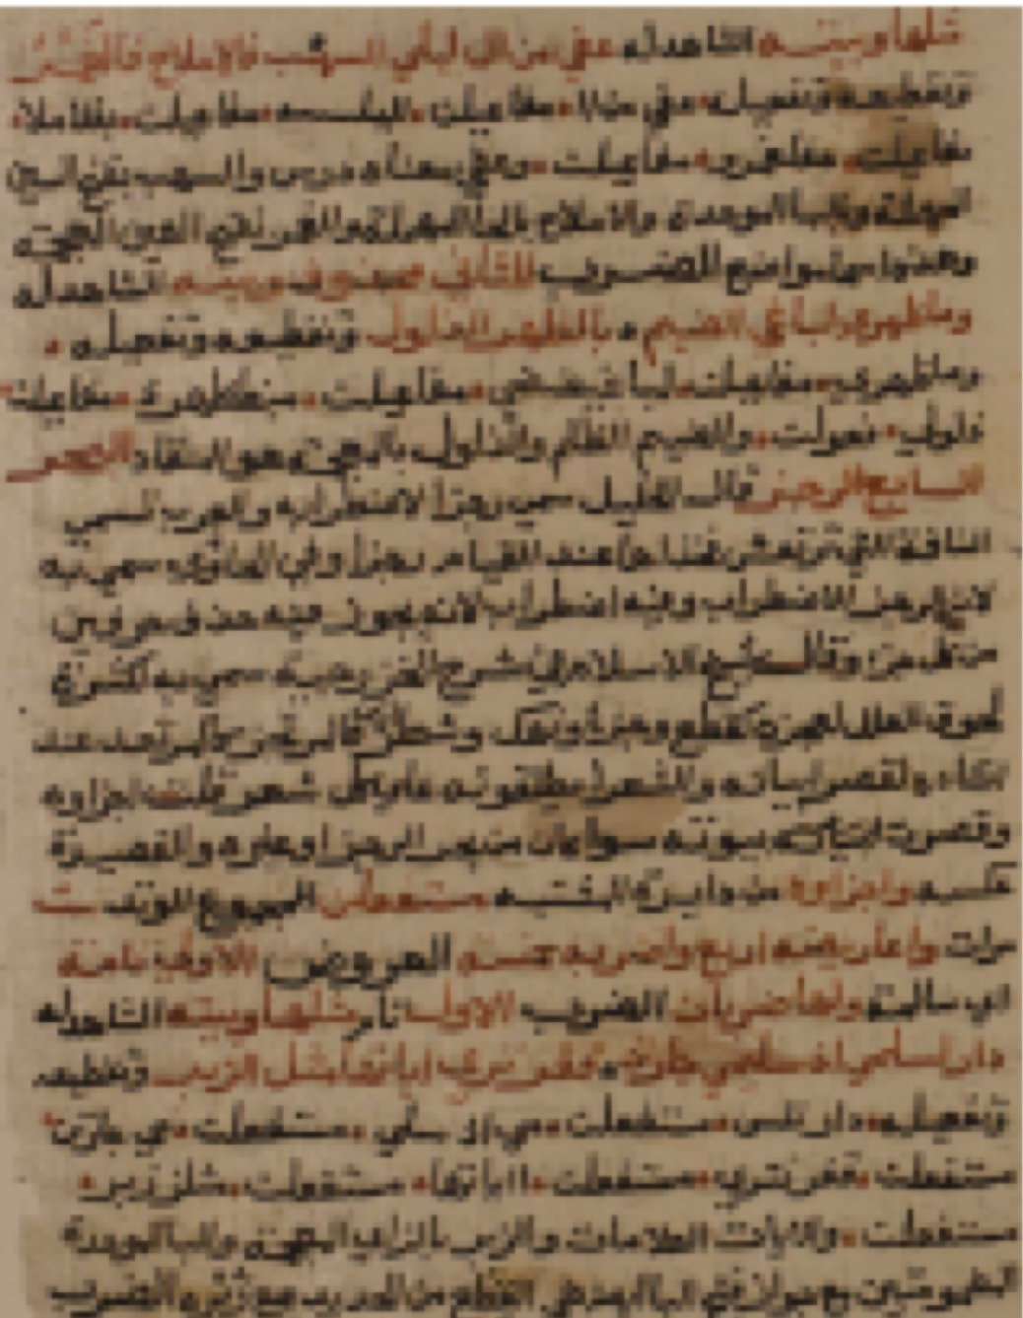
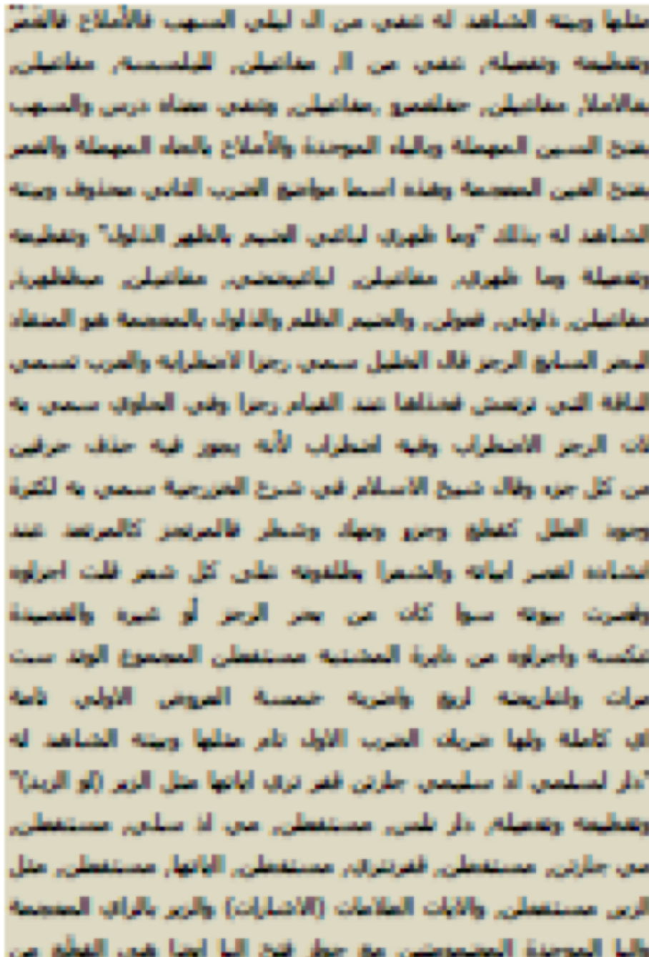
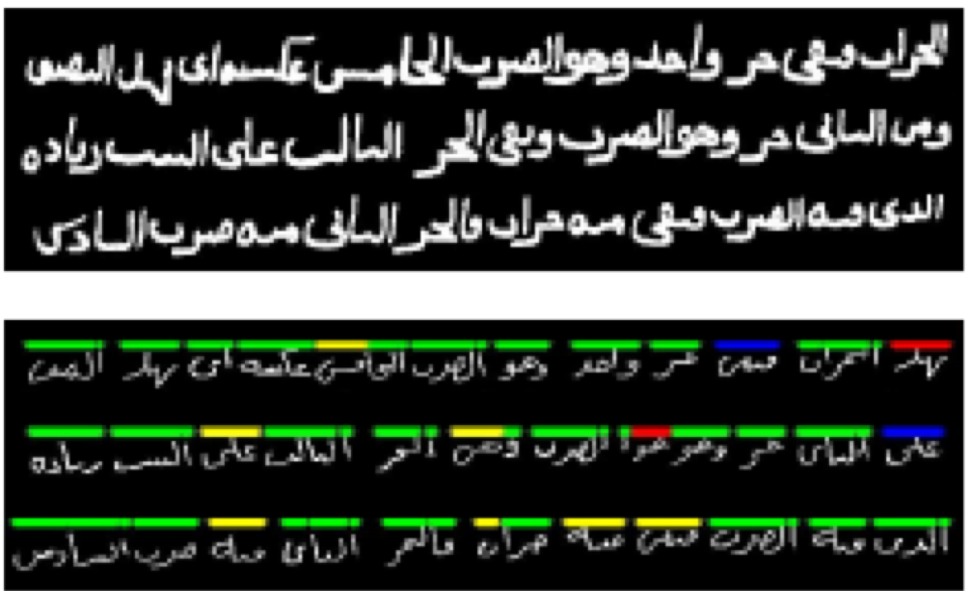
Align manuscripts
Simplify reading
Simplify reading
Notes:
And we can align two historical document image

Slide 9
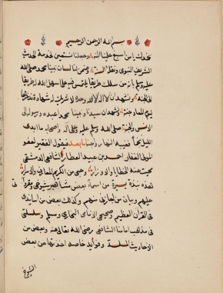
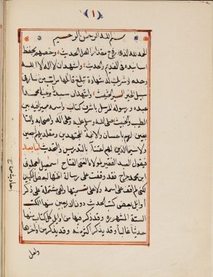
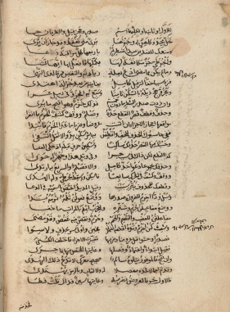
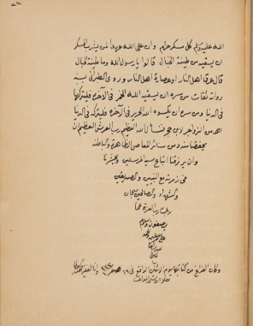
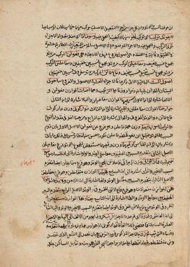
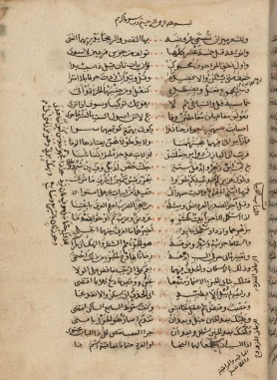
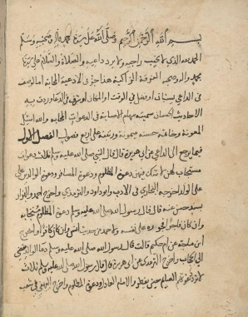
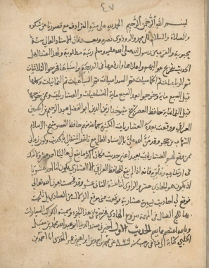
Writer 1
Writer 2
Writer 3
Notes:
And we can identify the writer of a document image

Slide 10
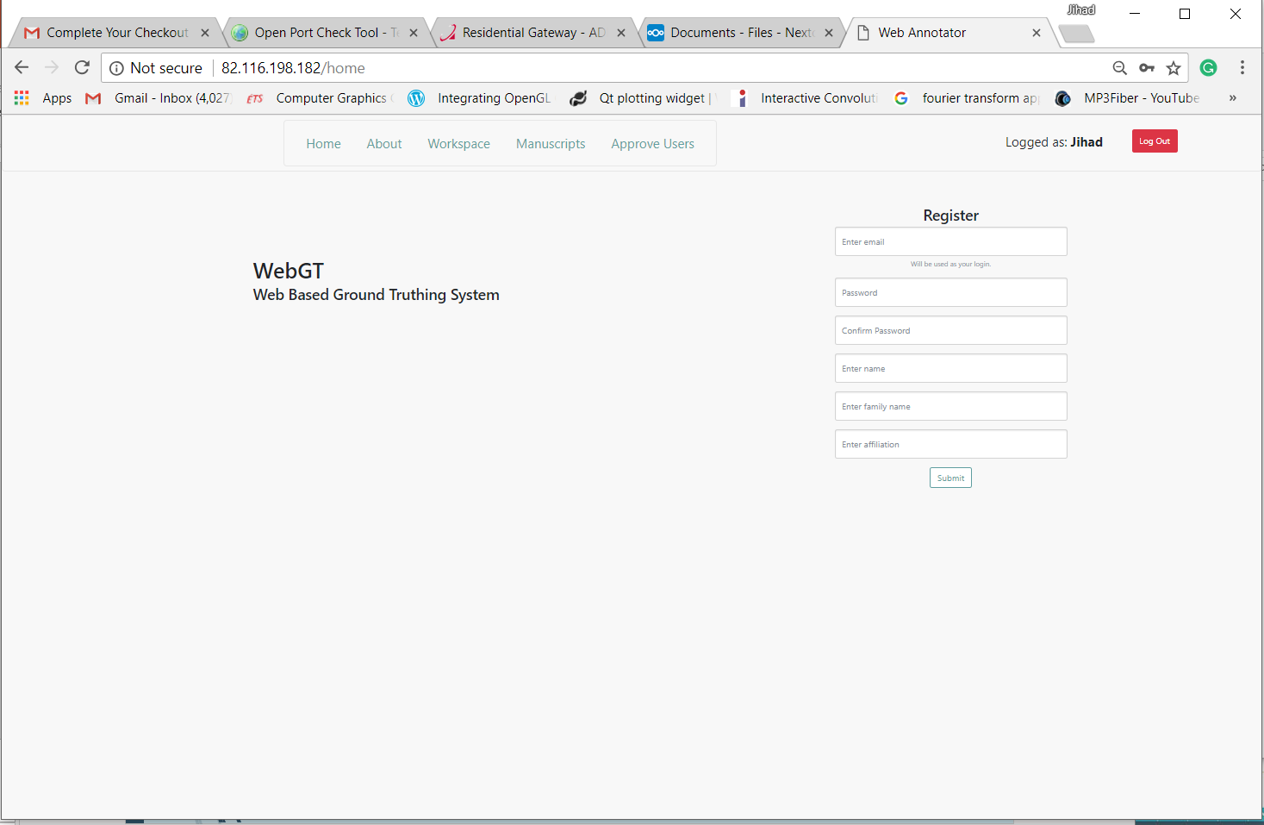
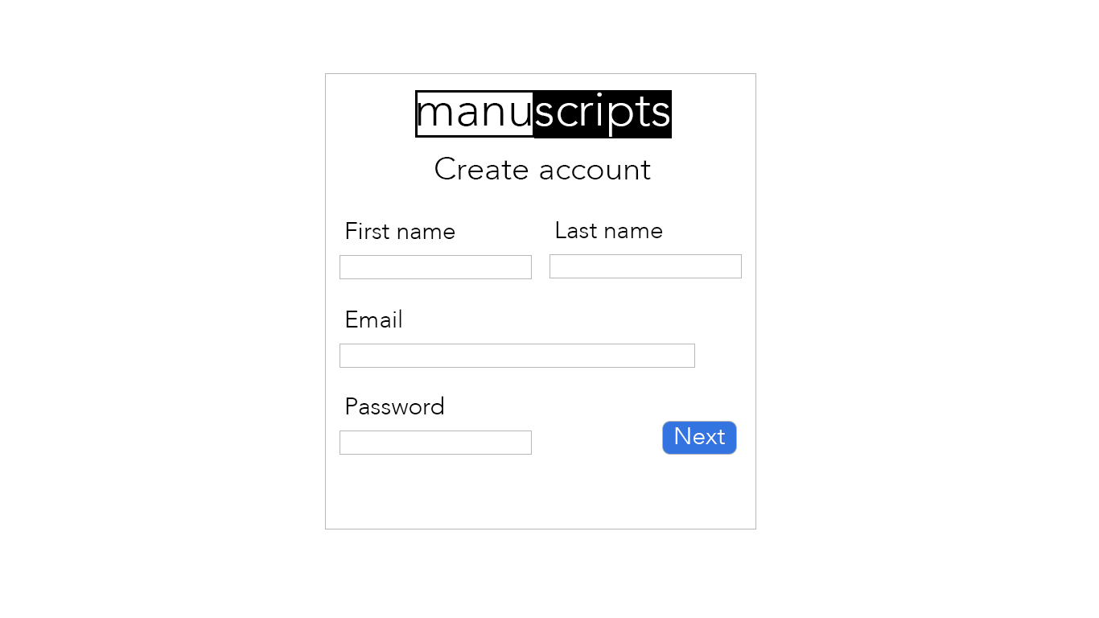
Web based system
Notes:
In future we plan to built a web based system that allows humanities scholars to make use of these algorithms on their historical document collections.

