Slide 1
Historical Document Image Processing using Deep Learning
Doctoral Research
Berat Kurar Barakat Jihad El-Sana
Notes:
Hi my name is Berat.
I am a PhD student of Professor Jihad El-Sana.
We research how to use deep learning methods for historical handwritten document image processing.

Slide 2
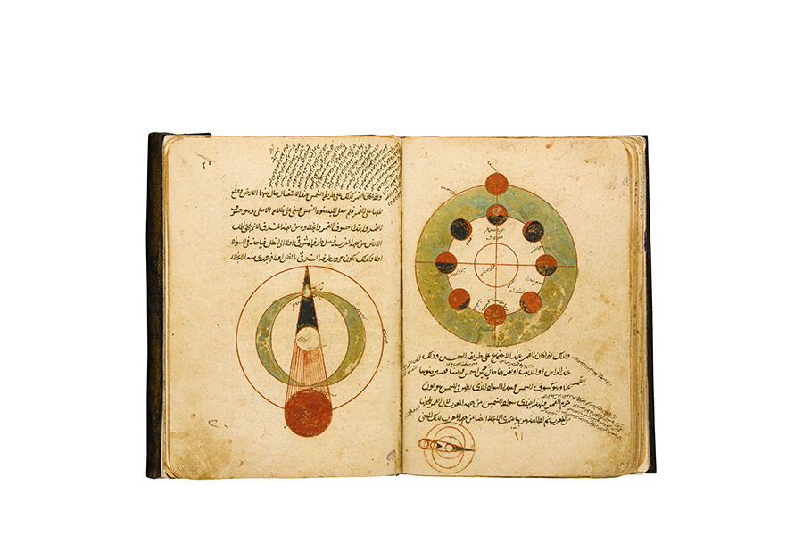
introduction
Notes:
I will start the presentation by introducing the overall story and remarking where our motivation takes place in this story.

Slide 3
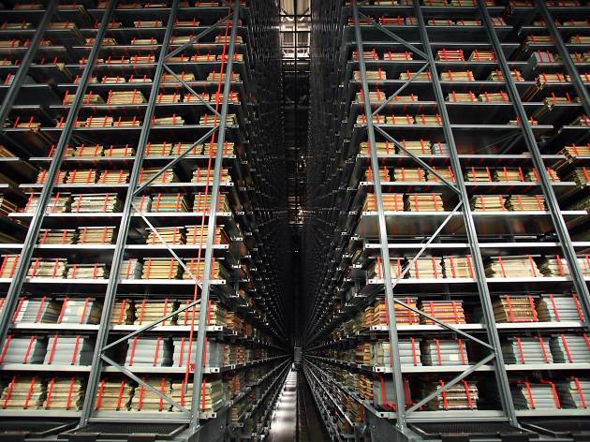
Significance of the work
So far British Library digitized over 30 million documents
Retrieved from
https://www.bl.uk/digitisation-services
Notes:
Historical documents are being digitized plentifully for preservation and dissemination.
But digital documents further need to be transcribed for easy explorability.
Hence there is a significant need for reliable historical document image processing algorithms.

Slide 4
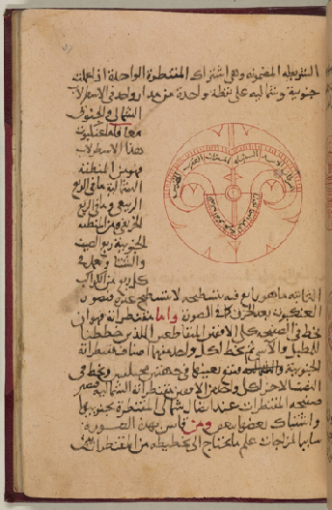
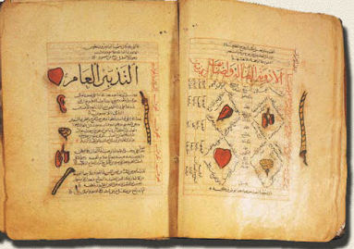
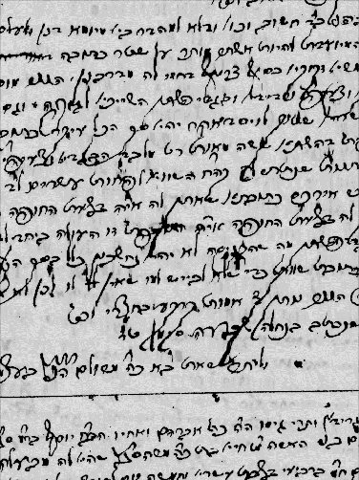

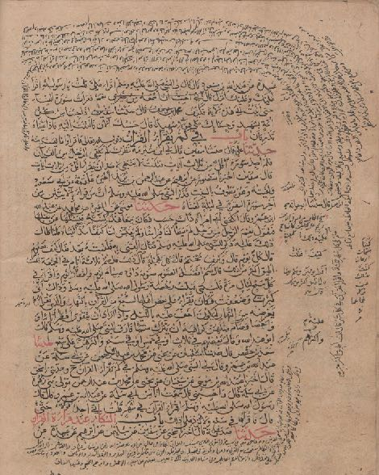
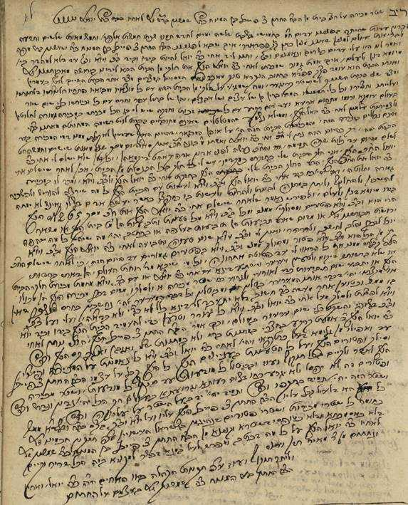
Notes:
Our target is to help humanities scientists in exploring the content of historical handwritten document images. So they can search and reach the information that they need in couple of seconds only by typing their keywords.

Slide 5
Significance of the work
?
Notes:
In order to grant access to the context by textual search, the images should be transcribed into digital text. But this task is error prone and conventional methods such as OCR falter when faced with odd challenges and the alienness of the historical document images.

Slide 6
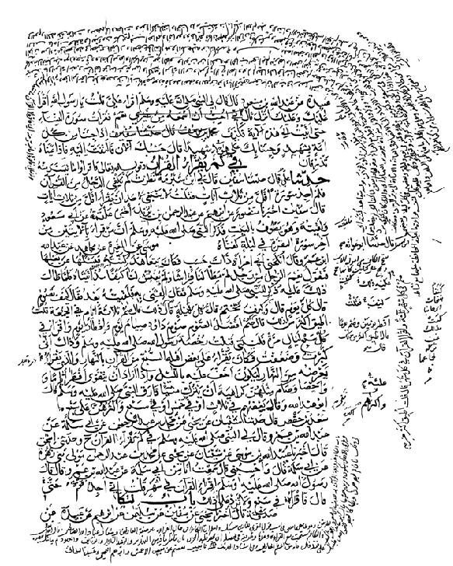
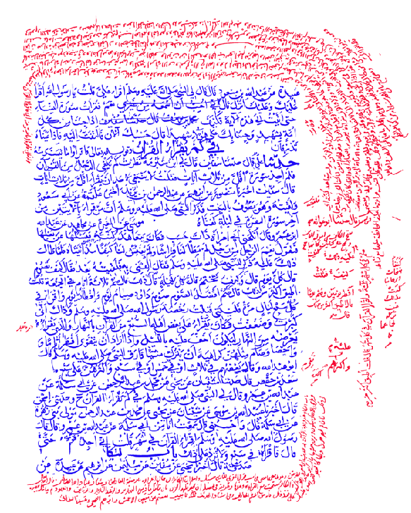
Page segmentation
Notes:
An example pathway for solving this problem is first to segment the document image into homogeneous text regions and classify these regions such as main text and side text regions.

Slide 7
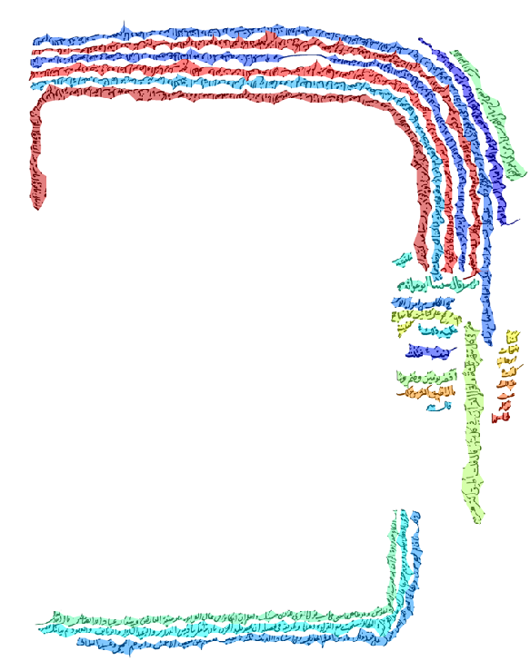
Text line segmentation
for side text
Notes:
Then to segment the side text region into text lines.

Slide 8
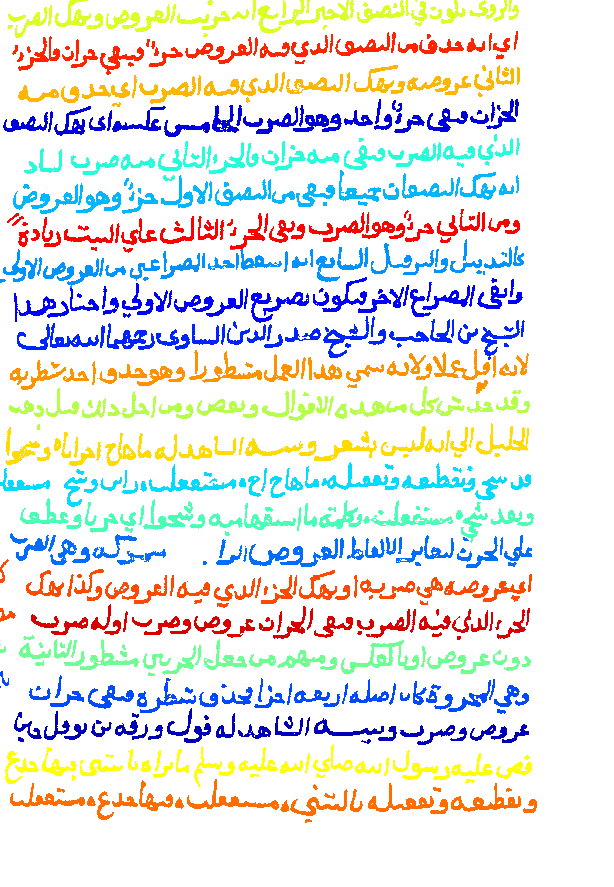
Text line segmentation
for main text
Notes:
Then to segment the main text region into text lines.

Slide 9
Transcribing into computer text
قطاعات الصناعة على الشبكة العالمية1
ويونيكود، حيث ستتم، على الصعيدين2
3والمحلي على حد سواء مناقشة
4يونكود في النظم القائمة وفيما يخص
Notes:
Finally to transcribe the segmented text lines into digital text.

Slide 10




Hypothesis
Deep learning
Page
segmentation
Text line
segmentation
Word
spotting
Notes:
The goal of our research is application of deep learning algorithms for page segmentation, text line segmentation and transcription of historical handwritten document images.

Slide 11
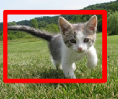

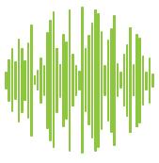



Hypothesis
Object
recognition
Deep
learning
Voice
recognition
Drug
discovery
Notes:
Because deep learning has improved state-of-the-art in several pattern recognition problems such as image recognition, voice recognition and drug discovery.

Slide 12
Hypothesis
Page
segmentation
Deep
learning
Text line
segmentation
Word
spotting
Notes:
Therefore we hypothesize that deep learning can leverage the complexity of historical documents and improve the performance of page segmentation, text line segmentation and transcription algorithms. However effective training of deep learning algorithms requires much labeled data. We have much data but, limited labeled data. Therefore in addition to using supervised learning, we also formulated these tasks as unsupervised learning problems.

Slide 13
page segmentation
Notes:
Let us start with page segmentation problem. I am going to talk about two works related to page segmentation. First is a paper work and second is the results of an international competition that we participated using the algorithm proposed in this paper.

Slide 14
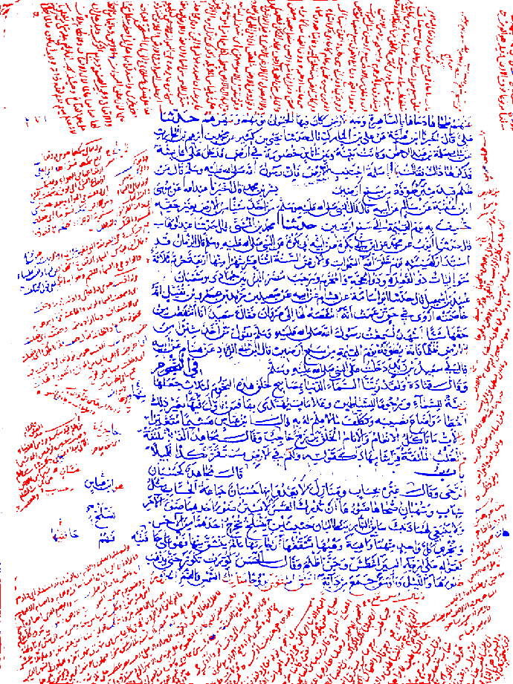
page segmentation
using
fully convolutional network
Annotation by Gunes Cevik
Berat Kurar Barakat and Jihad El-Sana
ASAR 2018 International Workshop on Arabic Script Analysis and Recognition
Notes:
In the paper work we propose to use fully convolutional network for page segmentation problem. This work has been published in Arabic Script Analysis conference in 2018.

Slide 15
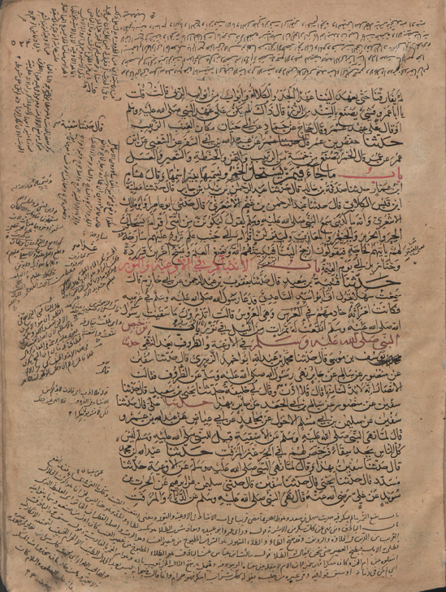
Side text
Main text
Notes:
The page segmentation problem is that given a document image we are required to group its pixels such that each group would contain homogeneous patterns from the document image. Then we are required to classify these regions such as main text and side text.

Slide 16
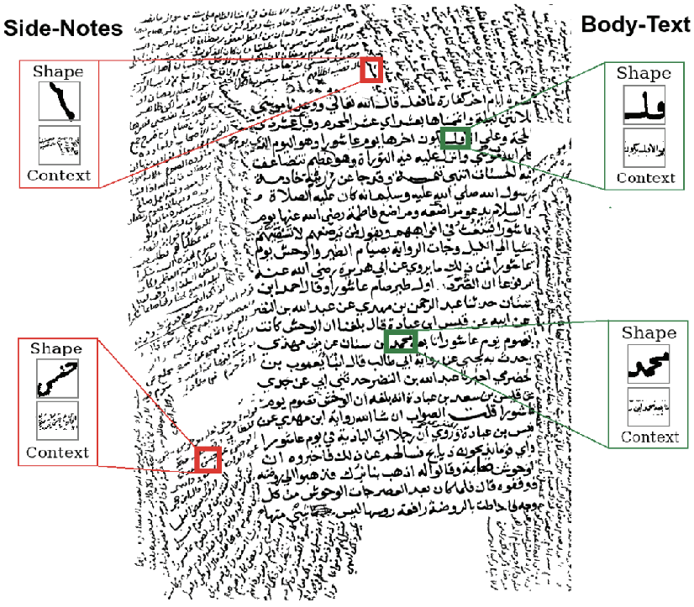
Bukhari et al, 2012
Multilayer perceptron
Connected component classification
Context features, redundant computation
Enormous time
Notes:
A feasible solution is proposed by Bukhari et al. They used multilayer perceptron to classify the connected components according to their context features which in turn leads to redundant and expensive computation in their overlapping context.

Slide 17
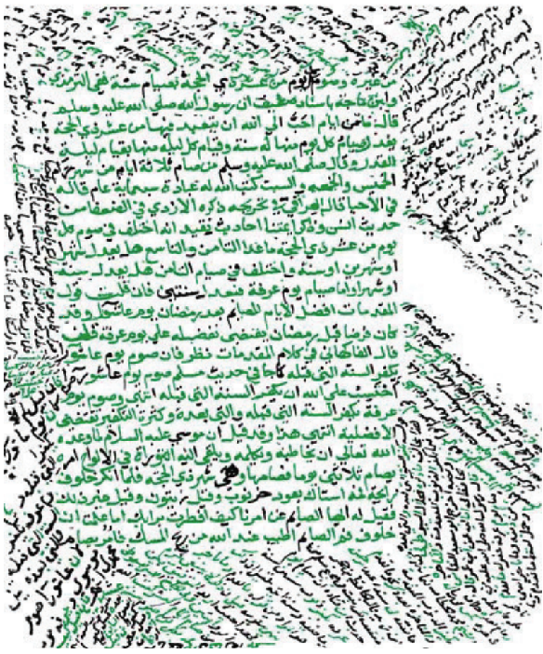
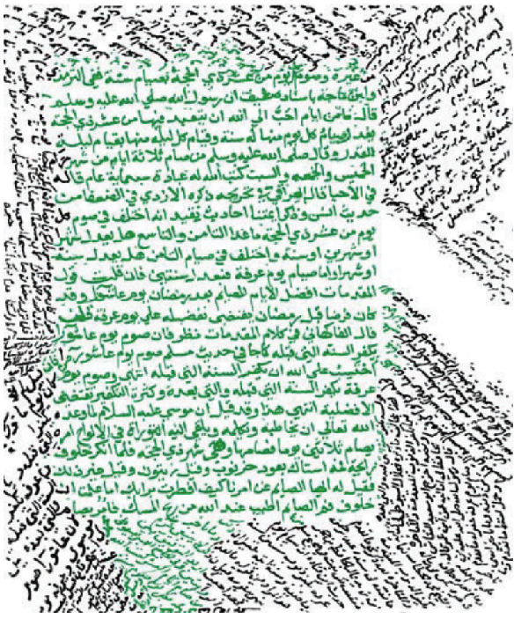
Post processing
Additional
enormous time
Notes:
Moreover the raw prediction (as shown in the left side) does not seem to discriminate the diacritics from the side text. This is probably because the physical sizes of diacritics and the side text elements are similar. That's why they needed to use a post processing step that assigns each connected component to the majority label of the neighbouring components. The post processing is also in component level using overlapping context and costs an additional enormous time. But resultantly they achieved a good result as shown in the right side.

Slide 18
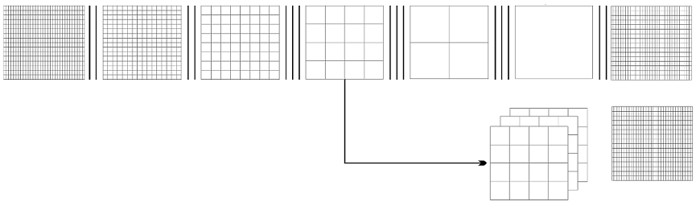
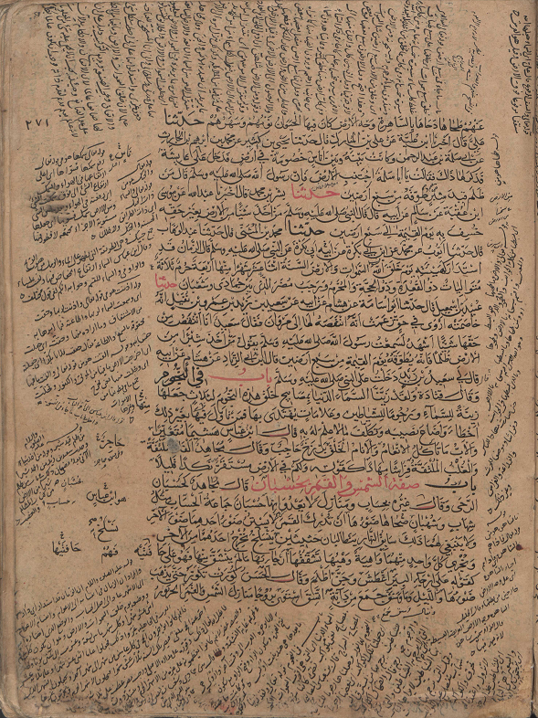
Fully convolutional network (FCN)
VGG-16
image
conv1
pool1
conv2
pool2
conv3
pool3
conv4
pool4
conv5
pool5
conv6-7
m
n
8 x upsampled
Prediction (FCN8)
4x conv7
2x pool4
pool3
m
n
J. Long, E. Shelhamer, and T. Darrell, “Fully convolutional networks for semantic segmentation”, 2015
Notes:
We propose to use fully convolutional network, namely FCN, for page segmentation problem. The FCN is originally proposed for semantic segmentation. The input is a color image of the size m by n. Then we have convolutional blocks. Each block consists of several convolutional layers and a maxpooling layer. First five blocks follow the design of VGG16 network except the final layer is replaced with two convolutional layers, 6 and 7. This is a conventional Convolutional Network and is called the encoder part of the FCN. Through the encoder, input image is downsampled by the pooling layers. Then the decoder part upsamples the downsampled outputs to the input image size. Resulting output is a matrix of m by n by number of classes. Our number of classes is 3 which are main text, side text and background pixels.

Slide 19
FCN training
 | Train | Validation | Test
Number of pages | 20 | 4 | 8
Set 1 (0<D<1) Number of patches | 100.000 | 20.000 | -
Set 2 (0.83<D<1) Number of patches | 100.000 | 20.000 | -
D = density
P(i, j) = pixel value
m = image height
n = image width
$$D=\frac{\sum_{i=0}^{m}{\sum_{j=0}^{n}{P(i,j)}}}{m×n}$$
Notes:
We used a dataset of 20 pages for training, 4 pages for validation and 8 pages for testing.
Since the GPU memory is not enough to hold a single page at one time we randomly generated 100.000 patches for training and 20.000 patches for validation. Since most of the labels are background, we tried to handle imbalanced labels by continuing the training on another dataset generated in the same way but eliminating the patches with density of less than a threshold. And the density is defined as the ratio of number of foreground pixels to the total number of pixels in a patch.

Slide 20
Page segmentation results
 | Main text F1 | Side text F1
FCN with set 1 | 0.90 | 0.68
FCN with set 2 | 0.95 | 0.80
Bukhari et al | 0.95 | 0.95
Notes:
Here are the quantitative results of page segmentation compared with the results of Bukhari et al.
First row shows FCN performance after training on set 1.
Second row shows FCN performance after further training on set 2.
Further training in set 2 improved the results but did not outperform Bukhari et al. in either class.

Slide 21
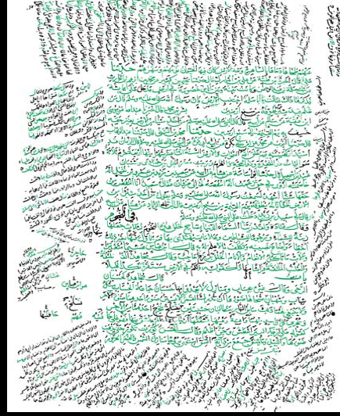
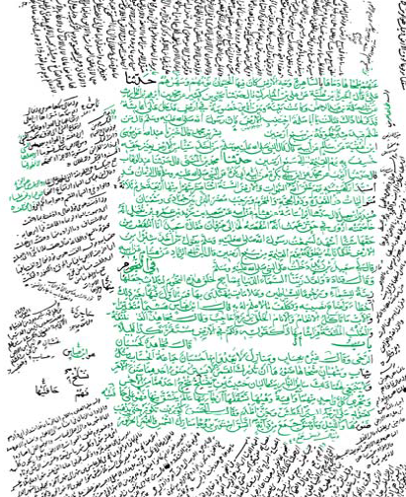
Bukhari et al
postprocessed
FCN
Bukhari et al
Predicts one page in ~15 seconds
Notes:
Here are the qualitative results of page segmentation. The leftmost one is a page segmented by FCN. The middle one is the same page segmented by Bukhari et al. and rightmost one is their result after postprocessing. Considering their component based classification for prediction and for postprocessing, our method's advantage is in terms of time efficiency as the FCN can predict one page in around 15 seconds.

Slide 22
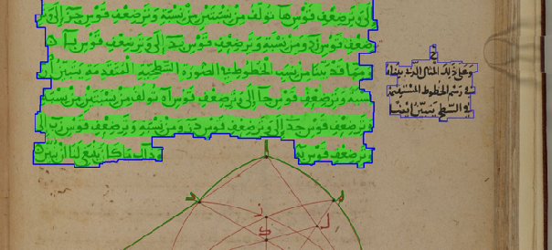
page segmentation
competition
Notes:
Now I am going to talk about our second work in page segmentation problem which is participating an international competition.

Slide 23
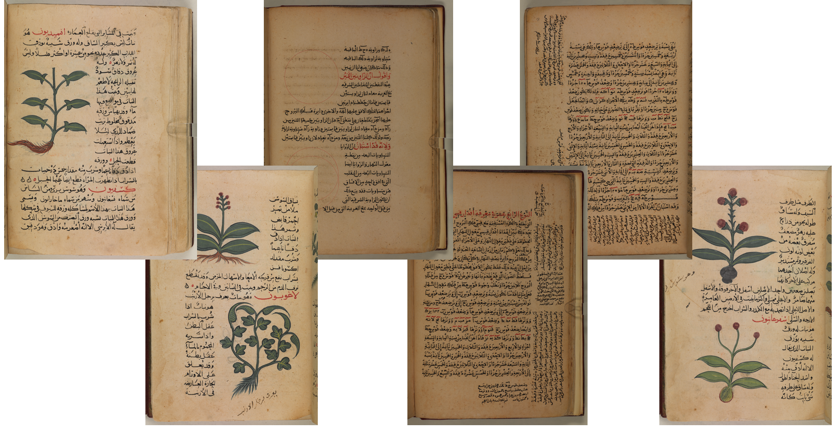
ICFHR 2018 Competition on Arabic Scientific Manuscripts
Notes:
It is a competition launched as a part of the International Conference on Frontiers in Handwriting Recognition held in 2018. The competition focussed on segmenting Arabic scientific manuscripts into main text, side text and nontext regions.

Slide 24
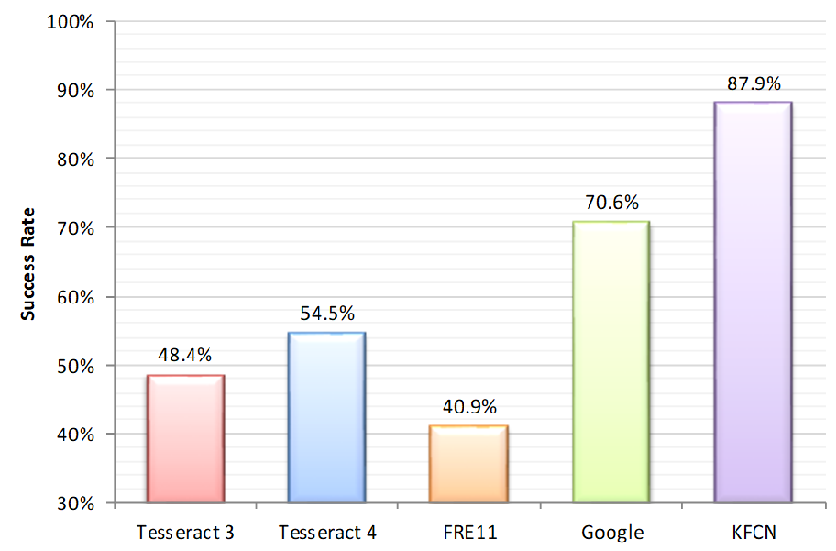
ICFHR 2018 Competition on Arabic Scientific Manuscripts
Notes:
Our method was announced as the winner of the segmentation track. It is represented here as KFCN. It achieved a success rate of 87.9 whereas in the second place google achieves a success rate of 70.6 by far.

Slide 25
text line segmentation
Notes:
Now let us continue with text line segmentation problem. I am going to talk about three paper works related to text line segmentation. Two of them propose supervised deep learning and the last one proposes an unsupervised deep learning for the text line segmentation problem.

Slide 26
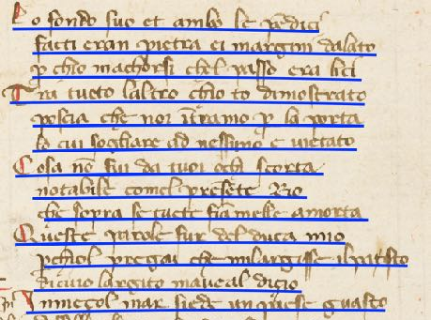
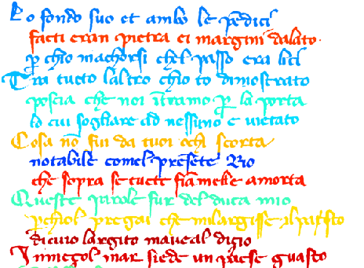
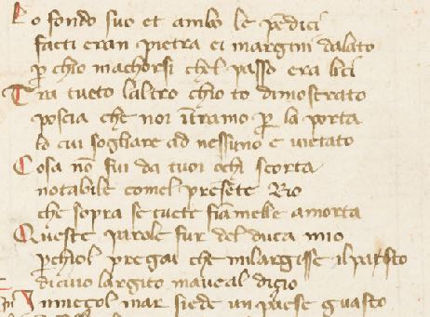
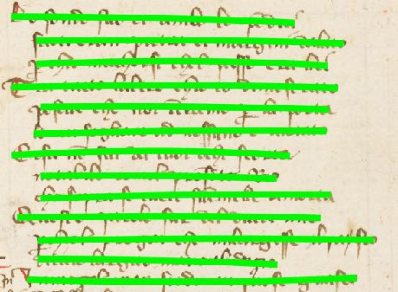
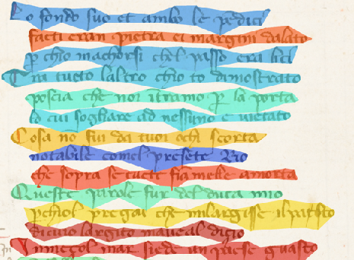
Detection
Extraction
Input
Notes:
But before we proceed I would like to clarify the text line segmentation term. In computer vision segmentation is a broad term that is the task of dividing an image into parts that are easier to analyse. This corresponds to two terms in document image analysis, text line detection and text line extraction. Text line detection identifies the location of each text line and represent them in means of baselines or blob lines. A baseline passes through the bottom part of the main body of each letter in a text line. A blob line connects the main body components of the letters in a text line. On the other hand text line extraction identifies the pixels of each text line and represent them as a list pixel coordinates or bounding polygons. In other saying, detection is a coarse grained representation and extraction is a fine grained representation. Extraction is preferable but detection is easier.

Slide 27
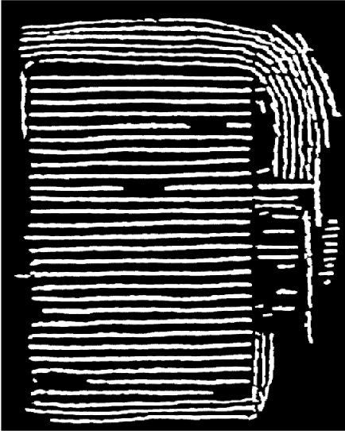
text line detection
using
fully convolutional network
Berat Kurar Barakat, Ahmad Droby, Majeed Kassis, and Jihad El-Sana
2018 ICFHR International Conference on Frontiers in Handwriting Recognition
Annotation by Gunes Cevik
Notes:
The first paper work has been published in Frontiers in handwriting recognition conference. The paper proposes to use fully convolutional network for text line detection on challenging historical handwritten documents.

Slide 28
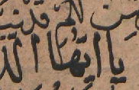
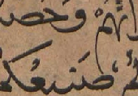
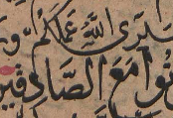
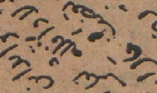
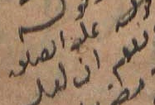
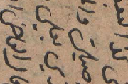
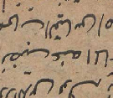
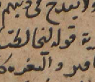
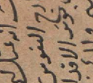
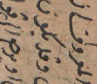
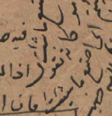
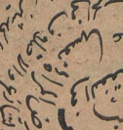
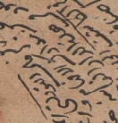
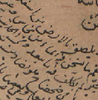
Touching
Overlapping
Crowded
Multi-skewed
Multi-directed
Curved
Notes:
It is challenging because these manuscript images contain narrow interline spaces with touching and overlapping components, crowded diacritics and inconsistent font types and sizes. Moreover, they contain multi-skewed text lines, for example 150 degree, 30 degree and 90 degree. Multi-directed text lines for example from left to right, from right to left, from up to down, form down to up. Curved text lines in different arc directions.

Slide 29
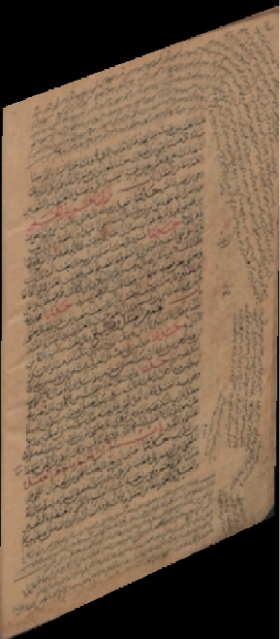

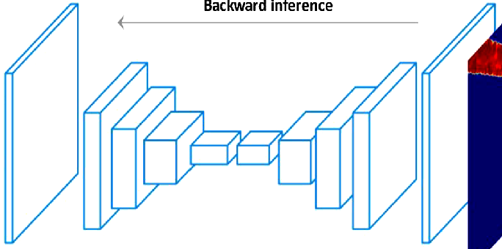
Ground truth
Input
Ground truth
FCN
Notes:
We formulated the text line detection problem as a binary dense prediction problem. Given an input document image we train an FCN so that it can dense predict whether a pixel is a blob line or not. The question is why didn't we formulated text line detection as a baseline prediction problem? The answer is because the baseline of a text line does not have a clear definition for a non-latin and interpenetrating script like Arabic.

Slide 30
Training details for text line detection
Dataset contains 30 historical handwritten document images
6-fold cross validation
Each fold is split into train, validation and test sets
50.000 random patches for training
6.000 random patches for validation
In each fold the model with the least validation loss is used for testing.
The network achieved an average validation accuracy of 88%.
Notes:
The training details are such as:
The dataset contains 30 pages. We applied 6 fold cross validation scheme for the experiments. Each fold is split into train, validation and test sets. 50.000 random patches are generated for the training and 6.000 random patches are generated for validation. In each fold we used the model with the least validation loss for predicting the test set. The network achieved an average validation accuracy of 88%.

Slide 31
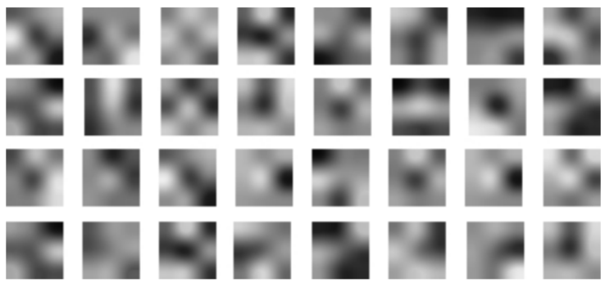
Sanity check
Visualization of the filters in the first convolutional layer
Notes:
That's why we made a sanity check and visualized the first convolutional layer filters.
We observed that the filters have conversion hence the network is learning. But the side notes spatially cover smaller area and this leads to less number of random patches with side note text lines in relative to the number of random patches with main text lines. Our take home message was that we need more labeled data.

Slide 32

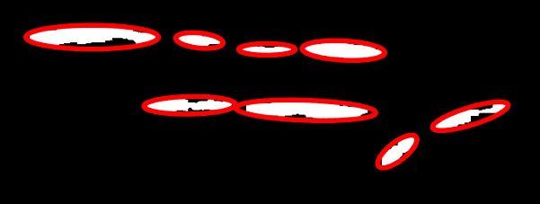

Postprocessing
Disconnected blob lines
$$C=\{c_{1},c_{2},...,c_{M}\}$$
$$i=1,2,…M$$
$$B_{1},B_{2},...,B_{N}⊆C$$
$$j=1,2,…N$$
Fitted ellipses and their direction vectors
$$B_{j}=\{c_{i}:α(c_{i})^{2}|v_{j}^{T}⋅θ(c_{i})|<ϵ\}$$
$$v_{j}=(cos(j\frac{π}{N}),sin(j\frac{π}{N}))$$
Directional dilation using a narrow kernel
$$α(c)=\frac{R_{maj}}{R_{maj}+R_{min}}$$
Notes:
Because we didn't have more labeled data, we needed to post-process the FCN output. Given a predicted blob lines image, first the orientation of each blob line is computed by fitting ellipses. Then the image is split into N layers where each layer contains the blob lines with same orientation. And alfa, which is the elongation rate of a fitted ellipse, indicates how sure are we about the orientation of the blob line. Finally each blob line is dilated using a narrow kernel in the blob direction.

Slide 33
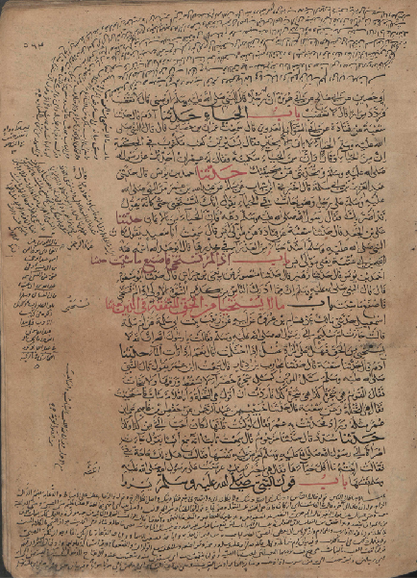


FCN
prediction
Postprocessed
FCN prediction
Input
Notes:
Given the input document image, on the left most side, we can see the difference between the raw FCN prediction which is in the middle and the post-processed FCN prediction which is on the right most side.

Slide 34

Notes:
Previously Cohen et al proposed a method for such challenging historical documents. Their method is based on automatic scale detection using Laplacian of anisotropic gaussian filters. Given the ground truth of a document image in the middle, the left most image shows the blob lines detected by Cohen et al and the right most image shows the blob lines detected by FCN. Cohen et al's result has a relatively low precision value which indicates the under segmentations in its visual results. In the same way FCN result has a low precision value in relative to its recall value which indicates the under segmentations in its visual results.

Slide 35
Text line detection results
 | Recall | Precision | F-measure
FCN | 0.82 | 0.78 | 0.80
Cohen et al | 0.74 | 0.60 | 0.66
Notes:
Here are the quantitative results compared with the results of Cohen et al.
First row shows FCN performance.
Second row shows Cohen et al's performance which FCN overperforms by far.

Slide 36


text line extraction
using
fully convolutional network
and
energy minimization
Annotation by Gunes Cevik
Berat Kurar Barakat, Ahmad Droby, Rym Alasam, Boraq Madi, Irina Rabaev, and Jihad El-Sana
2020 PatReCH International Workshop on Pattern Recognition for Cultural Heritage
Notes:
The second paper work has been published in the international workshop on pattern recognition for cultural heritage.
The paper proposes to extract text lines by first detecting the text lines using an FCN, then extracting the text lines by using an energy minimization framework that is guided by the detected blob lines. We hypothesize that this combination is an optimal solution for text line extraction of complex layout documents. Because the both, FCN and energy minimization, do not have to assume any text line orientation, character size and interline space.

Slide 37

Text line detection
using FCN
Text line extraction
using EM
Input
Notes:
The method works like this: Given an input document image we use an FCN for detecting the blob lines that strike through the text lines. Then we use the detected blob lines to guide an energy minimization function for extracting the text lines.

Slide 38
Energy minimization
$$\text{E}(f)=\underset{e∈E,l_{e}∈L}{∑}D(e,ℓ_{e})+\underset{\{e,e^{′}\}∈N}{∑}\frac{1}{e^{d_{n}(e,e^{′})}}⋅δ(ℓ_{e}≠ℓ_{e^{′}})$$
$L$ = Set of binary blob lines
$E$ = Set of binary elements
$N$ = Set of nearest element pairs
$D$ = Cost of assigning element $e$ to label $l_{e}$
$d_{n}$ = Profit of assigning neighbour elements to different labels
$δ$ = Indicator function = Is 1 when neighbour elements have different labels
Notes:
We have already talk about the blob line detection using FCN. I am going to talk about the energy minimization part of the method. Let L be the set of binary blob lines, and E be the set of binary elements in the document image. Then energy minimization finds a labeling f that assigns each element e, to a label le, so that the energy function E(f) has the minimum.
The energy function contains a data cost and a smoothness cost. Data cost is the cost of assigning an element to a label, and it is measured by the Euclidean distance between the element and the blob line that it is assigned. So in other saying it tends to assign every element to the nearest blob line. But what about the satellite elements that are not touched by a blob line? We use the smoothness cost for them. Smoothness cost is the cost of assigning neighbour elements to different labels, and it has an inverse ratio with the normalized distance between two neighbour elements that are assigned to different labels.

Slide 39

Smoothness cost from Gestalt principles
Correct segmentations with smoothness cost
Wrong segmentations without smoothness cost
Notes:
The philosophy of the smoothness cost comes from the Gestalt principles of human behaviour in grouping the objects. Accordingly, as proximate as two objects humans tend to group them together. We can see its illustration in this figure. In the first row we can see that the diacritics are correctly assigned to the label of the nearest element instead of the label of the nearest blob line. And in the second row they are wrongly assigned to the label of the nearest blob line because the lack of smoothness cost.

Slide 40

VML-MOC dataset text line extraction results
 | LineIU | PixelIU
FCN+EM | 35.12 | 60.97
Cohen et al | 60.99 | 80.96
Notes:
Here are the results on a multiply oriented and skewed text line dataset. The results are compared with the results from Cohen et al. who uses automatic scale selection using laplacian of anisotropic gaussian filters. Our results are far below theirs.

Slide 41

VML-AHTE dataset text line extraction results
 | LineIU | PixelIU
FCN+EM | 94.52 | 90.01
Mask-RCNN | 93.08 | 86.97
Notes:
Here are the results on an Arabic handwritten dataset. The results are compared with the results of Mask-RCNN which is a deep learning method for instance segmentation. Our results overperforms Mask-RCNN.

Slide 42

DIVA dataset text line extraction results
 | LineIU | PixelIU
FCN+EM | 99.22 | 97.54
System9+4.1 | 97.86 | 97.05
Notes:
Here are the results on a Latin handwritten dataset. The results are compared with state of the art result. Our results over performs the state of the art but on par.

Slide 43

text line extraction
using
unsupervised deep learning
Annotation by Gunes Cevik
Berat Kurar Barakat, Ahmad Droby, Rym Alasam, Boraq Madi, Irina Rabaev, Raed Shammes and Jihad El-Sana
2020 ICPR International Conference on Pattern Recognition
Notes:
The third paper work proposes an unsupervised deep learning method for text line extraction problem. It has been recently published in ICPR2020

Slide 44

Pseudo rgb image
of detected lines
Input
Binary blob lines
Extracted text lines
Notes:
The method works like this: Given an input document image we train a two stream network for predicting whether the two input patches are similar or different. Then in the prediction phase, we use only the single stream to extract the features of the patches of a document. For every patch we consider the first 3 principals of its features to generate the pseudo-rgb image. Then we threshold the pseudo-rgb image into binary blob lines. Finally we extract the text lines using the energy minimization framework assisted by the detected blob lines.

Slide 45

Siamese network
Notes:
Here is the architecture of the two stream network for predicting whether the two input patches are similar or different. Notice that the streams share the common weights during the training.

Slide 46

Similar pairs
Example of similar pairs
$$s=\frac{min(a_{1},a_{2})}{max(a_{1},a_{2})}$$
$a_{i}$ = Number of foreground pixels, $i∈\{1,2\}$
$$(a_{2}-a_{1})→0⟹s→1$$
Notes:
So how do we generate the training data? Its philosophy comes from the fact that a human can annotate the text lines of a language that he does not spoke. This is explained by the gestalt principals that human tends to group the proximate elements together. We formulated this fact by a similarity score. Given two patches let their number of foreground pixels be a1 and a2. Then the similarity score measures the relative amount of their foreground pixels. So for the similar patches this score converges to 1.

Slide 47

Different pairs
Example of different pairs
$$s=\frac{min(a_{1},a_{2})}{max(a_{1},a_{2})}$$
$a_{i}$ = Number of foreground pixels, $i∈\{1,2\}$
$$(a_{2}-a_{1})→∞⟹s→0$$
Notes:
And for the different patches the similarity score converges to 0.

Slide 48

Effect of similarity score on the performance
Notes:
So we need to decide a threshold value for discriminating the similar patches from the different patches.
In the figure the green line shows that the performance increases as the similarity score for the similar pairs increases. And the blue line shows that the performance increases as the similarity score for the different pairs decreases.

Slide 49




AHTE dataset text line extraction results
Pseudo rgb image
of detected lines
Input
Extracted text lines
Notes:
Here are the results on an Arabic handwritten dataset. The results are compared with the results of Mask-RCNN which is a deep learning method for instance segmentation and our previous method FCN+EM. Our results are on par with the supervised methods.

Slide 50




ICFHR2010 dataset text line extraction results
Pseudo rgb image
of detected lines
Input
Extracted text lines
Notes:
Here are the results on a modern handwritten dataset. The results are compared with state of the art result. Their results over perform by far.

Slide 51



ICFHR2010 dataset text line extraction results
 | LineIU | PixelIU
UTLS | 88.41 | 87.40
System9+4.1 | 97.86 | 97.05
Pseudo rgb image
of detected lines
Input
Extracted text lines
Notes:
Here are the results on a Latin handwritten dataset. The results are compared with state of the art result. Their results over perform by far.

Slide 52
conclusion
and
future work
Notes:
And I am going to finalize by a short conclusion and a future work.

Slide 53
Conclusion
Scarce of labelled data is a problem for the supervised methods.
Pre-training is necessary but there is a gap of image-net scale dataset with a distribution coming from document images.
Unsupervised methods can over perform supervised methods but with ad-hoc parameters.
Formulation without ad-hoc parameters is necessary.
Intuitively, labelling effort is favourable over designing ad-hoc parameters because the former can be accomplished by human recognition skills, whereas the latter requires further mathematical skills.

Slide 54






Future work: Unsupervised text line segmentation
Similar patches
Input
Unsupervised prediction
Different patches
Notes:
So now we are working to find an unsupervised formulation without ad-hoc parameters. In the preliminary work we train the machine to learn that randomly cropped two patches contain the same text line pattern. And to learn that they contain different text line pattern if one of them is rotated. Given the input document, here is the prediction result from the machine trained in such way.

