Slide 1
Letter-level paleography for DSS

Slide 2
Our research aims to advance the paleographical study of the Dead Sea Scrolls by developing a method to segment ink areas in fragment images, improve detection of recognized letters, and enable letter-level paleography analysis.

Slide 3
Multispectral method: Segmenting everything

Slide 4
The primary objective is to create an efficient and accurate method for segmenting ink areas within the fragment images. By utilizing multispectral clustering, our goal is to automate the segmentation process and reduce the need for manual annotation. This approach will significantly speed up the analysis of millions of pixels while maintaining high segmentation accuracy. The segmented ink areas will serve as the basis for subsequent tasks.

Slide 5
A single fragment image consists of around 12,000,000 pixels (3000x4000). Machine learning methods rely on annotated images, and segmentation annotation can be particularly challenging, as it requires the segmentation of each individual pixel. Currently, scholars are using image editing programs such as GIMP to manually segment the desired areas. However, we can utilize multispectral clustering to achieve segmentation, benefiting both scholars and machine learning methods.
The drawback of multispectral segmentation is that human assistance is still necessary to assign the clusters to the correct classes. Additionally, not all fragments contain the same objects. Some may lack ink, while others may lack rice paper, or they may include shadows and other variations. Nevertheless, this approach would greatly assist annotators and scholars in segmenting millions of pixels rapidly, as the human involvement would be limited to deciding the classes.

Slide 6
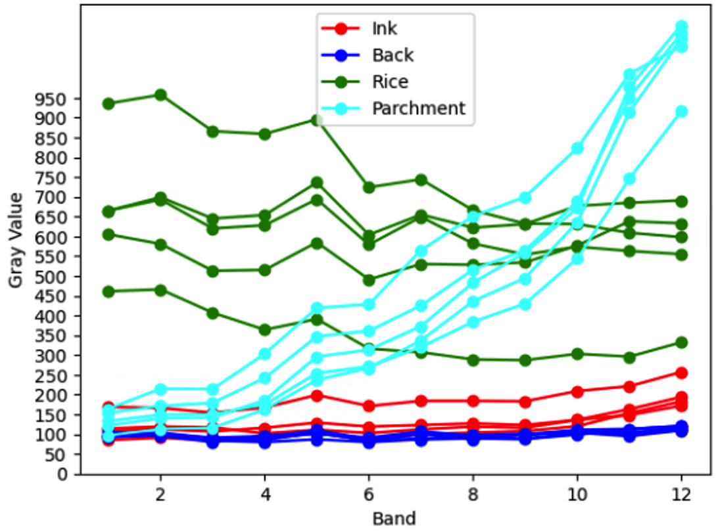
Gray value trend of pixels across multispectral bands

Slide 7
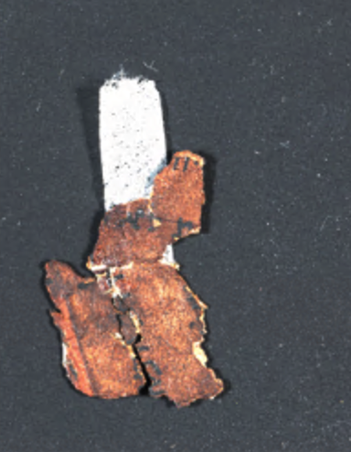
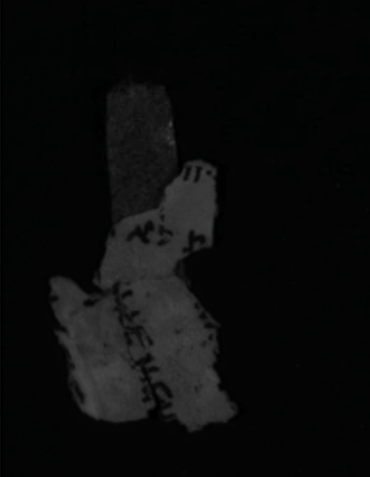
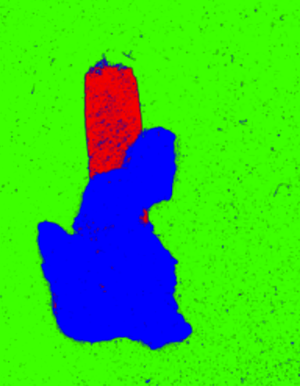
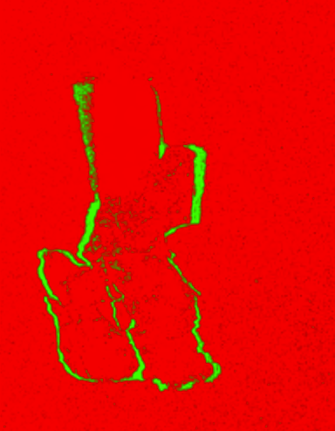
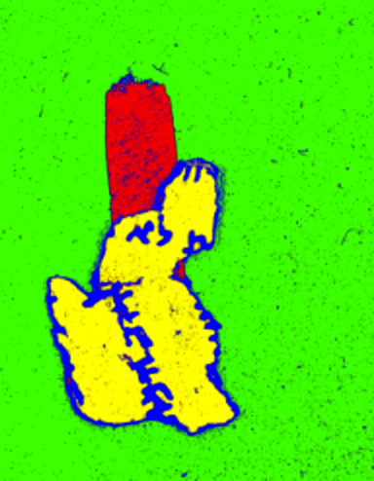
Notes:
Color, infrared, otsu, MS parchment, MS holes and shadows, MS letters

Slide 8
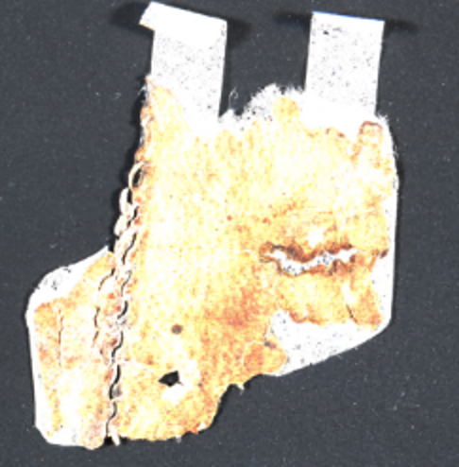
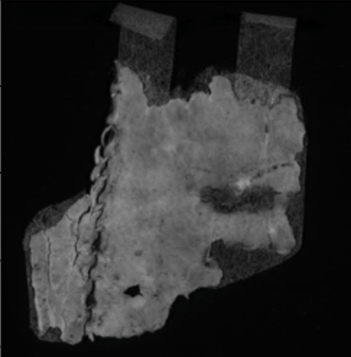
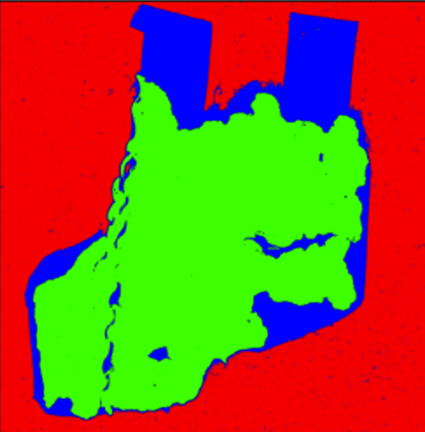
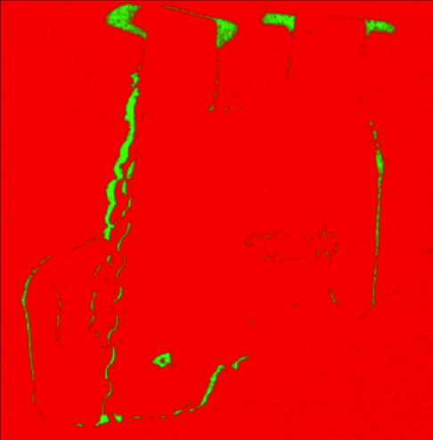
Notes:
Color, infrared, otsu, MS parchment, MS holes and shadows

Slide 9
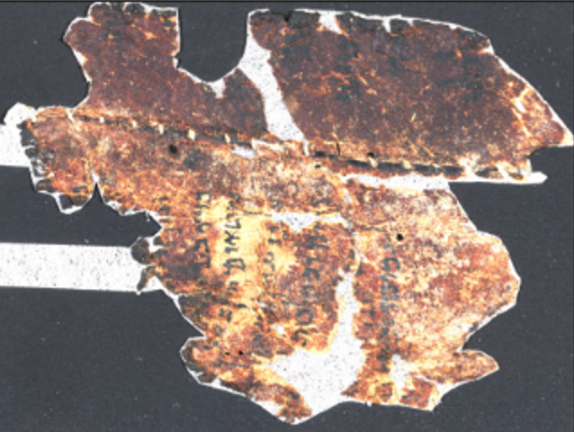
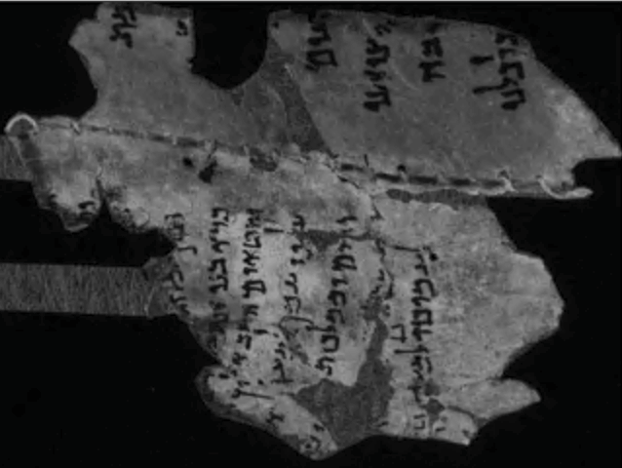
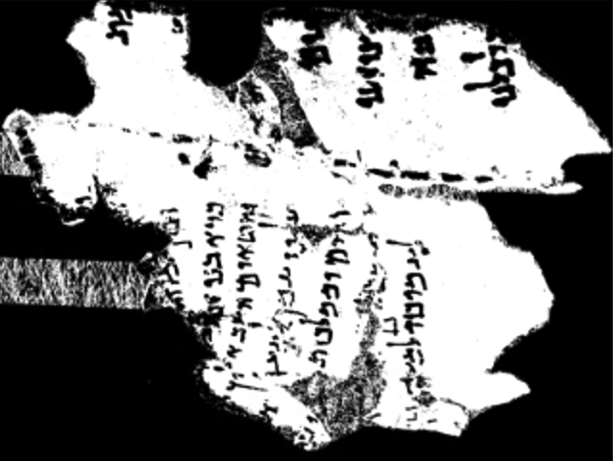
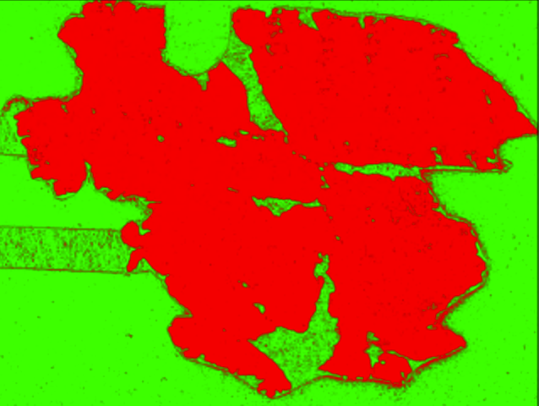
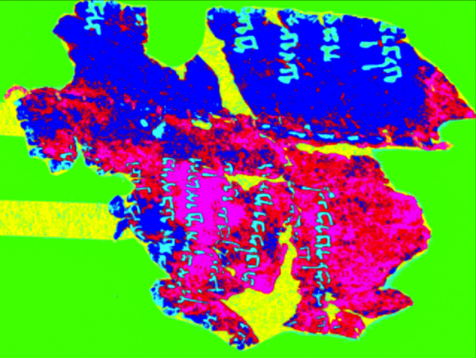
Notes:
Color, infrared, otsu, MS parchment, MS holes and shadows, MS letters

Slide 10
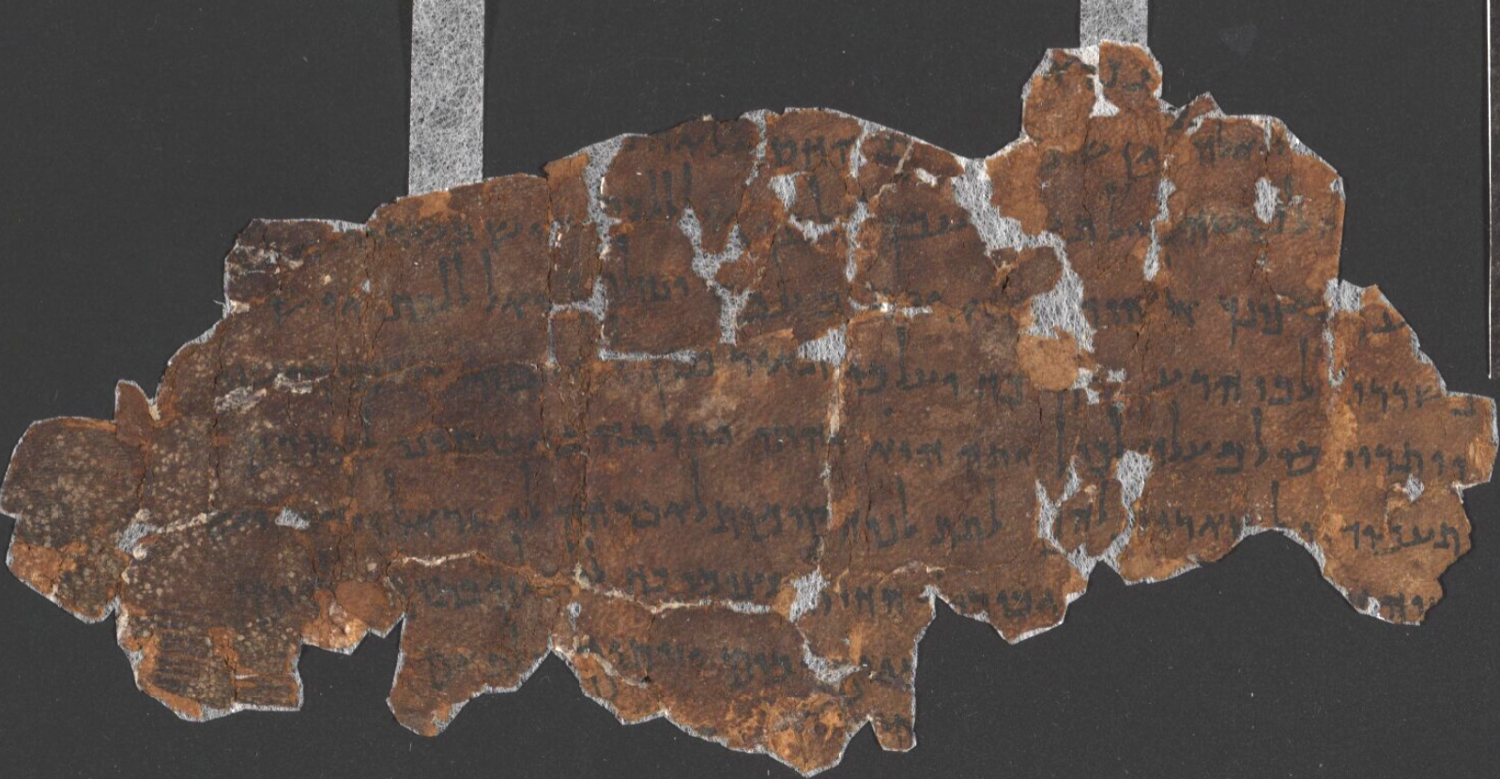
Notes:
Color

Slide 11
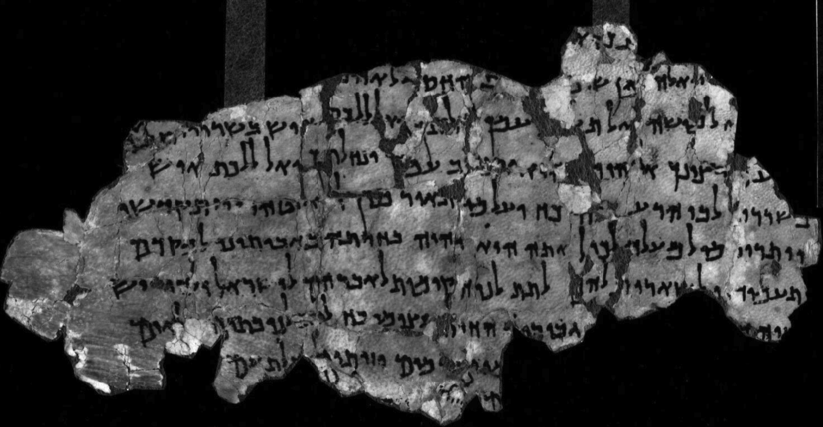
Notes:
Infrared

Slide 12
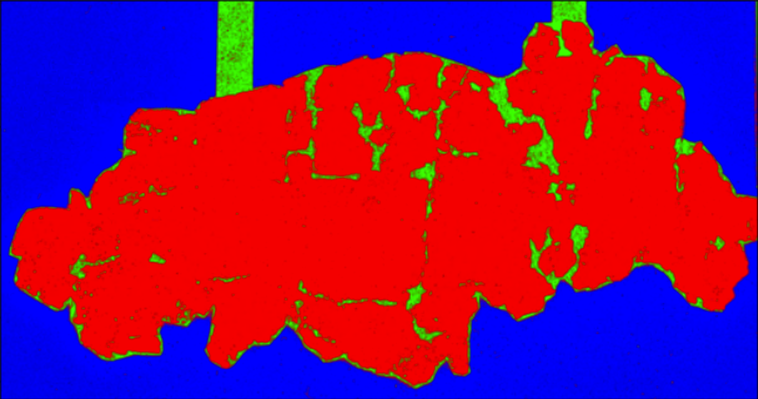
Notes:
Multispectral parchment and rice

Slide 13
Notes:
Multispectral holes and shadows

Slide 14
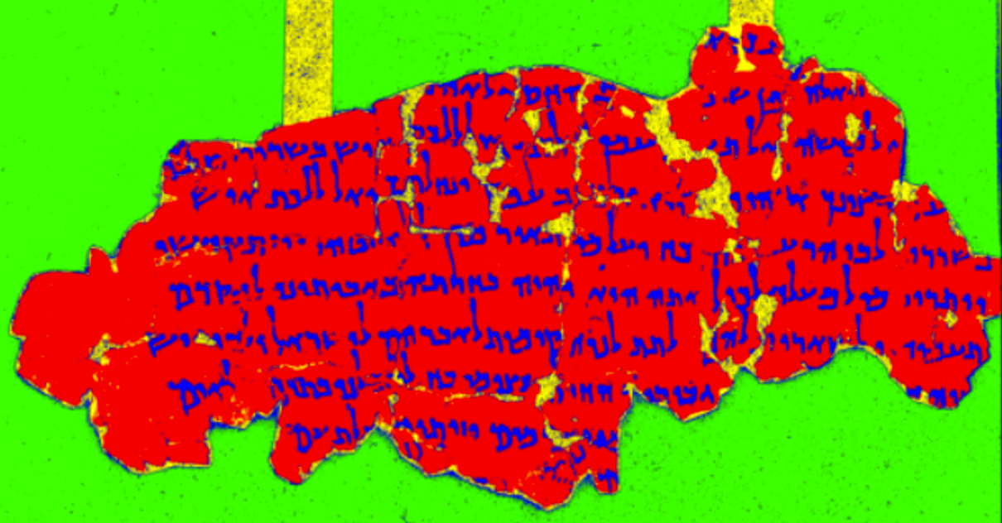
Notes:
Multispectral letters

Slide 15
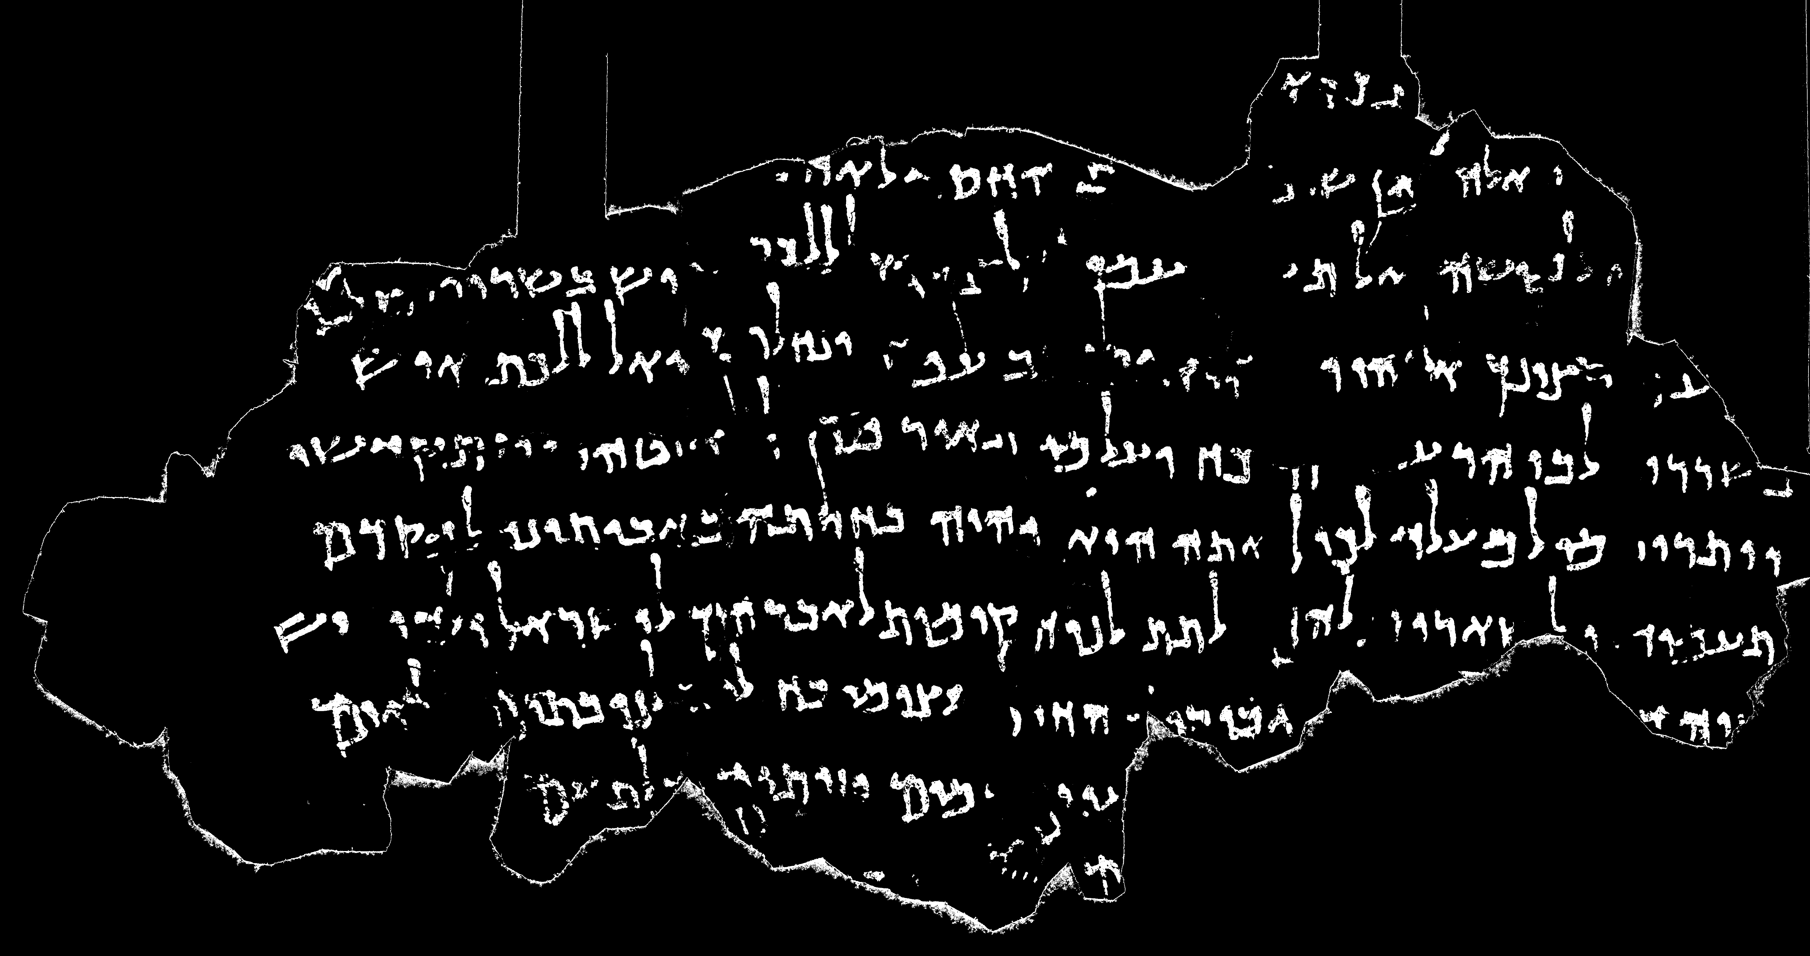
Multispectral
Notes:
Multispectral letters

Slide 16
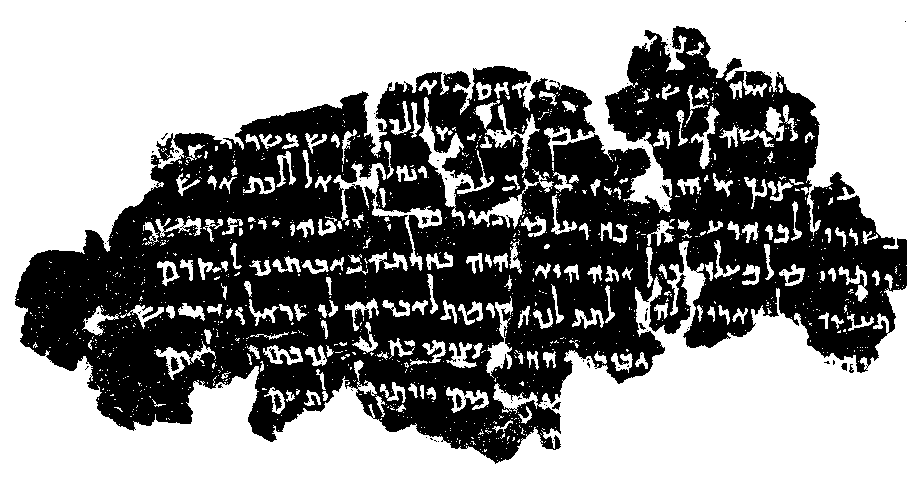
Otsu
Notes:
Otsu

Slide 17
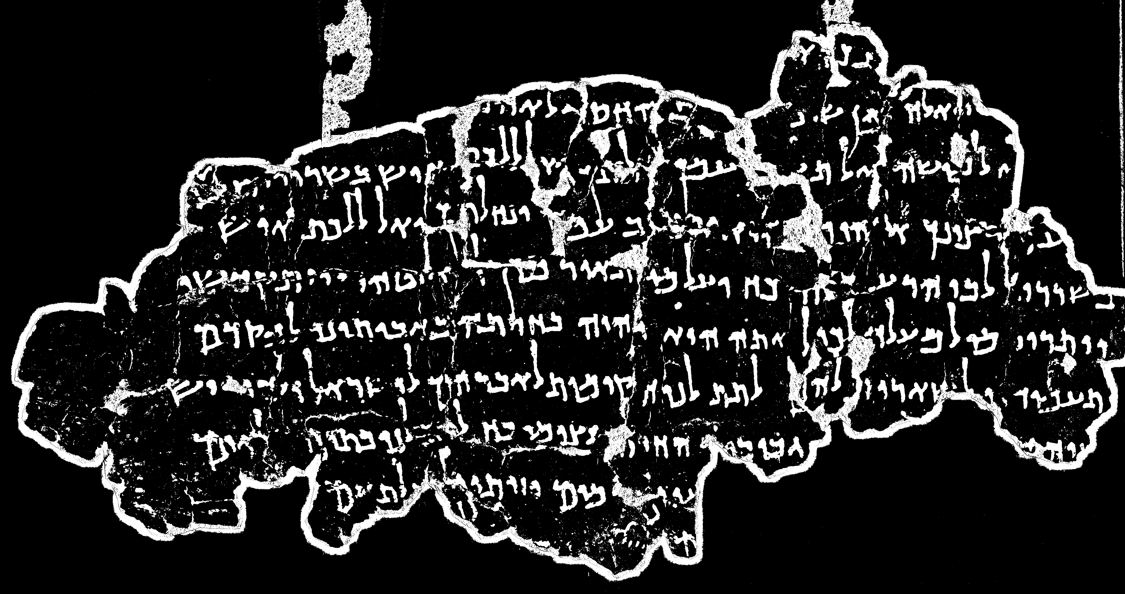
Sauvola
Notes:
Sauvola

Slide 18
Refining Kraken’s letter detection

Slide 19
Building upon the segmented ink areas, our second objective is to enhance letter detection by integrating the results of ink segmentation. By incorporating the refined ink regions into existing text recognition algorithms, such as Kraken, we can improve the accuracy of individual letter detection within the fragments. This integration will extract more precise letter-level information, revealing details about handwriting styles and variations.

Slide 20
We use the energy minimization framework to improve Kraken’s rough letter detection.
We assume that each character detected from Kraken corresponds to one and only one character but, each character might consist of several connected components.
Minimum of the energy function corresponds to a good segmentation which urges to assign components to the label of the closest character segment while straining to assign closer components to the same label.
The touching letters are segmented in pixel level.

Slide 21
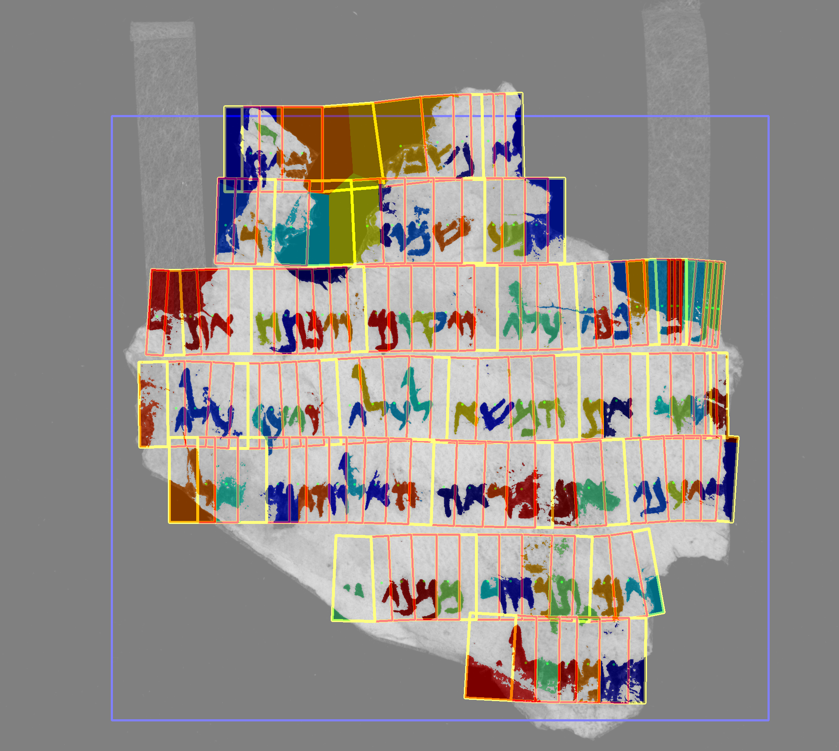

Slide 22
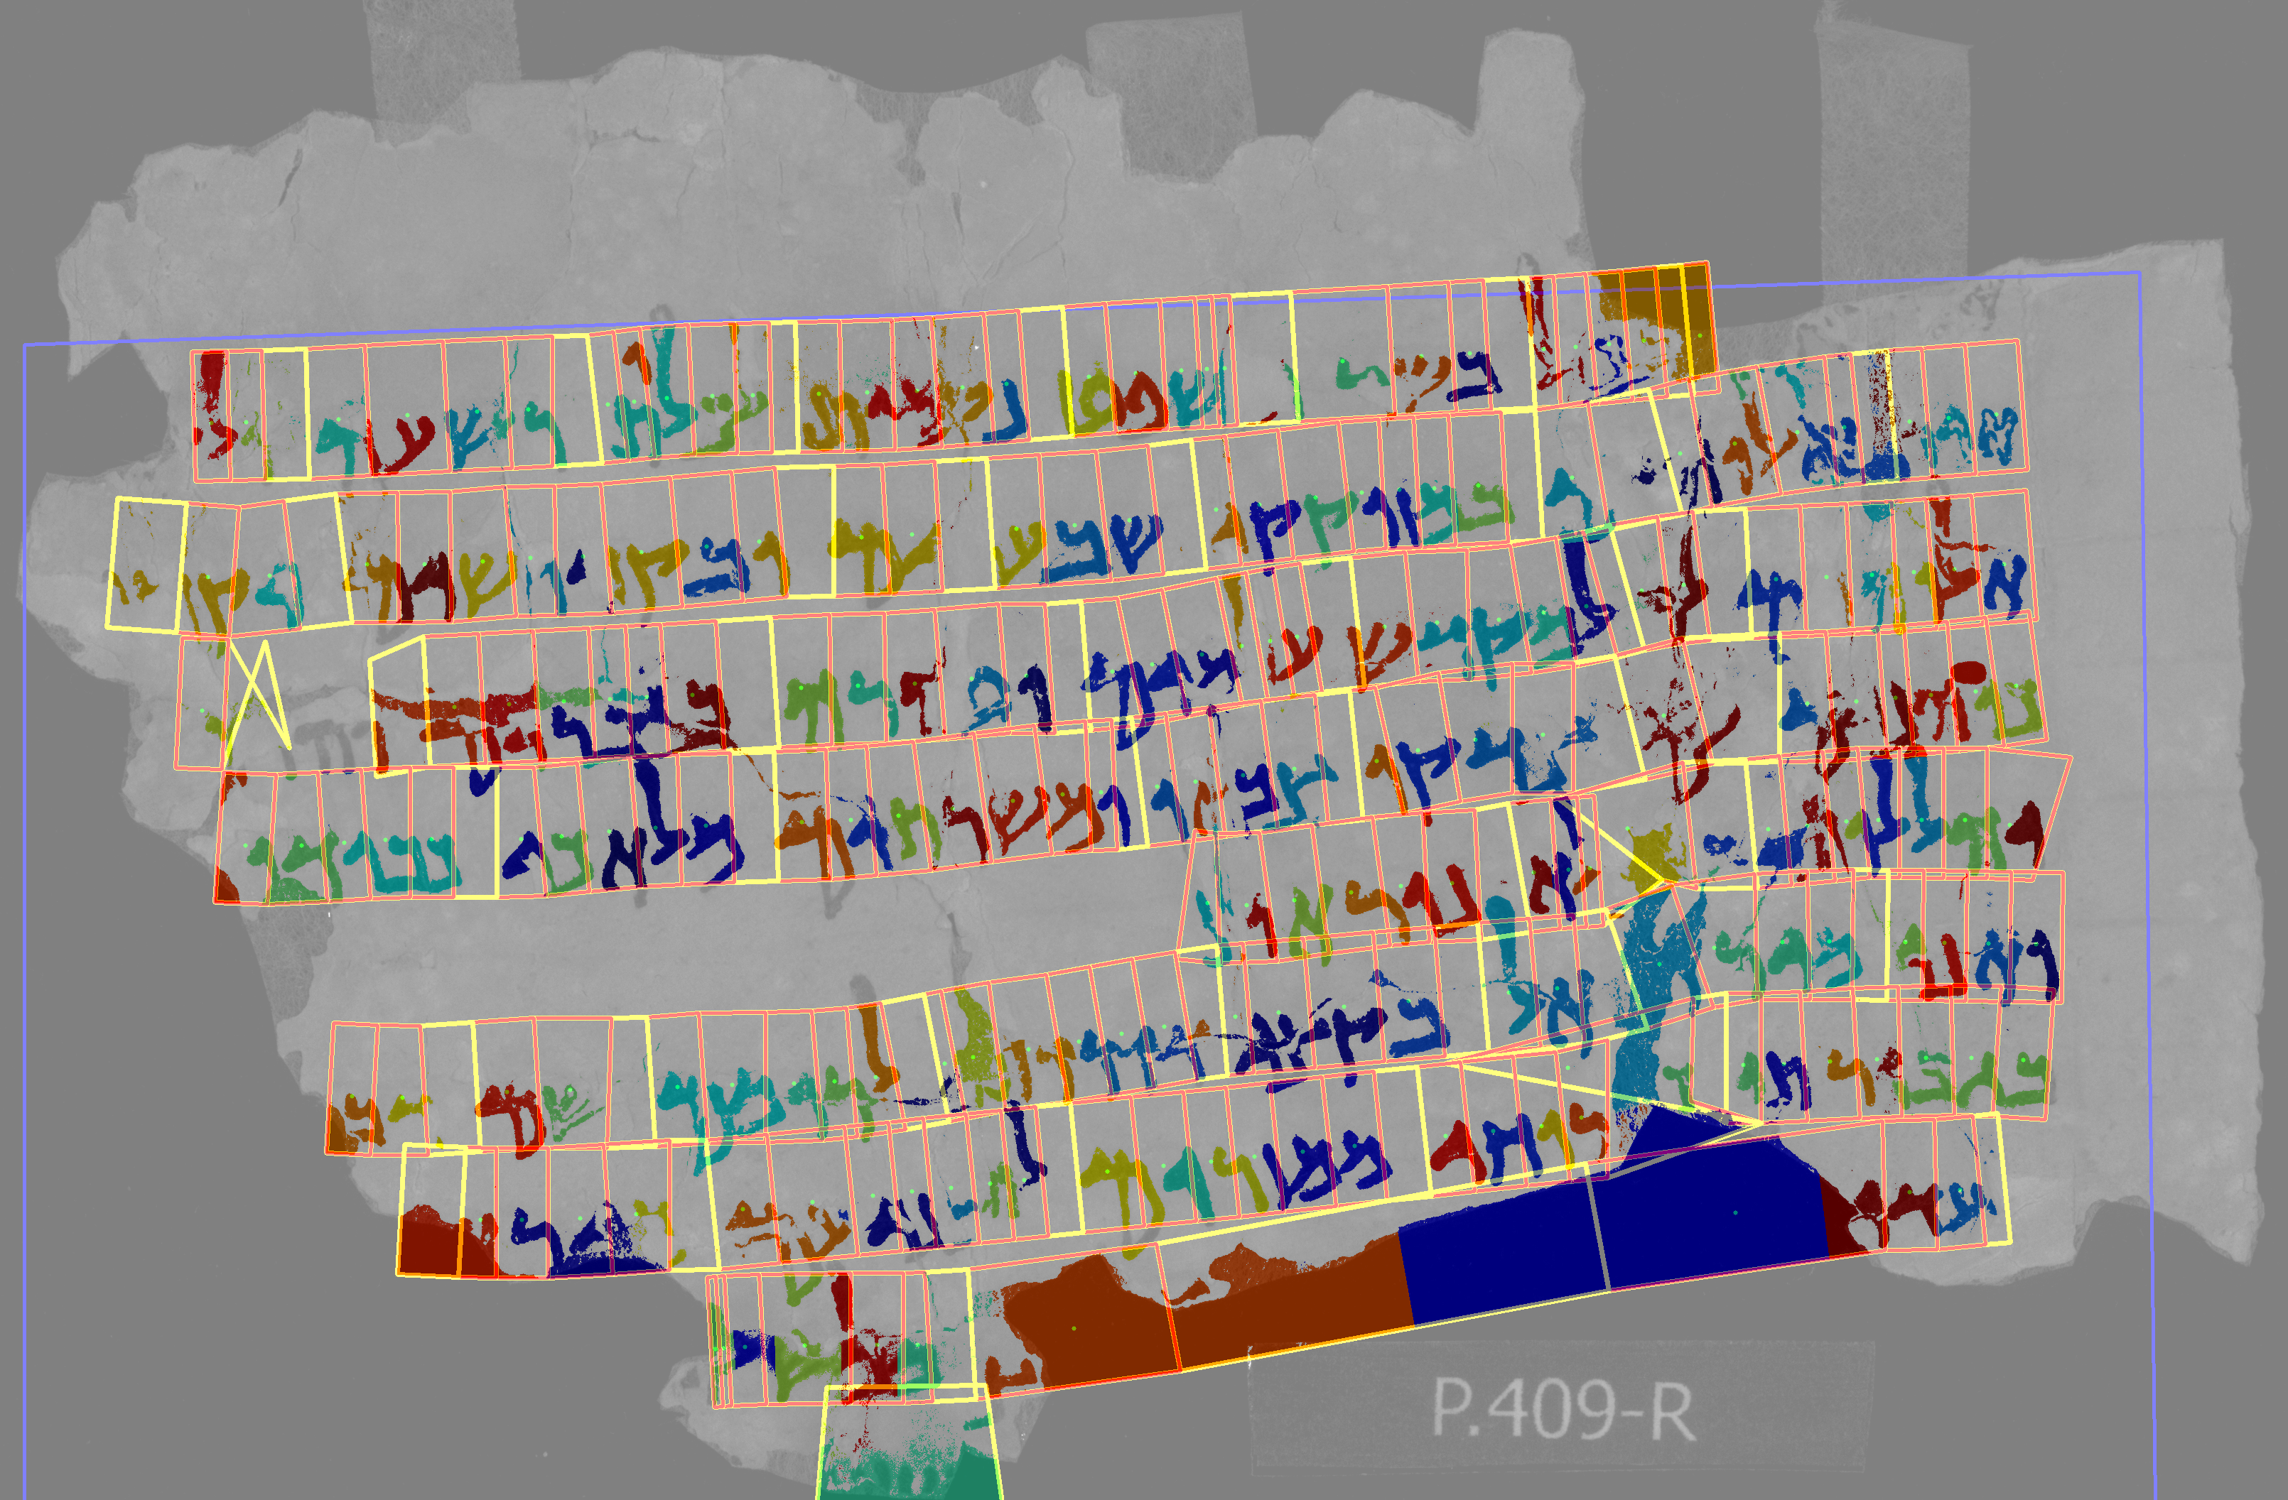

Slide 23
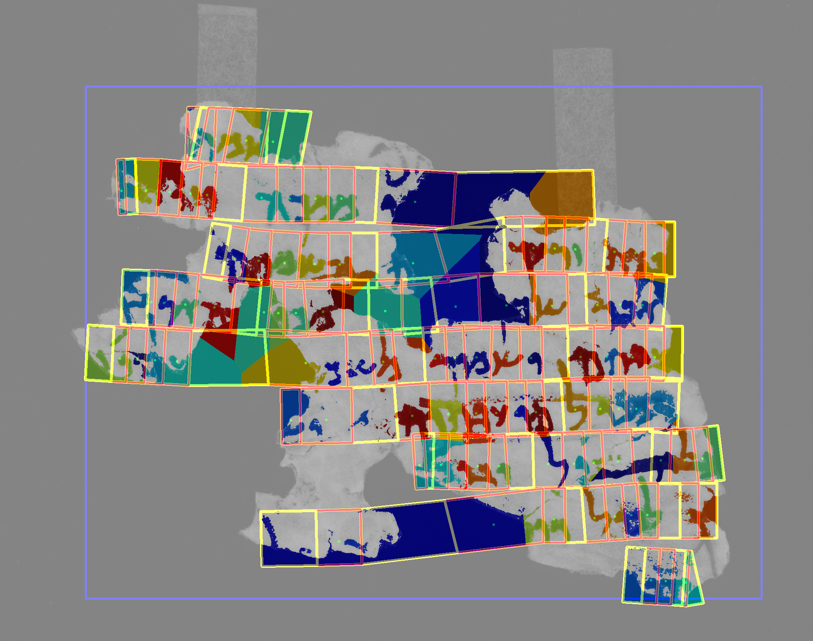

Slide 24
Letter level paleography

Slide 25
The final goal of our proposal is to implement letter-level paleography, capitalizing on the accurate segmentation and refined letter detection results obtained in the previous steps. The letter-level paleography approach provides deeper insights into the evolution of writing styles, as the prototypes constructed from individual letters are expected to be more descriptive compared to connected component level or image patch level prototypes.

Slide 26
No initial results on letter level paleography
Previous work using patch level paleograpgy are below
Digital Hebrew Paleography: Script Types and Modes Ahmad Droby, Irina Rabaev, Daria Vasyutinsky, Berat Kurar Barakat, and Jihad El Sana 2022 Journal of Imaging, MDPI
Hard and Soft Labeling for Hebrew Paleography: A Case Study Ahmad Droby, Daria Vasyutinsky, Irina Rabaev, Berat Kurar Barakat, and Jihad El Sana (DAS) 2022 IAPR International Workshop on Document Analysis System
Is a deep learning algorithm effective for the classification of medieval Hebrew scripts? Daria Vasyutinsky, Irina Rabaev, Ahmad Droby, Berat Kurar Barakat, and Jihad El Sana 2022 #DHJewish - Jewish Studies in the Digital Age
VML-HP: Hebrew paleography dataset Ahmad Droby, Berat Kurar Barakat, Irina Rabaev, Daria Vasyutinsky, and Jihad El Sana (ICDAR) 2021 International Conference on Document Analysis and Recognition
SmartScript: a Web-Based System for Classification of Medieval Hebrew Scripts Daria Vasyutinsky, Irina Rabaev, Ahmad Droby, Berat Kurar Barakat, and Jihad El Sana 2021 The ACH Conference
Deep learning for palaeographic analysis of medieval Hebrew manuscripts: a DH team collaboration experience Daria Vasyutinsky, Irina Rabaev, Berat Kurar Barakat, Ahmad Droby, and Jihad El Sana 2020 Twin Talks: Understanding and Facilitating Collaboration in Digital Humanities

