Slide 1
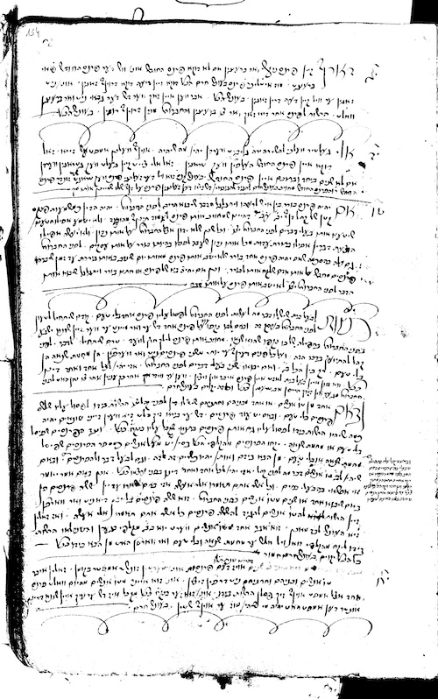
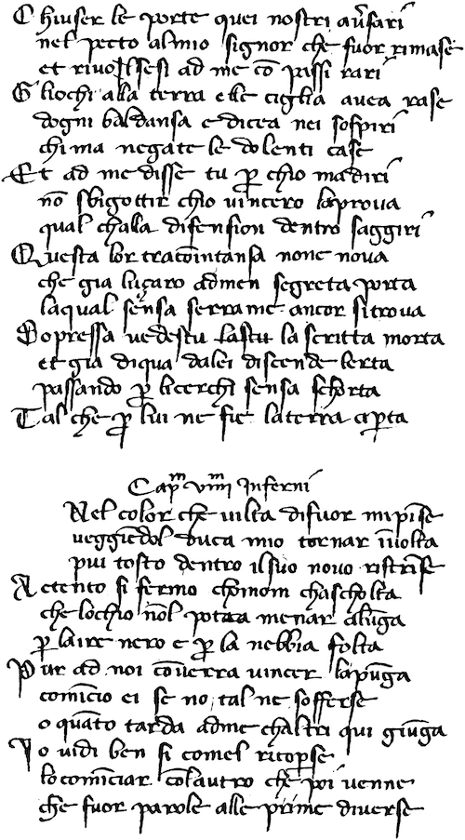
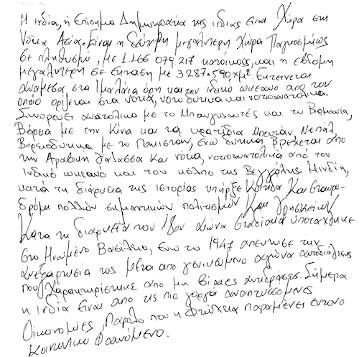
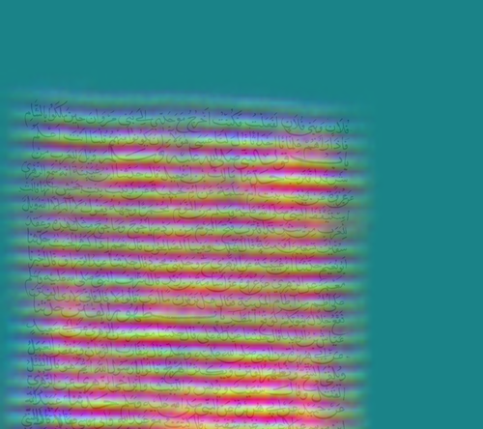
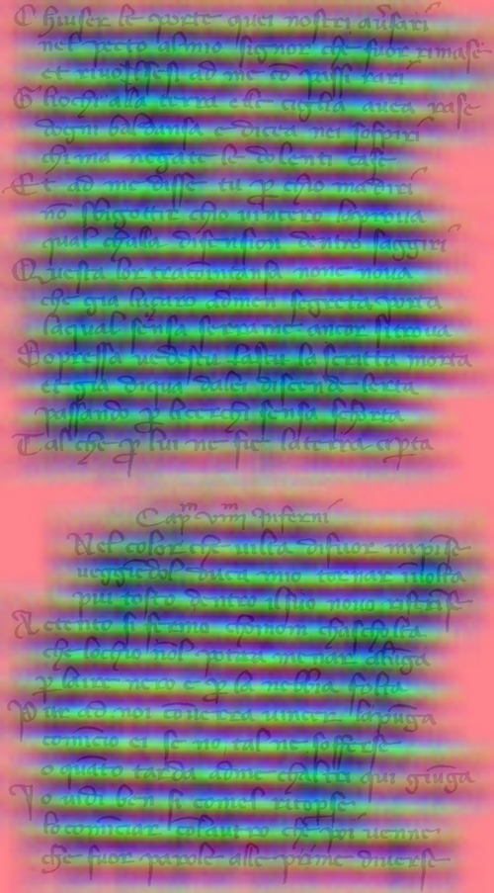
Differentiate coarse patterns to segment text lines
Berat Kurar Ahmad Droby Raid Saabni Jihad El-Sana
16th International Conference on Document Analysis and Recognition
ICDAR 2021
Notes:
We propose an unsupervised deep learning method for handwritten text line segmentation. The method trains the machine on a surrogate task. Then the learned features are used to detect the blob lines that strike through the text lines.

Slide 2
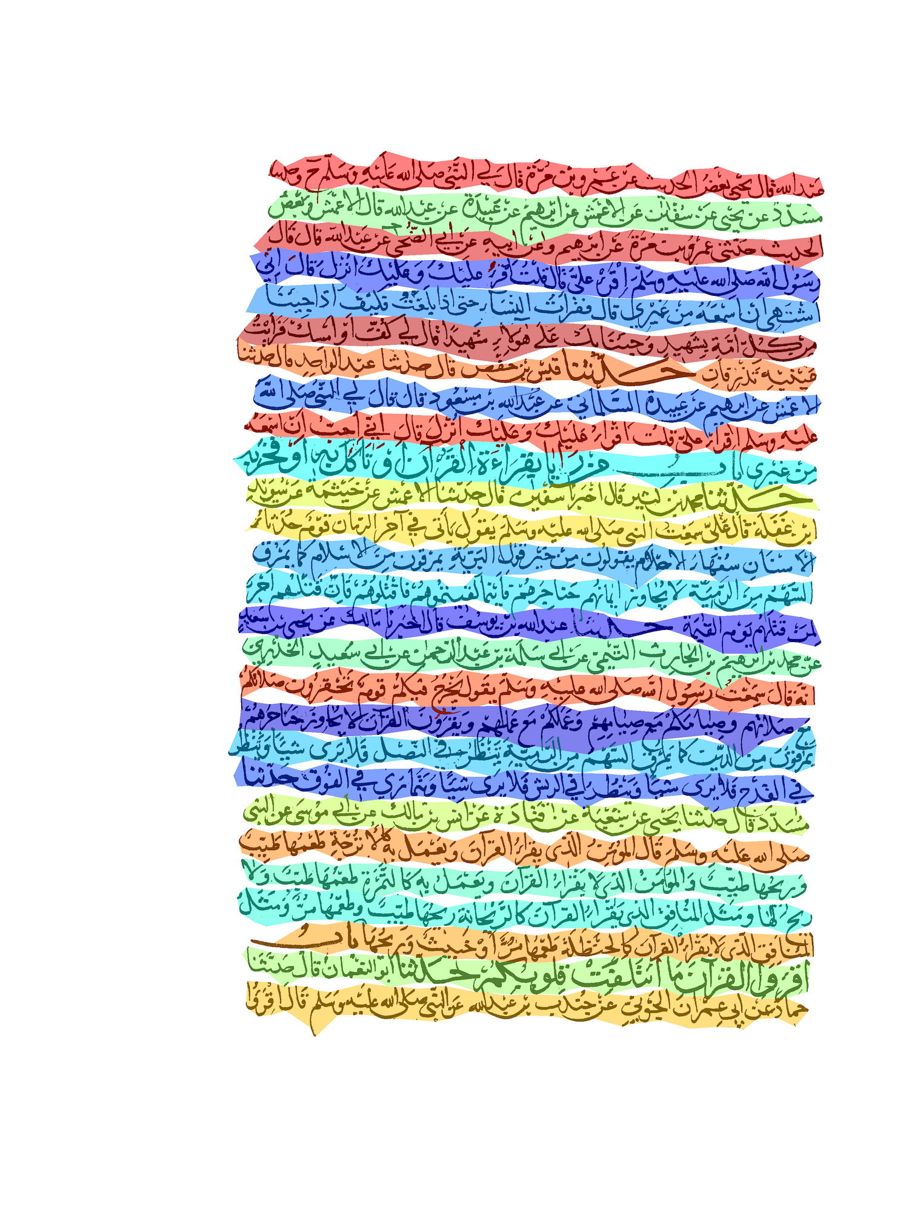
Transcription
بتحويل الكتابة العربي الى كتابة مفهومة من قبل اغلب برامج
Text line segmentation
Sequential model
Text line
Notes:
Text line segmentation is an important preprocessing task the for handwritten text recognition. Especially the recent state of the art models for handwritten text recognition are sequential and require the input to be a text line.

Slide 3
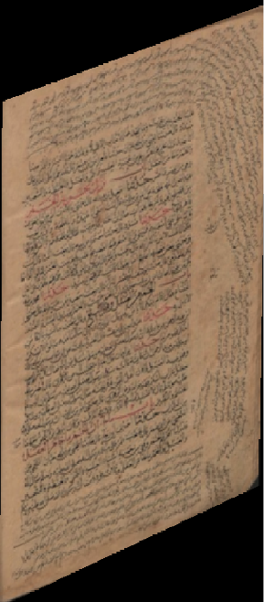
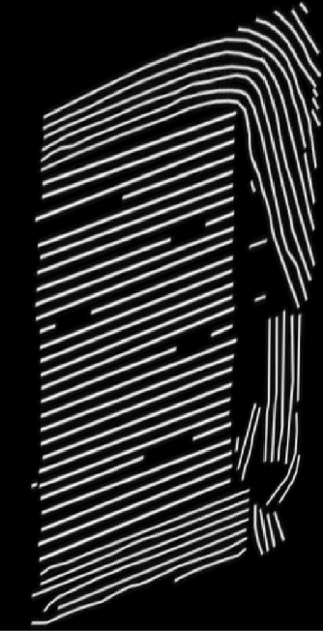
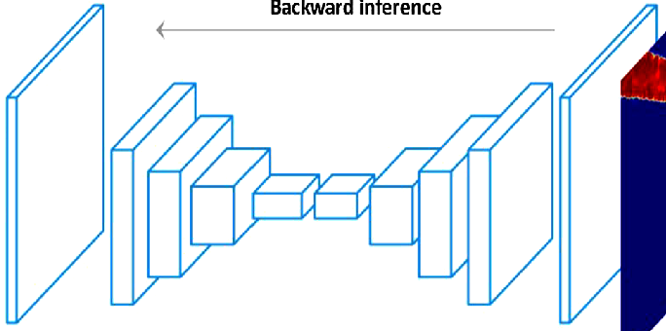
Input
Ground truth
Ground truth
FCN
Renton et al. 2017
Kurar et al. 2018
Gruning et al. 2019
Kurar et al. 2021
Notes:
The recent literature formulates the text line segmentation as a supervised dense prediction problem. Given an input document image a fully convolutional network is trained to dense predict whether a pixel is a blob line or not under the supervision of human annotated blob lines that strike through the text lines. These methods are state of the art but they require vast amount of human effort.

Slide 4
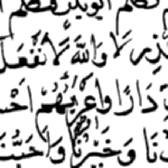
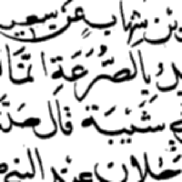
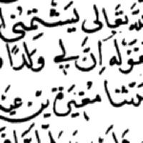
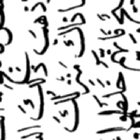
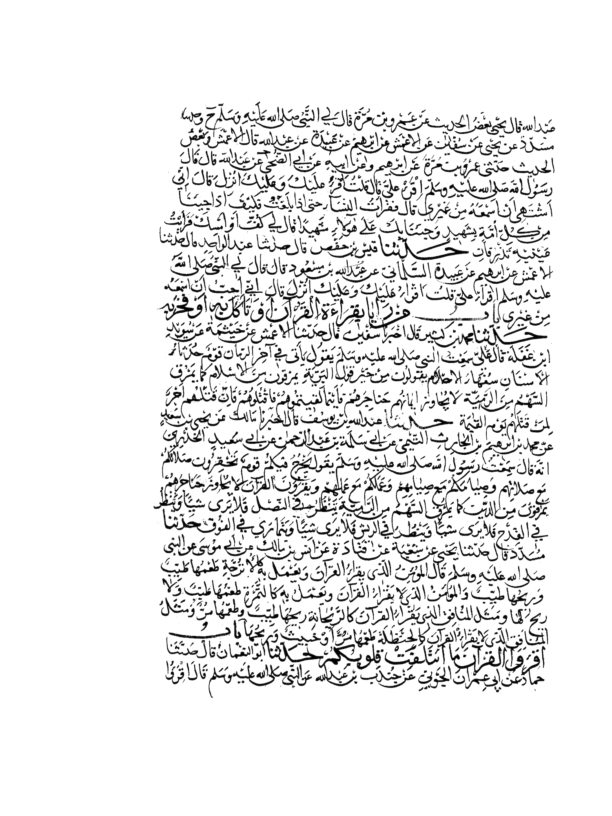
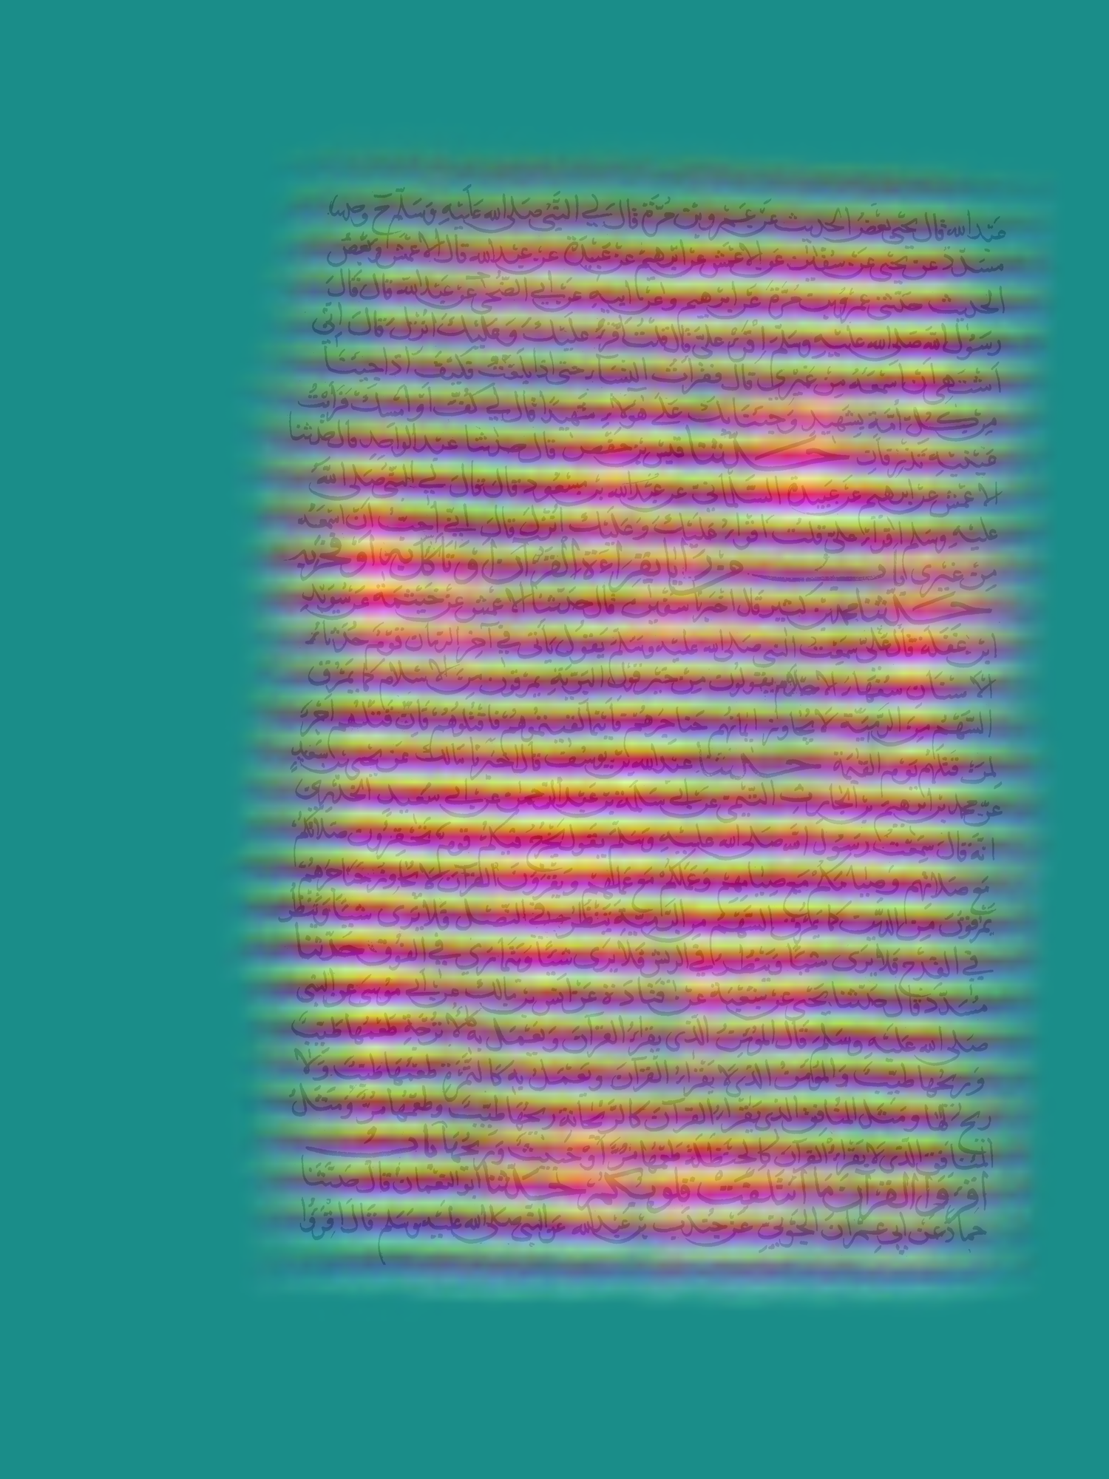
Method
CNN
CNN
Similar pattern
Different pattern
A document patch and its neighbour contain the same text line pattern
A document patch and its 90 degree rotated neighbour contain different text line pattern
Input
Unsupervised prediction
Text line segmentation
CNN
EM
Clustering the learned features lead to blob lines
Blob lines guide energy function to segment text lines
Notes:
Actually the human visual perception can trivially differentiate the coarse text line patterns. Inspired by this fact, we train a convolutional network to learn that a patch and its neighbour contain the same text line pattern and a patch and its 90 degree rotated neighbour contain different text line pattern. Given an input document image, the trained network is used to predict the blob lines that strike through the coarse text line patterns. Finally, we use the blob lines to assist an energy minimization function for segmenting the handwritten text lines.

Slide 5
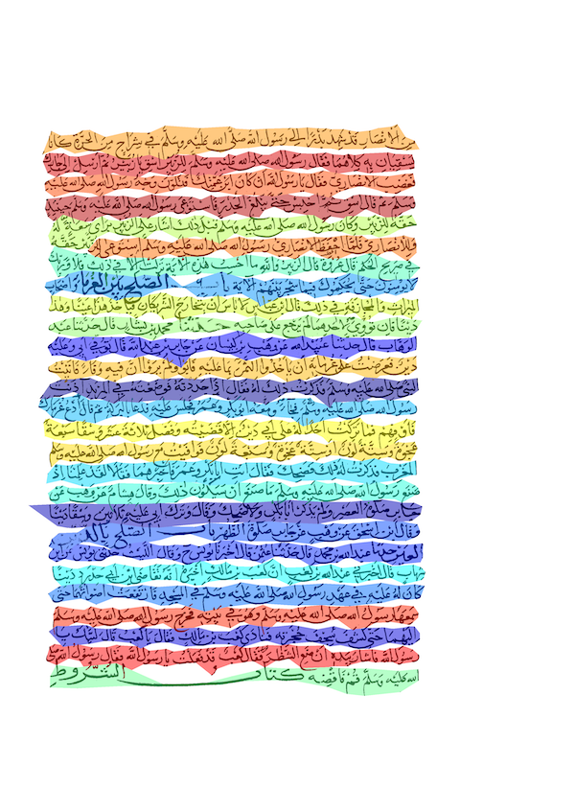
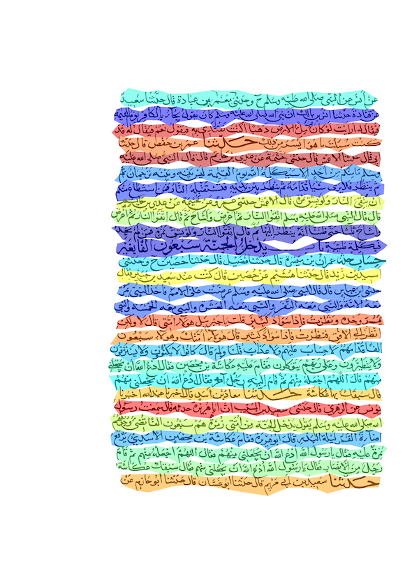
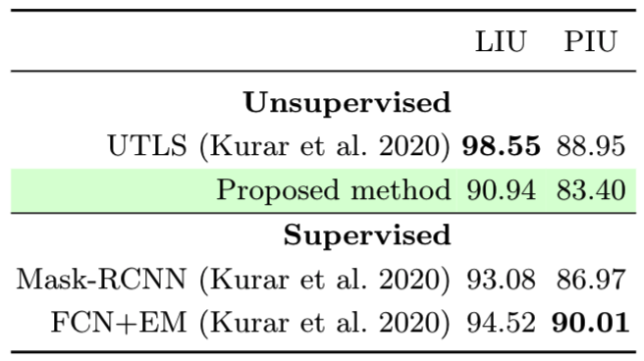
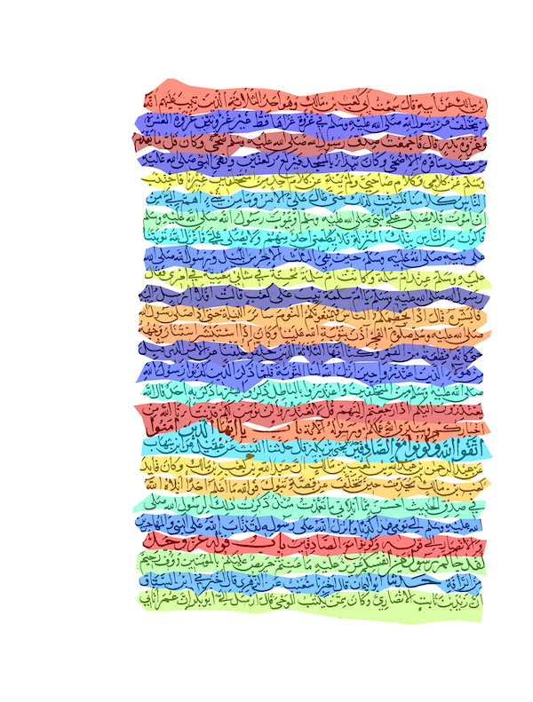
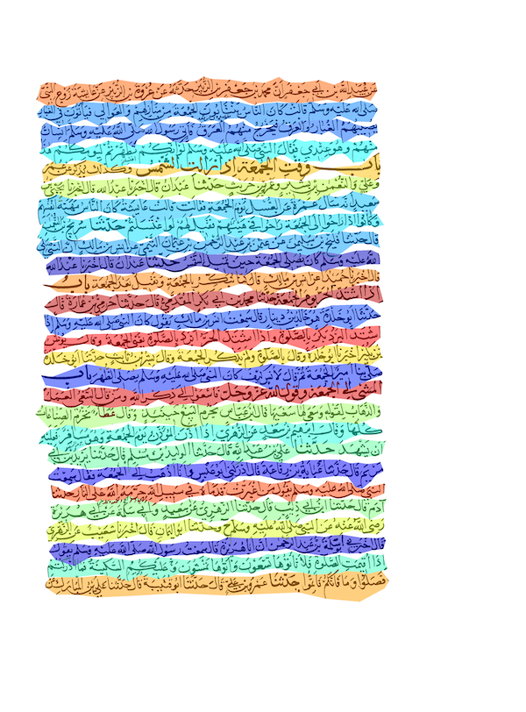
Arabic dataset
Notes:
Here are the results from an Arabic handwritten dataset. This dataset is challenging by crowded satellite elements. No matter how crowded the satellite elements are, the method is successful because the global pattern of the document is monotonic.

Slide 6
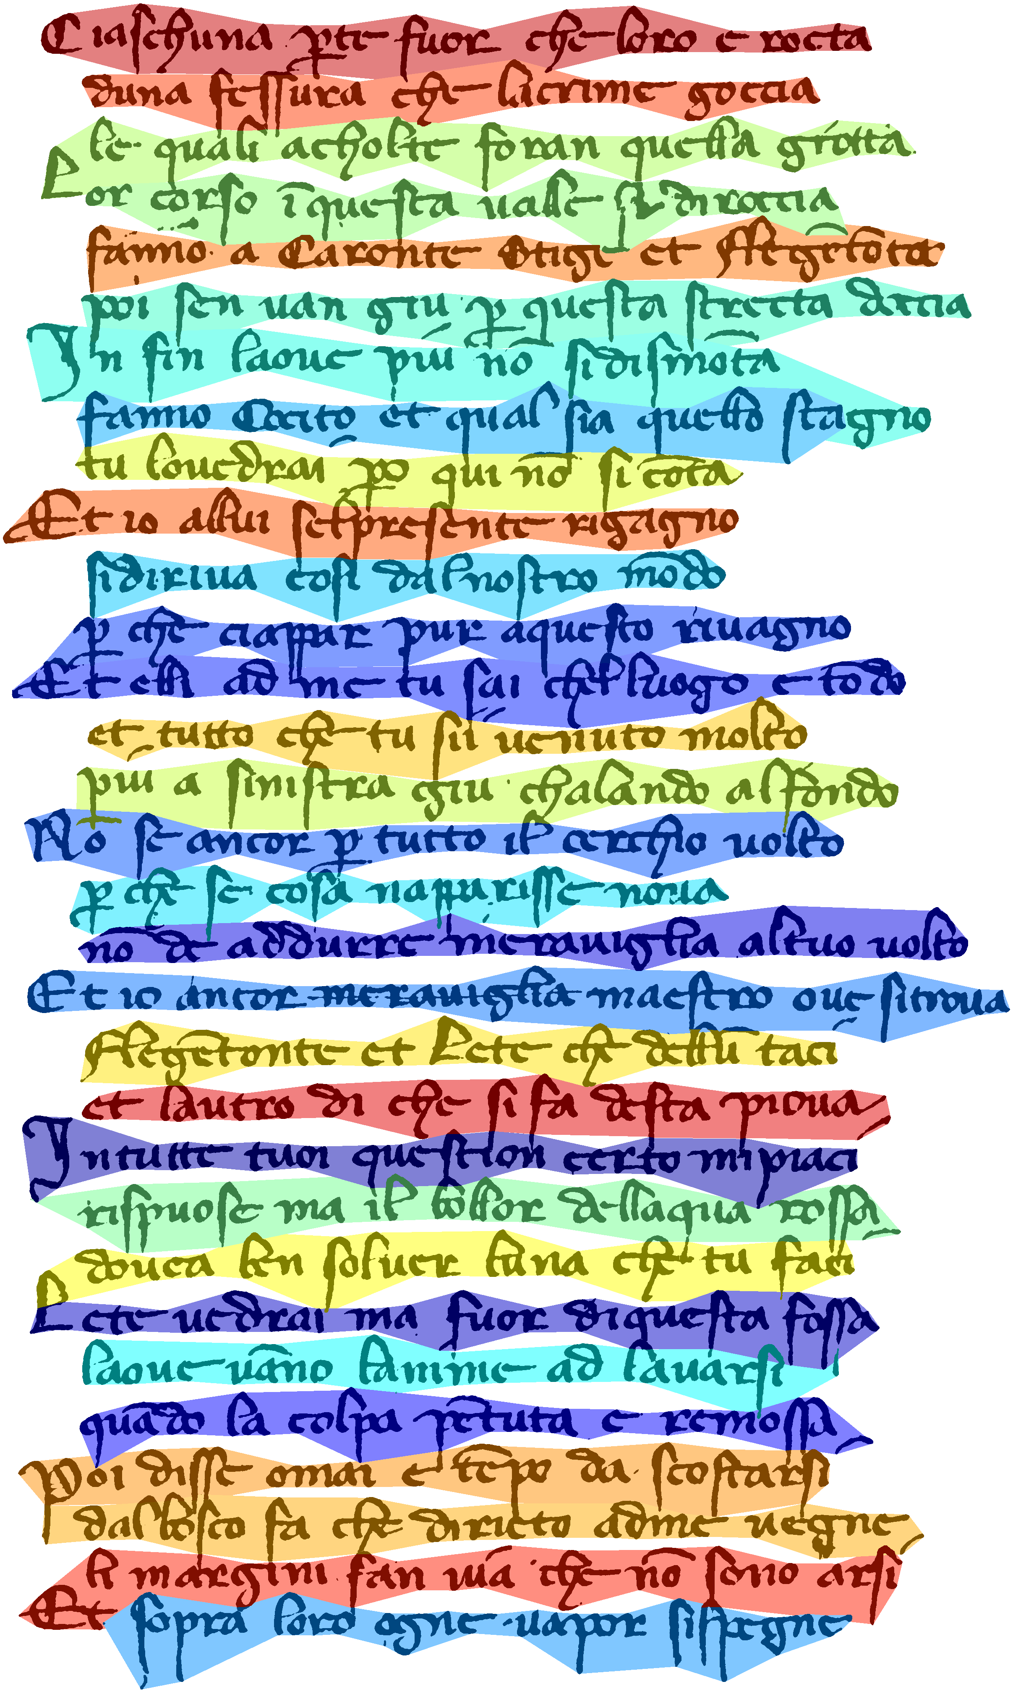
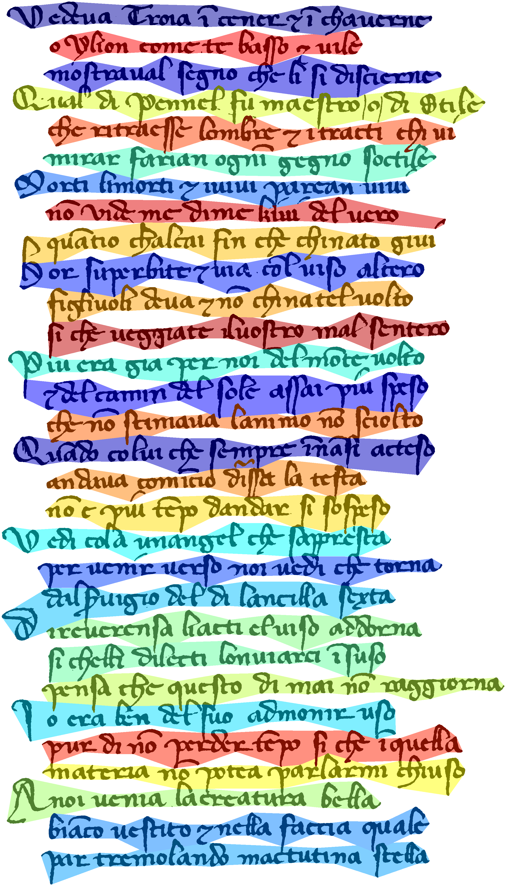
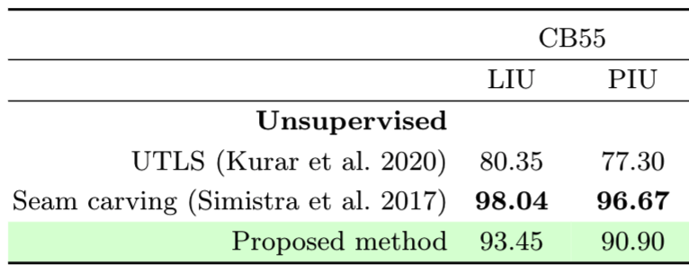
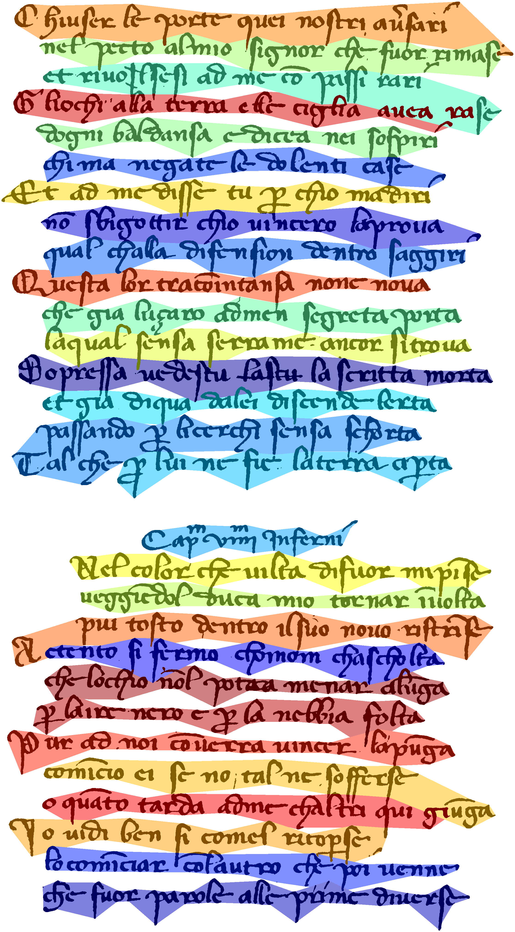
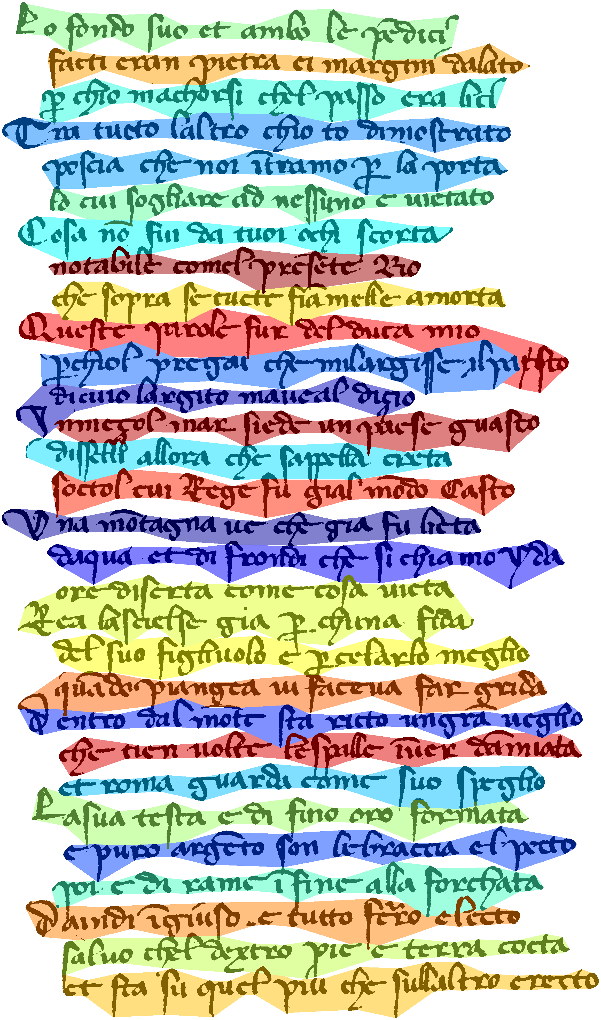
Latin dataset
Notes:
Here are the results from a Latin handwritten dataset. This dataset is challenging by consequently touching components among several text lines. Between the unsupervised methods the seam carving algorithm overperforms the proposed method. No matter how the touching components fill the interline space the method is successful because the global pattern of the document is monotonic.

Slide 7
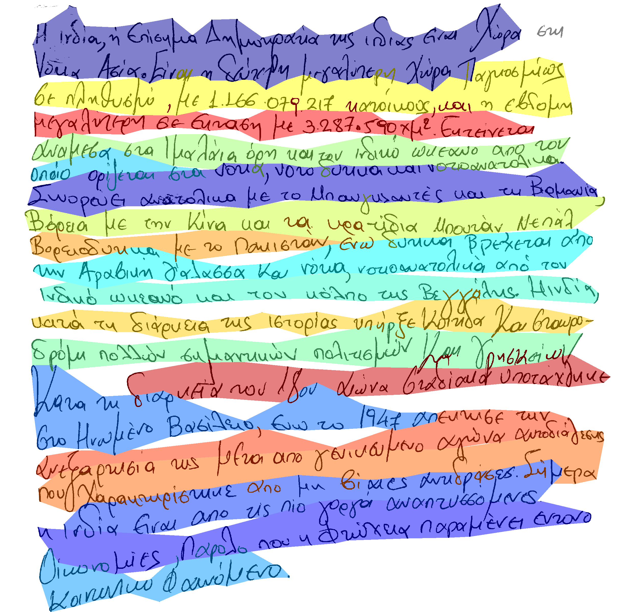
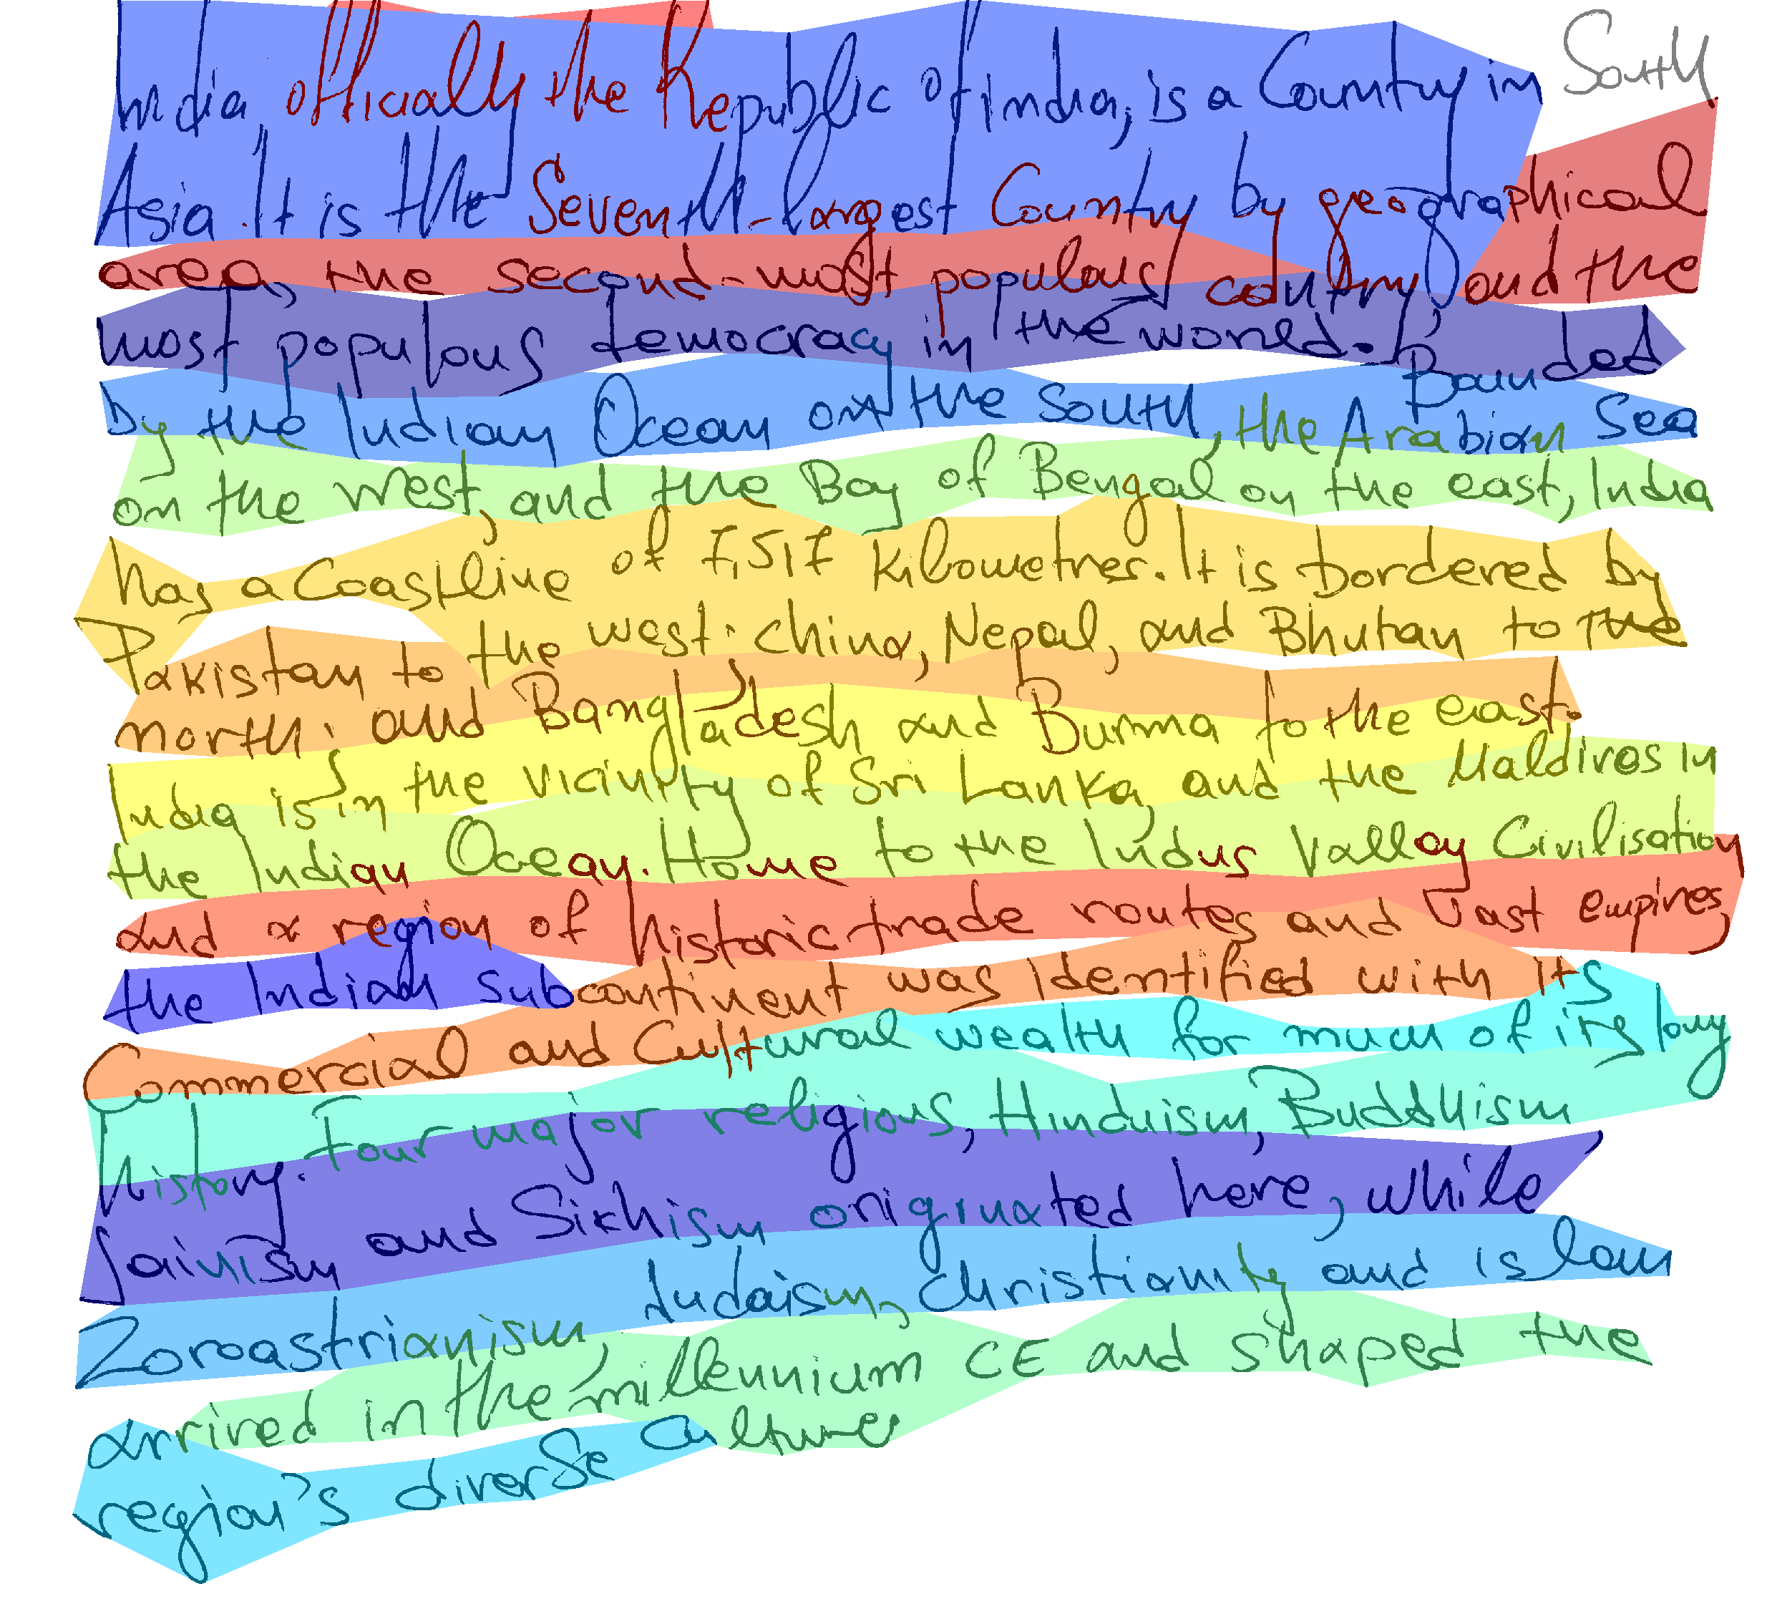
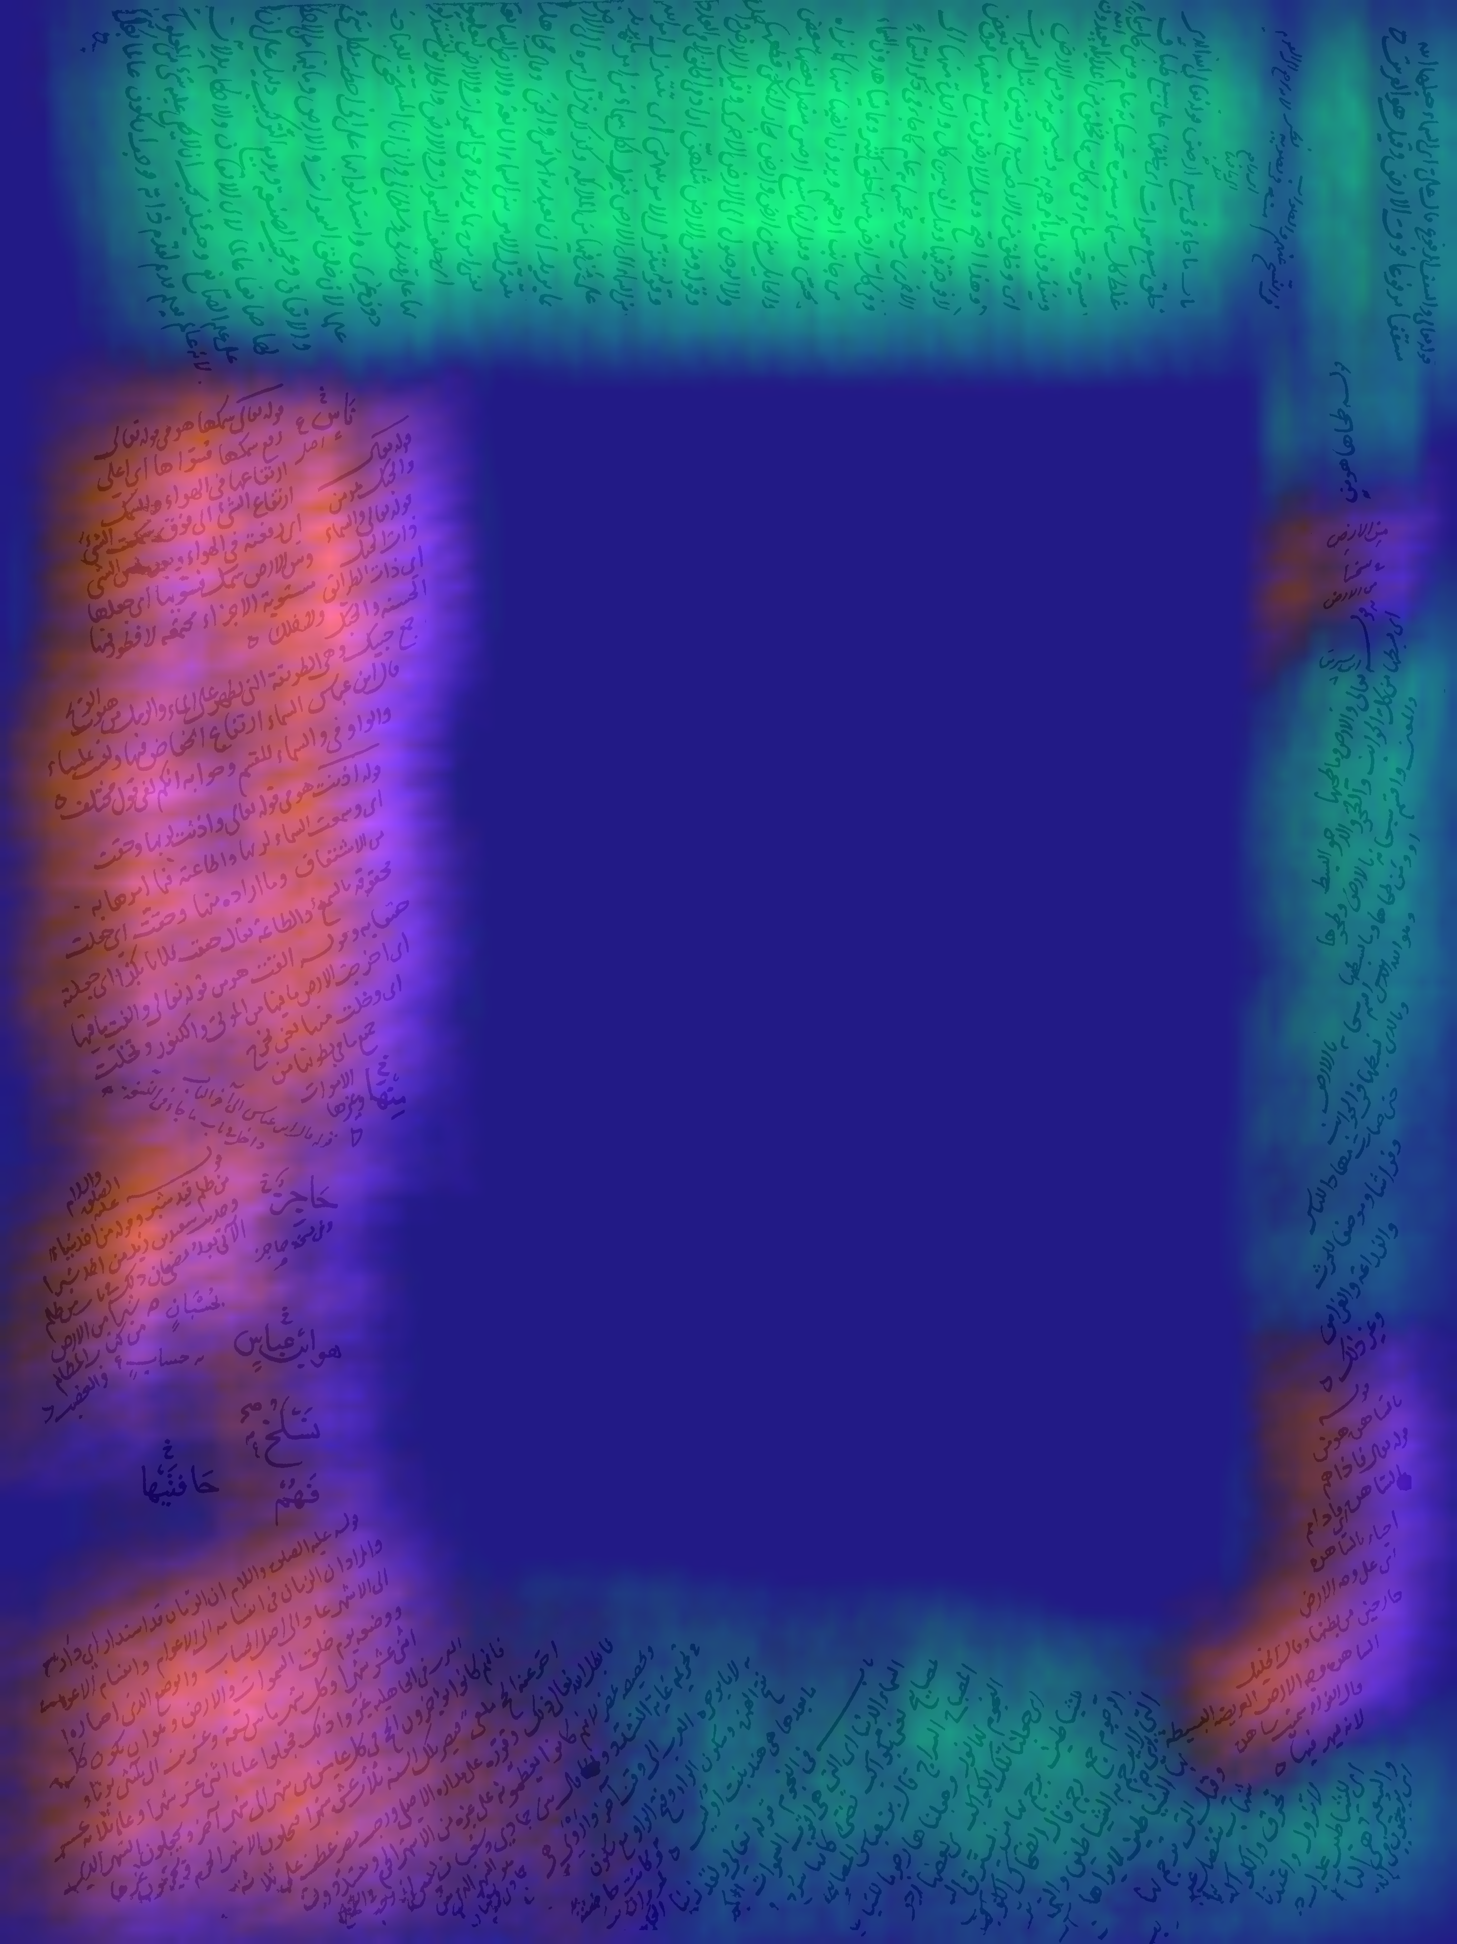
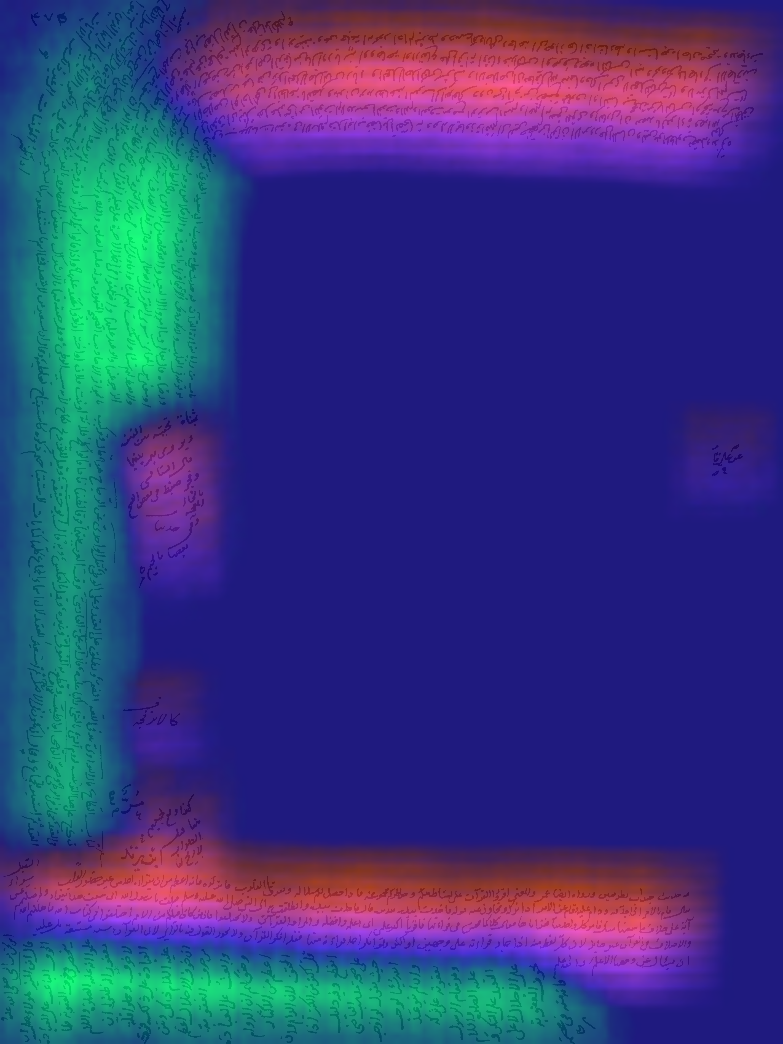
Failure cases
Fluctuating lines
Curved and skewed lines
Notes:
We have talked that the proposed method is successful as far as the input document contains a globally monotonic pattern. Therefore as one would expect the method is not successful on the documents with fluctuating text lines or severely skewed and curved text lines.

Slide 8
Conclusion
We formulate the text line segmentation task as an unsupervised deep learning problem and eliminate the human annotation effort.
A document patch and its neighbour contain the same text line pattern.
A document patch and its 90 degree rotated neighbour contain different text line pattern.
The method is successful on the documents with crowded satellite elements, touching components and slightly skewed text lines.
The method is unsuccessful on the documents with fluctuating, severely skewed and curved text lines.

