Slide 1
Binarization Free Layout Analysis for Arabic Historical Documents Using Fully Convolutional Networks
Berat Kurar Barakat Jihad El-Sana
Department of Computer Science
Ben-Gurion University of the Negev
Notes:
Hi, I am Berat Kurar, from Ben Gurion University of the Negev.
I am going to present you our work with the title binarization free layout analysis for Arabic historical documents which I work on it under supervision of Prof. Jihad Elsana.

Slide 2
Table of Contents
Problem definition
Contribution
Related work
Method
Experiments
Results
Conclusion
Notes:
I will make a problem definition and describe our contribution for it
Then I will discuss some related works on this problem.
Then I will explain our method and details of experiments
Finally I will present the results and conclude.

Slide 3
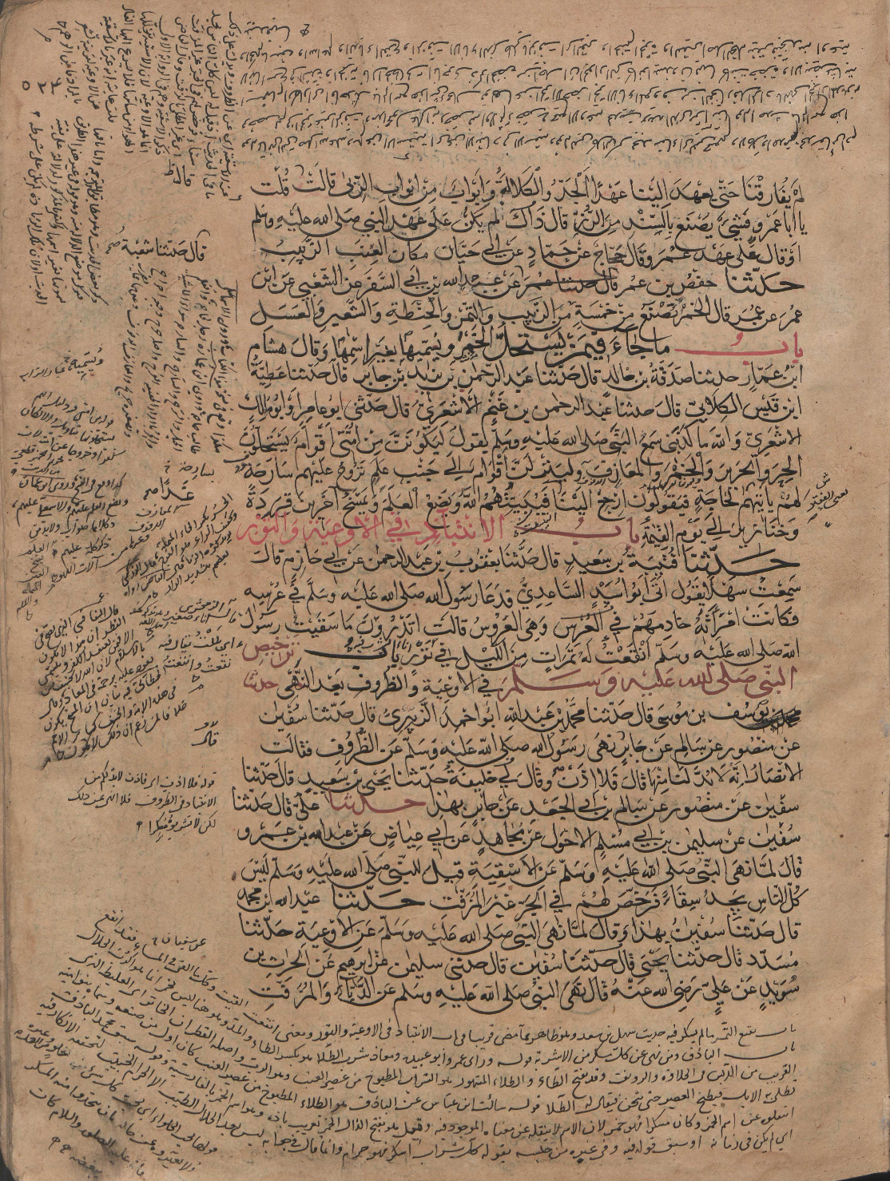
Problem definition
Side text
Main text
Notes:
Page layout analysis is an important pre-processing step for the other document image processing algorithms.
Given a document image, we first need to segment it into homogeneous regions and then classify these regions.
For example in this paper we classify the regions as main text and side text.

Slide 4
Contribution
Original
Page layout analysis
Non-binarized historical manuscript
Complex layout
Fully Convolutional Network (FCN)
Patch based classification
Pixel level fine segmentation
Notes:
We propose a method for page layout analysis of non-binarized historical manuscripts with complex layout as shown in the image here.
This method is uses FCN and makes patch based predictions.
And the output is a fine segmentation in pixel level

Slide 5
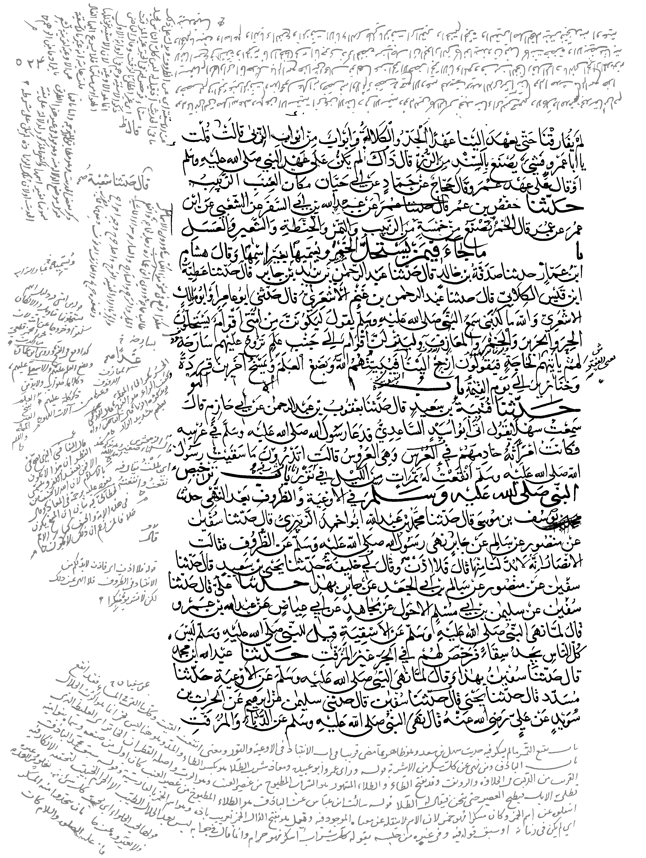
Related work
Binarized
Bukhari et al, 2012
Binarized historical manuscript
Complex layout
Multilayer Perceptron (MLP)
Connected component based classification
Post processing on test set
Pixel level fine segmentation
Notes:
Previously Bukhari et al, 2012 made fine segmentation in pixel level on the same dataset with complex layouts.
However their method differs from ours, by their input is binarized and they used MLP to make connected component based classification using context features, which in turn leads to redundant and expensive computation in overlapping contexts.
In addition they do post processing with parameters that are fitted to test set.

Slide 6
Contribution
Simple layout
Complex layout
Xu et al, 2017
Non-binarized historical manuscript
Simple layout
Fully Convolutional Network (FCN)
Patch based classification
Pixel level fine segmentation
Notes:
FCN has been already used for page layout analysis by Xu et al, 2017.
On non binarized historical manuscripts to make pixel level fine segmentation using patch based classification.
However as we can see in these images their dataset does not cover full range of difficulties in comparison to our dataset with multi-skewed and curved lines in multi orientations.

Slide 7
Method
VGG-16
image
conv1
pool1
conv2
pool2
conv3
pool3
conv4
pool4
conv5
pool5
conv6-7
m
n
8 x upsampled
Prediction (FCN8)
4x conv7
2x pool4
pool3
m
n
J. Long, E. Shelhamer, and T. Darrell, “Fully convolutional networks for semantic segmentation”, 2015
Notes:
The FCN architecture we used is based on the FCN proposed for semantic segmentation by Long et al.
Input is the image.
Then we have convolutional blocks. Each block consists of several convolutional layers and a maxpooling layer.
First five blocks follow the design of VGG 16 network except the discarded final layer. Instead of the final classification layer, two convolutional layers, conv6 and conv7 are added.
This is a conventional Convolutional Network (CNN) and is called the encoder part of the FCN.
Through the encoder, input image is downsampled by max pooling layers.
Then the decoder part upsamples the downsampled outputs to input image size using transpose convolution.
FCN8 upsamples conv7 layer 4 times, pool4 layer 2 times and add them to pool3 layer, then upsamples the summation 8 times to reach to input image size again.
Resulting output is a tensor of m by n by number of classes. This tensor contains a classification score for each pixel in the input.
FCN has made great improvements in object segmentation field [20]. It is an end to end segmentation framework that extracts the features and learns the classifier function simultaneously.

Slide 8
Data
 | Train | Validation | Test
Number of pages | 20 | 4 | 8
Set 1 (0<D<1) Number of patches | 100.000 | 20.000 | -
Set 2 (0.83<D<1) Number of patches | 100.000 | 20.000 | -
D = density
P(i,j) = pixel value
m = image height
n = image width
$$D=\frac{\sum_{i=0}^{m}{\sum_{j=0}^{n}{P(i,j)}}}{m×n}$$
Notes:
We used a dataset of 20 pages for training, 4 pages for validation and 8 pages for testing.
We created two sets
Set1 contains randomly cropped 100.000 patches for training
Set2 contains randomly cropped 100.000 patches for training with density grater than 0.83
Density is defined as the ratio of number of foreground pixels to the total number of pixels in a patch

Slide 9
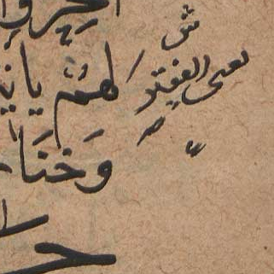
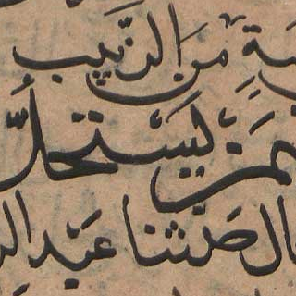
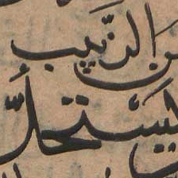
Data
$$D<0.83$$
Set 1
$$D>0.83$$
Set 2
$$320×320$$
Our input size
$224×$224
Original input size
Notes:
Here is the difference between a patch with a density less than 0.83 and a patch with a density greater than 0.83.
Means that it contains mostly text. We follow such a scheme since during the training with sett with faced with class imbalance problem.
We also change the original input size of FCN8 network. Its original size 224 by 224 contains 2 lines at most. We changed it to be 320 by 320 to include 3 lines approximately, which means more context information.

Slide 10
Training
Optimizer = Stochastic Gradient Descent
Learning rate = 0.001
VGG-16 pre-trained weights
Train on Set 1
Continue on Set 2
Train up to 50 epochs
Save least loss model
Train
Notes:
We train by Stochastic Gradient Descent (SGD) with a learning rate of 0.001.
We initialize VGG-16 with its publicly available pre-trained weights.
We first trained on set 1 until overfitting.
Then using the output weights we further trained on set 2
And save the least loss model.

Slide 11
Quantitative results
 | Main text F1 | Side text F1
Set 1 | 0.90 | 0.68
Set 2 | 0.95 | 0.80
Bukhari et al | 0.95 | 0.95
Notes:
Hera are the quantitative results
In set 1

