Slide 1
Case Study: Fine Writing Style Classification Using Siamese Neural Network
Alaa Abdalhaleem Berat Kurar Barakat Jihad El-Sana
Department of Computer Science
Ben-Gurion University of the Negev
Notes:
Hi, I am Berat Kurar, from Ben Gurion University of the Negev.
I am going to talk on a work for writing style classification using Siamese network, in which I collaborated with my collegue Ala Abdalhaleem under supervision of prof. Jihad El-Sana.

Slide 2
Table of Contents
Problem definition
Contribution
Related work
Method
Experiments
Results
Conclusion
Notes:
I will make a problem definition and describe our contribution for it
Then I will discuss some related works on this problem.
Then I will explain our method and details of experiments
Finally I will present the results and conclude.

Slide 3
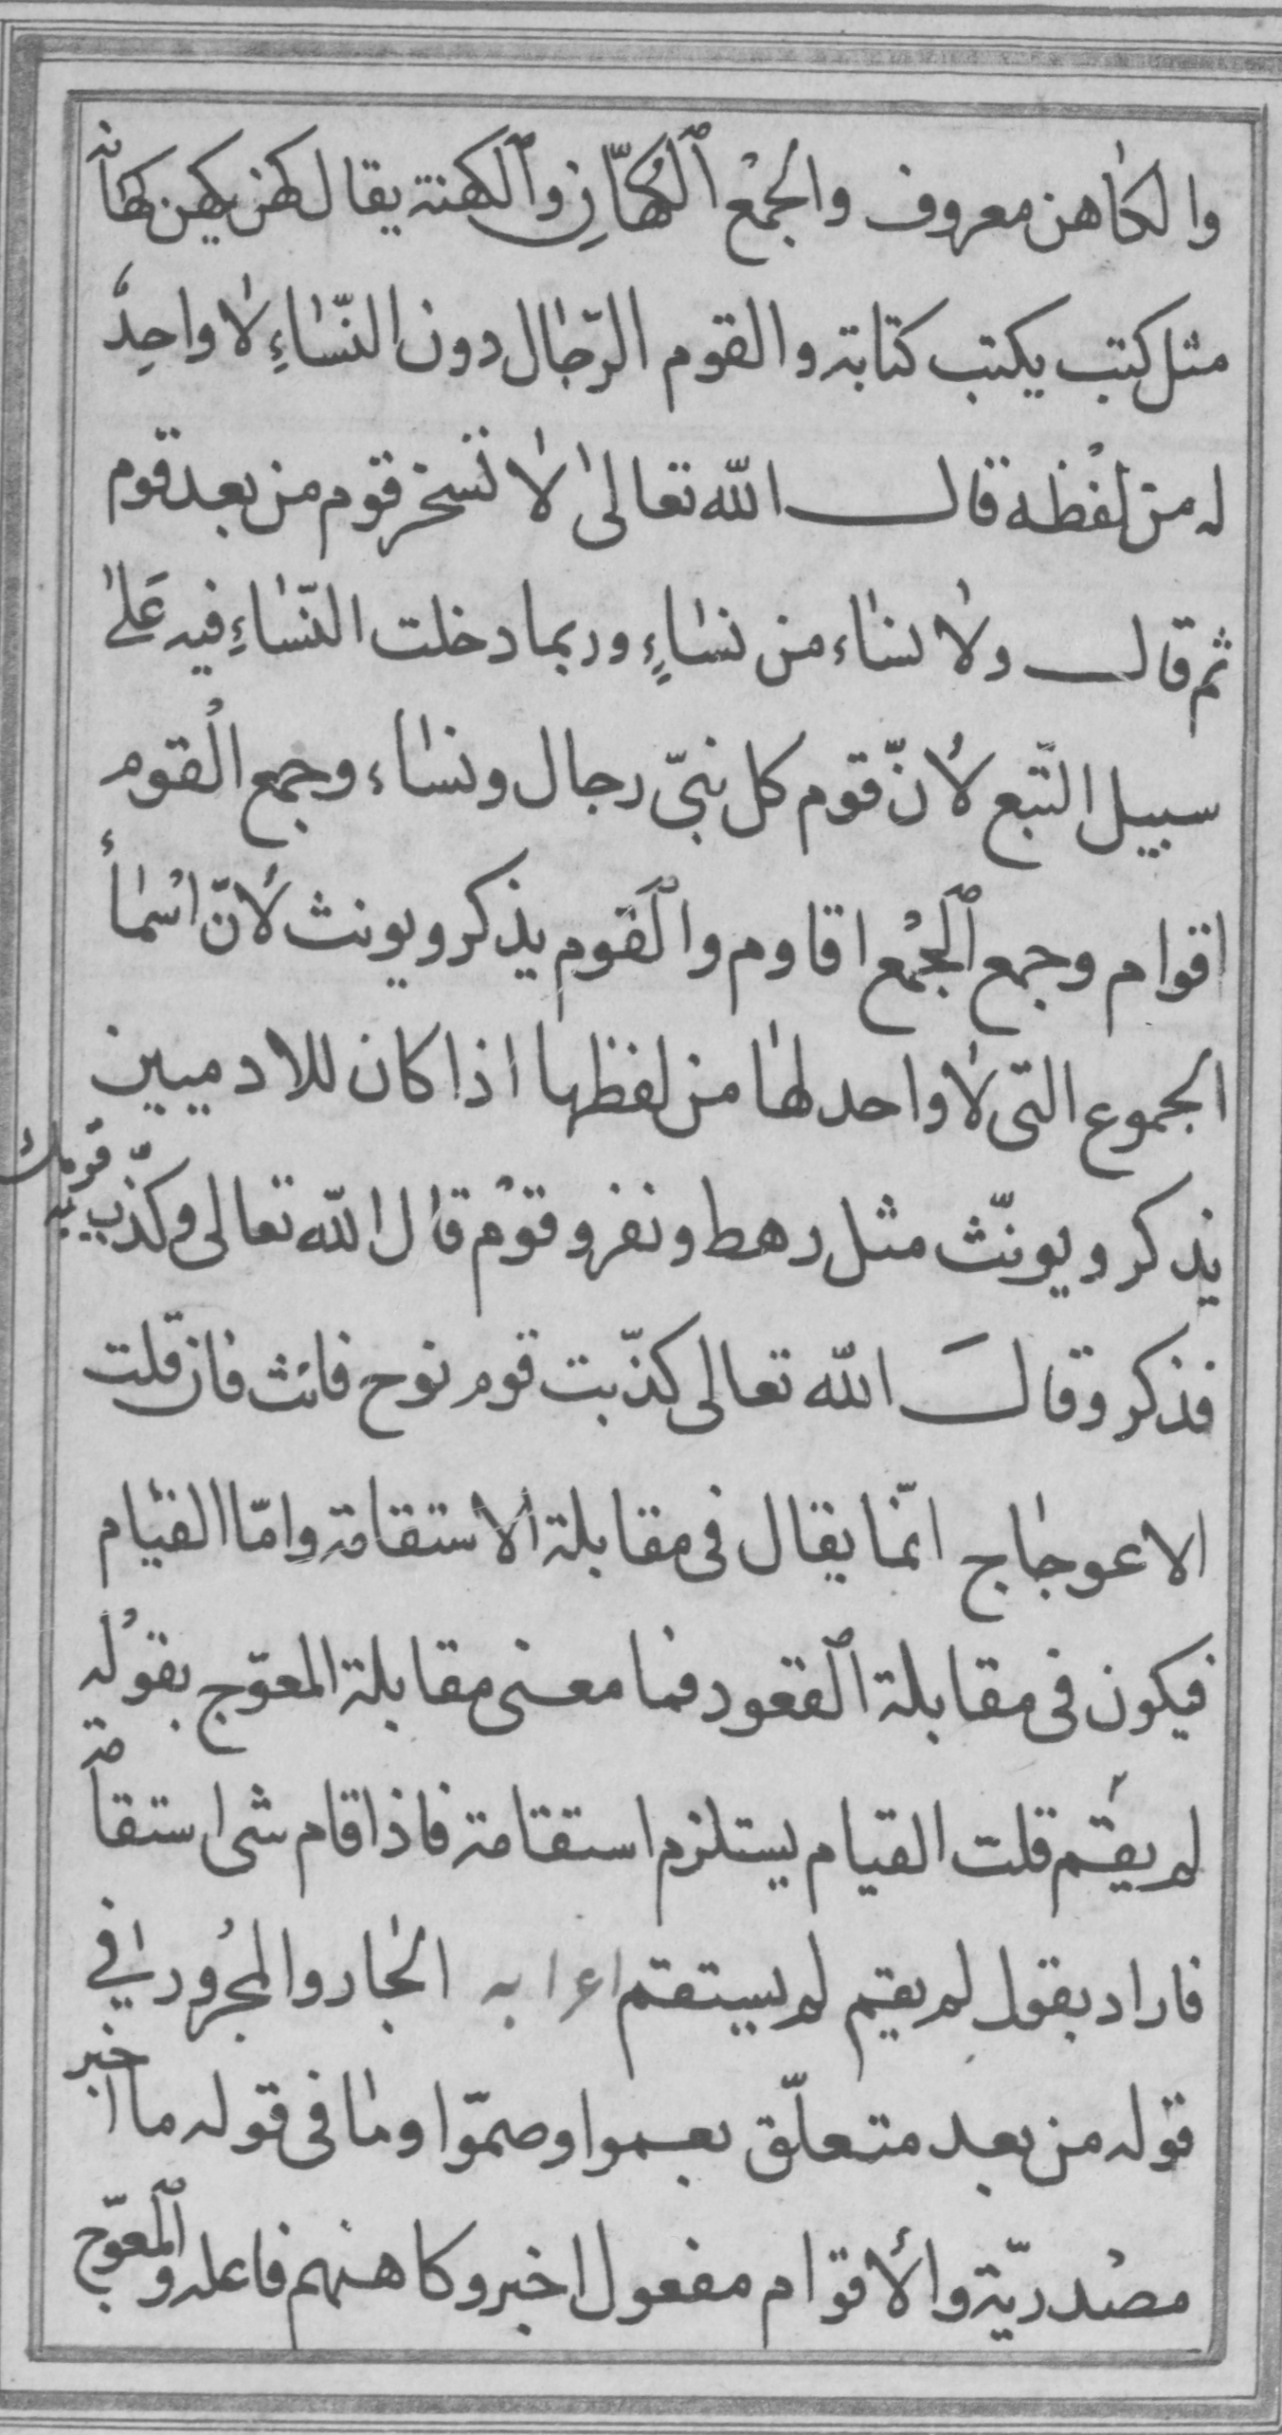
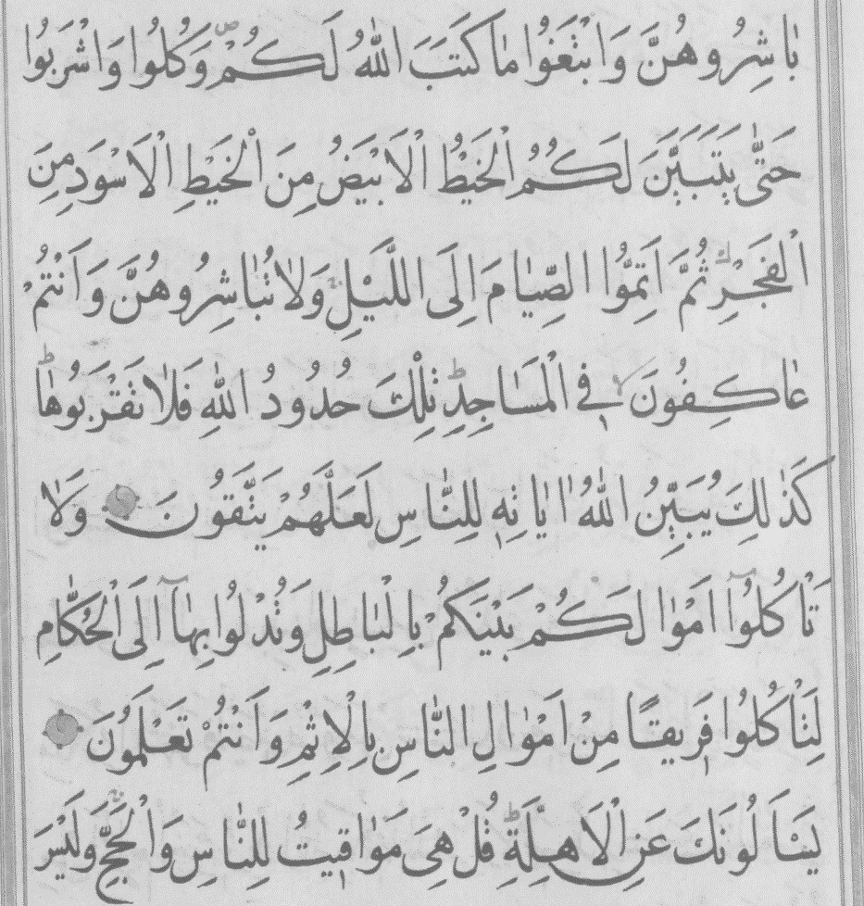
Problem definition
Principle of handwriting style uniqueness
BOOK 1
BOOK 2
Notes:
A well known fact in the literature is the principle of handwriting style uniqueness.
That is, no two writers share the same handwriting style.
For example here is given two pages from two manuscripts.
Even at first glance, we can recognize that two writers do not share handwriting style.
And if we have a close look, we can see that writer of the book1 writes the words wider and shorter in relative to the writer of the book2.
Given a query document assigning one of the known writers to it, is called writer identification and is well studied in the literature.

Slide 4
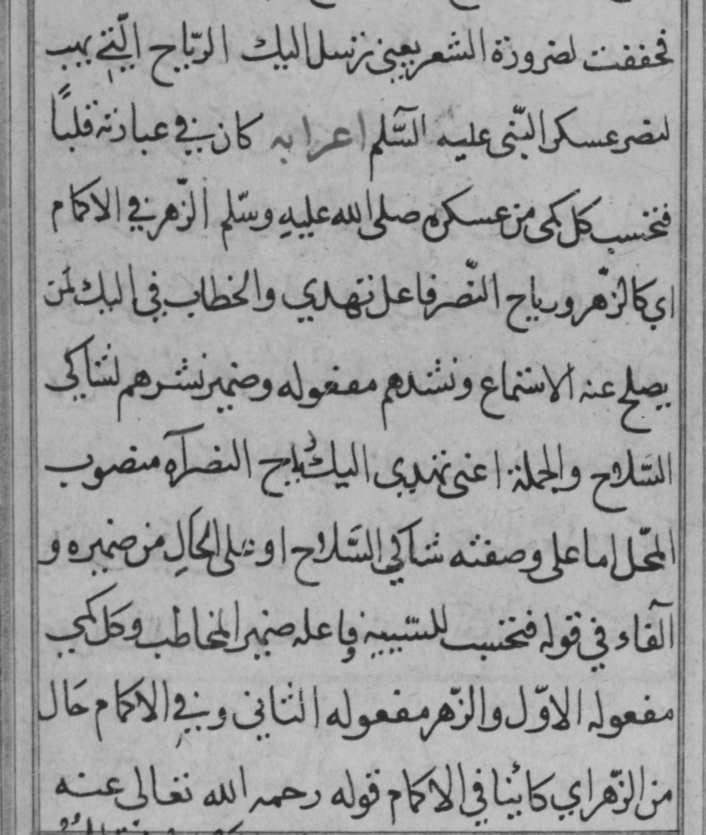
Problem definition
Principle of in-writer variation
BOOK 1
BOOK 1
Notes:
We studied another problem based on the principle of in-writer variation.
That is no one person writes exactly the same letter formations.
A person’s writing style may change due to use of different pens, physical conditions like noise and poor light or age.
For example here is given two pages from a single manuscript.
If we have a close look we can see that words in the left page well formed and bigger than the words in the right page.

Slide 5
Contribution
Automatic system
Divide manuscript into parts with similar writing styles
Siamese Convolutional Neural Network (CNN)
Input: Two document patches
Output: Same or different
Notes:
So our work presents an automatic system for dividing a manuscript into parts, according to their similarity in handwriting style.
This system is based on a Siamese convolutional network which inputs two document patches and outputs whether they contain similar writing style or not.

Slide 6
Related work
Chu and Srihari, 2014:
Single branch CNN
Input: Concatenated two word images
Output: Same or different
Children’s writing style change by time
Fiel and Sablatnig, 2015:
Single branch CNN
Input: Single word images
Output: Classes in the number of writers
Writer identification and retrieval
Notes:
Previously Chi and Srihari used CNN for a similar problem. They train a single branch CNN using concatenated word images with labels of same or different. Trained network is used to determine the change in the writing style of children by time.
Fiel and Sablatnig they also train a single branch CNN using single words with classes in the number of writers. Trained network trimmed from the classification layer is used to extract features for writer identification and retrieval.

Slide 7
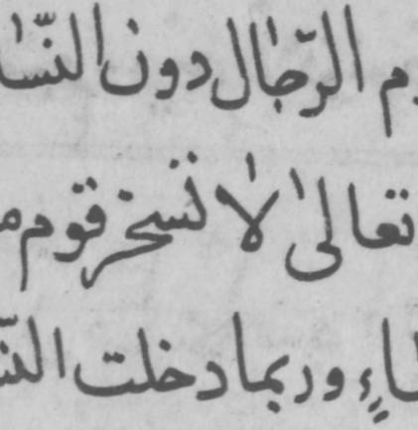
Method
Siamese CNN architecture is based on Koch et al, 2015
Patches
Siamese CNN
CNN
F(x₁)
L₁
x₁
Single
neuron
Same
or
Different
W
CNN
F(x₂)
x₂
Notes:
Our method is based on Siamese CNN taken from the work of Koch et al. for one-shot character recognition.
It consists of two identical CNN branches that share the same weights vector W.
It inputs two document image patches, computes their feature vectors, measures the L1 distance between them and decides whether these patches contain similar writing style or not.

Slide 8
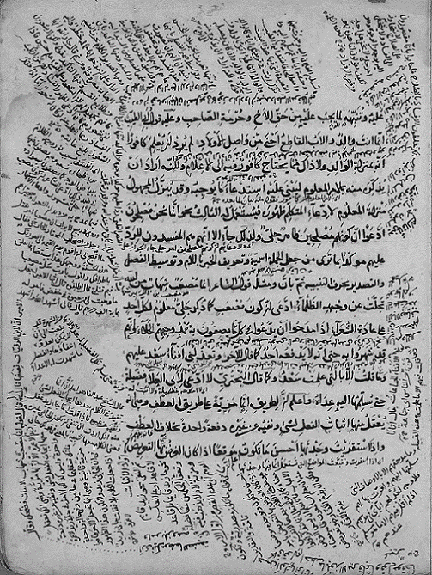
Datasets
WAHD Dataset (Abdelhaleem et al, 2017)
3 manuscripts
139, 239 and 392 pages
VML Dataset (Kassis et al, 2017)
1 manuscripts
140 pages
Notes:
We worked on two publicly available datasets, WAHD and VML
We selected 3 manuscripts of pages 139, 239 and 392 from WAHD dataset.
And one manuscript of pages 140 from VML dataset.
Each manuscript belongs to one author and consistent in terms of font size and type.

Slide 9
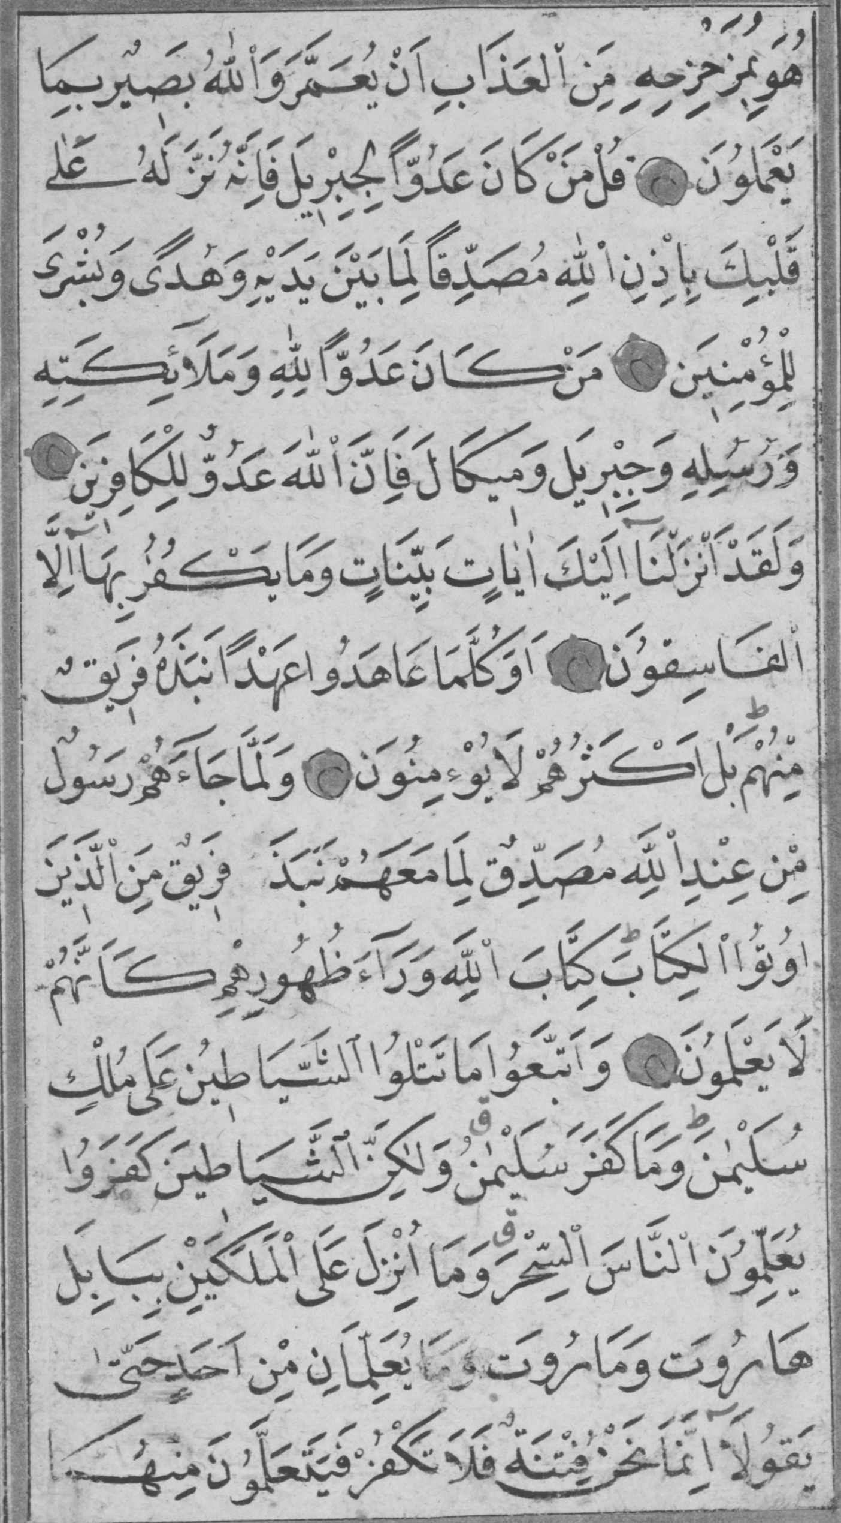
Experiments
Train set sizes: 8266, 4270, 2560 pairs
Same (1)
Different (0)
Notes:
In experiments we changed some hyperparameters to improve the performance.
We experimented with training set sizes of around 8, 4 and 2 k pairs.
A pair of patches from the same page is labeled as same, and a pair of patches from different books is labeled as different.
This ensures maximum similarity for same pairs and maximum dissimilarity for different patches.

Slide 10
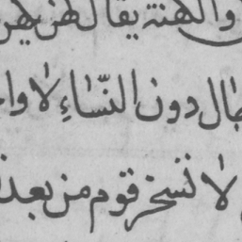
Experiments
Patch sizes
$$150 ×150$$
$$120 ×120$$
$$75 ×75$$
$$40 ×40$$
Notes:
We generated 4 different sizes of patches
But each time we reduce the spatial resolution so that the patch includes around 3 lines of script.

Slide 11
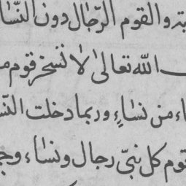
Experiments
Number of script lines
$$150 ×150$$
$$150 ×150$$
3 lines
4 lines
Notes:
Getting the best result with the patch size of 150 pixels we generated another train set with patches of 150 pixels but with 4 lines of script.

Slide 12
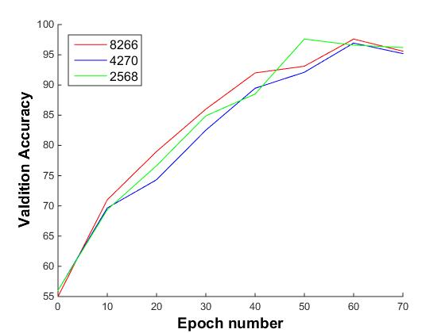
Results
Performance with different train set sizes

Slide 13
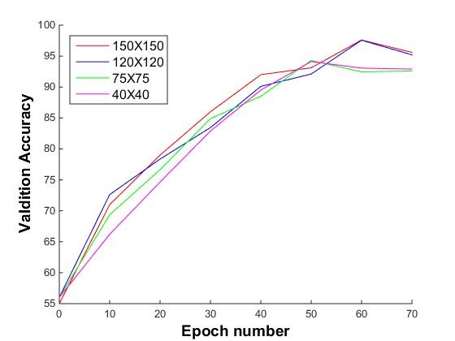
Results
Performance with different patch sizes

Slide 14
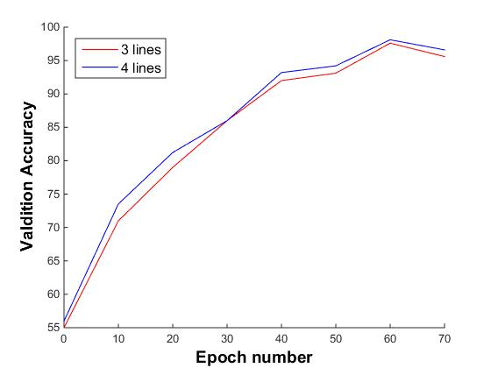
Results
Performance with different number of lines

Slide 15
Results
Summary of results
Train size | Number of lines | Patch size | Test accuracy
8266 | 3 | 150x150 | 98.15
8266 | 3 | 120x120 | 98.58
8266 | 3 | 75x75 | 94.75
8266 | 3 | 40x40 | 94.40
8266 | 4 | 150x150 | 98.37
4270 | 3 | 150x150 | 96.40
2568 | 3 | 150x150 | 95.13

Slide 16
Conclusion
An automatic system for dividing a book into similar parts by writing style
Input: 2 paragraphs from a book
Output: Similarity of input paragraphs
Future work: Modern handwritten datasets

