Slide 1
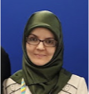
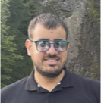
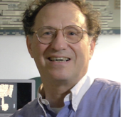
Computational Paleography of Medieval Hebrew
Scripts
Berat Kurar-Barakat
Daria Vasyutinsky-Shapira
Sharva Gogawale
Mohammad Suliman
Nachum Dershowitz
CHR 2024: Computational Humanities Research Conference, Aarhus, Denmark

Slide 2
Collaboration
MiDRASH ERC Synergy project 101071829
Views and opinions expressed are those of the authors
only and do not necessarily reflect those of the
European Union or European Research Council.
Neither the European Union nor the granting
authority can be held responsible for them.

Slide 3
Agenda
Computational Paleography Tasks
Script Types and Modes
Ashkenazi Square Clustering Dataset
Evaluation and Results
Conclusion & Future Work

Slide 4
Computational Paleography Tasks
Out of all the medieval Hebrew manuscripts, only ~3,500 are dated.
Paleography and codicology are key methods for determining manuscript provenance.
We aim to transcend the boundaries of traditional human paleography by utilizing computational algorithms to cluster medieval Hebrew script types.
Clustering square scripts is especially challenging because of their uniformity.
Conventional algorithms have been relatively ineffective in identifying features critical for paleographical clustering.

Slide 5
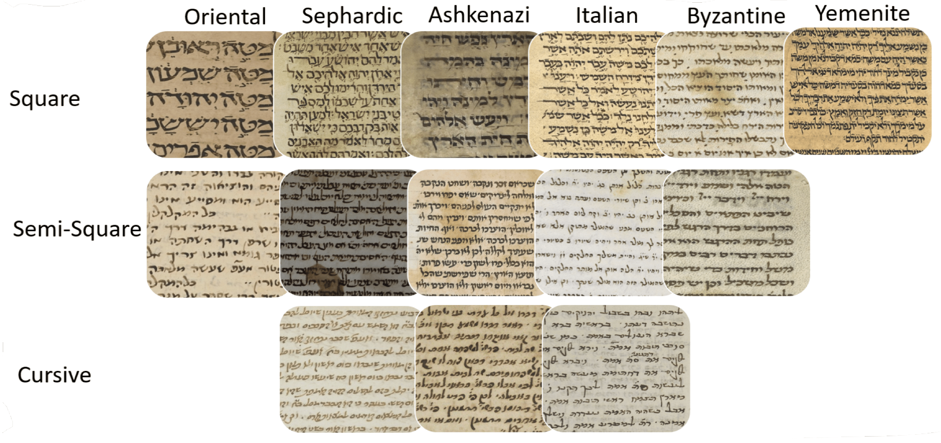
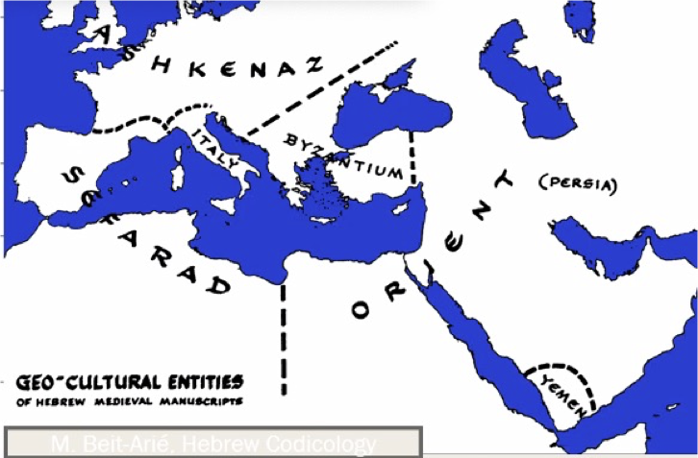
Script Types and Modes
We begin with the relatively well-studied Ashkenazi square script, we will proceed to other script types.

Slide 6
Ashkenazi Square Clustering(ASC) Dataset
The Ktiv project digitized over 80% of Hebrew-character manuscripts, creating a unified catalog of tens of thousands of items.
The Friedberg Genizah Project contributed metadata and images of around 350,000 medieval manuscript fragments.
We prepared ASC dataset that includes 206 high-resolution images from 59 manuscripts, focusing on Ashkenazi Square script.
The dataset features annotated text regions and lines, with known origins for 28 manuscripts and 31 of unknown provenance.

Slide 7
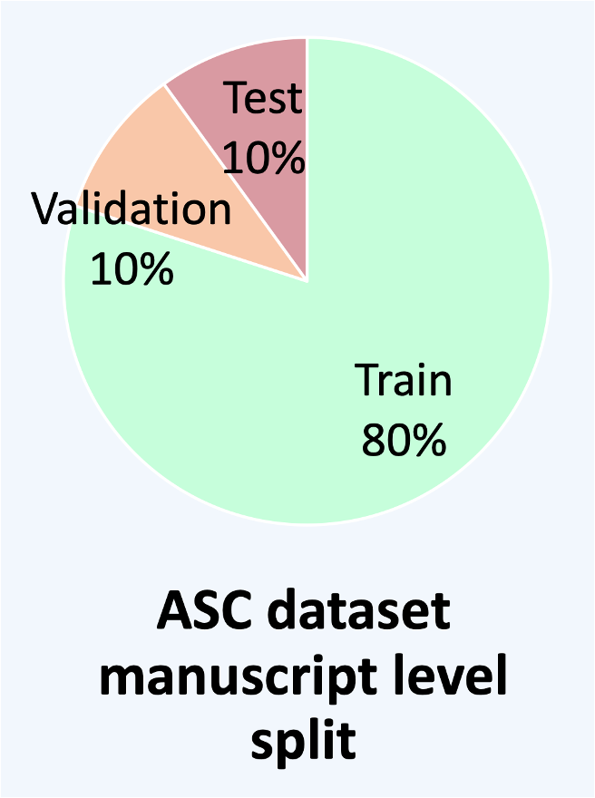
Ashkenazi Square Clustering(ASC) Dataset
 | GERMANY | FRANCE | UNKNOWN | TOTAL
MANUSCRIPTS | 17 | 11 | 31 | 59
PAGES | 62 | 35 | 109 | 206
TEXT REGIONS | 136 | 61 | 260 | 457
TEXT LINES | 4413 | 1799 | 8080 | 14292

Slide 8
Ashkenazi Square Clustering(ASC) Dataset
German Samples
French Samples
Unknown Samples

Slide 9
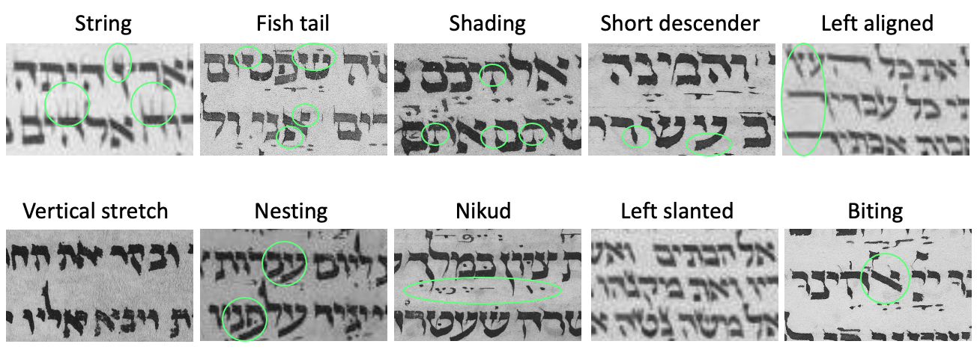
Methods
10 critical features were selected in collaboration with expert paleographers for their significance in script classification.
This enabled detailed clustering of manuscripts based on subtle script variations.
Diacritics

Slide 10
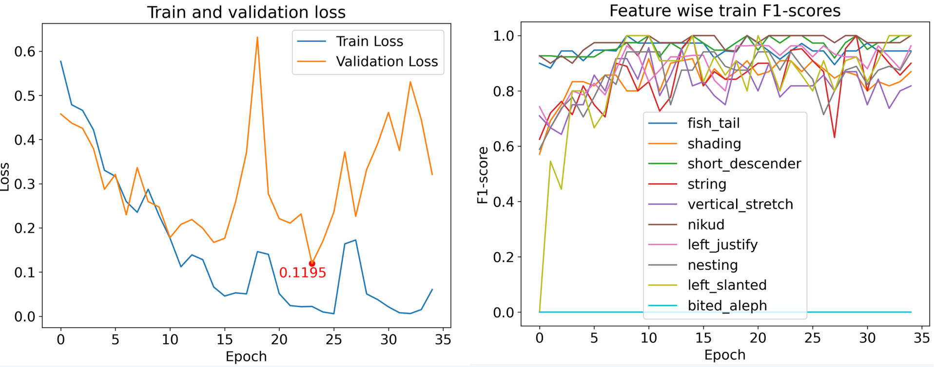
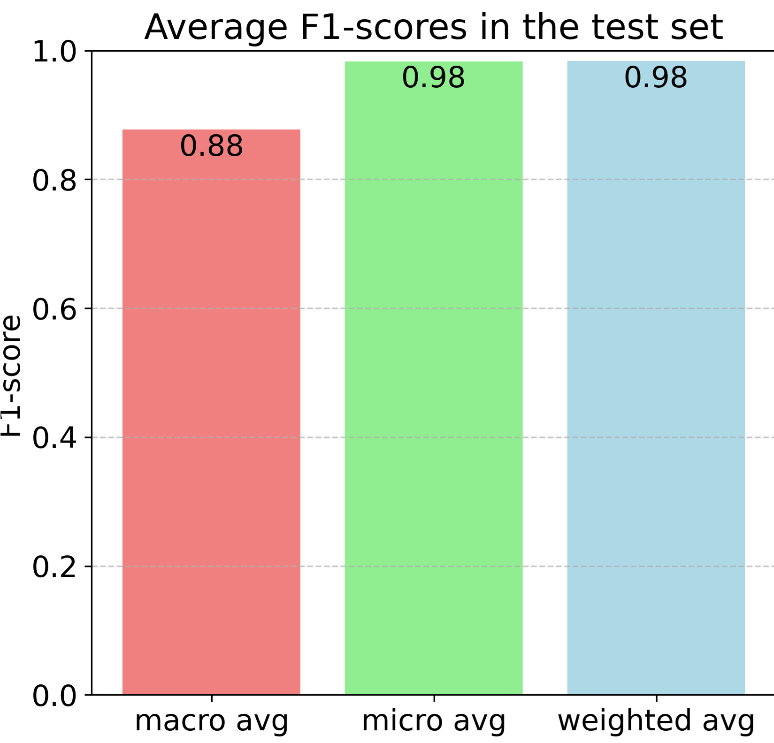
Predicting Paleographic Features
Trained a network using multilabel approach to predict the features, achieving 98% accuracy on unseen test data.
We evaluated the model with macro average, micro average, and weighted average F1 scores, balancing class sizes for comprehensive performance insights.
diacritics

Slide 11
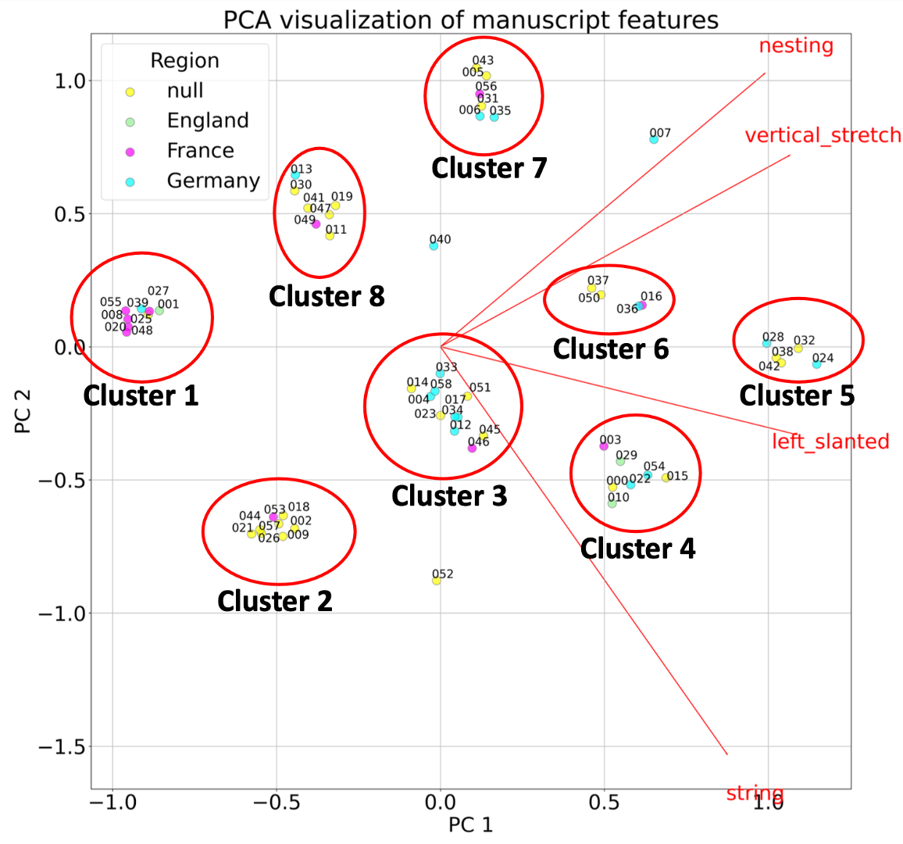
Exploring Subclusters
To identify subclusters, we performed a brute-force search for feature combinations that led to cohesive clusters, using Principal Component Analysis (PCA) for 2D visualization.
We tested all features and found that χ² feature selection effectively highlighted clusters, addressing the challenge of recognizing patterns across multiple manuscripts.
The clustering algorithm successfully grouped manuscripts of known provenance and suggested meaningful groupings for others.

Slide 12
Conclusion and Future Work
Initial research on early Ashkenazi square manuscripts revealed meaningful clusters, though dataset size limits further improvement.
Future work involves applying refined algorithms to larger datasets of other Hebrew script types.
New experiments focus on clustering Genizah fragments (10th–12th centuries) scribed in Oriental and Sephardic scripts.
The goal is to compare paleographic similarity, as determined by algorithms, with textual similarity for deeper insights.
Thank you !

