Slide 1
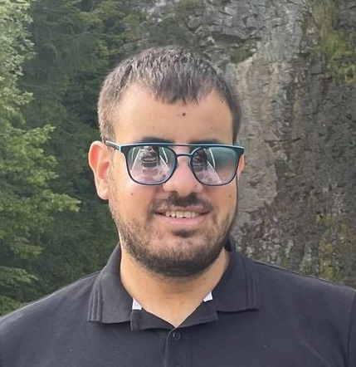
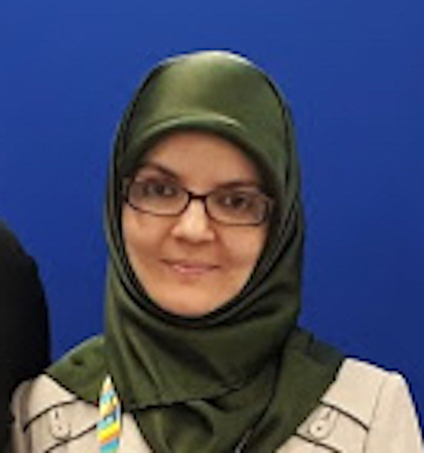
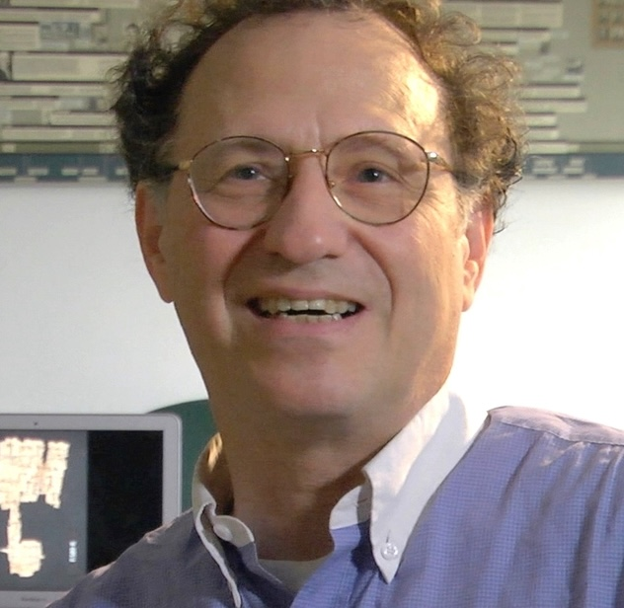
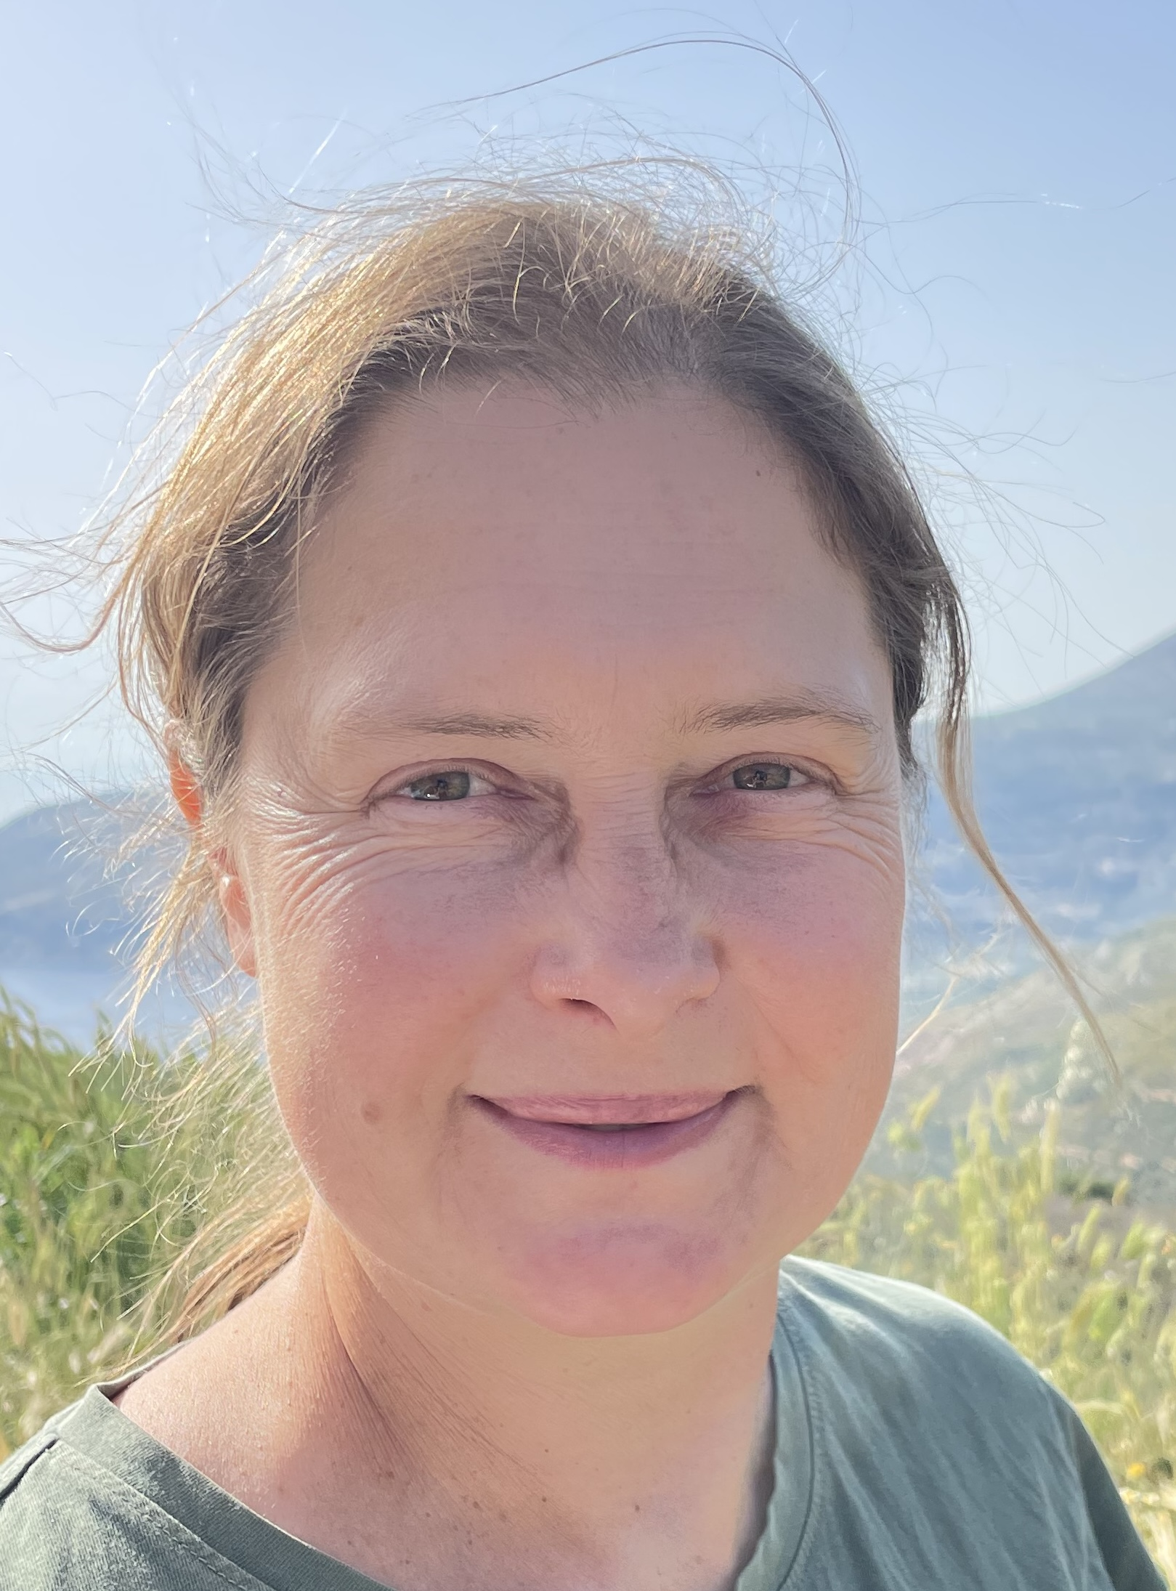
Automatic Clustering of Hebrew Manuscripts
Daria Vasyutinsky Shapira
Berat Kurar-Barakat
Mohammad Suliman
Sharva Gogawale
Nachum Dershowitz
Tel Aviv University, Israel

Slide 2
Collaboration
MiDRASH ERC Synergy project 101071829
Ecole Pratique des Hautes Etudes, Paris-Sciences-Lettres Université
Tel Aviv University
Bar-Ilan University
National Library of Israel
Haifa University
Views and opinions expressed are those of the authors only and do not necessarily reflect those of the European Union or European Research Council.
Neither the European Union nor the granting authority
can be held responsible for them.

Slide 3
Outline
We aim to transcend the boundaries of traditional human paleography by utilizing computational algorithms to cluster medieval Hebrew script types.
Clustering square scripts is especially challenging because of their uniformity.
Conventional algorithms have been relatively ineffective in identifying features critical for paleographical clustering. This study employs a more deterministic approach, identifying crucial paleographical features as determined by paleographers.
We begin with the relatively well-studied Ashkenazi square script, we will proceed to other script types.

Slide 4
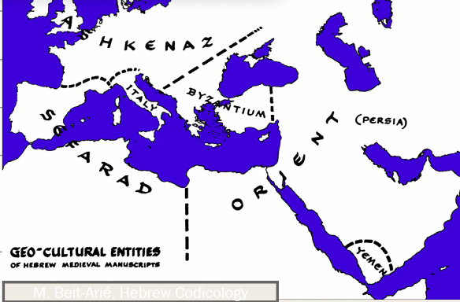

Slide 6
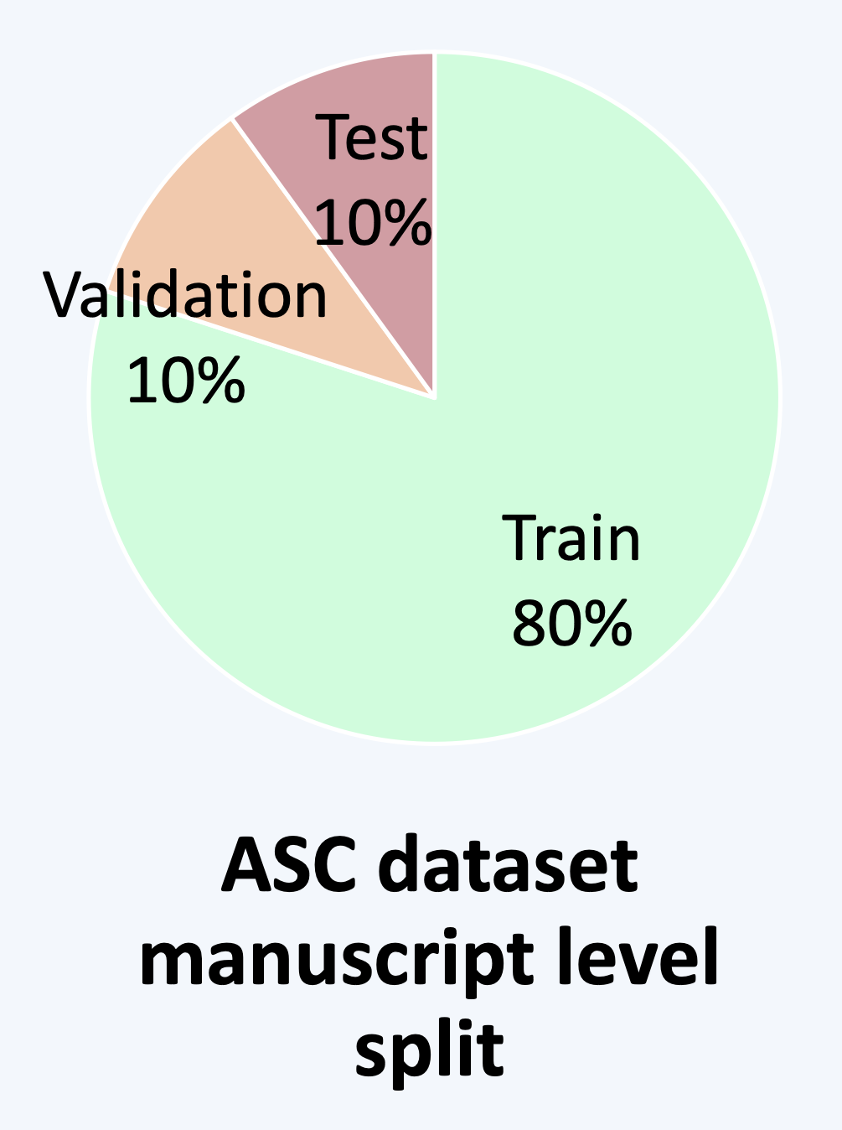
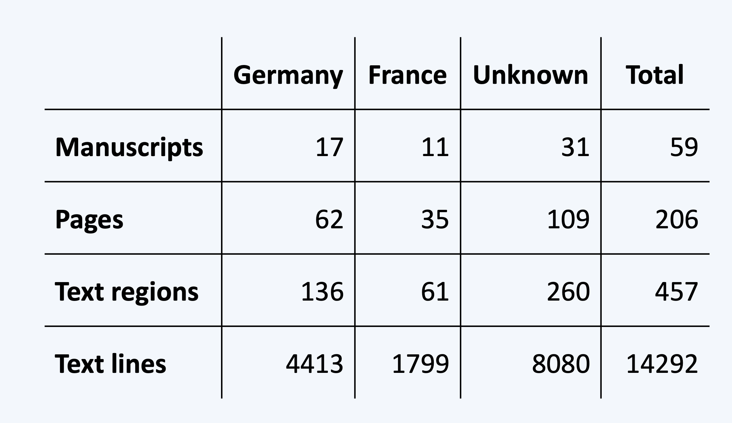

Slide 7
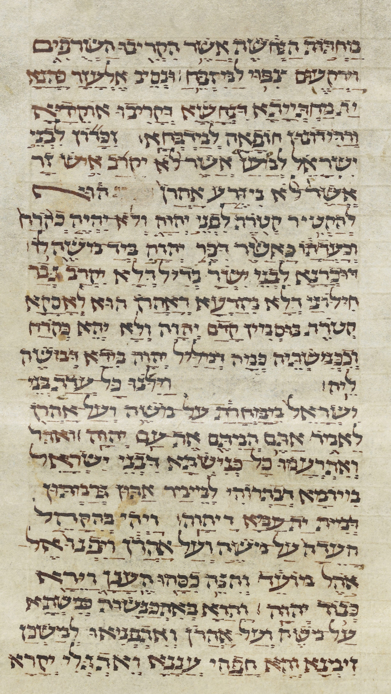
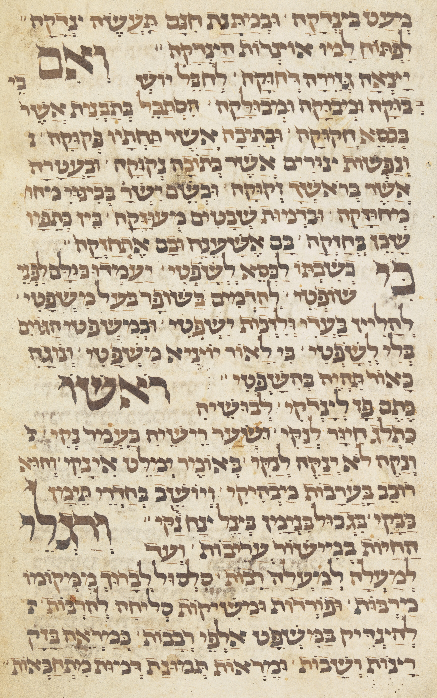
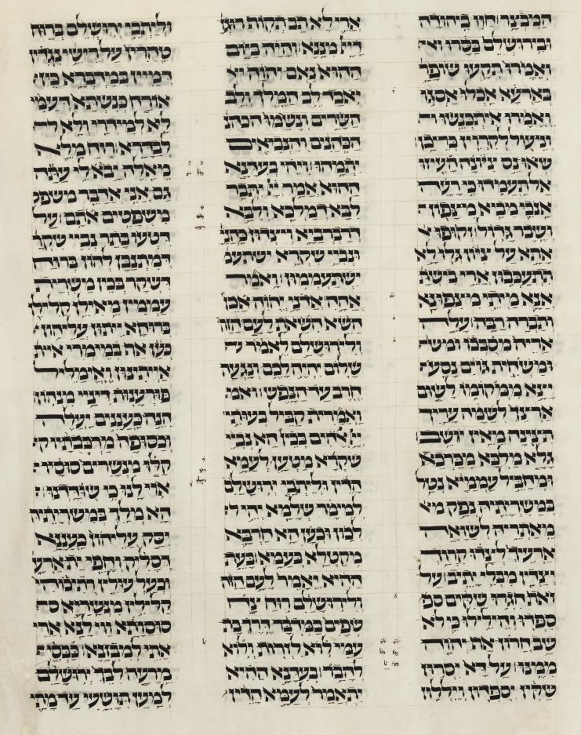
France 1251–1300
Germany 1276–1325
Germany 1343

Slide 8
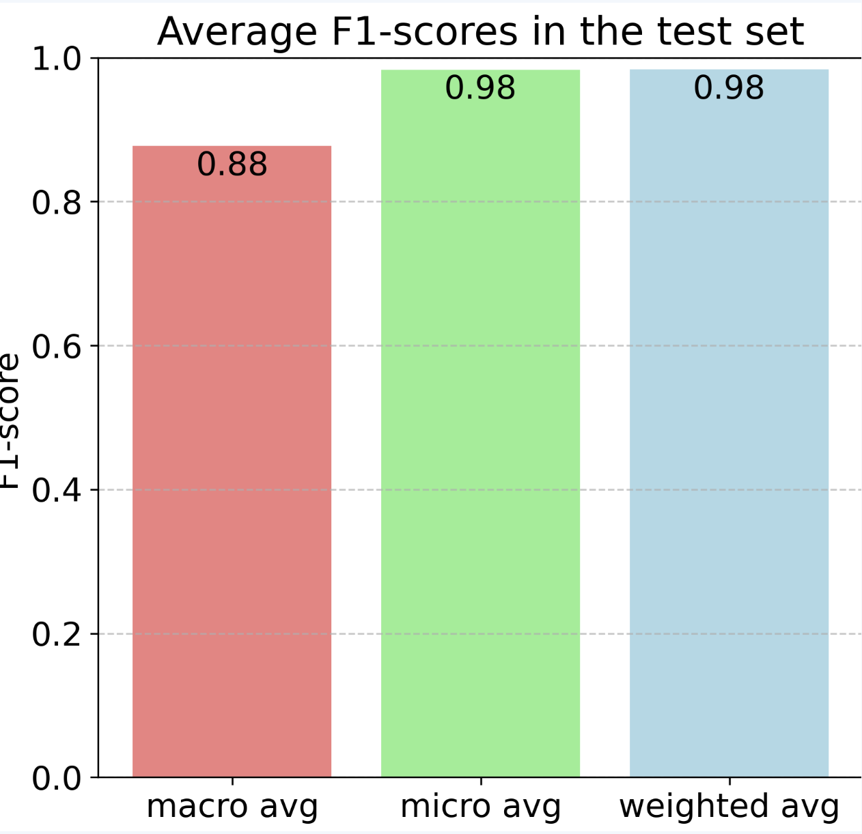
Training a VGG-19 network for predicting paleographical features

Slide 9
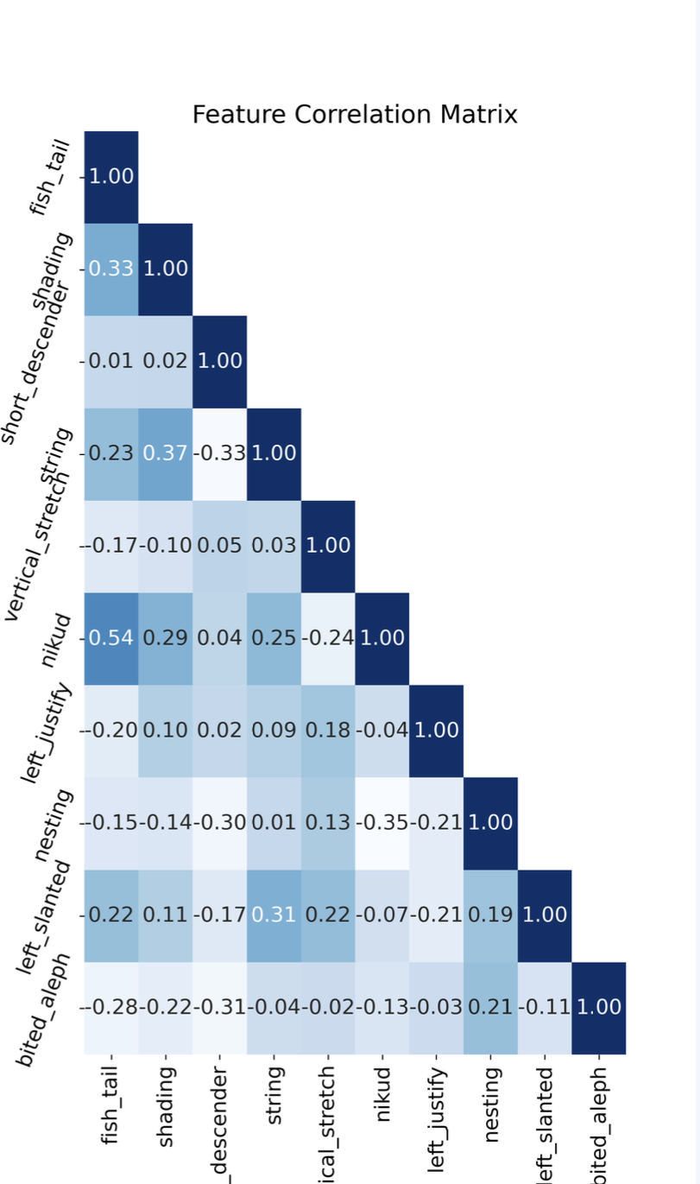
Paleographical features:
Vocalization marks
Left justify
Vertical stretch
Strings
Short descender
Fish tale
Left slanted
Biting
Nesting
Shading

Slide 10
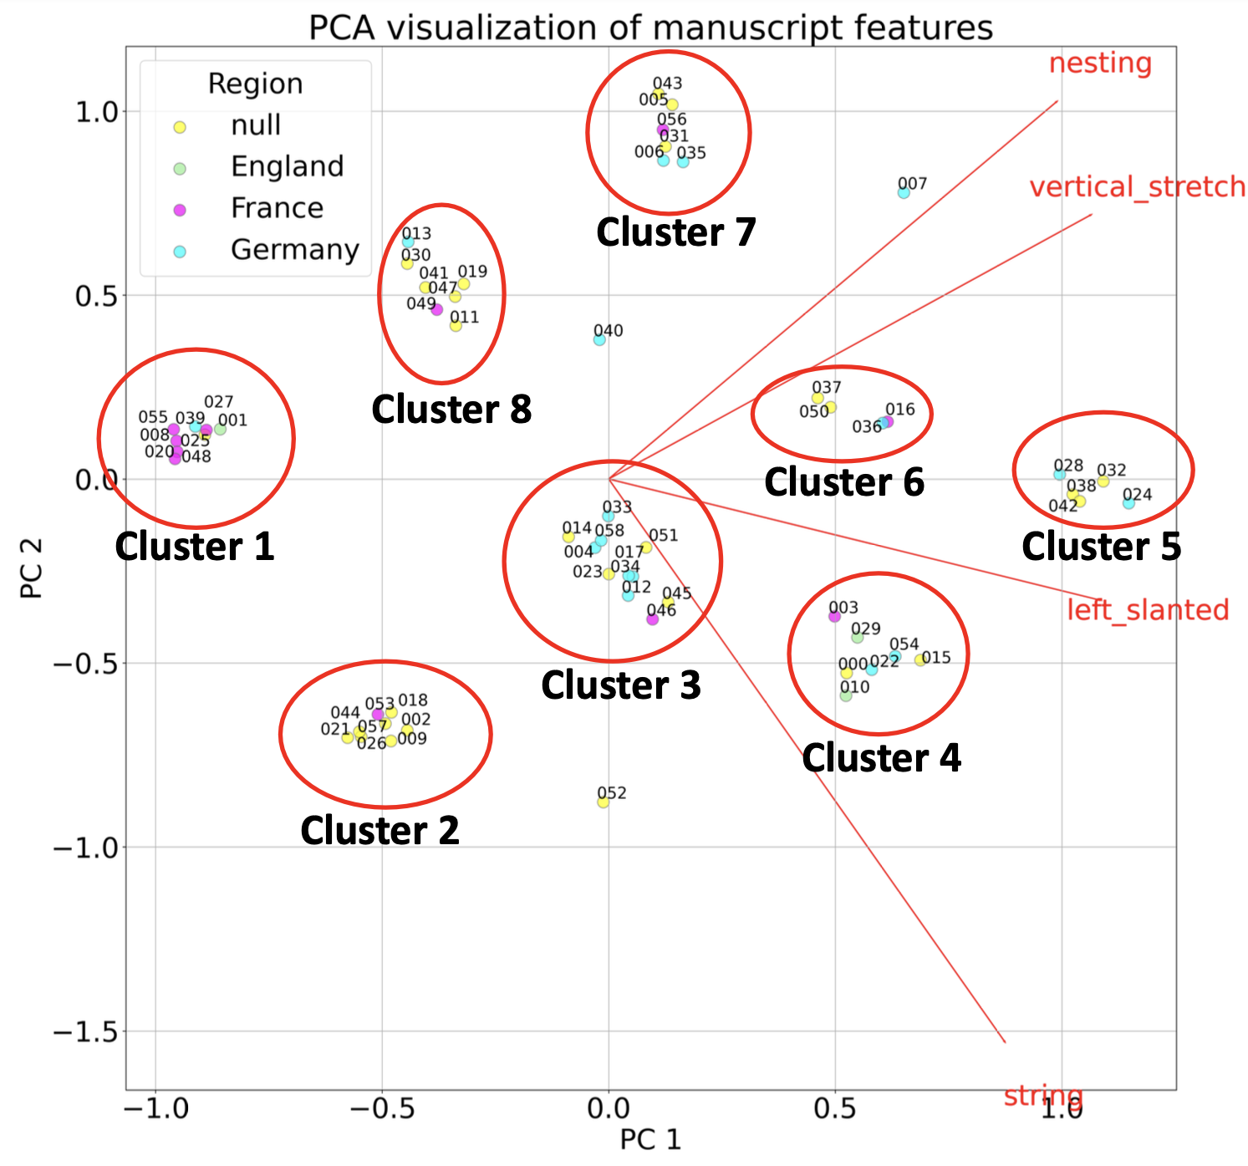

Slide 11
Focusing initially on Ashkenazi square script, we plan to apply successful methods to other lesser studied types of medieval Hebrew script, such as Byzantine and Yemenite. We expect to discover new paleographic patterns and enhance our understanding of sub-clustering within these script types.
Thank you!

