Slide 1
Twin Talks 3:
Understanding and Facilitating Collaboration in DH
July 23, 2020
Organisers:
Steven Krauwer (steven@clarin.eu)
Darja Fišer (darja.fiser@ff.uni-lj.si)
and Programme Committee
on behalf of:
CLARIN ERIC (www.clarin.eu)
DARIAH ERIC (www.dariah.eu)
SSHOC (sshopencloud.eu)

Slide 2
Opening
Predecessors:
Twin Talks 1, Copenhagen, DHN2019
Twin Talks Panel, Liège, DH Benelux 2019
Twin Talks 2, Riga, DHN2020
Main objective:
A better understanding of the collaboration between humanities and digital experts when solving humanities research problems and the obstacles encountered
Expected outcome:
Recommendations for those involved in the education of humanities scholars & professionals and technical experts to develop better training programmes
Identification of initiatives that CLARIN ERIC, DARIAH ERIC and SSHOC could take in order to support this

Slide 8
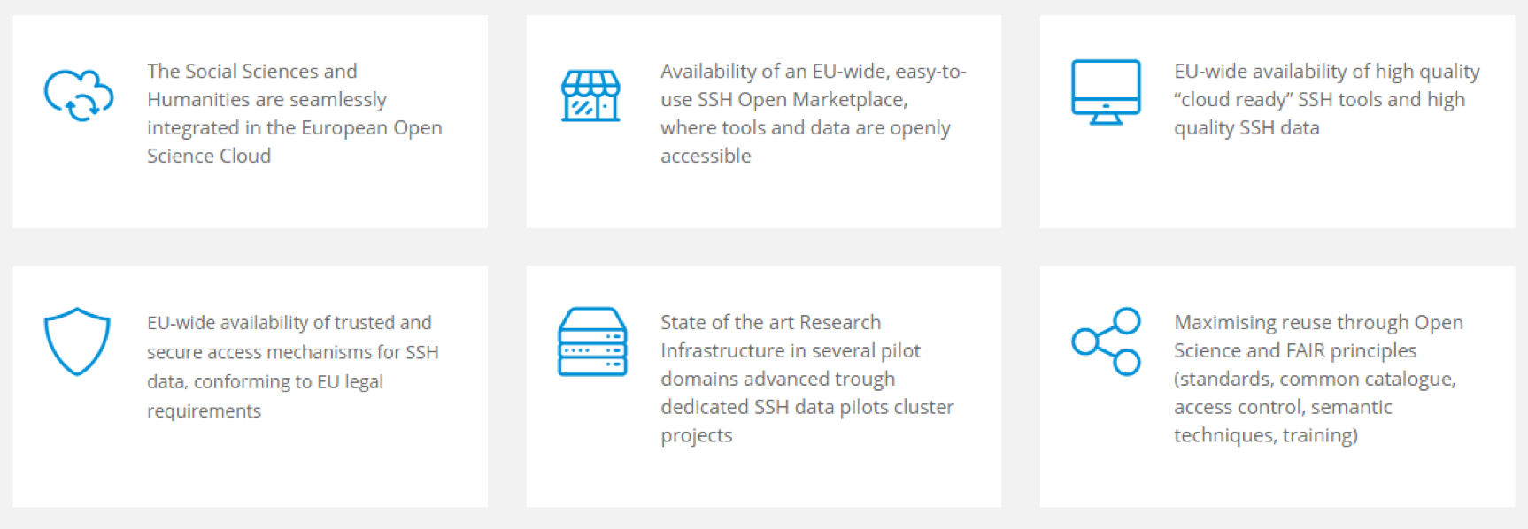
Expected impact

Slide 9
Workshop schedule
15:00 - 15:10 | Opening | Steven Krauwer and Darja Fišer
15:10 - 15:20 | Talk 1: Deep learning for paleographic analysis of medieval Hebrew manuscripts | Jihad El-Sana, Daria Vasyutinsky Shapira, Irina Rabaev, Berat Kurar Barakat and Ahmad Droby
15:20 - 15:30 | Talk 2: Bridging the gap between culture studies and computational linguistics | Inge van de Ven and Menno van Zaanen
15:30 - 15:40 | Talk 3: The Whole is Greater Than the Sum of its Parts Analyzing Aristotle Commentaries in Collaboration between Philology and Data Science | Michael Krewet, Danah Tonne, Germaine Götzelmann, Philipp Hegel and Sibylle Söring
15:40 - 15:50 | Q&A | All
15:50 - 16:00 | Talk 4: Towards improving OCR accuracy with Bulgarian Language Resources | Ivan Kratchanov, Laska Laskova and Kiril Simov
16:00 - 16:10 | Talk 5: Bringing Together the Digital with Research, Teaching, and Conservation | Robert M. Ehrenreich, Michael Haley Goldman and Jane E. Klinger
16:10 - 16:20 | Talk 6: No room for hate: What research about hate speech taught us about collaboration? | Ajda Šulc and Kristina Pahor de Maiti
16:20 - 16:30 | Q&A | All
16:30 - 16:50 | Discussion | All
16:50 - 17:00 | Take-home messages and closing | Steven Krauwer and Darja Fišer

Slide 10
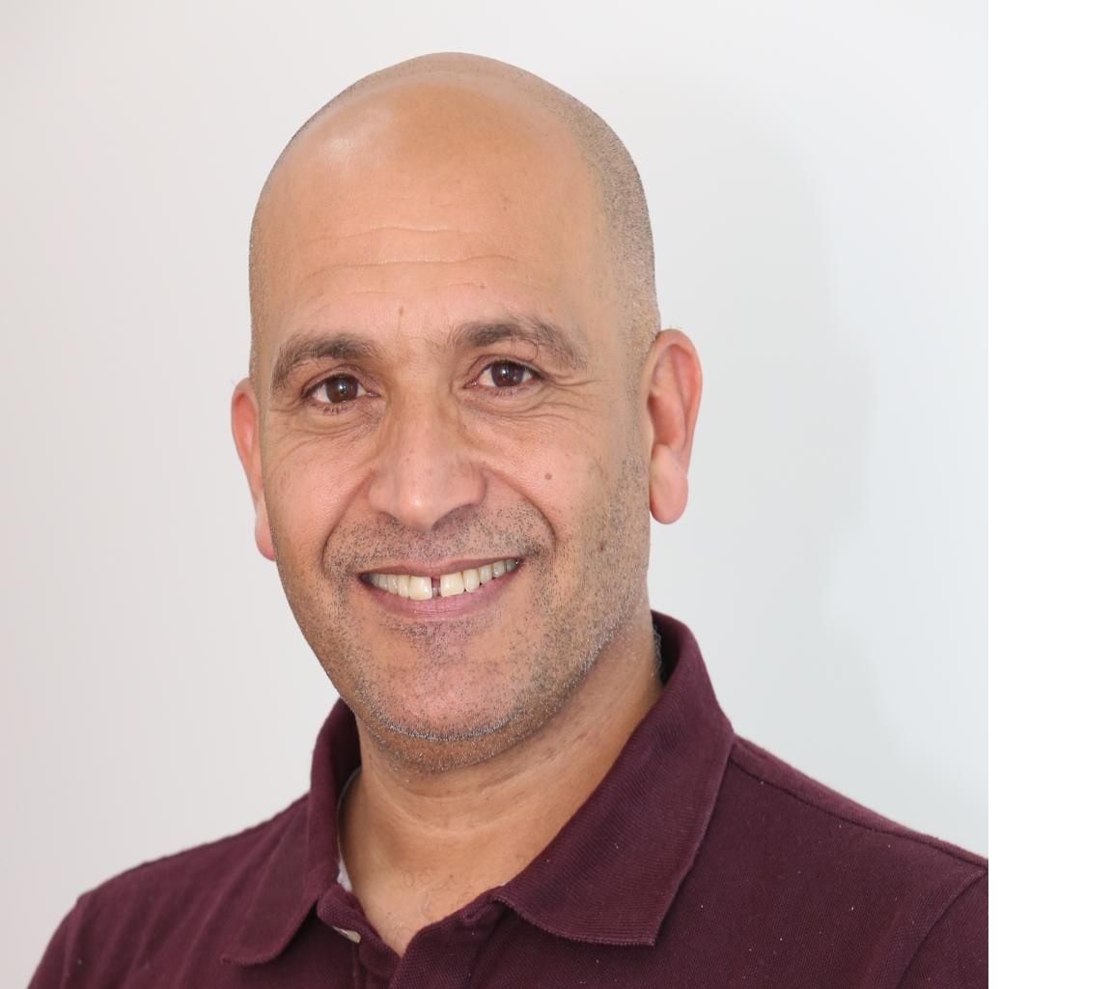
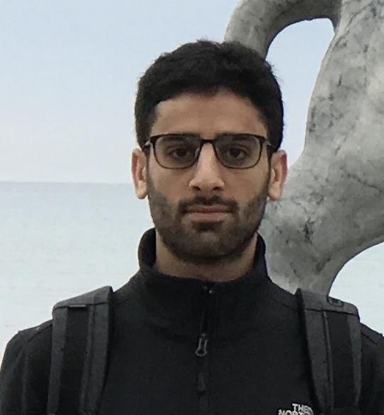
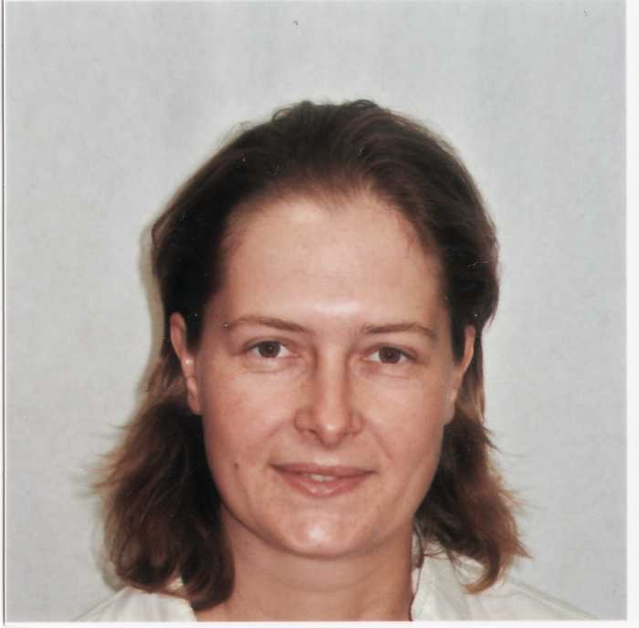
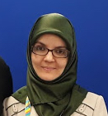
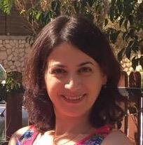
Talk 1
Deep learning for paleographic analysis of medieval Hebrew manuscripts
Jihad El-Sana¹, Daria Vasyutinsky Shapira¹, Irina Rabaev², Berat Kurar Barakat¹ and Ahmad Droby¹ ¹Ben-Gurion University of the Negev, Beer-Sheva, Israel ²Shamoon College of Engineering, Beer-Sheva, Israel {el-sana,dariavas,berat,drobya}@post.bgu.ac.il irinar@ac.sce.ac.il

Slide 11
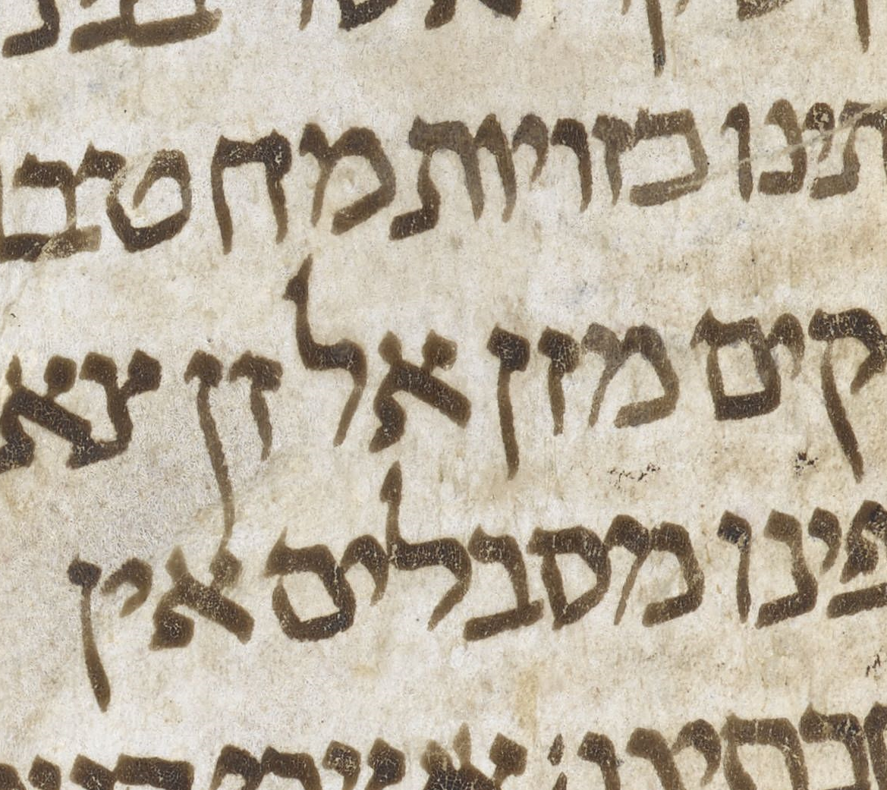
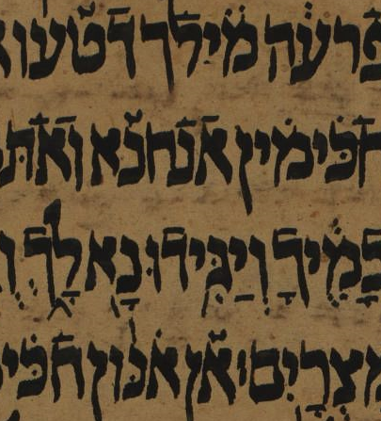
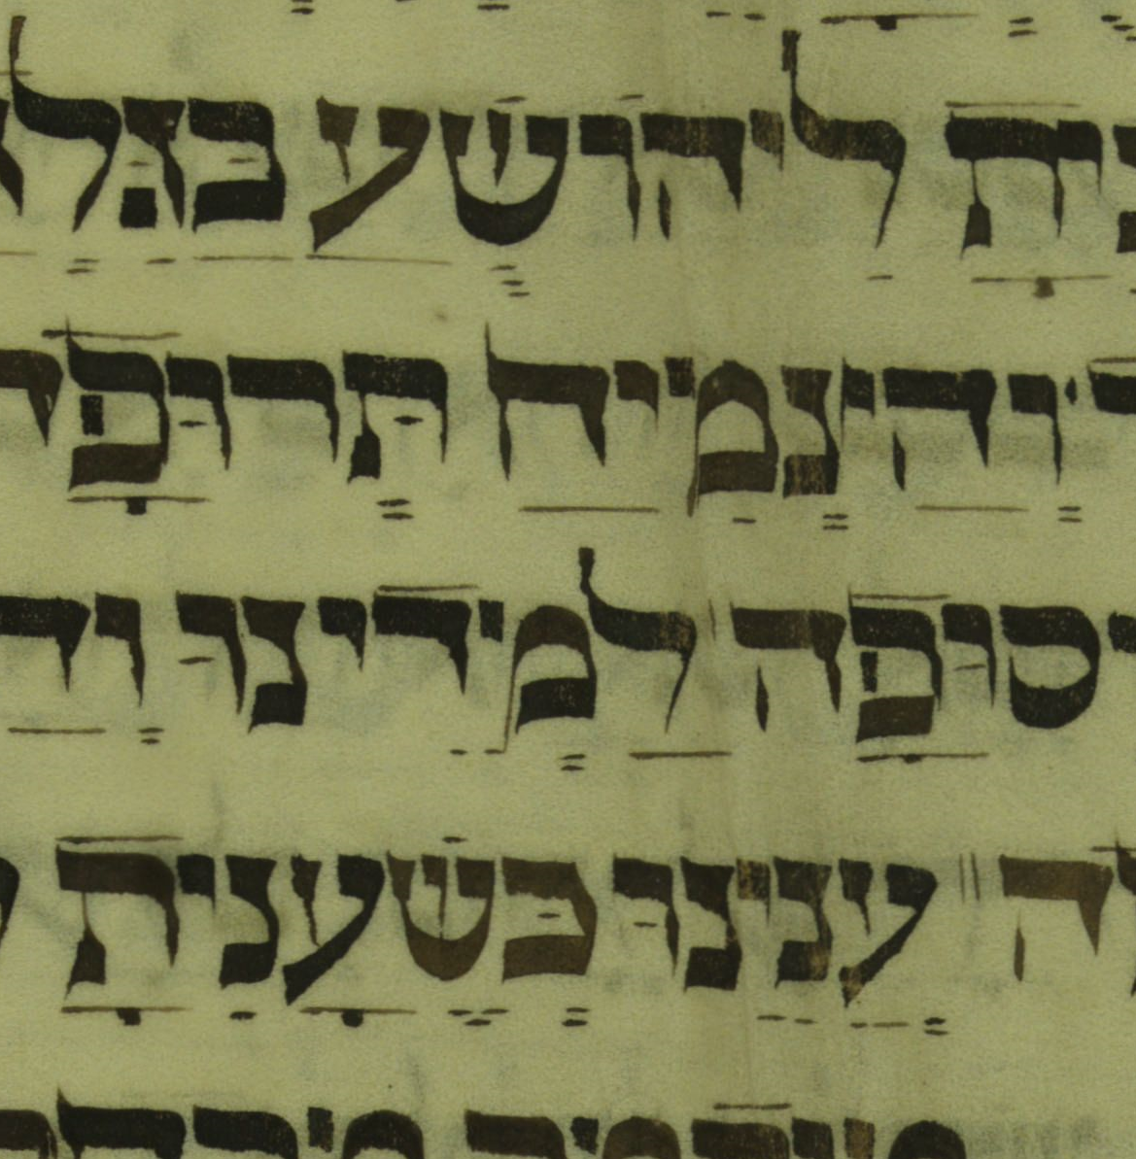
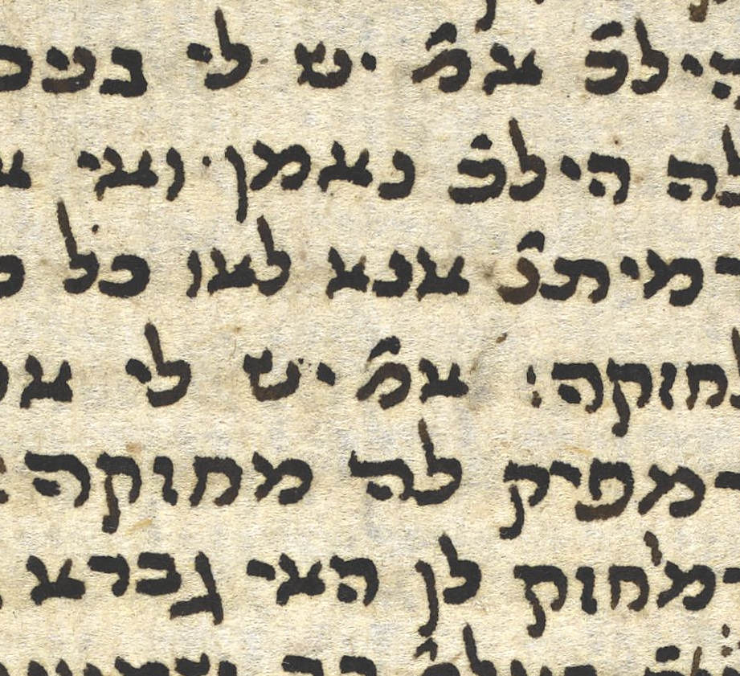
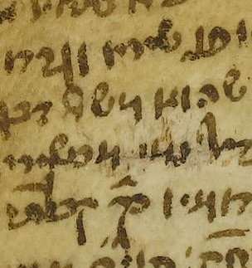
Talk 1 Deep learning for paleographic analysis of medieval Hebrew manuscripts The research problem
Classify script types and sub-types in medieval Hebrew manuscripts
Script type provides clues such as
Geographical region
Time of writing

Slide 12
Talk 1 Deep learning for paleographic analysis of medieval Hebrew manuscripts Classes of Hebrew Scripts
Medieval Hebrew Scripts can be classified into 15 classes

Slide 13
Talk 1 Deep learning for paleographic analysis of medieval Hebrew manuscripts The proposed solution
Utilize Deep Neural Network to learn to discriminate among script types
So far, we have experimented with two different architectures (simple CNN with three convolutional layers and ResNet).
The training and validation sets sizes are 538,468 and 70,000
The validation accuracy is 0.96 (simple CNN)

Slide 14
Talk 1 Deep learning for paleographic analysis of medieval Hebrew manuscripts The collaboration experience
Our collaboration experience is by far very positive and groundbreaking.
The encountered obstacles include:
It was initially hard to find a counterpart – no common platform
Lack of a common technical language
Different demands for presentation and publication
Intermediate tasks are formulated and changed on the go.
Notes:
·

Slide 15
Talk 1 Deep learning for paleographic analysis of medieval Hebrew manuscripts Conclusions and recommendation
It is very likely that the role played by DH in academic research will increase in the coming years (we are talking about both practical and theoretical applications).
Recommendations:
A common platform where researchers from the humanities and computer sciences could more easily find each other (especially when they don’t know what exactly they are looking for).
Dedicated university courses in the fundamentals of computer sciences tailored for MA and PhD students of Humanities.

Slide 16
Talk 2
Bridging the gap between culture studies and computational linguistics
Inge van de Ven and Menno van Zaanen
Inge van de Ven, Tilburg University
Menno van Zaanen, South African Centre for Digital Language Resources

Slide 17
Bridging the Gap between Culture Studies & Computational Linguistics
Inge van de Ven
Tilburg University
Tilburg, Netherlands
i.g.m.vdven@uvt.nl
Menno van Zaanen
South African Centre for Digital Language Resources
Potchefstroom, South Africa
menno.vanzaanen@nwu.ac.za

Slide 18
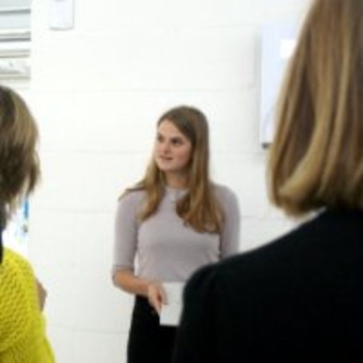
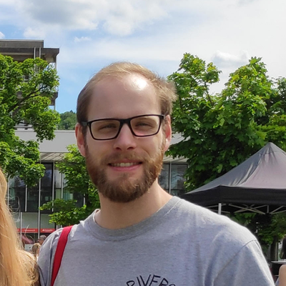
The situation
Research Traineeship Program
Tilburg School of Humanities and Digital Sciences
Aim: increase collaboration, give students research experience
Proposal written, submitted, approved
Funding for two student assistants (Iris Cuppen & Christoph Aurnhammer)
Collaboration between two departments
Culture Studies
Cognitive Science and Artificial Intelligence

Slide 19
The research problem
Bridging the gap
... between close reading and distant reading
... between Computational Linguistics and Culture Studies
How to bridge the gap between close and distant reading?
Many approaches possible
Where to start?
Meaning of terminology and functionality
Compare computational and manual annotations

Slide 20
The solution
Using manual annotation to evaluate and supplement an LDA topic modeling model
Group texts based on similarity (topic, (discourse) function, etc)
Divide project into two sub-projects with clear boundaries
Qualitative approach: manually annotate text
Quantitative approach: unsupervised learning approach
Subreddit r/politics, thread: “Should the Democrats nominate a celebrity in 2020? What would be the pros and cons?” 449 responses (461 including deleted comments)
Result: partial overlap between qualitative and quantitative annotation
Unclear exactly how to define topic, (discourse) function, etc

Slide 21
The collaboration experience
Different views on
... research approaches (qualitative versus quantitative)
... meaning of close reading and distant reading
How to get from general research idea to concrete RQs?
Dividing project helped with
focus on specific tasks (with known methodologies)
explaining terminology and concepts through examples
collaboration through alignment of tasks
understanding other research methodologies

Slide 22
Conclusions & recommendations
“Forced” collaboration across research areas is interesting and leads to
new research (new/combined methodologies)
understanding of other methodologies
Recognized difficulties
terminological differences between research fields
combining research methodologies
Successful when all researchers
are open to collaboration (across research areas)
are willing to learn and step across research boundaries

Slide 23
Talk 3:
The Whole is Greater Than the Sum of Its Parts Analyzing Aristotle Commentaries in Collaboration between Philology and Data Science
Michael Krewet¹, Danah Tonne², Germaine Götzelmann²,
Philipp Hegel³ and Sibylle Söring¹
¹ Freie Universität Berlin, Germany
² Karlsruhe Institute of Technology, Germany
³ Technical University of Darmstadt, Germany

Slide 24
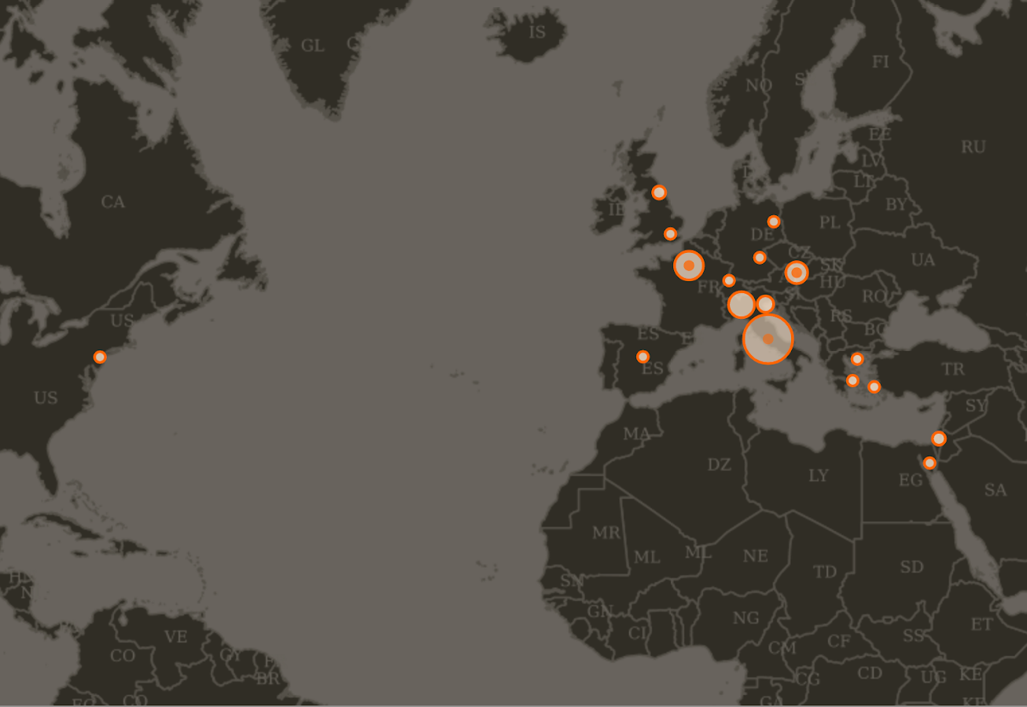
Source: DARIAH-DE Geo-Browser

Slide 25
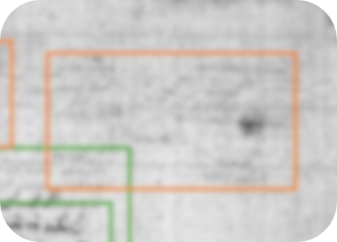
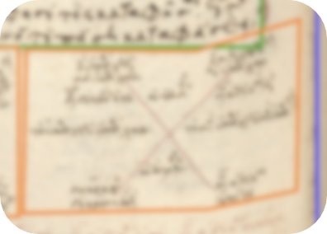
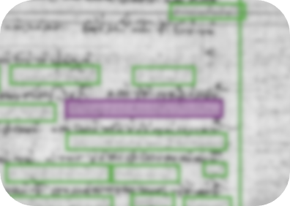
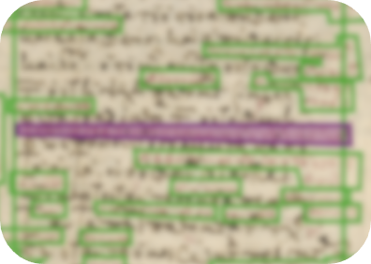
Example of Knowledge Transfer
Paris, BNF, Par. Gr. 1971,
f. 34v and 33r (detail)
Vatikan, BAV, Urb. Gr. 56,
f. 88r and 82r (detail)
Wien, ÖNB, Suppl. Gr. 67,
f. 117v and 113r (detail)

Slide 26
Find relations
and transfers
Search & Analyze
matching words, copying errors, faulty diagrams, ...
Big Data Methods
Manual enrichment transcribing, translating, semantic tagging
Semantic Querying
RESTful Services, SPARQL
Analysis Tools
Data Visualization
Scholarly manuscript description
35,000 annotations*
Web Annotation Data Model
Digitization of codices
100+ metadata files TEI xml
Research Data Infrastructure
~4200 images jpeg, tiff
* ~10,000 manual annotations, ~25,000 annotations by algorithms for layout analysis
Image sources: tool icon (Wikimedia Commons, creator: STyx), magnifier icon (Wikimedia Commons, creator: SimpleIcon)

Slide 27
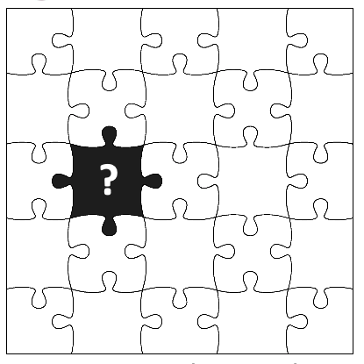
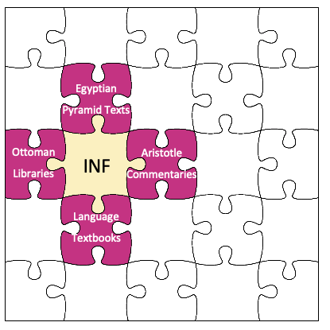
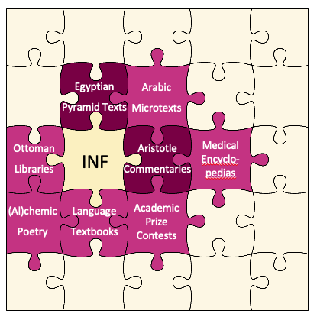
Collaboration in a Collaborative Research Center (CRC 980: Episteme in Motion)
Egyptian
Pyramid Texts
Aristotle
Commentaries
Phase I (2012-2016):
Heterogenous projects from ‘small disciplines’
Well-established collabs
DFG recommendation:
Information Infrastructure project (INF)
Phase II (2016-2020):
INF project implemented with
4 pilot projects (Egyptology, Classics, Historical Linguistics,
Greek Studies)
Phase III (2020-2024):
Extending collaborations
Deepening collaborations
Operation and dissemination
for all CRC projects

Slide 28
The Tedious Bits of Joint Research
The quotes below are a work of fiction. Any resemblance to actual persons, living or dead, or actual events is purely coincidental.
“We don’t have any data at all.”
“We would have a lot of data if we would have more people to collect it.”
“We do it with Excel / we do it on paper - is that alright?”
“Michael is doing all that great stuff we will never be able to do”
Start small. Prototype. Iterate.
Match resources on both sides.
Some things can be parsed. Some things have to be changed!
The initial effort can be scary. Lead by example.

Slide 29
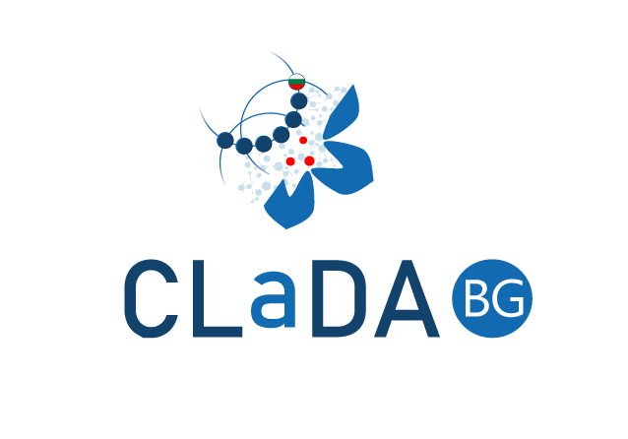
Talk 4
Towards improving OCR accuracy with Bulgarian Language Resources
Ivan Kratchanov¹, Laska Laskova², Kiril Simov² ¹Digitization Centre, National Library “Ivan Vazov”, Plovdiv, Bulgaria ²AI&LT, Institute of Information and Communication Technologies, Sofia, Bulgaria digitization@libplovdiv.com, {laska|kivs}@bultreebank.org

Slide 30
Talk 4 Towards improving OCR accuracy with Bulgarian Language Resources The research problem
Perform a correct OCR of Bulgarian texts printed with respect to older orthograph norms (the period from 1850 to 1945) – the period of involving
Normalization of the OCRed texts with respect to the contemporary Bulgarian orthography in order they to be used for search and to be annotated linguistically
И | безъ | припомнюванията | на | Kоммиссията
И | без | припомнянията | на | Комисията
and | without | reminders.the | of | Commission.the
вѫрвѭтъ | по | прѣдначьртаний | си | пѫть | .
вървят | по | предначертания | си | път | .
walk.3pl | on | outlined.the | their.refl | way | .
“And without the Commission reminding them, they walk along their way.”

Slide 31
Talk 4 Towards improving OCR accuracy with Bulgarian Language Resources The proposed solution
Construction of new models within the OCR software (FineReader) – training models on levels of old letters or the basis of old words
Construction of language resources with respect to old Bulgarian orthography – creation of an “old-inized” version of inflection lexicon of Bulgarian and creation of parallel corpora old/new orthography
Building of Neural Network spell checker for Old Bulgarian
NN Machine Translation between older Bulgarian and contemporary language

Slide 32
Talk 4 Towards improving OCR accuracy with Bulgarian Language Resources The proposed solution
Step 1: Symbol-level training with FINEREADER (at National Library)
relies on dictionaries to "leverage recognition quality by escalating words hypotheses found in a dictionary.“But: it has a built-in dictionary only for the modern Bulgarian language
Step 2: Adding an “old-inized” dictionary (at IICT)
Development of a CLaDA-BG model for transforming a contemporary dictionary into an old one

Slide 33
Talk 4 Towards improving OCR accuracy with Bulgarian Language Resources The collaboration experience
Specialists from National Library and IICT looked at the results and exchanged opinions on further improvement steps
IICT developed the old lexicon that was used by the library software for training
The National Library provided raw data before 1945 that were made compliant to the new orthography by IICT
The National Library evaluated the results
Notes:
·

Slide 34
Talk 4 Towards improving OCR accuracy with Bulgarian Language Resources Conclusions and recommendation
Use both – lexica and corpora to improve the OCR tool!
Recommendations:
The “old-inized” lexicon has to be improved further (adding more archaic words, names).
We are in process of creation of parallel corpus of OCRed/old/new versions of Bulgarian. The idea is to train Neural Network language models for each level in order the repairment to be done on word level in context.

Slide 35
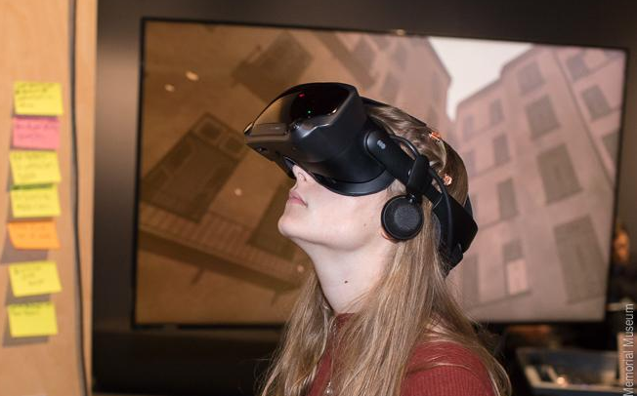
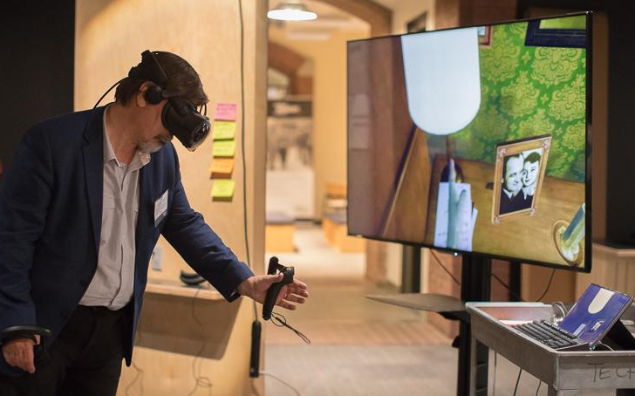
Talk 5
Bringing Together the Digital with Holocaust Research, Teaching, and Conservation
Robert M. Ehrenreich, Michael Haley Goldman and Jane E. Klinger
Digital Humanities projects at USHMM increasing since 2008
GIS; DH Associate Fellows; AR/VR applications
Demanded new cross-programs approach
Led to consideration of other potential growth opportunities

Slide 36
Talk 5
Bringing Together the Digital with Holocaust Research, Teaching, and Conservation
3D Scanning seems especially fruitful since promotes:
Material-culture research projects
Close examination of objects’ characteristics, properties, manufacture, types and potential sources of material
Access to multiple holdings/examples and fragile artefacts for analysis and comparison
Teaching and Exhibitions
Greater interactivity by general public
Opportunities to integrate collections into virtual and augmented reality and other technologies
Object-based museum education outside physical museum

Slide 37
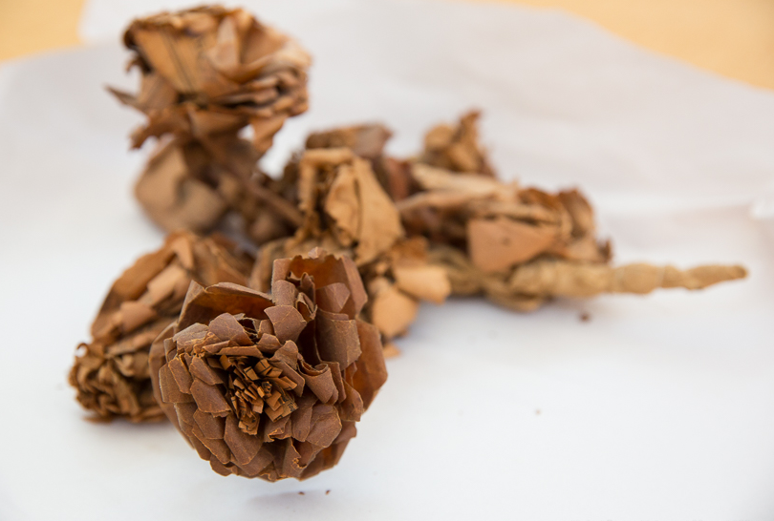
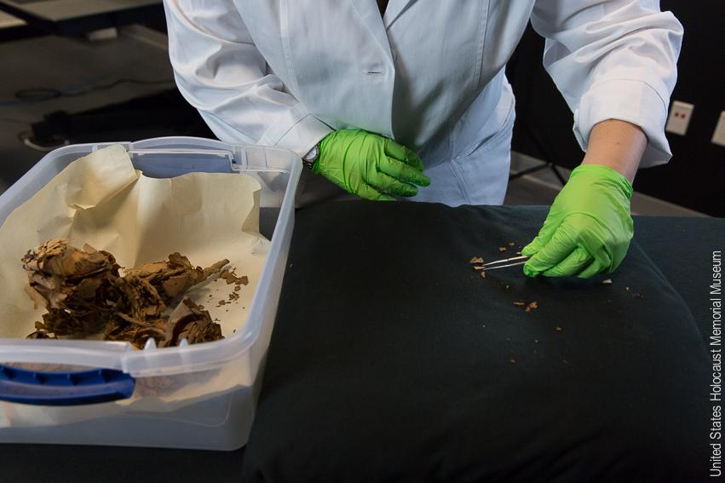
Talk 5
Bringing Together the Digital with Holocaust Research, Teaching, and Conservation
Conservation
New documentation methodology providing visual information previously unavailable with other techniques
Ability to highlight vulnerabilities not readily visible using other techniques
Additional analysis for formulating conservation plans
Visual access when artefact is too fragile for direct use

Slide 38
Talk 5
Bringing Together the Digital with Holocaust Research, Teaching, and Conservation
Critical criteria
 | Research | Teaching/Exhibitions | Conservation
High Resolution | ✅ |  | ✅
Full depiction | ✅ | ✅ | ✅
Interactivity | ✅ | ✅ | ✅
Accuracy | ✅ |  | ✅
Multi-spectrum | ✅ |  | ✅
Safe handling |  |  | ✅
Ease of application |  | ✅
Collaboration | ✅ |  | ✅

Slide 39
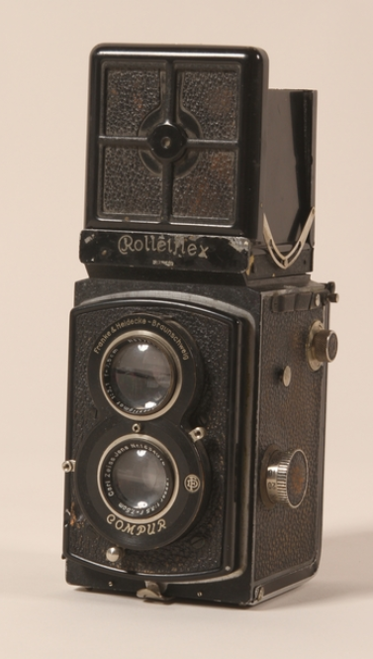
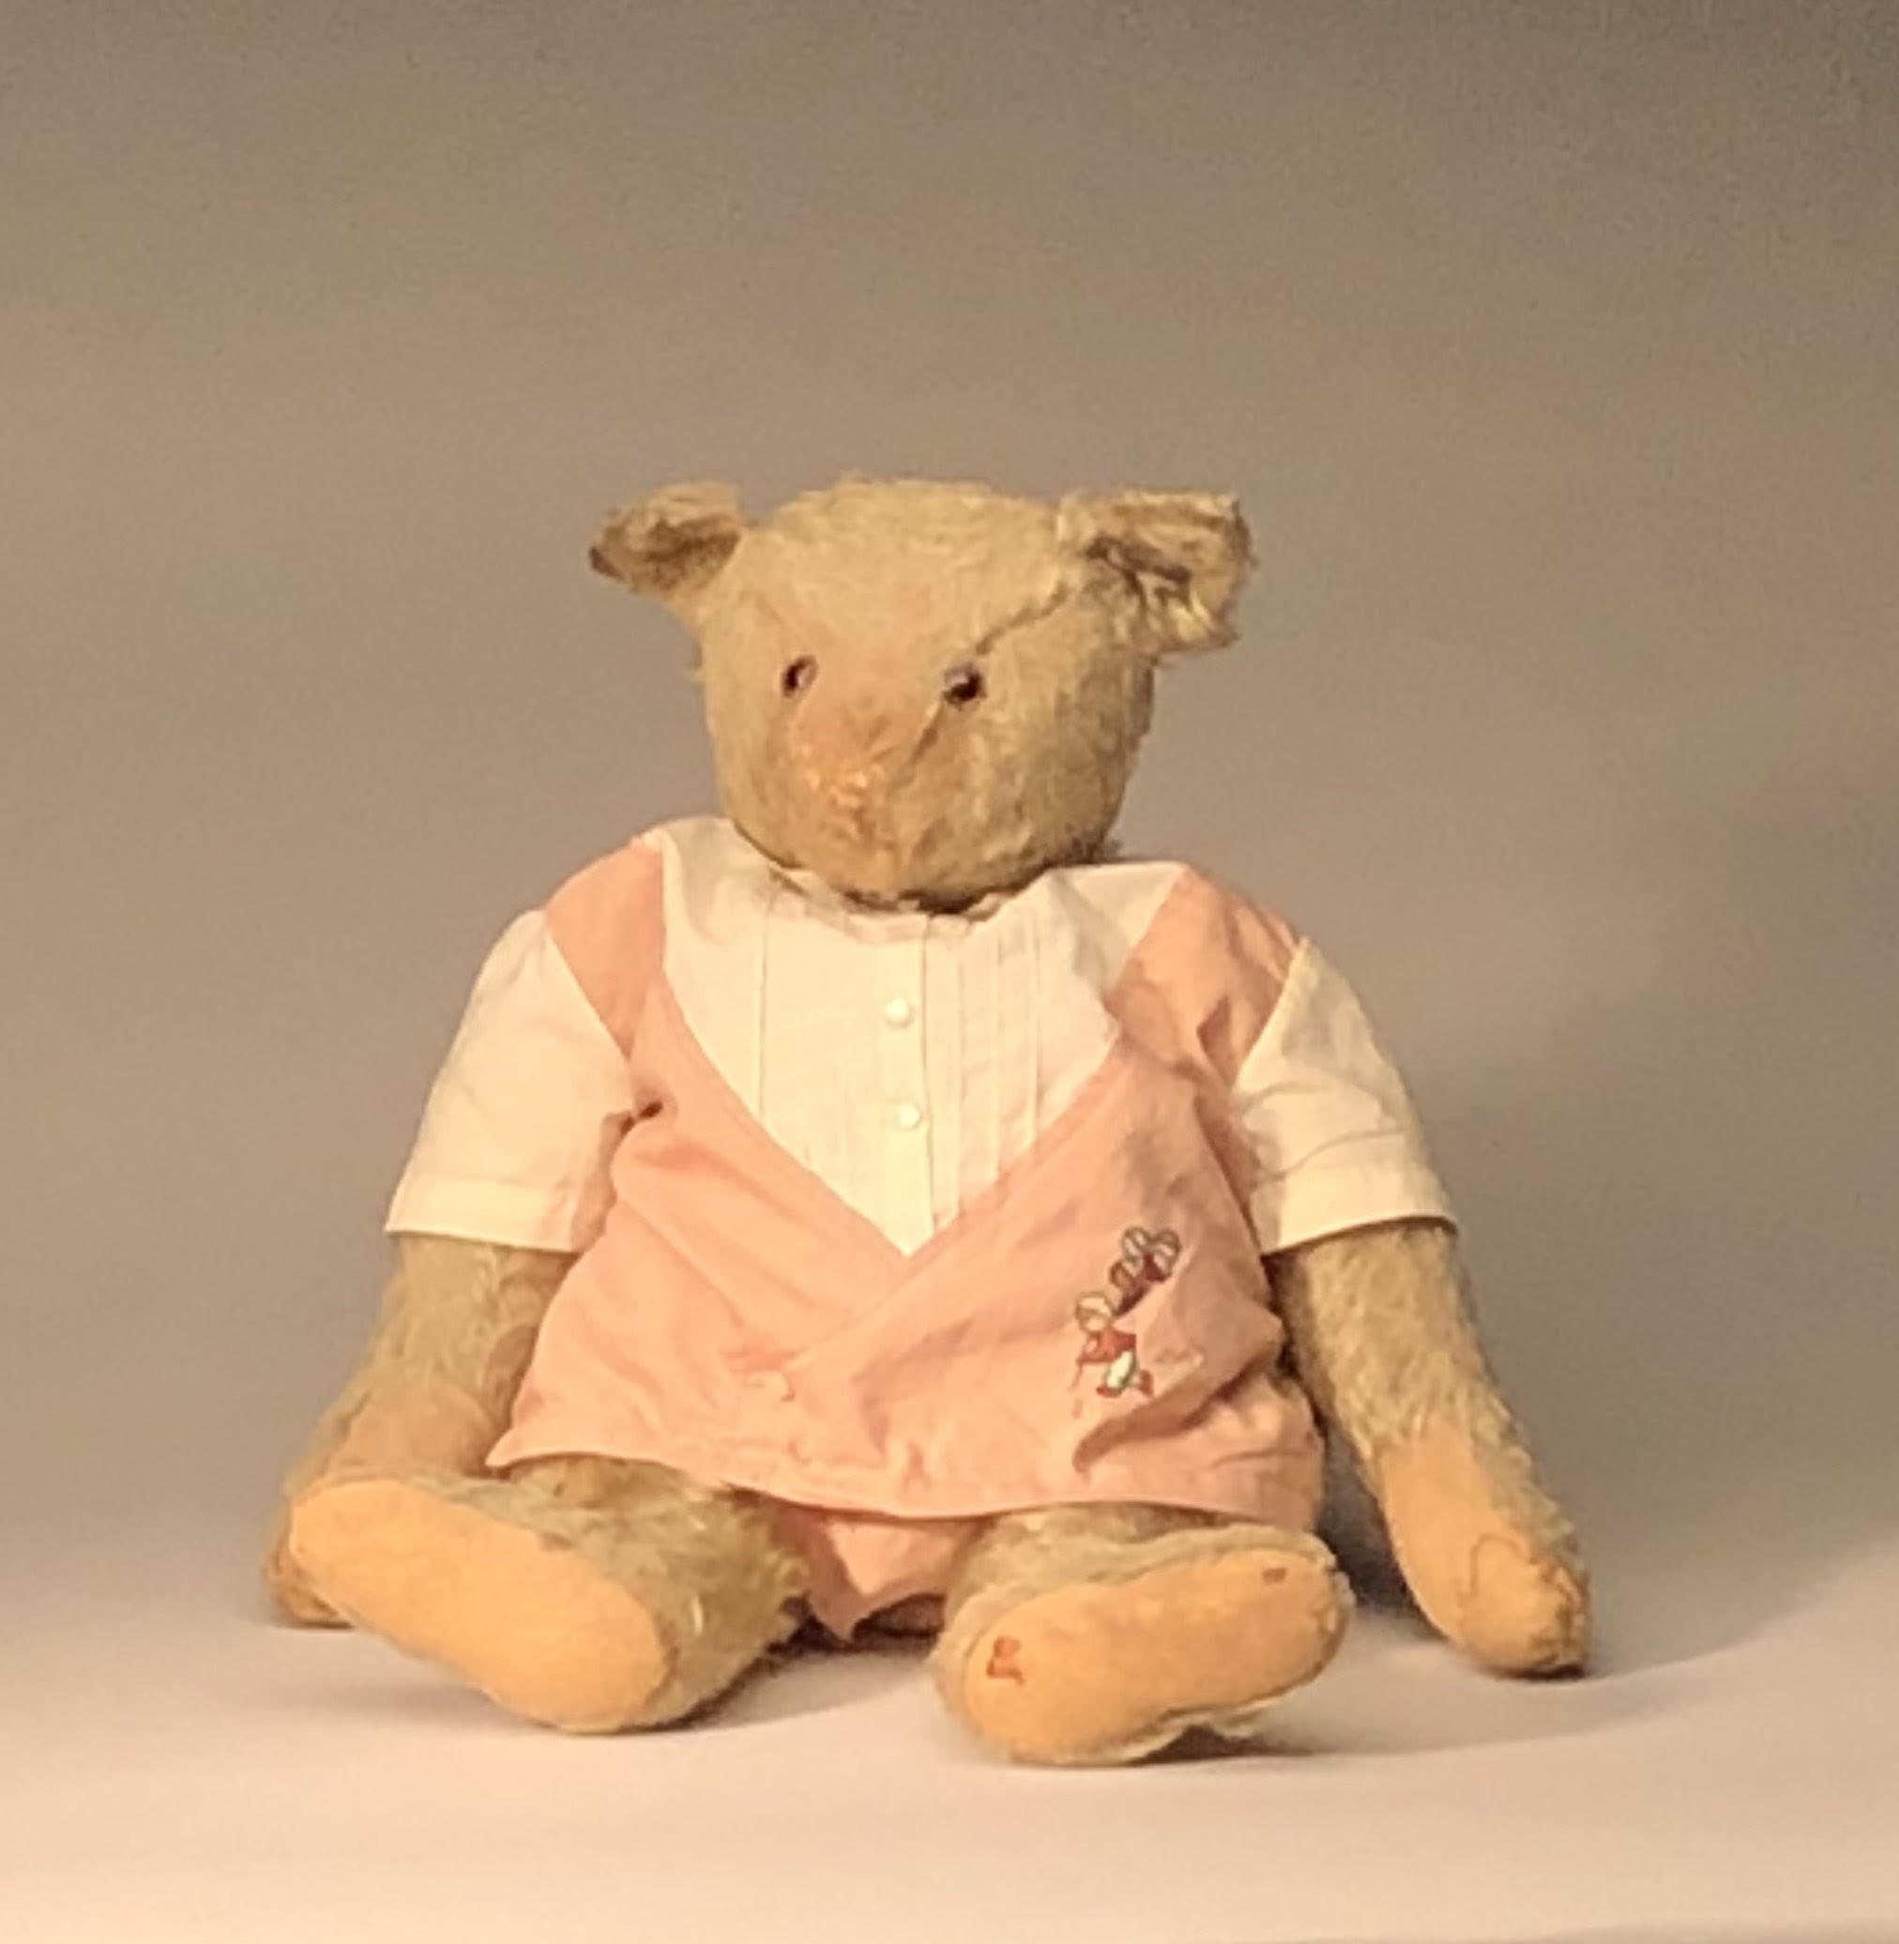
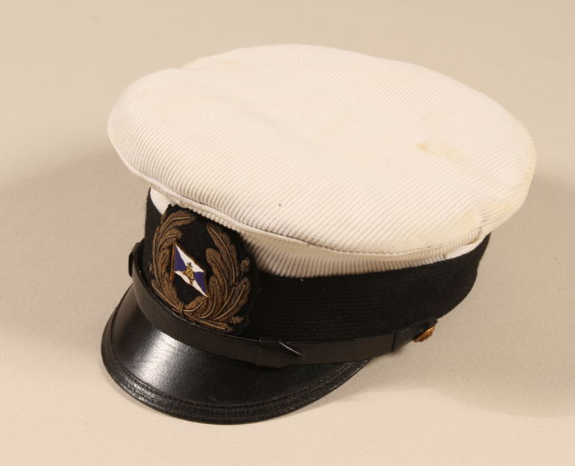
Talk 5
Bringing Together the Digital with Holocaust Research, Teaching, and Conservation
Opted for scan-once approach
Reduces stress on and risk of damage to objects
Optimizes staff time
Shares financial resources

Slide 40
Talk 5
Bringing Together the Digital with Holocaust Research, Teaching, and Conservation
Difficult finding something that fits everyone’s need
Learning curve and ease of use
Ability to scan complex object shapes and surface characteristics with reasonable throughput
Ability to use and disseminate information, internally and externally
Baseline equipment cost: $500 - $250,000
Training, maintenance, and upgrade costs: Unknown
Most important: Learning each others’ and technologies’ terminology

Slide 41
Talk 6
No room for hate: What research about hate speech taught us about collaboration?
Ajda Šulc, Faculty of Social Sciences, University of Ljubljana
ajda.sulc@gmail.com
Kristina Pahor de Maiti, Faculty of Arts, University of Ljubljana
kristina.pahordemaiti@ff.uni-lj.si

Slide 42
The research problem
Main goal:
improved understanding of hateful discourse on social media
Collaboration opportunities:
creating a dataset with rich metadata
sharing methodological approaches and background knowledge
Social Science > Sociology
-S-
What is the share of HS on social media?
How radical is HS?
Who are the main targets?
How the context influences HS production?
Humanities > Linguistics
-L-
What are the typical linguistic features of HD wtr to non-HD?
How is discourse used to support power relations and ideologies?
Computer Science > Comp Linguistics
-CL-
How to build a robust annotation schema applicable across languages and cultures?
Which features are the most useful for HD detection?

Slide 43
Solutions and collaboration experience
Defining and balancing goals
Solutions
Authentic communication
data type: FB comments on news posts
automated extraction of FB news media posts between 2010 and 2017 and associated comments
Adequate dataset size for quantitative analyses and machine learning tasks
top media outlets by their popularity in country
official FB profile is used for news sharing
significant amount of comments is being written as a response to the news posts
but still doable for manual annotation
Relevant sample with metadata
relevant news posts about previously selected controversial topics on minorities (migrants and LGBT)
expected high density of hateful comments → time and cost-efficient annotation process
Data extraction:
top 3 news media outlets
30 posts & 6.545 comments on migrants
93 posts & 4.571 comments on LGBT

Slide 44
Solutions and collaboration experience
Annotation schema: dilemmas
Annotation schema: solution
combining the needs: a complex 2-level schema
Annotation process
training annotators (32)
complex schema & subjectivity
modal annotations used for analysis
What are we researching?
→ HS definition
S: sociological definition & legal aspects
L & CL: broad definition – any speech that causes offense
→ coining a new term: SUD
Who is the target?
S: the analysed minorities (LGBT, migrants), other targets based on their background
L & CL: any target group
Should we consider the context?
S & L: socio-cultural, historical, text (other comments, article)
CL: text (threads)
Do we include borderline cases?
S: include also indirect hateful messages
L & CL: not desirable
TYPE
acceptable speech
inappropriate speech
background - offensive
background - violence
other - offensive
other - violence
TARGET
migrants/LGBT
related to migrants/LGBT
journalist or media
commenter
other

Slide 45
Conclusions and recommendations
TAKE THE TIME
For regular discussions
e.g., (mis)understanding the scope of the HS term
For brainstorming sessions and work on real data from the beginning
e.g., instead of improving the schema on the go, it would be better to use real-data from the beginning
For noting down and communicating any decisions regarding the dataset
e.g., what to do with comments without a prevalent tag, how to mark them for later use
LISTEN to and LEARN from each other
To better understand the needs and analytical approaches from other disciplines
e.g., strictness in methodology (S), focus on qualitative interpretation (L), goal-oriented approach (CL)
To learn and incorporate research techniques from other disciplines
e.g., using corpus linguistic techniques in S, inferential statistics and sociological survey methods in L
To better understand the complexity of the research process and the studied phenomenon
e.g., S-experts raising awareness regarding legal and ethical considerations when working with data (the need for data anonymization, psychological support for annotators, etc.)

Slide 46
Conclusions and recommendations
BE SURE YOU’RE ON THE SAME PAGE
Regarding the key terms used
e.g., redefining existing terms or introducing new ones?
Regarding the definitions and the scope of research
e.g., especially important when annotating not clear-cut phenomena, such as SUD
SIMPLIFY
Compromises are inevitable, but don’t settle for simplistic solutions
e.g., a simple schema is usually a preferred option, but the final outcome might not be informative enough for research purposes in various disciplines
Manage your expectations
e.g., constant negotiation of needs and requirements takes time

Slide 47
General discussion
What we want to see at the end is
Take home messages for educators
Take home messages for the infrastructures (CLARIN, DARIAH and SSHOC)
Take home messages for the community at large

Slide 48
Closing
Submit your paper to appear in joint proceedings of TT2&TT3 in October2020
Attend TT2 at DHN2020

