Slide 1

Computational Analysis of Scribal Hands in Huntington 200
Berat Kurar-Barakat Daria Vasyutinsky-Shapira Nachum Dershowitz
Tel Aviv University
Notes:
Hi everyone. I am Berat from Tel Aviv University. I am going to present a computational study of scribal hands in the medieval Hebrew manuscript Huntington 200.
We worked on it together with Dr. Daria Vasyutinsky-Shapira and Prof. Nachum Dershowitz. We explore whether unsupervised computational methods can find meaningful scribal groupings in huntington 200 and compare these groupings with the divisions suggested by the scholars.

Slide 2
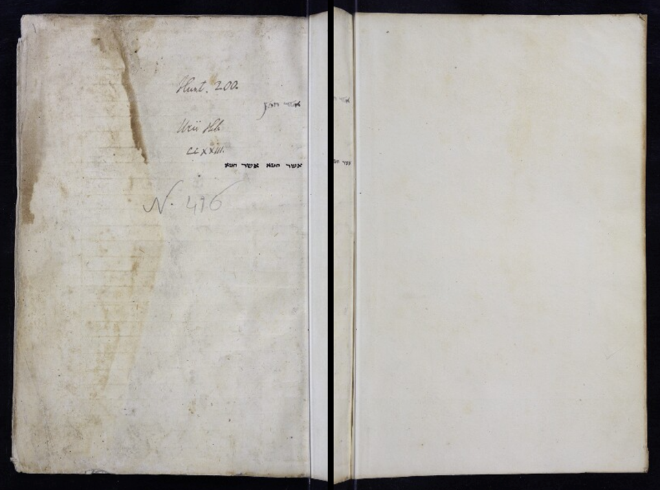
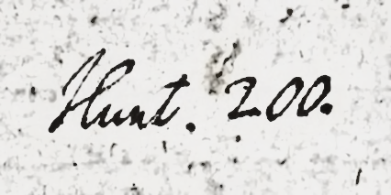
Hunt. 200
Hebrew manuscript from the Bodleian Library in Oxford
Bought in the 1670s in Aleppo by Robert Huntington
Scholars argue about the number of its scribes
Copied in 1279, in Egypt
Olszowy-Schlanger, User-Production of Hebrew Manuscripts Revisited:
The Case of Manuscript Oxford, Bodleian Library, Huntington 200, 2023.
Notes:
Huntington 200 is a Hebrew manuscript from the Bodleian Library in Oxford. It was bought in the 1670s in Aleppo by Robert Huntington. Although the colophon names Ezra ben Nathanael as the scribe, this information appears to be misleading and he was only one of several scribes who copied it. Therefore the scholars argue about the number of its scribes. The manuscript was copied in 1279, most likely in Egypt, based on paleographic evidence that there exist some Genizah fragments written by one of the Huntington 200 scribes.

Slide 3
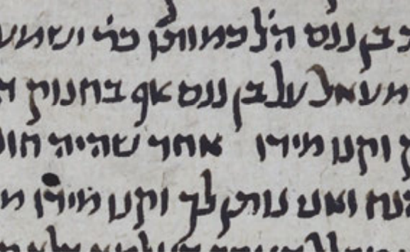
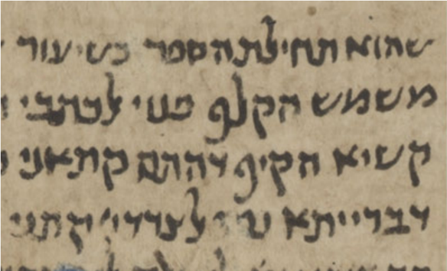
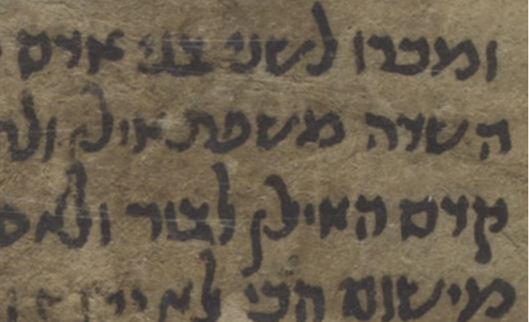
Hunt. 200
Hunt 200 sample
Scribe 4
Ezra ben Nathanael
Genizah sample
T-S AS 95.33r (4a)
Genizah sample
T-S AS 85.49v (4b)
Olszowy-Schlanger, User-Production of Hebrew Manuscripts Revisited:
The Case of Manuscript Oxford, Bodleian Library, Huntington 200, 2023.
Notes:
This one scribe was Ezra ben Nathanael. At the far left we see a huntington 200 sample written by him and at its right side we see two Geniza samples written by him too.
Ezra ben Nathanael copied a large part of the manuscript. He collated and corrected the whole huntington 200 manuscript. His script is also more decorative than others. He seems to be a private patron reader who asked family members and friends to help him copy a book for him.

Slide 4
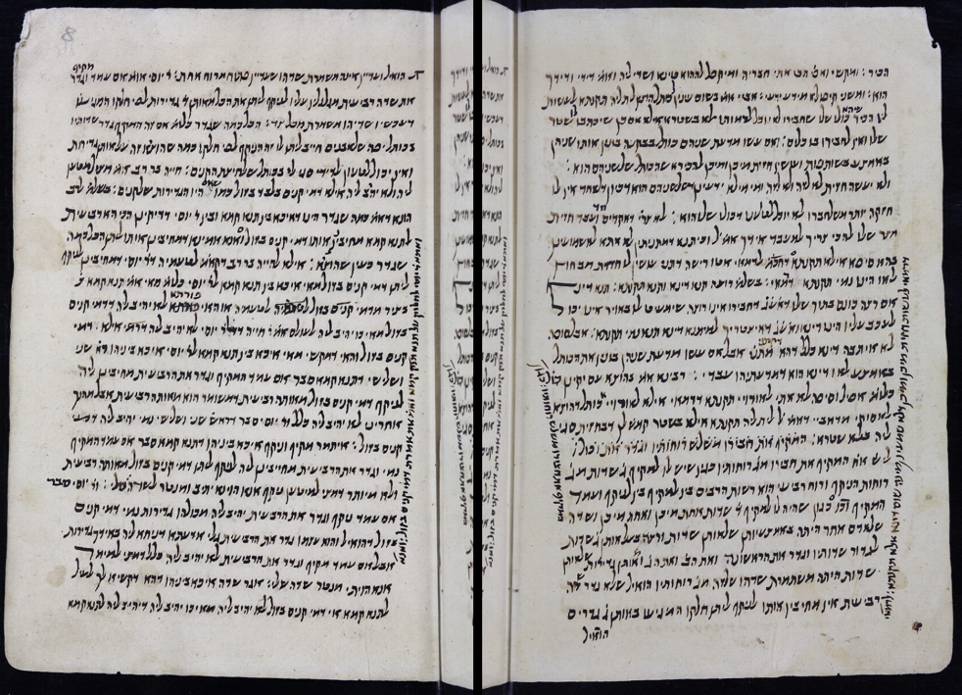
Hunt. 200: codicology
A medium sized manuscript of around 24 by 16 cm
Written on Oriental paper
Lines count varies between scribes
Written using iron-gall ink
477 handwritten pages
Olszowy-Schlanger, User-Production of Hebrew Manuscripts Revisited:
The Case of Manuscript Oxford, Bodleian Library, Huntington 200, 2023.
Notes:
Huntington 200 is not a luxury manuscript. It is a medium-sized manuscript of the size around 24 cm by 16 cm. It is written on Oriental paper. It was ruled with a misṭara, but the number of lines is not consistent and varies between scribes and sometimes even between the recto and verso of the same leaf. It is written using iron-gall ink and it contains 477 handwritten pages.

Slide 5
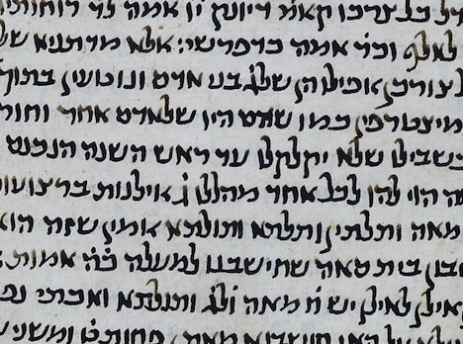
Hunt. 200: paleography
A medium sized manuscript of around 24 by 16 cm
Written on Oriental paper
Lines count varies between scribes
Written using iron-gall ink
477 handwritten pages
Olszowy-Schlanger, User-Production of Hebrew Manuscripts Revisited:
The Case of Manuscript Oxford, Bodleian Library, Huntington 200, 2023.
Notes:
Huntington 200 is written using non-square Oriental script type. It was copied by different scribes. They worked separately but towards the common goal of producing a single codex and the scribes shared unequal number of pages.

Slide 6
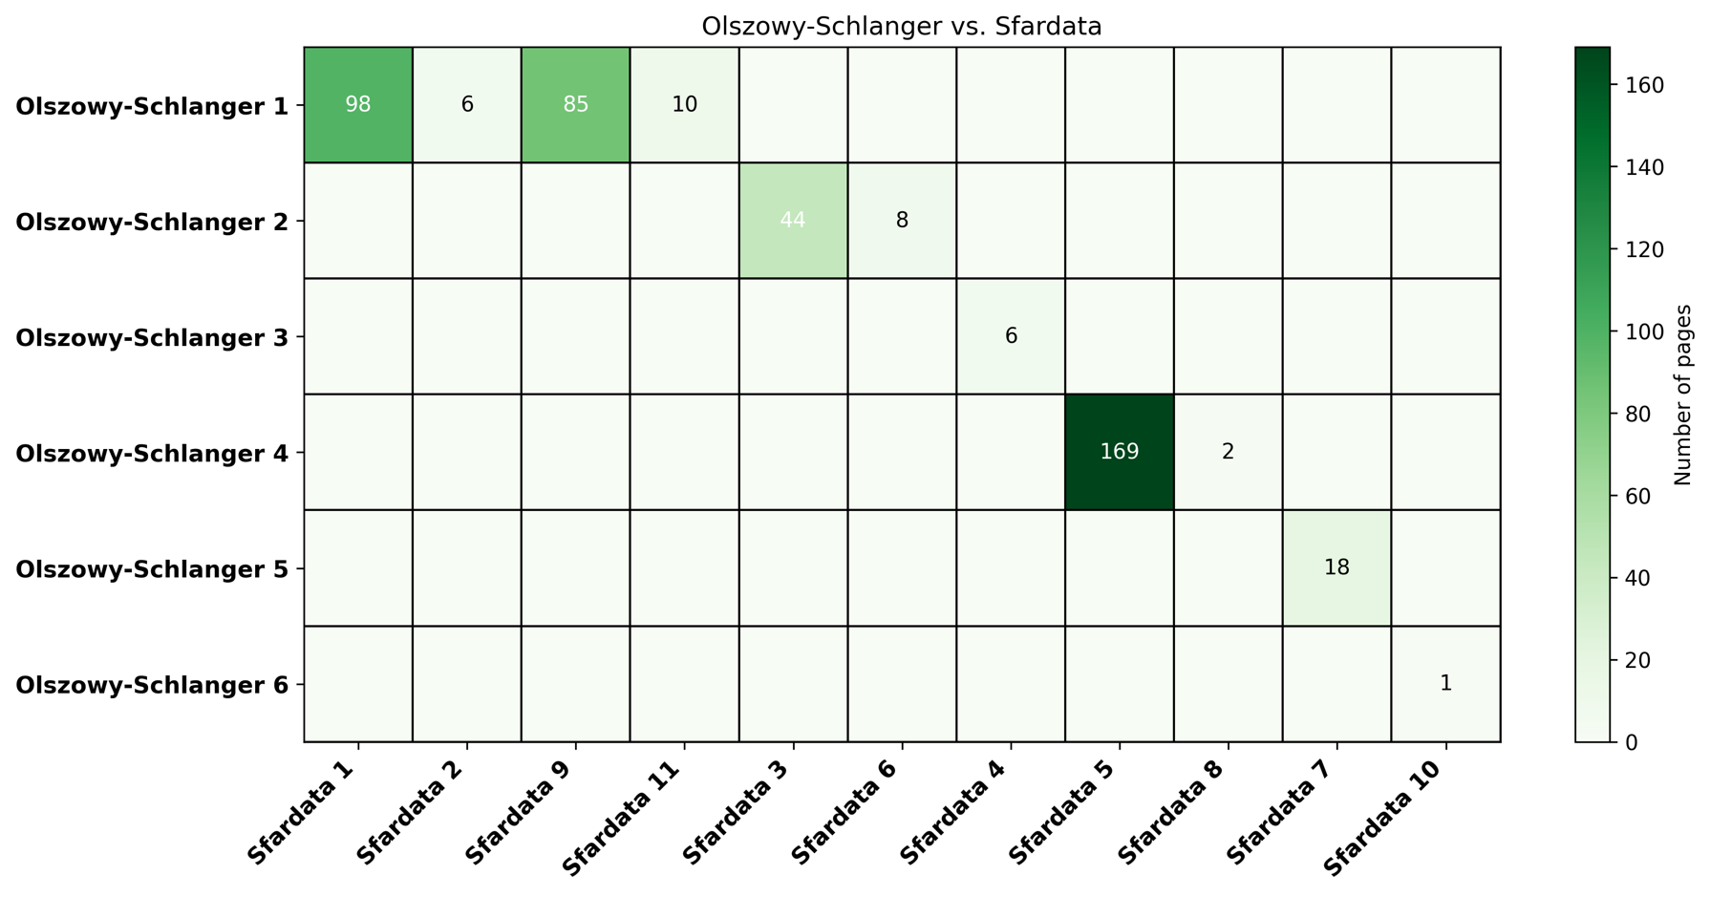
Hunt. 200: number of scribes
Notes:
Here we see the correspondence between the Olszowy-Schlanger scribes and the sfardata scribes. Olszowy-Schlanger states that Huntington 200 was copied by six scribes, and Sfardata states that it was copied by eleven scribes. This figure shows how these two systems overlap. Each square gives the number of pages that both systems assign to the same scribe. For example, Olszowy-Schlanger Scribe 1 overlaps with several Sfardata scribes that are number 1, 2 , 9 and 11. Olszowy-Schlanger Scribe 3 matches with Sfardata Scribe 4. Olszowy-Schlanger Scribe 4 matches with Sfardata Scribe 5. Olszowy-Schlanger Scribe 5 matches with Sfardata Scribe 7. And Olszowy-Schlanger Scribe 6 matches with Sfardata Scribe 10.

Slide 7
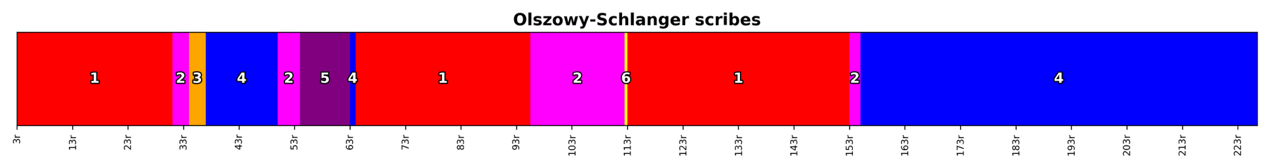
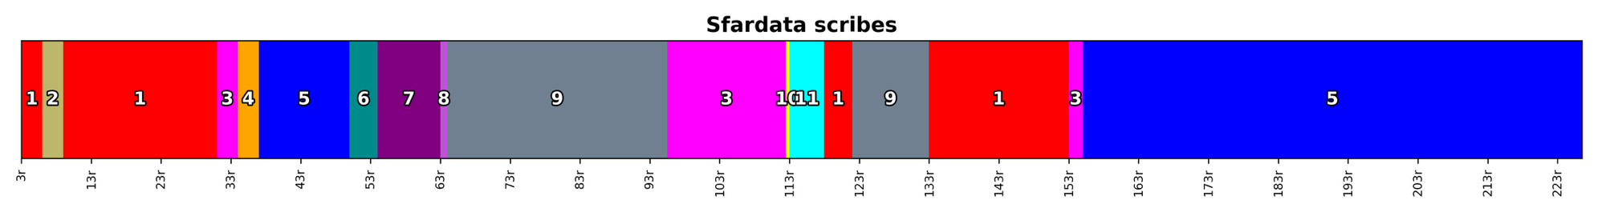
Hunt. 200: number of scribes
Notes:
And here we see color barcodes for Huntington 200. At the horizontal axis each thin bar is a page, and the color encodes the scribe label. The top strip follows Olszowy-Schlanger’s divisions, and the bottom follows SfarData's divisions. So we can see where the two scribal divisions agree and where they differ. For example a major difference is observed when the sfardata divison splits the olszowy-schlanger scribe 1 into 4 scribes that are the sfardata scribes number 1,2,9 and 11. But at the other divisions there is a major agreement.

Slide 8
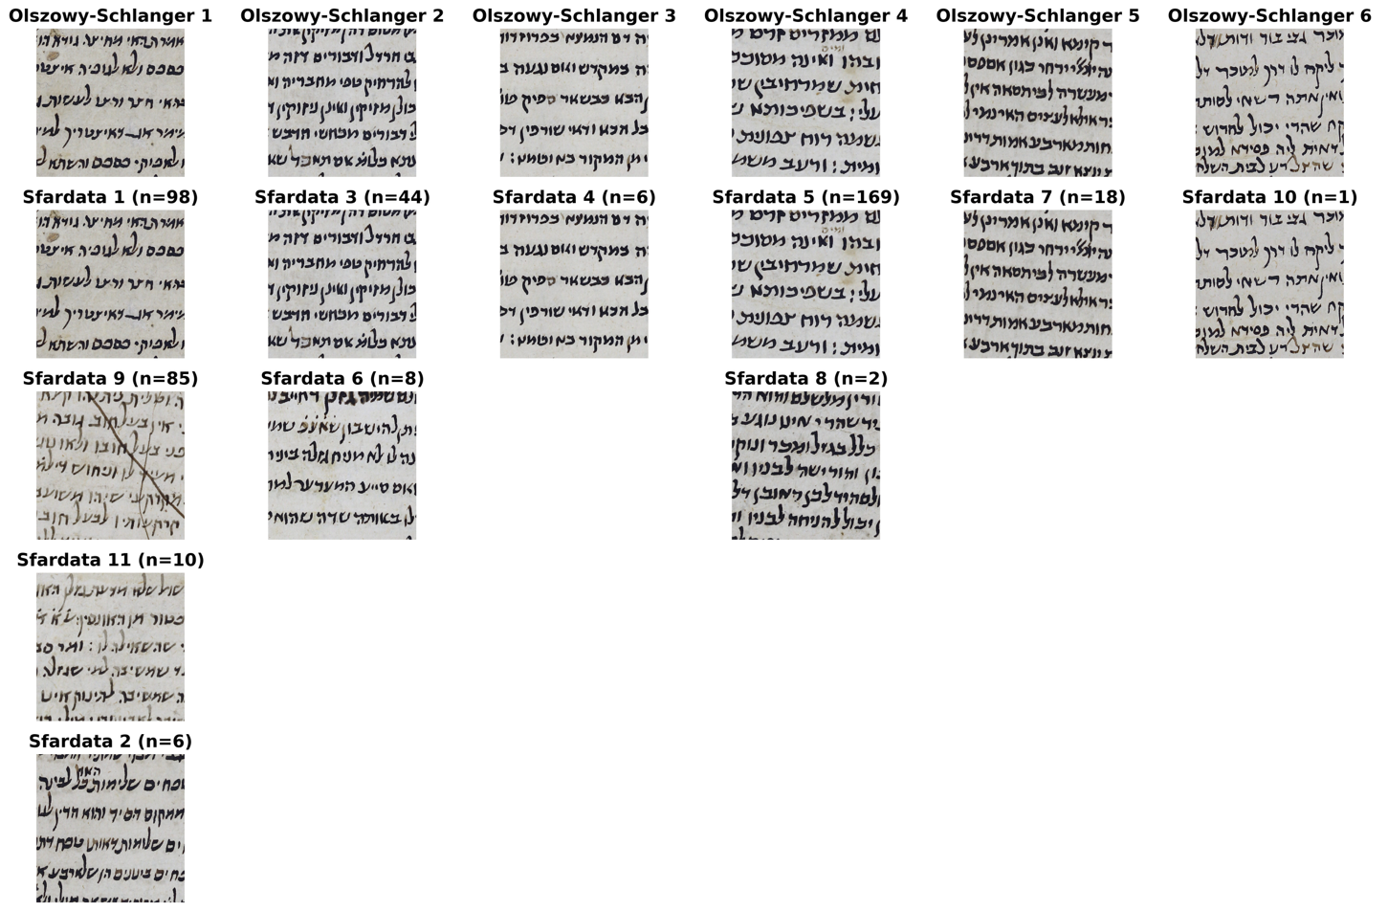
Hunt. 200: number of scribes
Olszowy-
Schlanger
Sfardata
Notes:
And here we see sample patches showing the similarity between the corresponding scribes in the Olszowy-Schlanger divisions and the Sfardata divisions. The top row shows one sample for each Olszowy-Schlanger scribe, and under each one we show the Sfardata scribes that correspond to it. For example, Olszowy-Schlanger scribe 1 is divided into four different scribes in Sfardata. and Olszowy-Schlanger scribe 2 is divided into two scribes in Sfardata, and so on. So here we have the chance to observe how diverse are the over splited divisions.

Slide 9
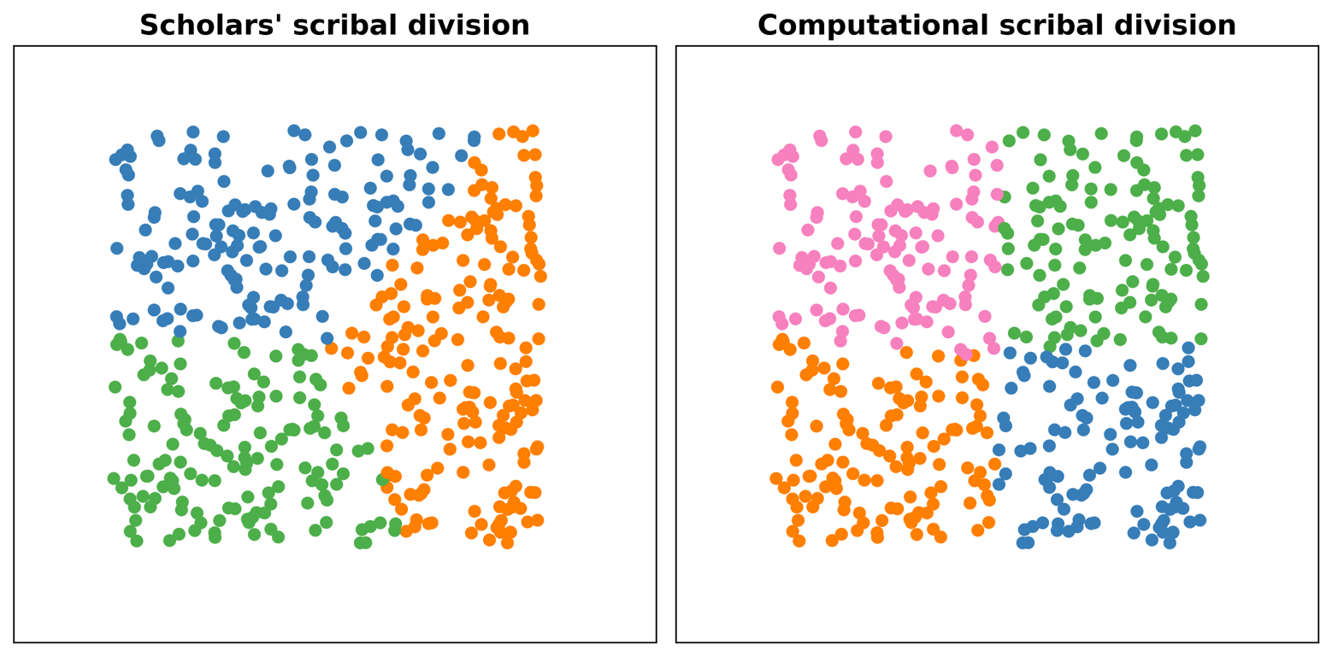
Scholarly vs. computational scribal division
Notes:
So, we wanted to add a new argument to the scholars’ discussion about the number of scribes in huntington 200 and in this work we studied whether unsupervised computational methods can find meaningful scribal groups in huntington 200. We also compare these computational scribal groups with the scribal divisions suggested by the scholars. For example, a scholar’s scribal division might look like the plot on the left, while a computational scribal division might look like the plot on the right. Right here the challenge exist: different systems look at the same data but decide on different boundaries. And the real ground truth of who wrote what is hidden in the past time.

Slide 10
Computational scribal division of Hunt. 200
Extract connected component (CC) features
Aggregate features of all connected components of a page
Cluster pages without knowing the number of scribes
1
2
3
Notes:
Since we don’t have ground truth labels we use unsupervised computational methods. Mainly there are three stages. At the first stage, we extract features of connected components. At the second stage we combine the features of all the connected components from a page into a single feature vector. At the last stage we cluster the pages without knowing the number of the scribes.

Slide 11
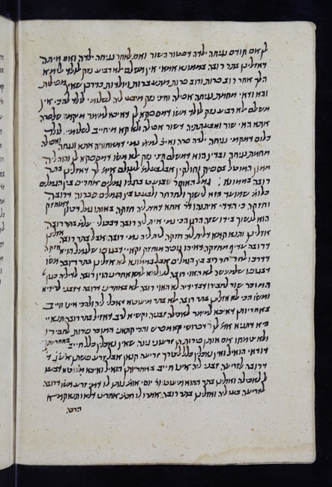


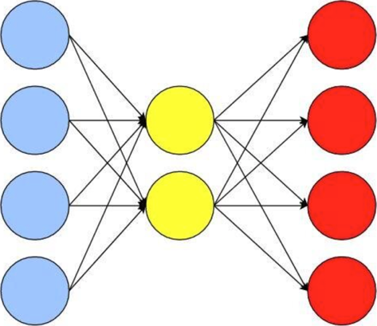


Extracting CC features using Sparse Auto Encoder (SAE)
Page
CCs
SAE
Input CC
Output CC
CC feature vector
Notes:
For extracting features of a connected component, we train a SAE. A SAE is an unsupervised neural network that takes in a connected component image and is trained to learn to compress this input connected component image into a one dimensional feature vector such that it can reconstruct the input connected component image using this one dimensional feature vector. Then we used the trained SAE to extract the features of connected components. So here it is useful to mention that usually connected components correspond to the letters in the Hebrew manuscripts.

Slide 12
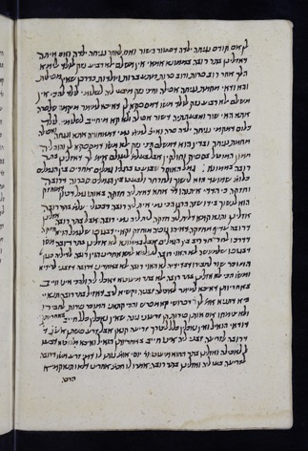
Extracting CC features using SAE
400 CC/pages
447 pages
~180.000 CCs
Notes:
For training the sparse auto encoder model, we used around 400 connected components per page, since we have 447 page images we got in total around 180.000 CCs.

Slide 13
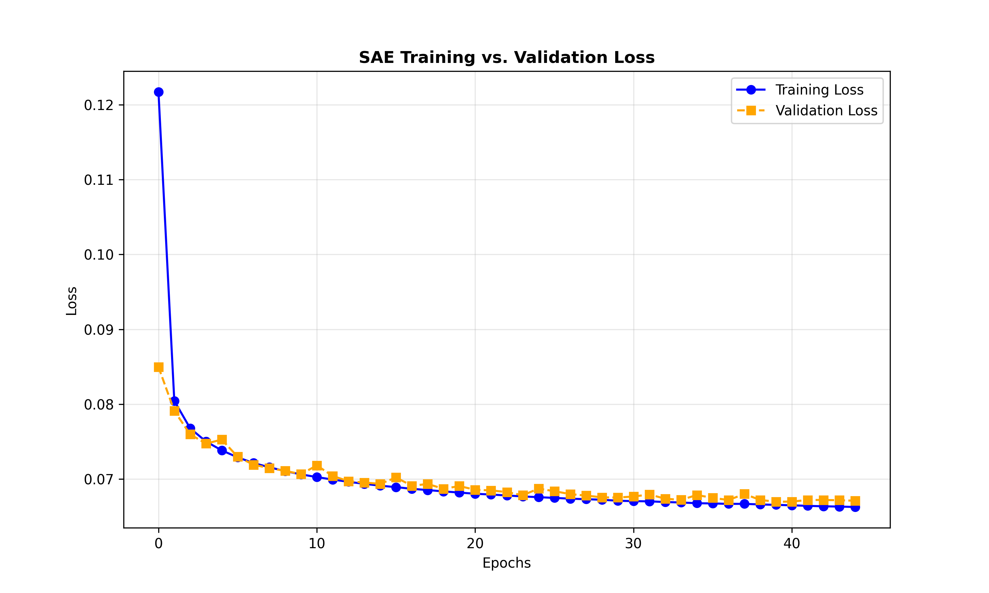
Extracting CC features using SAE
Notes:
Then we train the sae on 160.000 CCs while validating its reconstruction performance on 20.000 CCs and we stop training when we reach a validation loss value of 0.0666.

Slide 14


Extracting CC features using SAE
Original CCs
SAE
SAE
SAE
SAE
SAE
SAE
Reconstructed
CCs
Notes:
Here at the top row we see example input connected component images and at the bottom row we see their reconstructed verions by the trained sparse auto encoder model. So, now we have a sae model that can give us a one dimensional feature vector for each connected component image. But in a page image we have many numbers of connected components. Therefore we need a way to combine the features of all the connected components in a page image, which is the second stage.

Slide 15
Combining CC features into a page feature
CC feature vector
CC feature vector
BoW
CC feature vector
Page feature vector
CC feature vector
CC feature vector
Page image
CCs
CC feature vectors
Notes:
At the second stage, for combining the features of all the connected components in a page image we used a bow model with 1000 words and we got a one dimensional feature vector for each page image.

Slide 16
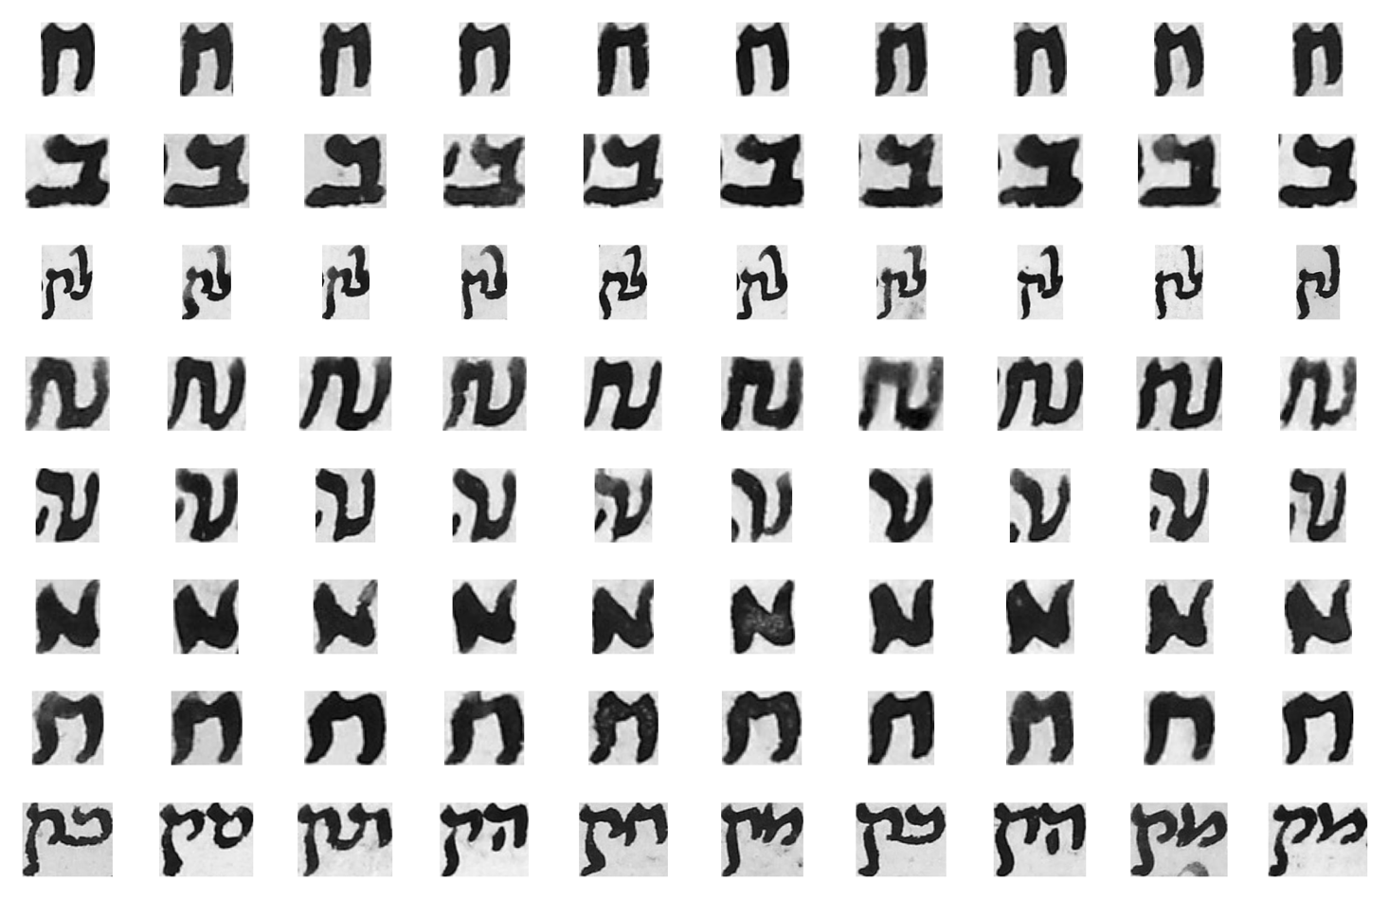
Example words in Bag of Words (BoW) model
Word 1
Word 2
Word 3
Word 4
Word 5
Word 6
Word 7
...
Notes:
Here we see example instances of some words from the BoW model. Each row shows the instances of a visual word. literally each word contains instances of a letter written with the same style. For example the first word and the seventh word are both for the letter he, but each word contain a he letter with a different handwriting style. This means that sae can successfully encode a letter image into a one dimensional vector. At this point we still have the question to be answered that what is the definition of the morphological similarity and what is the definition of style similarity? I mean these two words contain letters morphologically similar but they were grouped in different words due to their style difference but why it is so, we still don’t have its computational definition.

Slide 17
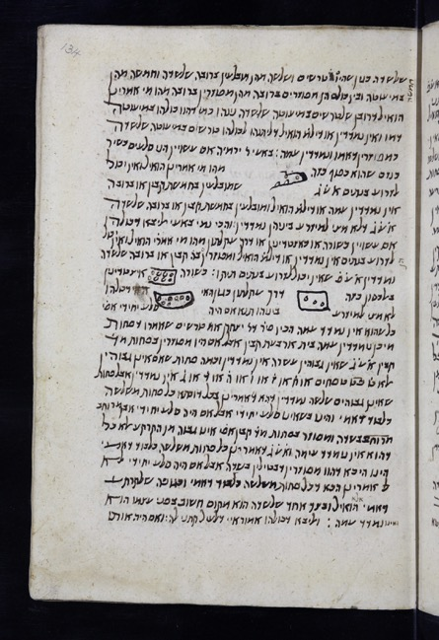
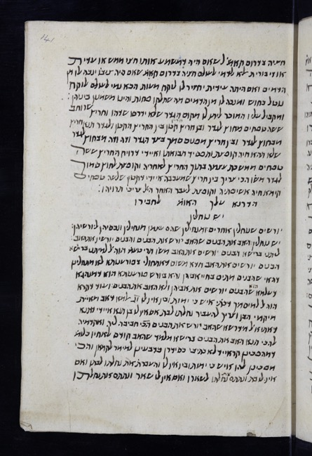
Represent handwriting in a page as a feature vector
...
Page feature vector
Page feature vector
Page feature vector
Notes:
Resultantly, we represent the handwriting in a page image by a one dimensional feature vector. Since we have a numerical feature vector for each page we can start making the computational analysis for Huntington 200.

Slide 18
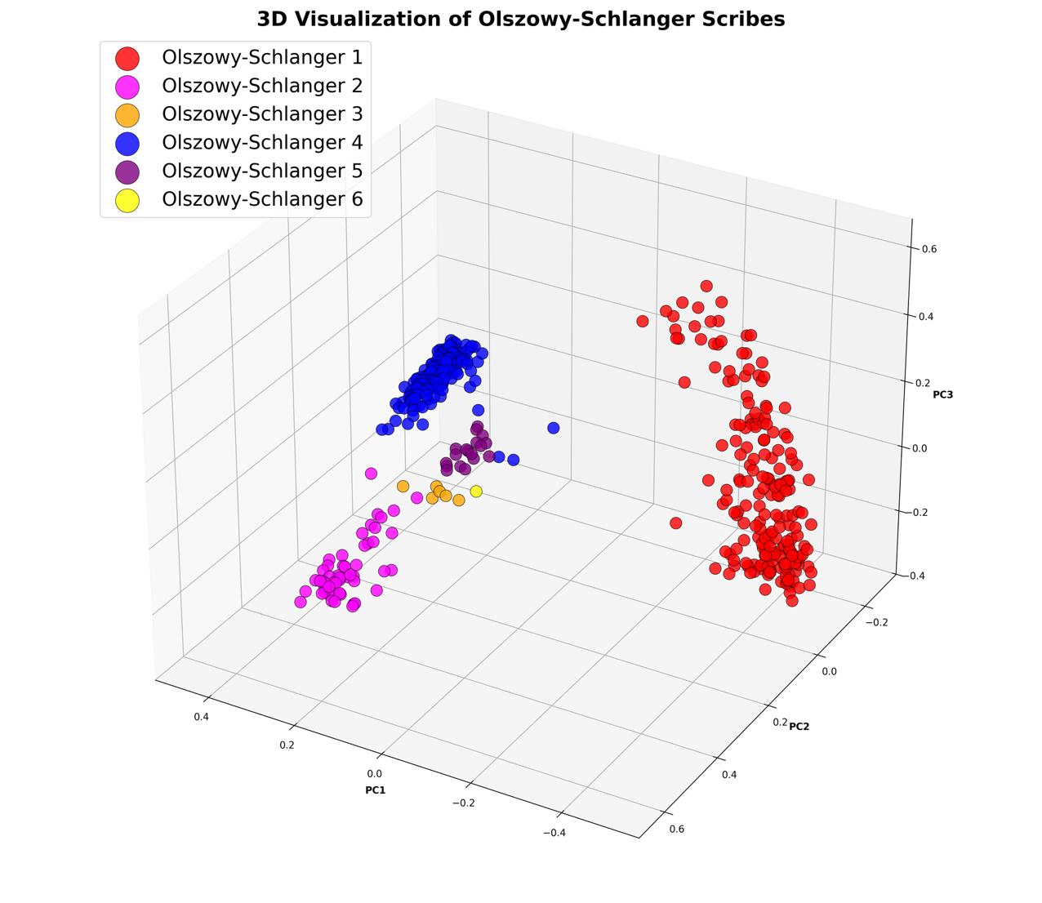
63r Olszowy 4
55r Olszowy 5
Notes:
This figure shows the distribution of huntington 200 pages in a 3 dimensional plot. Each dot represents a single page. The color of the dot represents the scribe identity assigned by olszowy-schlanger. So we can see how olszowy-schlanger labels are aligned with the visual clusters. For example scribe 1 in red color and scribe 4 in blue color form a very dense and compact groups. An interesting case is that page 63r is assigned to the scribe 4 but it exist close to the cluster of scribe 5, especially to the page 55r in the cluster of scribe 5.

Slide 19
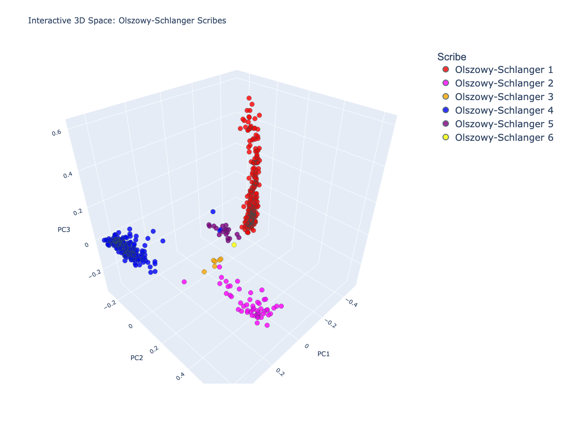
Notes:
Lets have a look at the distribution in an interactive 3 dimensional space plot.

Slide 20
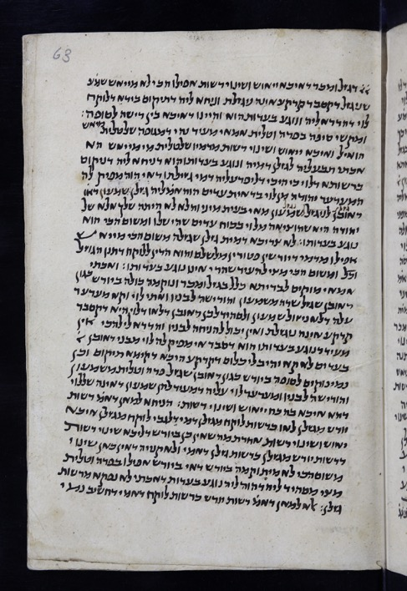
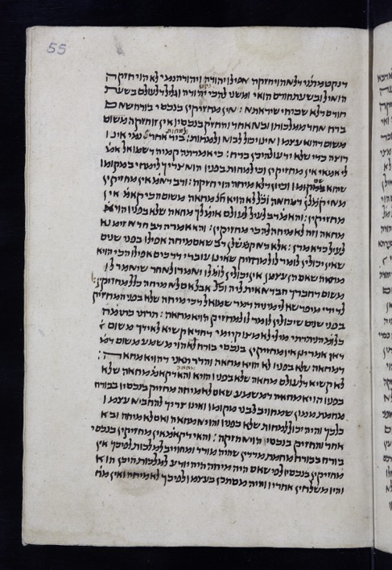
Olszowy scribe labels: an interesting case
Olszowy 4
63r
Olszowy 5
55r
Notes:
Here is the visual similarity of these two pages that are shown closely in the computational visualization although they are assigned to two different scribes by Olszowy-Schlanger.

Slide 21
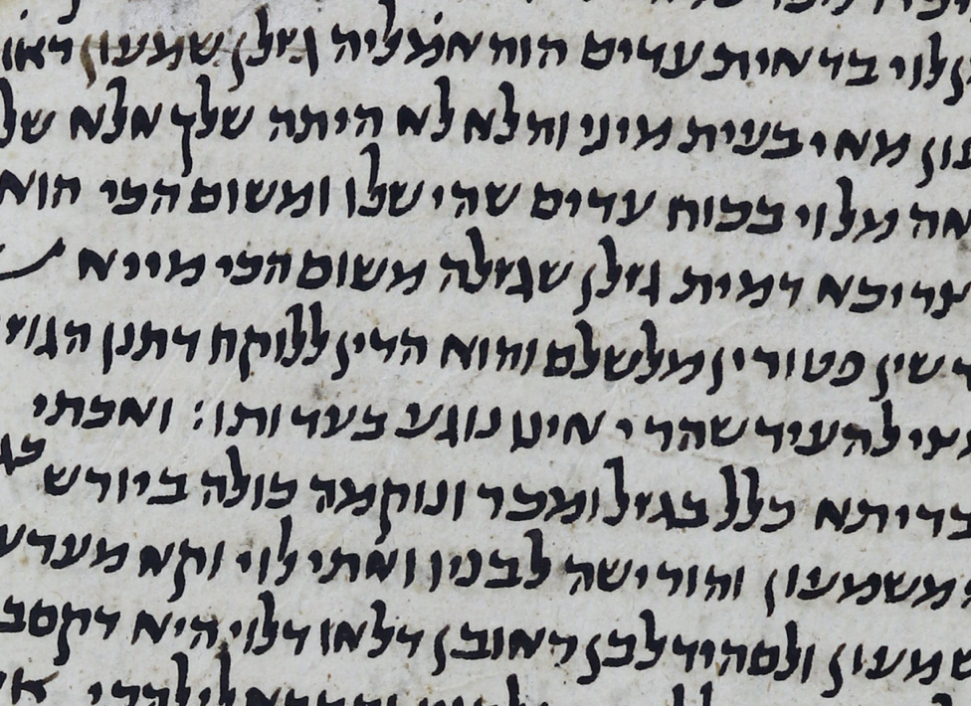
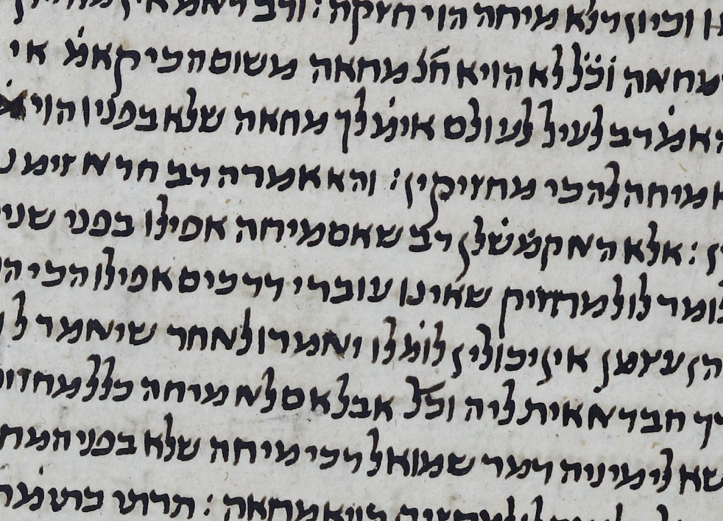
Olszowy scribe labels: an interesting case
Olszowy 4
63r
Olszowy 5
55r
Notes:
And this slide shows them in a zoomed way. Computationally we still don’t have the method that can answer for exactly which reason they were mapped in a close distance. For now we only know that they were mapped at a close distance due to the similariy of some letter instances in them.

Slide 22
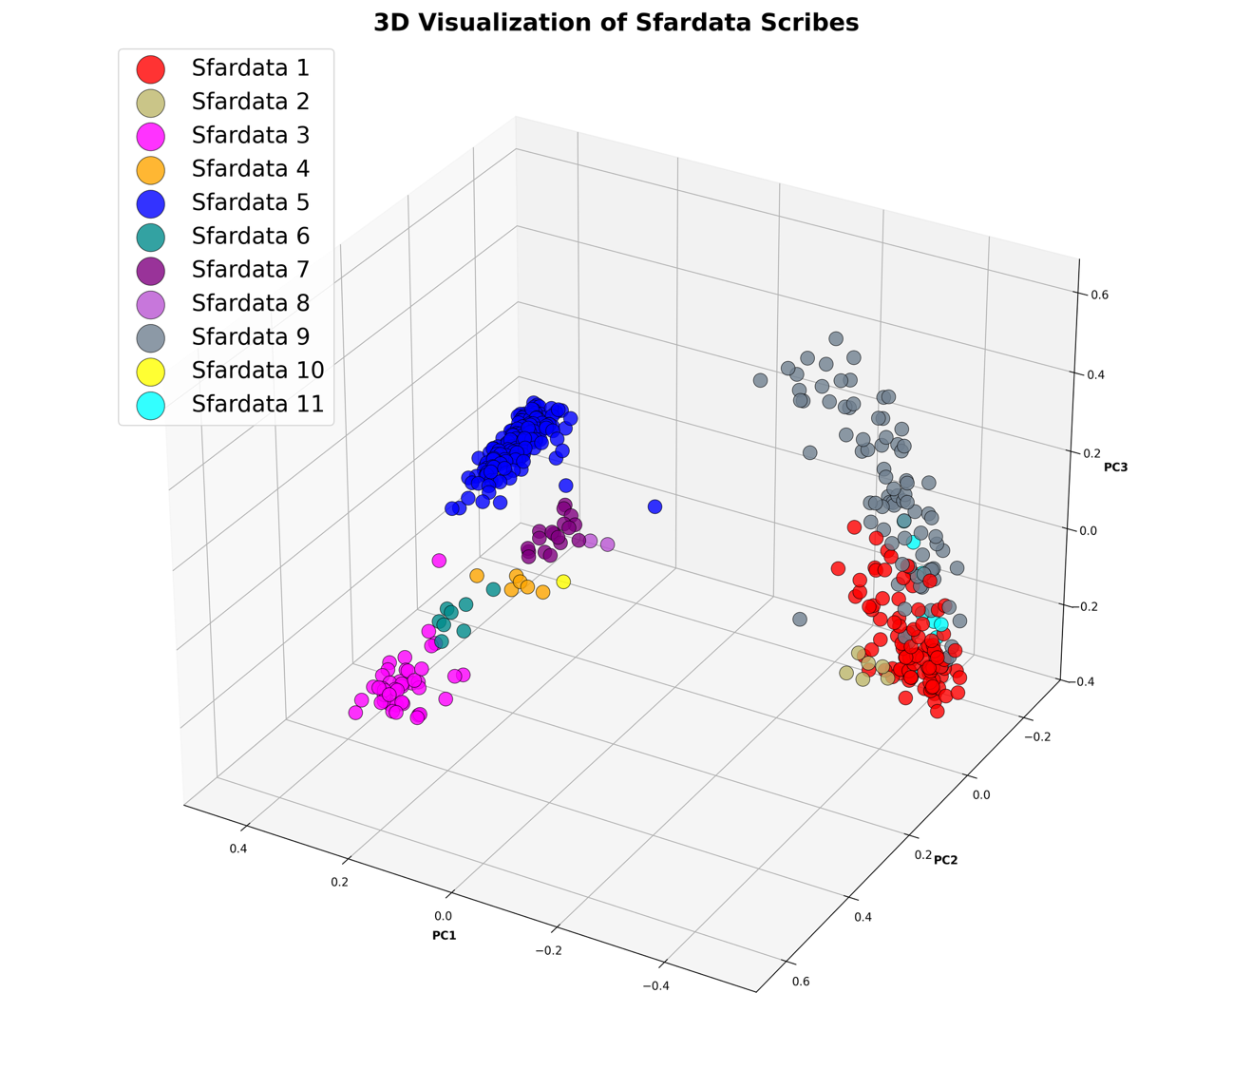
“these folios were copied by scribe 1 and the differences are limited to the color and quality of ink.”
Olszowy-Schlanger, User-Production of Hebrew Manuscripts Revisited:
The Case of Manuscript Oxford, Bodleian Library, Huntington 200, 2023.
66r
10r
Notes:
Now lets have a look at the sfardata scribe labels on the computational feature space. Again this figure shows the distribution of huntington 200 pages in a 3 dimensional plot. Each dot represents a single page. The color of the dot represents the scribe identity assigned by sfardata. So we can see how sfardata labels are aligned with the visual clusters. For example scribe 5 in blue color forms a very dense and compact group. Most interesting case is that the cluster that appears at the right side is splited into 4 different scribes. That is the olszowy-schlanger scribe 1 splited into sfardata scribe number 1,2, 9 and 11. Olszowy-schlanger already stated this in her paper that ‘these folios were copied by scribe 1 and the differences are limited to the color and quality of the ink.’ On the top part of this cluster exists the page 66r and at the bottom part of this cluster exists the page 10r. now we are going to look if really there is a difference between their handwriting style although they are mapped distant away from each other in the computational feature space.

Slide 23
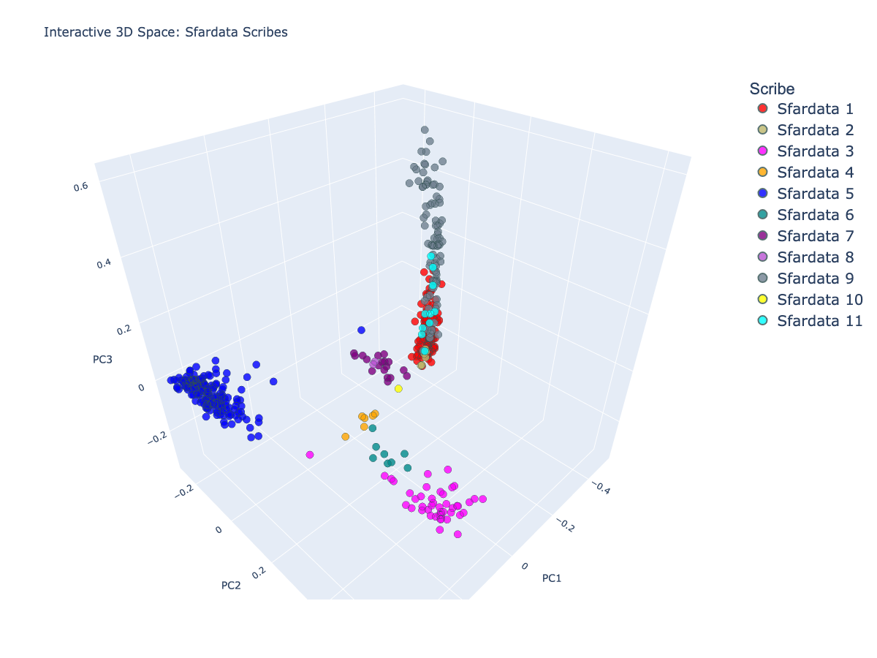
Notes:
But first lets have a look at the distribution in an interactive 3 dimensional space plot.

Slide 24
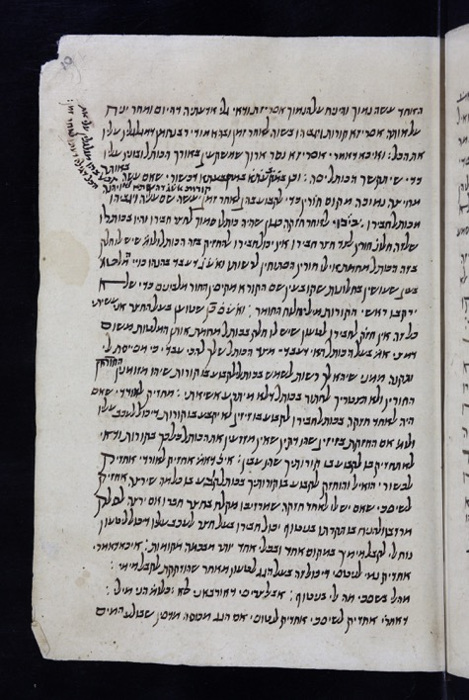
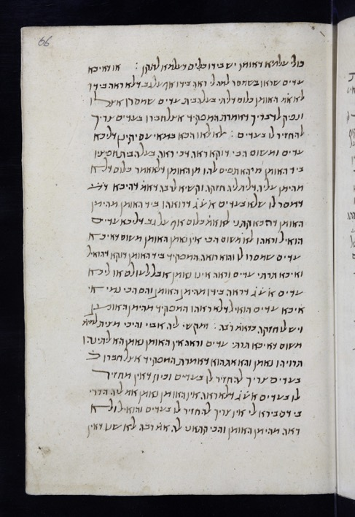
Sfardata scribe labels: an interesting case
Sfardata 1
10r
Sfardata 9
66r
Notes:
Here is the visual similarity of these two pages that are shown in the same cluster by the computational visualization although they are assigned to different scribes by Sfardata.

Slide 25
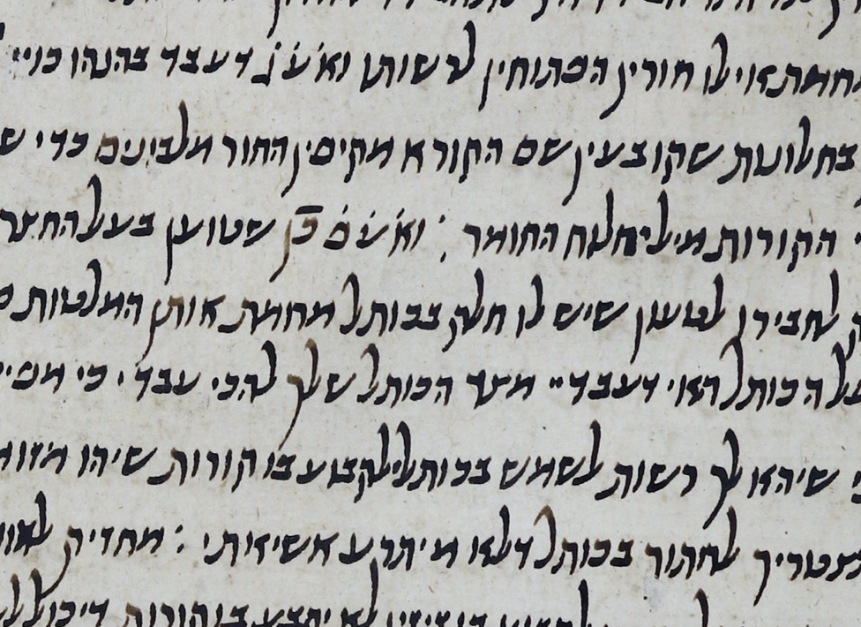
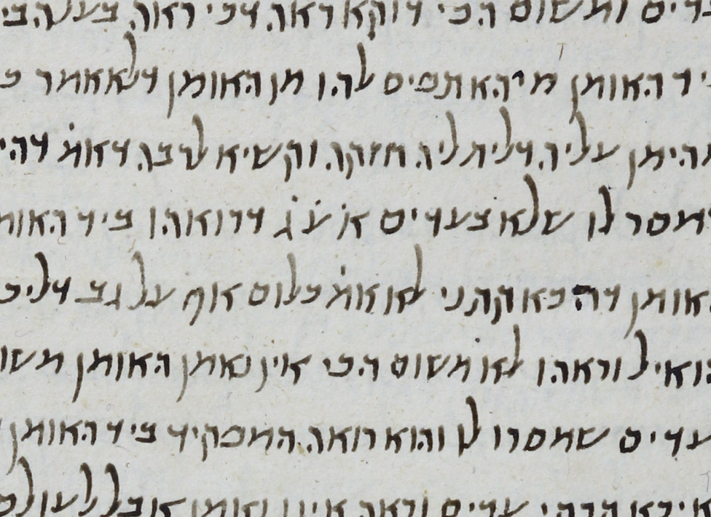
Sfardata scribe labels: an interesting case
Sfardata 1
10r
Sfardata 9
66r
Notes:
And this slide shows them in a zoomed way. Again as we said computationally we only know that they were mapped in the same cluster due to the similariy of some letter instances in them. But sfardata assigned them to different scribes.

Slide 26
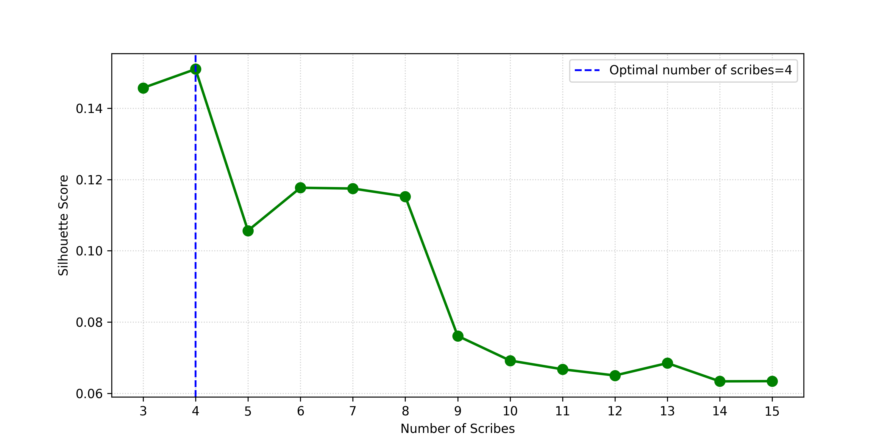
Computational number of scribes
Notes:
Now we are going to talk about the third stage that is finding the number of scribes and the pages written by each scribe. For this we use spectral clustering, which works on a similarity graph of the pages. It tries to minimize the graph cut: it avoids cutting edges between highly similar pages, and it prefers to cut edges between less similar pages. To choose the number of scribes, we use the silhouette test. We run spectral clustering with different number of clusters, from 3 to 15. For each number, we compute the silhouette score. The silhouette score measures how close pages are to their own cluster, and how far they are from the nearest other cluster. In other saying it measures how cohesive each cluster is. So in this plot we see that the best silhouette score is achieved when the number of clusters is 4. Therefore, the computational method suggests that the data naturally separates into four computational scribes.

Slide 27
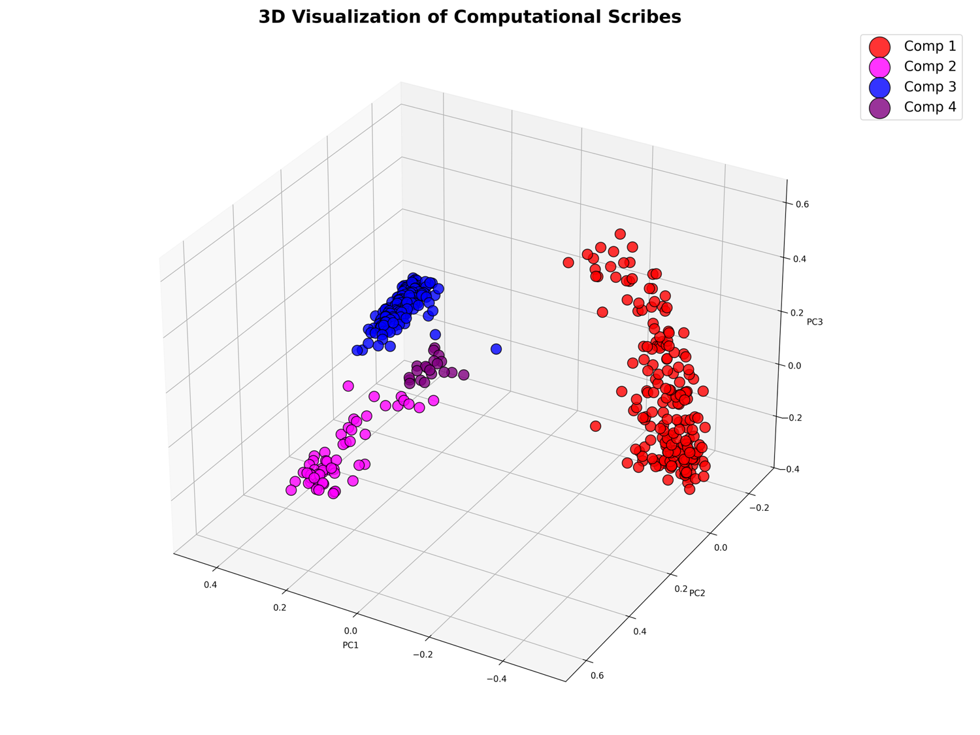
201r
189v
Notes:
This figure shows the 3d visualization of the computational scribes. The color of the dot represents the scribe identity assigned by the computational method. So we can see how computational labels are aligned with the visual clusters. For example scribe 1 in red color and scribe 3 in blue color form a very dense and compact groups. An interesting case is that page 189 verso is very distant from all the scribes but it was assigned to the computational scribe 3. And the most distant sample in computational scribe 3 cluster to this page is 201 recto. Now we are going have a look at them to understand how they were assigned to the same scribal group.

Slide 28
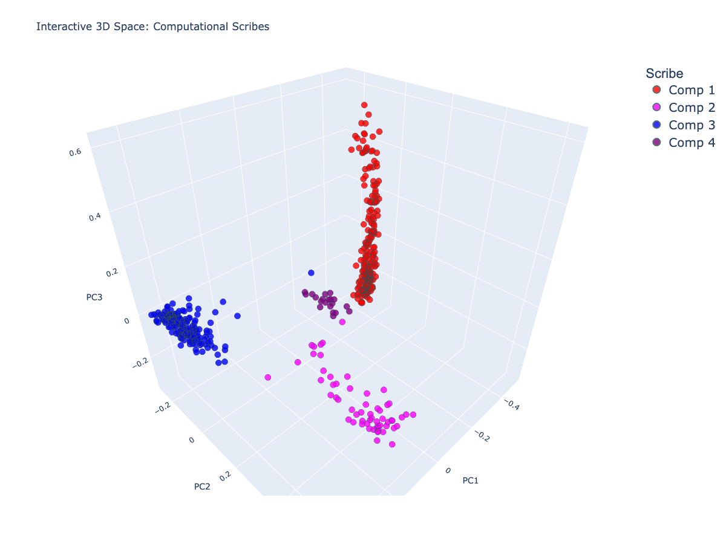
Notes:
But first lets have a look at the distribution in an interactive 3 dimensional space plot.

Slide 29
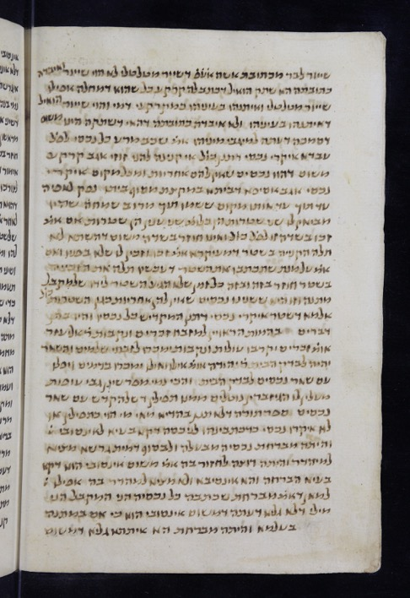
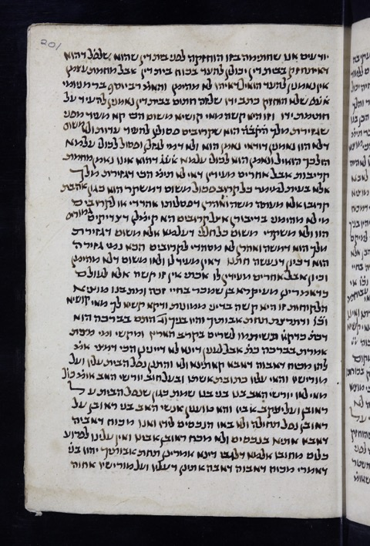
Computational scribe labels: an interesting case
Comp 1
189v
Comp 1
201r
Notes:
Here is the visual similarity of these two pages that are shown distant in the computational visualization although they are assigned to same computational scribe 1.

Slide 30
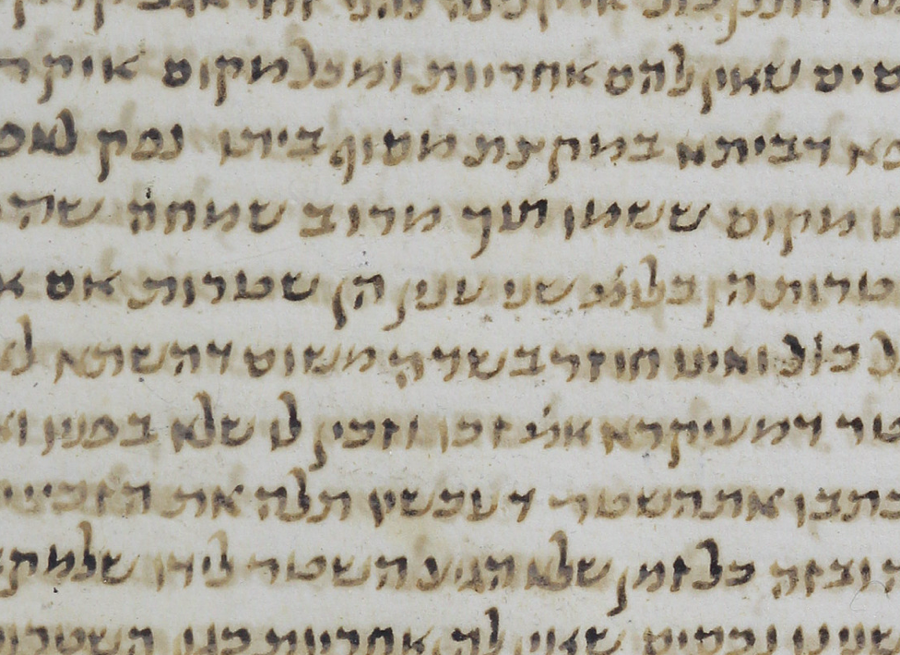
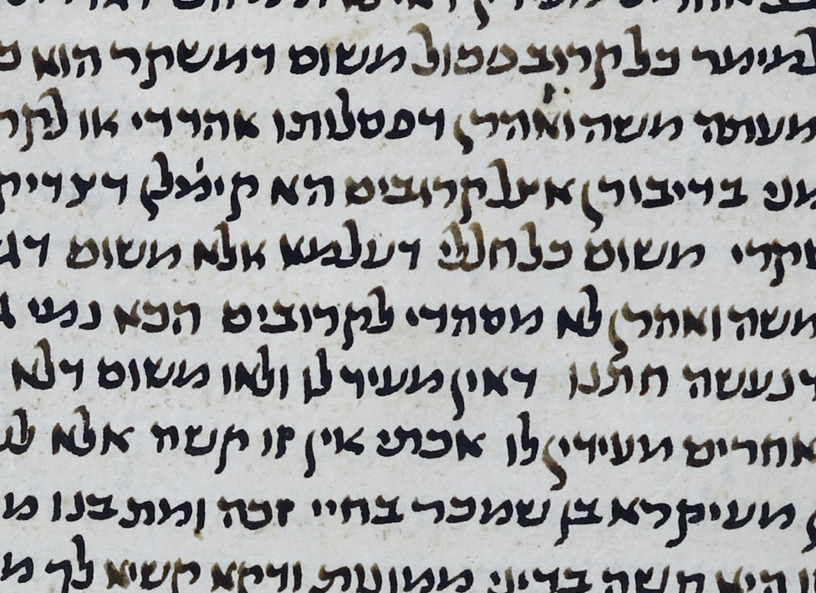
Computational scribe labels: an interesting case
Comp 1
189v
Comp 1
201r
Notes:
And this slide shows them in a zoomed way. Page 189 verso is the sample that is mapped to an odd place in the computational feature space but it is in the same computational scribe group with the page 201r.

Slide 31
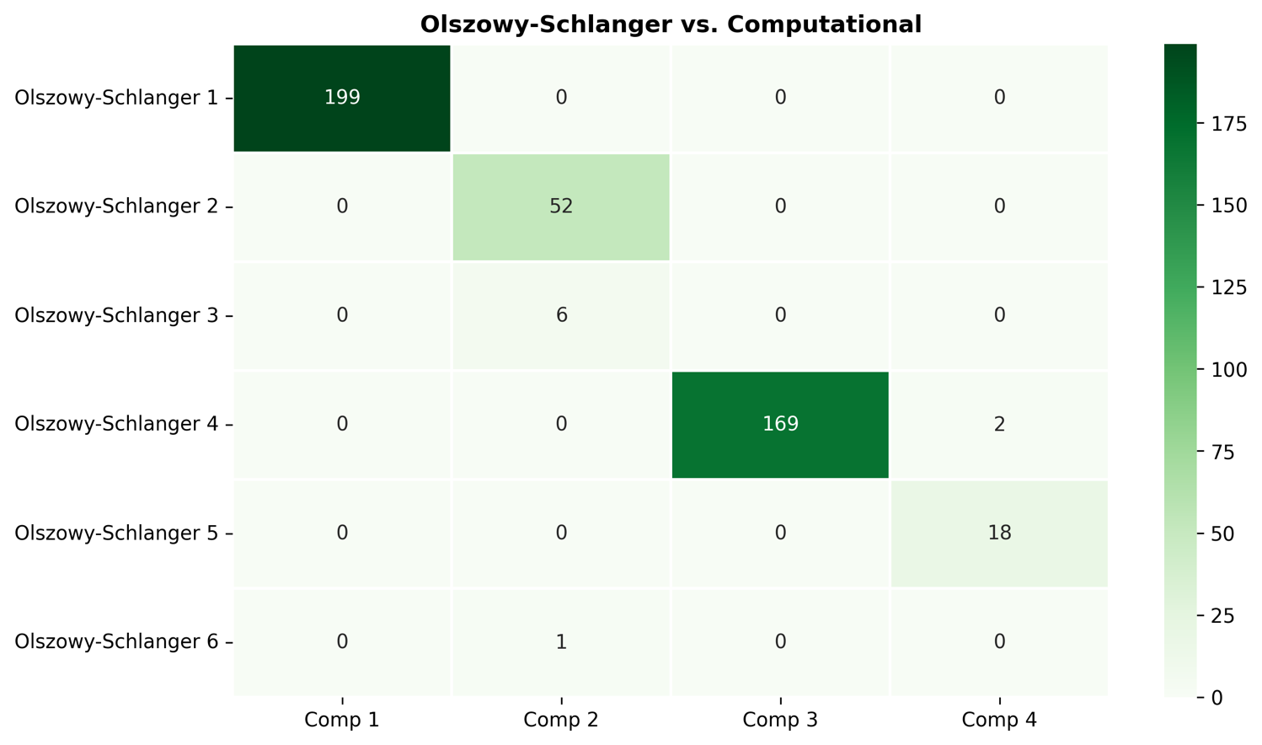
Olszowy vs. computational scribes
Adjusted Rand Index
(ARI) = 0.984
Notes:
Now we are going to compare the computational scribal divison with the scholars' scribal divisions. This heatmap compares Olszowy-schalnger’s scribal division with the computational scribal division. Each row is an Olszowy-schalnger scribe, and each column is a computational scribe. The number in each cell shows how many pages fall into that overlap. So we see that computational scribe 1 fully matches with Olszowy-schlanger scribe 1. And computational scribe 2 merges olszowy-schlanger scribes number 2, 3 and 6 which is expected because there are 4 computational scribes and 6 Olszowy-schlanger scribes. The computational scribe 3 matches with olszowy-schlanger scribe 4 and so on. To summarize the alignment between the olszowy-schlanger scribes and the computational scribes we computed the Adjusted Rand Index. it measures the number of pairs that are in the same cluster. So, the Adjusted Rand Index score is 0.984, which is very close to 1. That means the computational scribal division agrees very strongly with Olszowy-schlanger’s scribal division, even though it produces fewer groups.

Slide 32
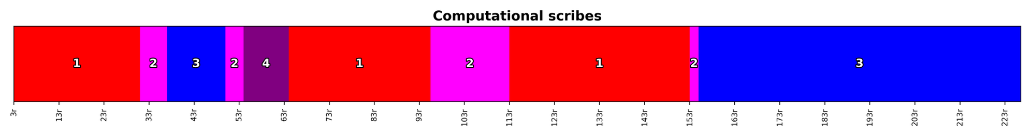
Olszowy vs. computational scribes
Notes:
And here we see the color barcode comparison for the olszowy-schlanger division and the computational division. as we said before at the horizontal axis each thin bar is a page, and the color encodes the scribe label. The top strip follows Olszowy-Schlanger’s divisions, and the bottom follows the computational divisions. So again we see that there is a major agreement between the olszowy-schlanger scribal division and the at the computational scribal division.

Slide 33
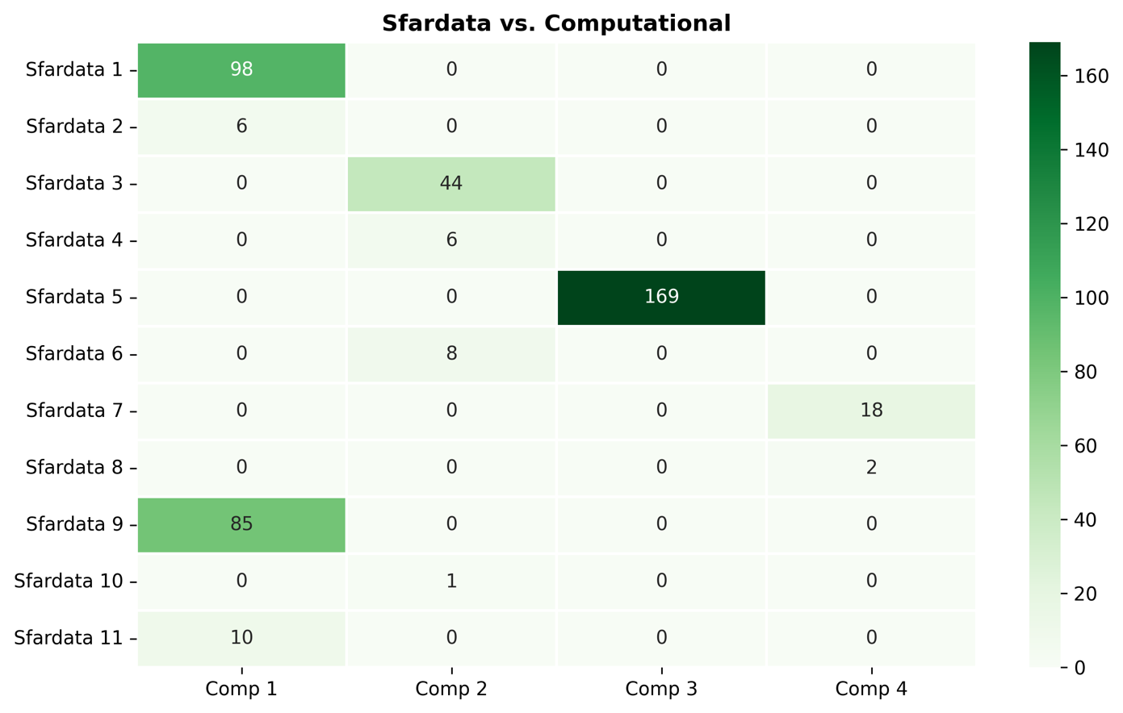
Sfardata vs. computational scribes
Adjusted Rand Index
(ARI) = 0.716
Notes:
This heatmap compares sfardata scribal division with computational scribal division. Each row is a sfardata scribe, and each column is a computational scribe. The number in each cell shows how many pages are common between a sfardata scribe and a computational scribe. For example computational scribe 1 merges sfardata scribes number 1,2,9 and 11 exactly in the same way as the olszowy-schlanger scribal division makes. The adjusted rand index score for the alignment between the sfardata scribes and computational scribes is 0.716. that means the computational scribal division agrees weakly with the sfardata scribal division.

Slide 34
Sfardata vs. computational scribes
Notes:
And in the color barcode comparison for the sfardata division and the computational divison there is a major agreement except the pages between 63-93 and the pages 113 and 133.

Slide 35
Conclusion
Unsupervised computation → 4 computational scribal groups
Agreement with scholars:
Olszowy vs Computational: ARI = 0.984
Sfardata vs Computational: ARI = 0.716
Future work: Improve similarity definitions and explainability
Notes:
To conclude, we proposed an unsupervised computational method to explore scribal grouping in Huntington 200. Without using any ground truth labels, our method suggests four computational scribal groups. When we compare these groups with scholars’ groups, we see a strong agreement with Olszowy’-schlanger’s division, with ARI = 0.984. The agreement with Sfardata is lower, which is ARI = 0.716. As for the next steps, we want to add more explainability by showing which visual patterns drive the clustering. We need a computationa defition for what is morphological similarity and what is style similarity.

Slide 36
Thank you!

