Slide 1
VML-MOC
Segmenting a multiply oriented and curved handwritten text line dataset

Slide 2
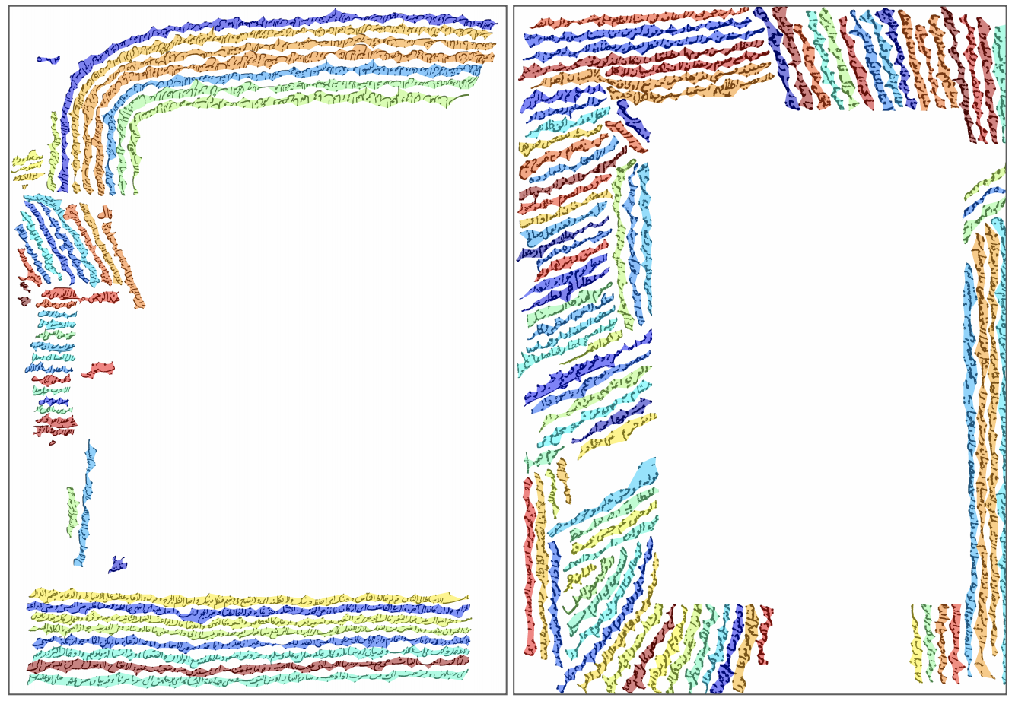
Problem definition
Lack of a natural benchmark dataset of skewed and curved text lines
How to segment skewed and curved text lines
Notes:
This paper publishes a natural and very complicated dataset of handwritten documents with multiply oriented and curved text lines, namely VML-MOC dataset. These text lines were written as remarks on the page margins by different writers over the years. They appear at different locations within the orientations that range between 0 ◦ and 180◦ or as curvilinear forms.
We evaluate a multi-oriented Gaussian based method and a single-oriented Gaussian based method to segment these handwritten text lines.

Slide 3
Related works

Slide 4
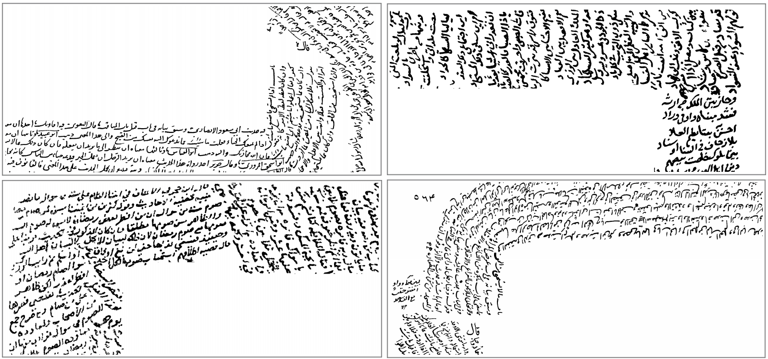
VML-MOC dataset
A collection of 30 pages selected from several manuscripts
20 pages for train set and 10 pages for test set
Purely contain binarized side notes
Skew range = [0◦ , 180◦ ], all possible arc shapes
Notes:
VML-MOC (Multiply Oriented and Curved) dataset is a collection of 30 pages selected from several manuscripts.
Prospective algorithms can be learning based and provide an official dataset split to evaluate different models.
Purely contain binarized side notes. Hence, the researchers can focus only on text line extraction of multiply oriented and curved text lines, devoid of dealing with the challenges of page segmentation.

Slide 5
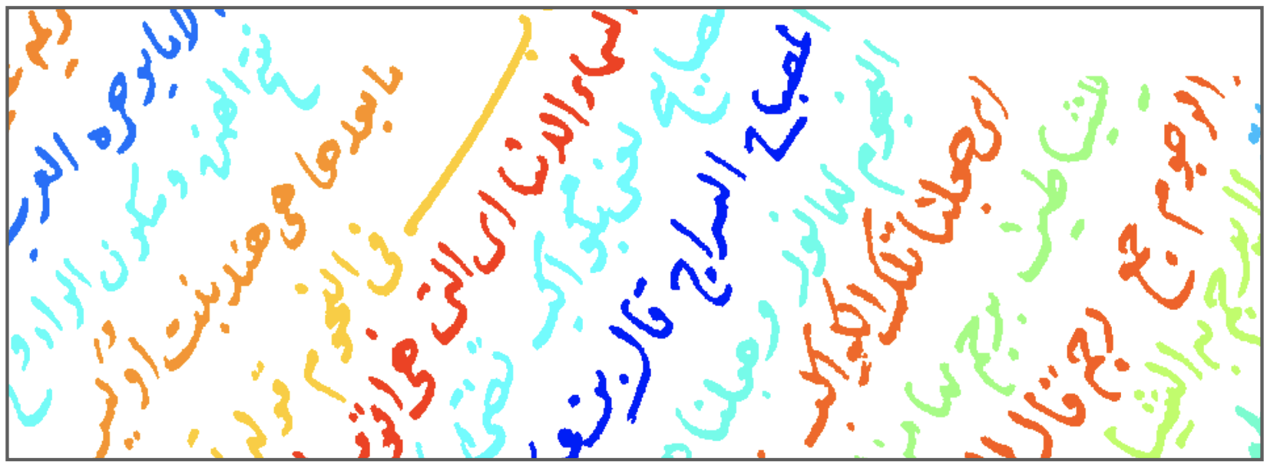
VML-MOC dataset
Raw pixel labeling
Notes:
Raw pixel labeling classifies each pixel as a part of a text line or background. It is a matrix of non-negative integers in the same size of the document image. Background pixels are labeled as 0. Pixels of the first text line are labeled as 1, pixels of the second text line are labeled as 2 and so on

Slide 6
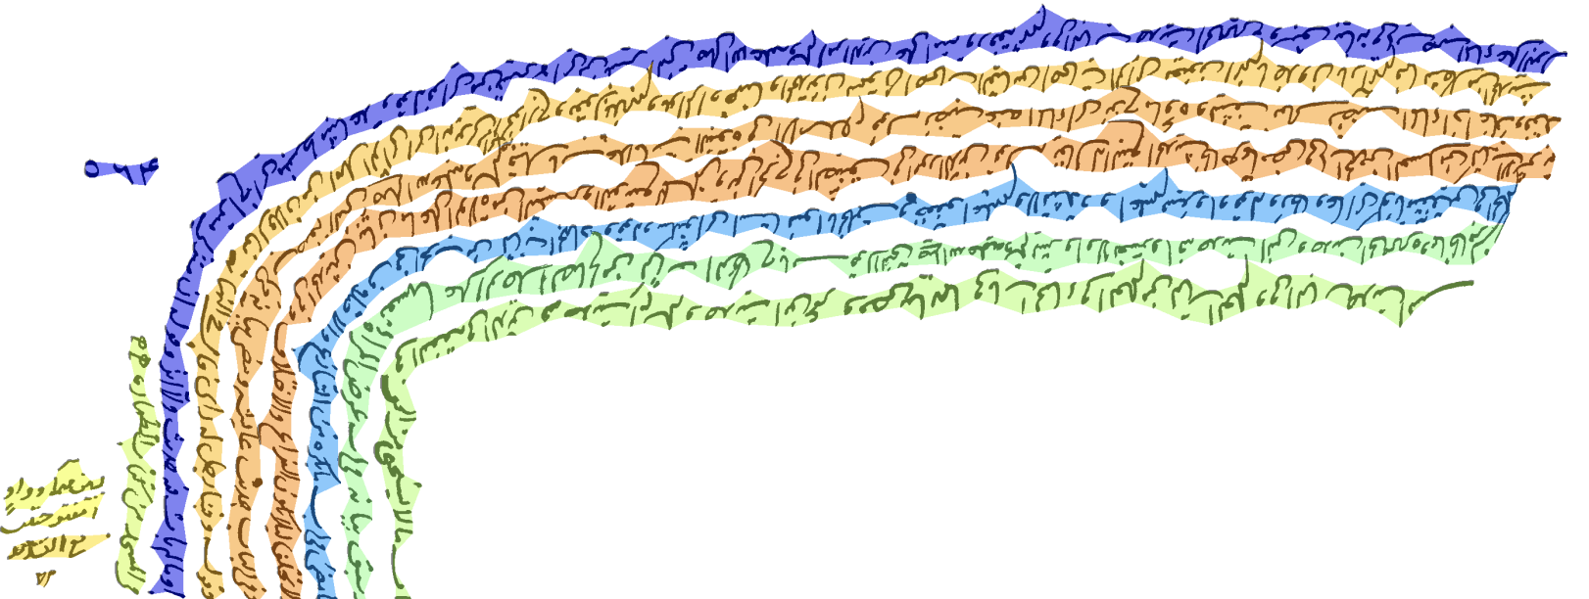
VML-MOC dataset
PAGE xml file
Notes:
PAGE xml file contains a bounding polygon for every text line in a document image. Bounding polygons were extracted using the raw pixel labeling as follows: Pixels of a text line were considered as a set of points, and a concave hull that envelops these points was computed and regarded as the bounding polygon of this text line. Figure 1 shows colored visualization of bounding polygons in PAGE xml file.

Slide 7
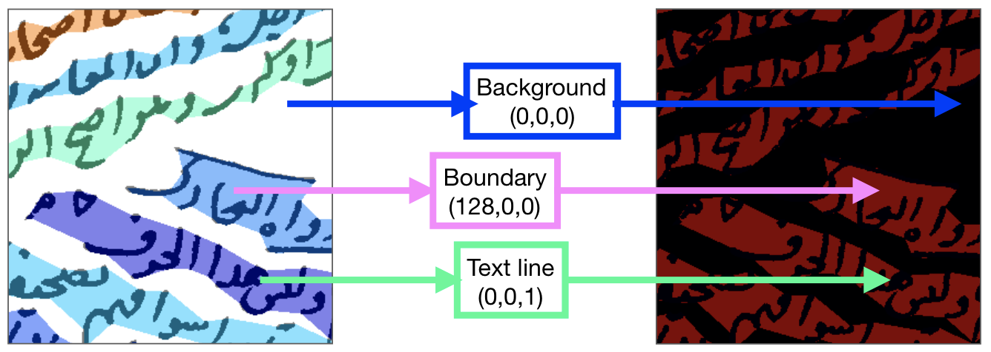
VML-MOC dataset
DIVA pixel labeling
Notes:
DIVA pixel labeling is provided to be used with the ICDAR2017 competition line segmentation evaluator [27]. It is a matrix of non-negative integers in the same size of the document image, and assigns a label for every pixel in the document image. It distinguishes text line pixels, background pixels and boundary pixels. Boundary pixels are inside of a polygon that do not belong to the foreground. To prepare DIVA pixel labeling, we first overlaid the binarized document image with the polygons given by the PAGE xml file. The foreground pixels within the polygons are encoded as text line using the color code (0, 0, 1) in RGB. The background pixels within polygons are encoded as boundary using the color code (128, 0, 0) in RGB. All the pixels out of polygons are encoded as background using the color code (0, 0, 0) in RGB. Figure 4 illustrates these encodings and corresponding color codes.

Slide 8
Proposed approach
Text line enhancement and binarization
Notes:
Convolution of a text line with second derivative of an anisotropic Gaussian elongated along the text line direction generates ridges over the text line areas. Here arise two issues with VML-MOC dataset: 1) Text line height varies due to ascenders and descenders, 2) Text line direction varies due to multiple orientations or curvatures.
To deal with these issues, we generated a filter bank using second derivative of anisotropic Gaussian. This bank contains all possible combinations of orientations within the range of [0◦ , 180◦ ] and scales within the range of [µ/2,(µ + σ/2)/2], where µ and σ are the average and standard deviation of the heights of connected components in the image. We applied this filter bank and considered the optimal scale and the optimal orientation for each pixel. Therefore each pixel returns the maximum possible response (Figure 5b) for it, using this filter bank. Enhanced text lines were then binarized by Niblack algorithm, to get the final blob lines that hovers over the text lines (Figure 5c).

Slide 9
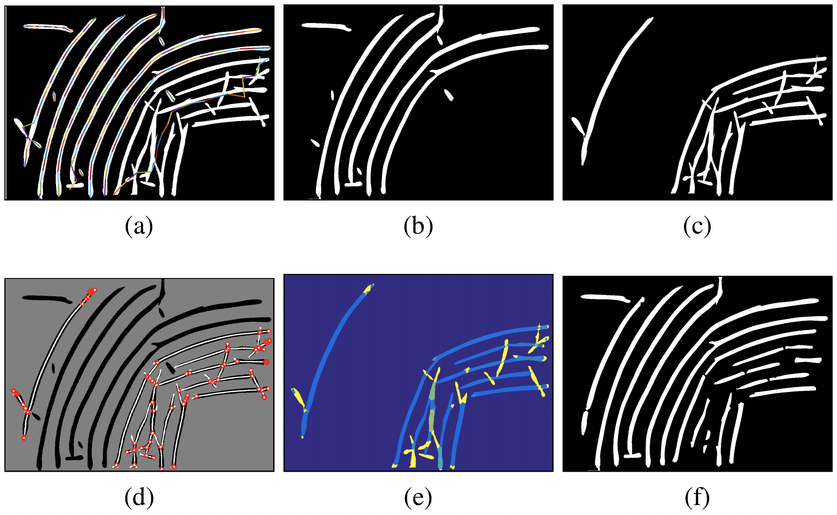
Proposed approach
False ligature removal
Notes:
(a) Least square linear splines fitted to the blob lines. Each spline in a blob line is represented by a color. Splines were fitted to horizontally aligned points, this figure shows re-rotated data for visualization purposes. (b) Valid blob lines. (c) Invalid blob lines. Notice the false ligatures on invalid blob lines. (d) Invalid blob lines are decomposed at their bifurcation points. (e) Each of the decomposed invalid blob lines is assigned a label cost. (f) False ligature blobs with high label cost are removed using energy minimization.

Slide 10
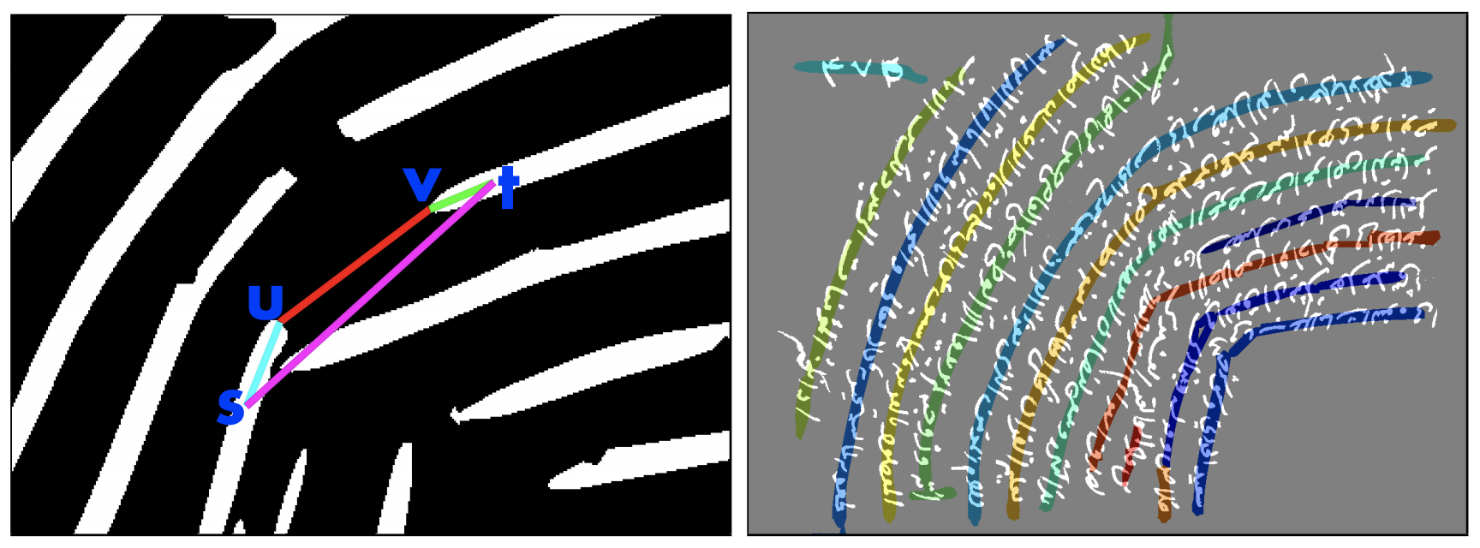
Proposed approach
Merging broken blob lines
Notes:
We merged the broken blob lines using a minimum spanning tree (MST) on an undirected weighted graph, G = (V, E). The set of vertices, V , is composed of all the end-points of the blob lines, in addition to a root vertex that is connected to all the end-points. The set of edges is E = E1 ∪ E2 ∪ E3: 1) E1 is the set of edges that connects two vertices of a blob line, their weight is set to 0. 2) E2 is the set of edges between the root and all the vertices, their weight is the normalized number of foreground pixels overlapping with the blob line. 3) E3 consists of edges between end-points that belong to different lines. Their weight is a local linearity measure defined in the following. In set E3, for every end-point we considered only the edges with the most successful linearity measure.
Local linearity measure: Local linearity measure shows how linear the connection is between two end-points, u and v, of two blob lines. For each end-point, u and v, it chooses a nearby point on its blob line. These near-by points are s and t, respectively (Figure 7a). Then local linearity measure is computed as in Equation

Slide 11
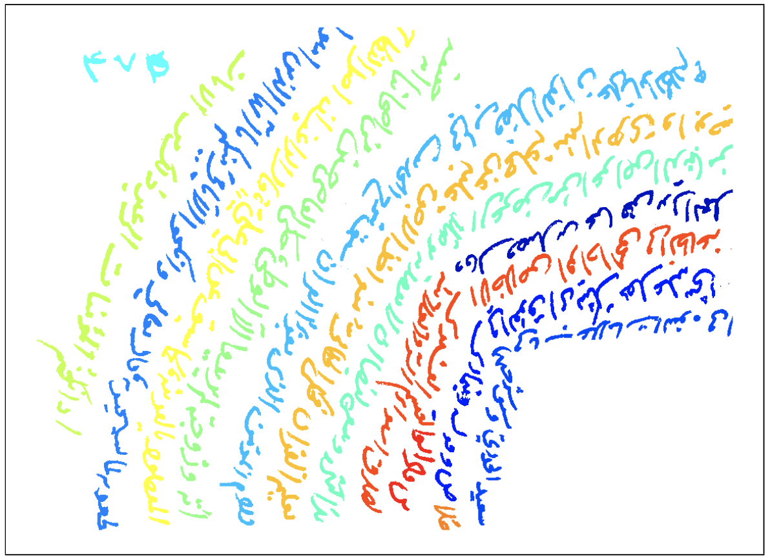
Proposed approach
Labeling connected components
Notes:
This phase uses energy minimization [28] for assigning connected components to text lines. Let L be the set of blob lines, and C be the set of connected components in the image. Energy minimization finds a labeling f that assigns each component c ∈ C a label lc ∈ L, where E(f) has the minimum. E(f) = P c∈C D(c, `c) + P {c,c0}∈N d(c, c0 ) · δ(`c 6= `c 0 ) + P `∈L h` (4) Energy function has three terms: data cost, smoothness cost, and label cost. 1) Data cost: For every c ∈ C, D(c, `c) is defined as the Euclidean distance between the centroid of c and the blob line lc. 2) Smoothness cost: Let N be the nearest component pairs. For every {c, c0} ∈ N , d(c, c0 ) = exp(−α · de(c, c0 )) where de(c, c0 ) is the Euclidean distance between the centroids of the components, c and c 0 . δ(`c 6= `c 0 ) is 1 if the condition inside the parentheses holds and 0 otherwise. 3) Label cost: For every blob line ` ∈ L, h` is defined as exp(β · r`) where r` is the normalized number of foreground pixels overlapping with blob line `.

Slide 12
Evaluation
Notes:
We used ICDAR2017 line segmentation evaluator tool [27] for the evaluation. This tool is freely available as open source2 . An open source tool has a reviewed source code that minimizes the risk of erroneous implementations. Besides, it enables fair comparison of methods in the same way as publicly published datasets.
Pixel IU is measured at pixel level. First, for each matching pair, line TP, line FP and line FN is computed. • Line TP is the number of foreground pixels that are correctly predicted in the matching pair. • Line FP is the number of foreground pixels that are falsely predicted in the matching pair. • Line FN is the number of foreground pixels that falsely aren’t predicted in the matching pair. Then pixel IU is calculated according to the following Equation 6:

Slide 13
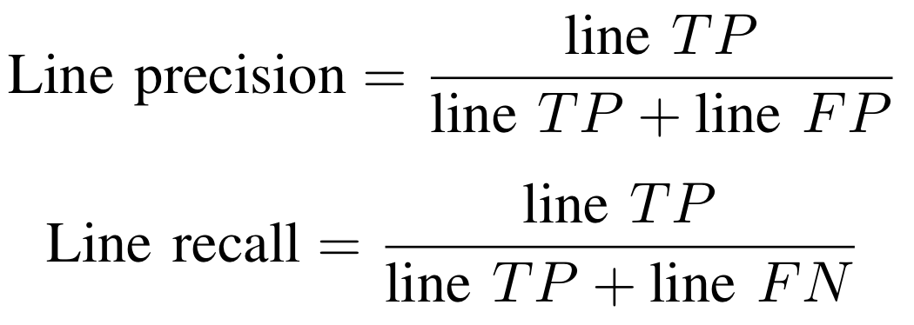
Evaluation
Notes:
CL is the number of correct lines, ML is the number of missed lines, and EL is the number of extra lines. For each matching pair: • A line is correct if both, the line precision and the line recall are above the threshold value. • A line is missed if the line recall is below the threshold value. • A line is extra if the line precision is below the threshold value.

Slide 14
Experiments

Slide 15
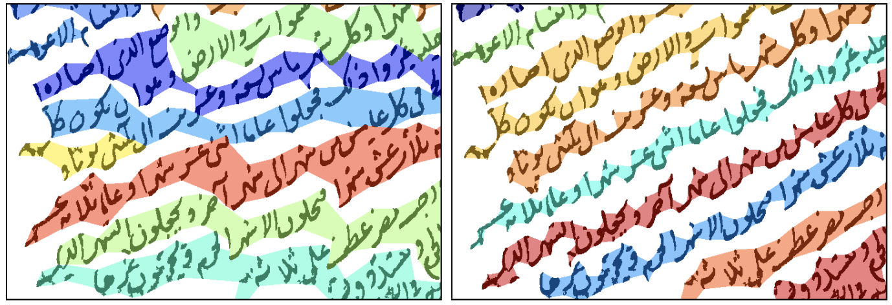
Conclusion
First multiply oriented and curved handwritten text line dataset, namely VML-MOC dataset
Evaluation of a single-oriented Gaussian based method and a multi-oriented Gaussian based method on this dataset
Ordinary text line segmentation methods are not successful on VML-MOC dataset
Line segmentation methods without horizontal line assumption has to be developed

