Slide 1
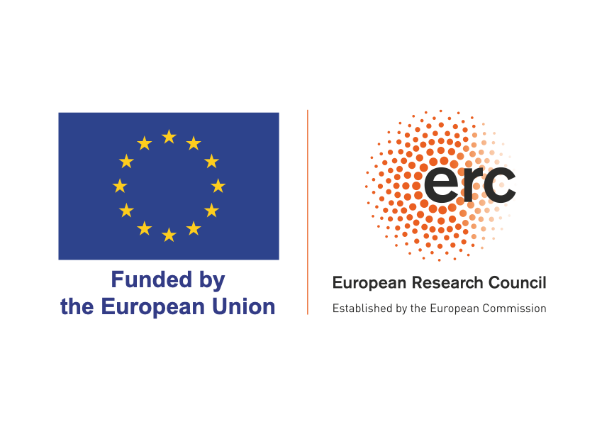
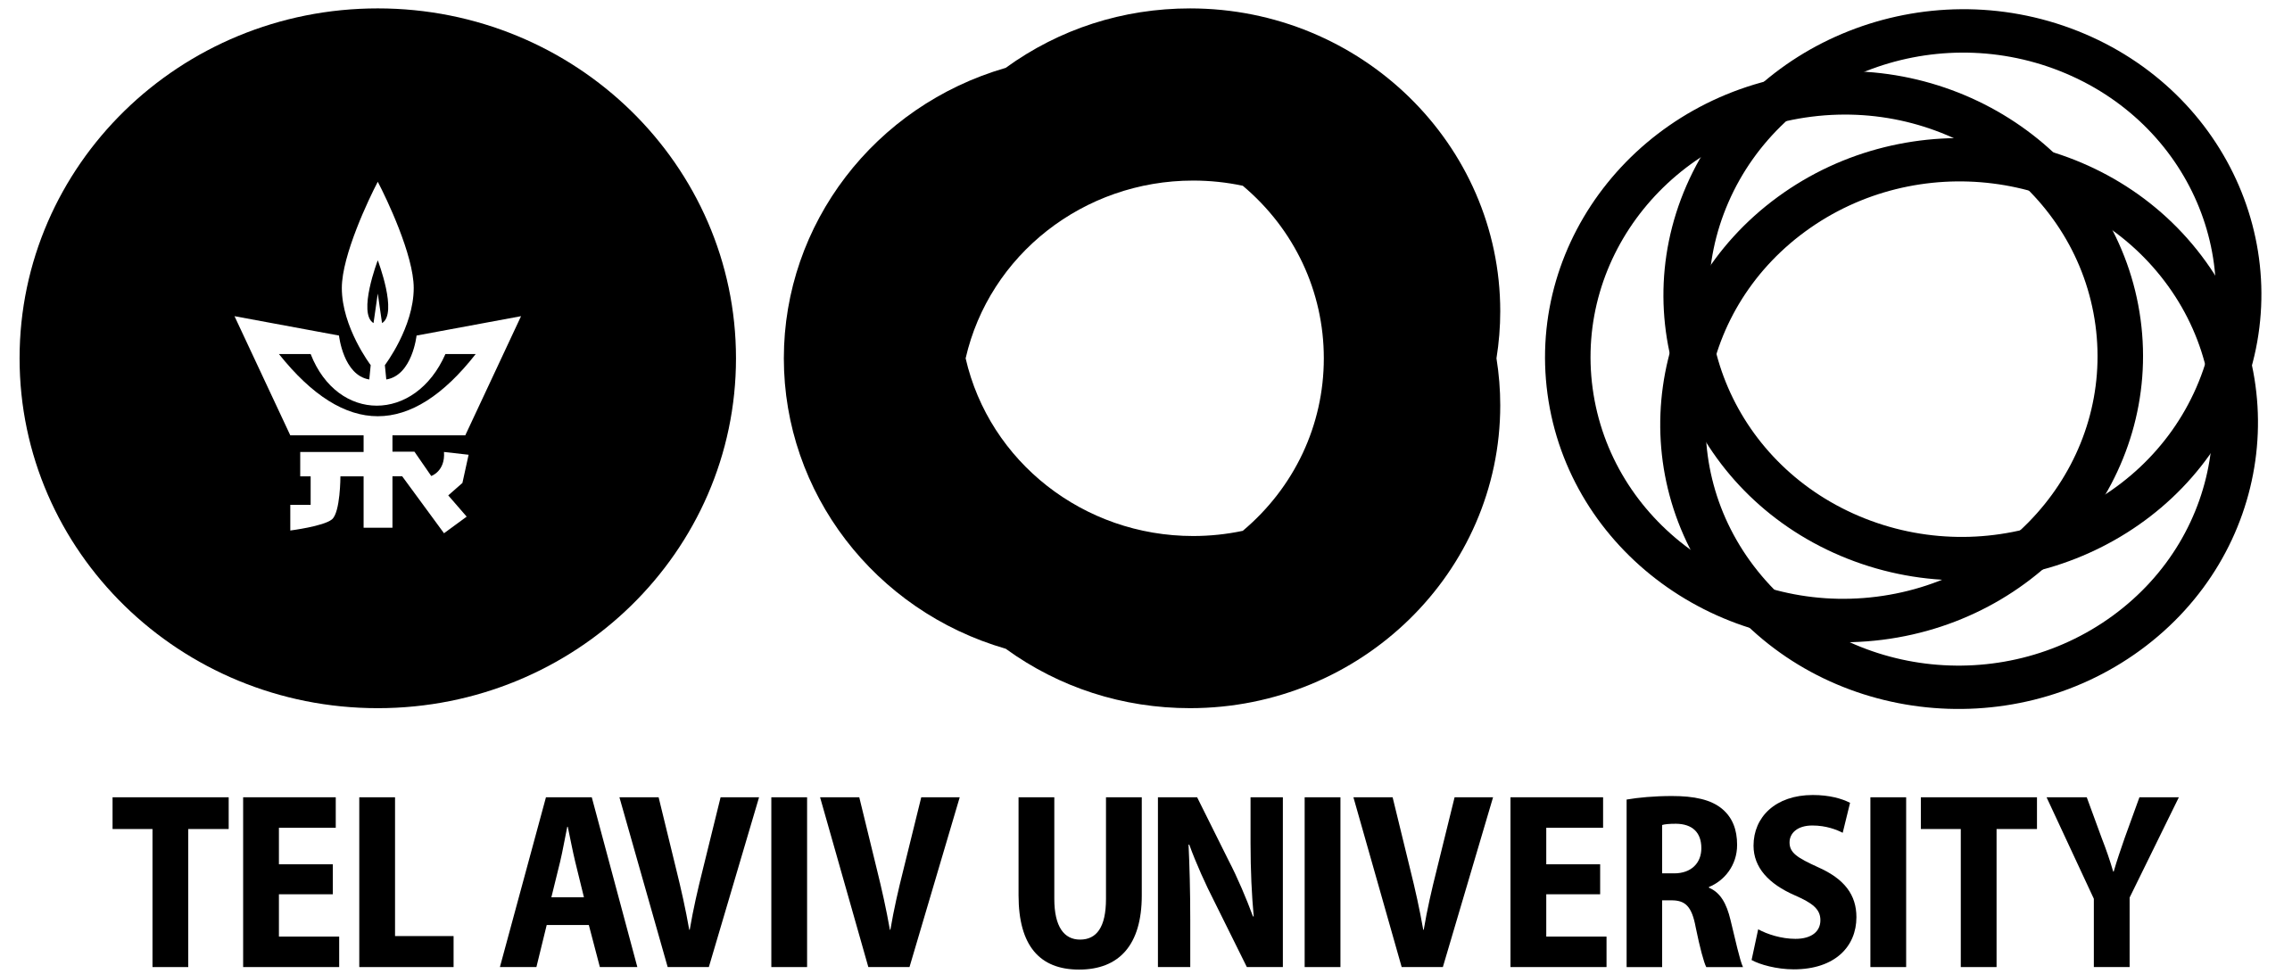
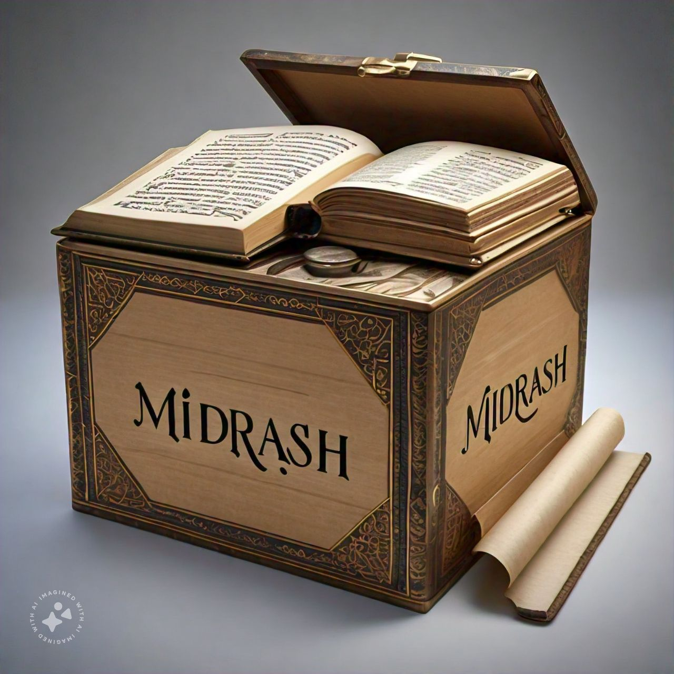
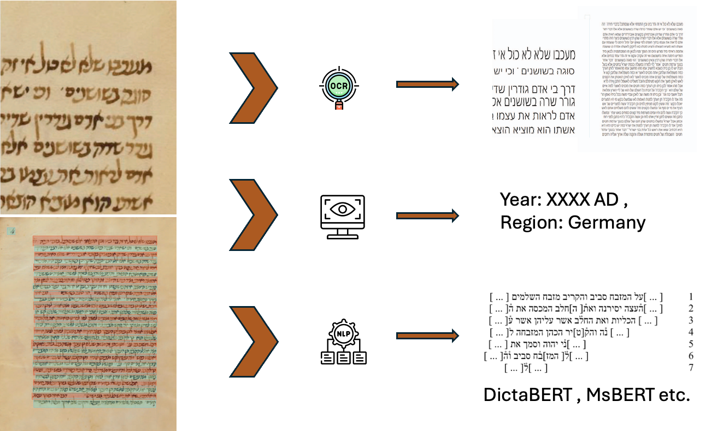
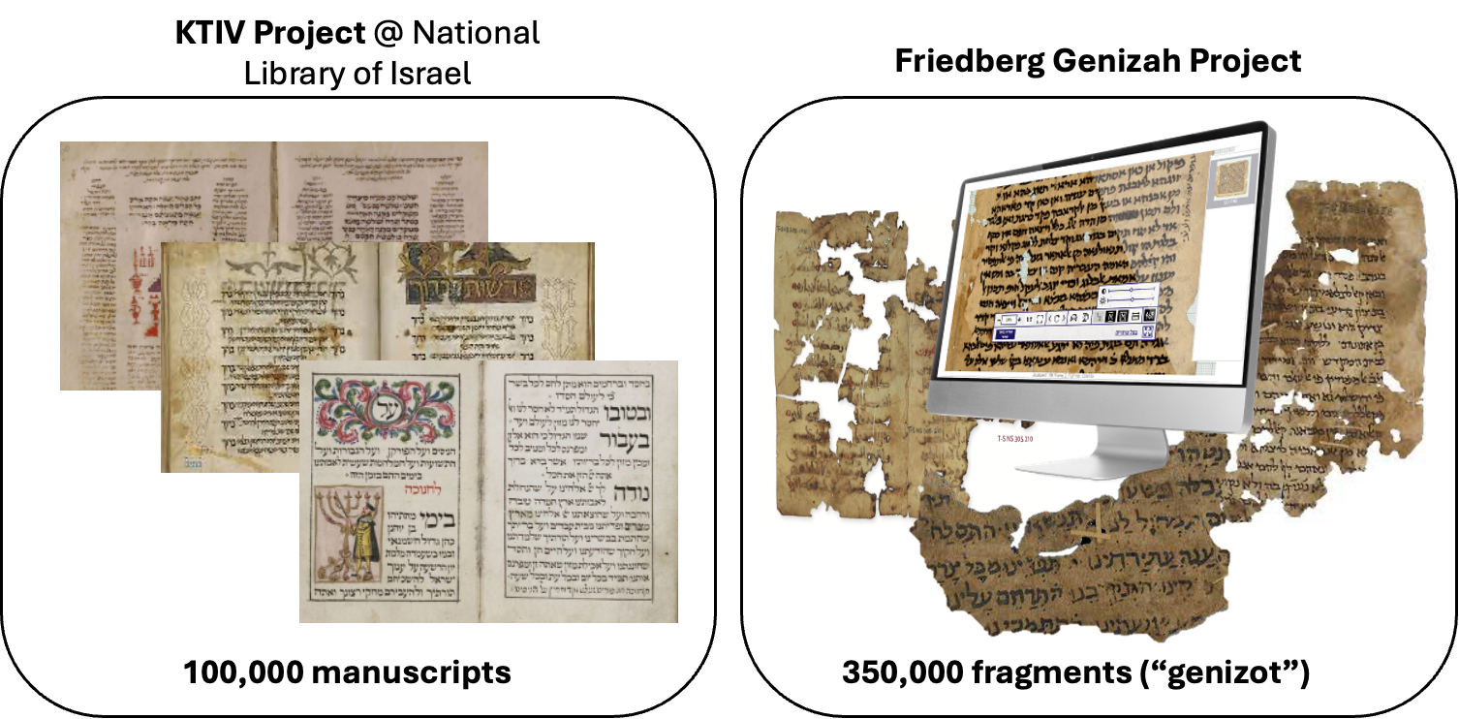
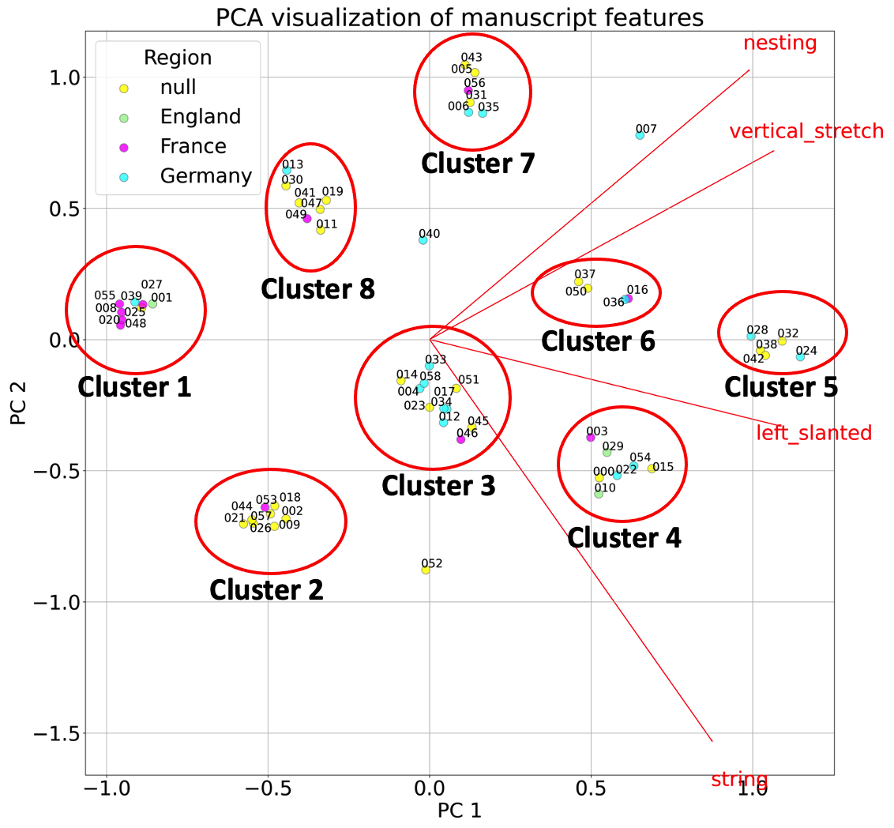
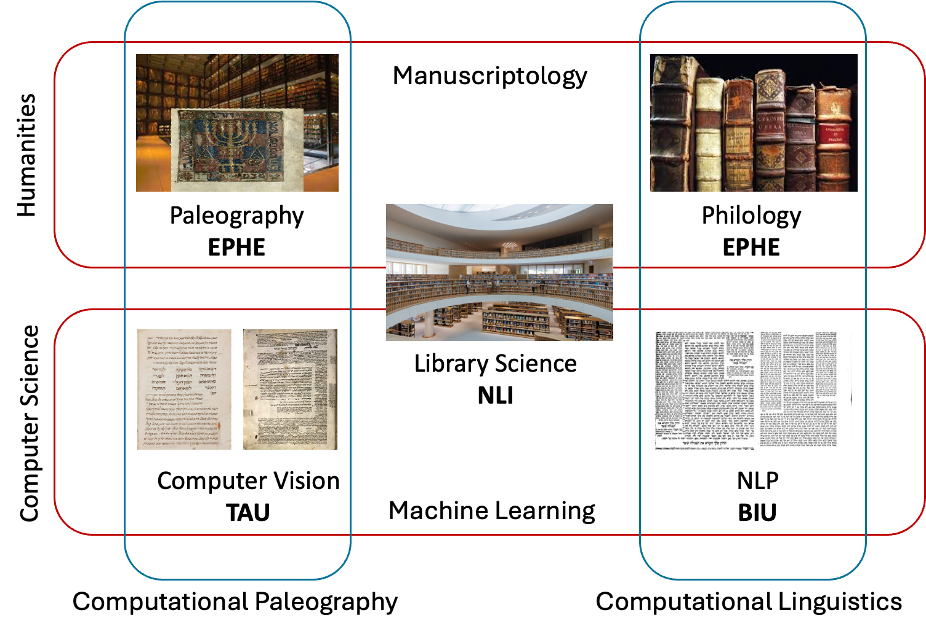
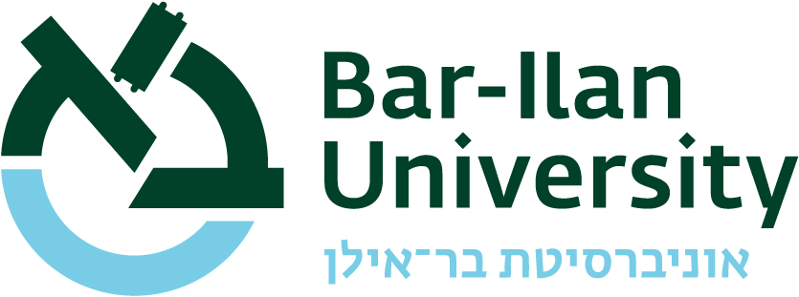
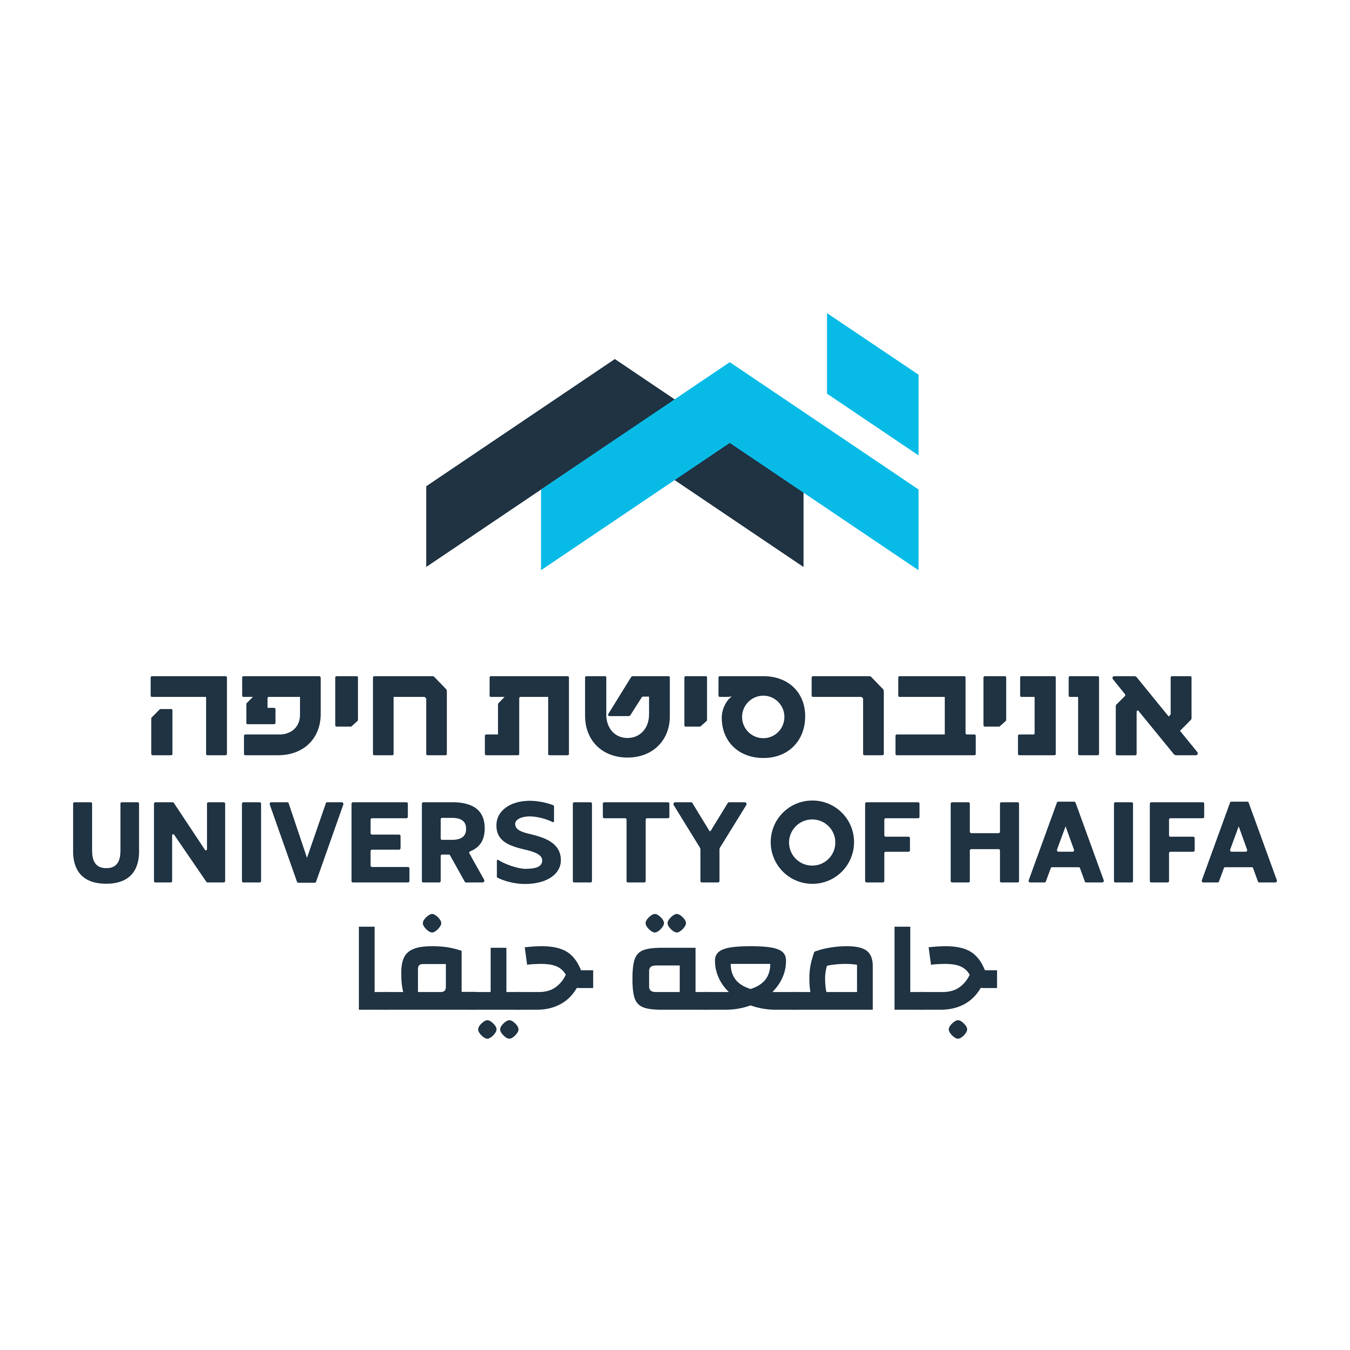
MiDRASH – A Project for Computational Analysis of
Medieval Hebrew Manuscripts
Presented by
Daria Vasyutinsky Shapira Berat Kurar-Barakat Sharva Gogawale
Mohammad Suliman Nachum Dershowitz
Daria Vasyutinsky Shapira Berat Kurar-Barakat Sharva Gogawale
Mohammad Suliman Nachum Dershowitz
Tel Aviv University
MiDRASH
Migrations of Textual and Scribal Traditions via Large-Scale Computational Analysis of Medieval Manuscripts in Hebrew Script
cPI Daniel Stökl Ben Ezra, cHI EPHE
PI Judith Olszowy-Schlanger, EPHE
PI Nachum Dershowitz, Tel Aviv University
PI Avi Shmidman, Bar Ilan University
An interdisciplinary project supported by the first ERC Synergy grant in Jewish studies and computational manuscript studies (2023–9). By integrating traditional philology with advanced computational tools, including machine learning, computer vision, and computational linguistics, MiDRASH analyzes the materiality, textuality, transmission, and historical contexts of these manuscripts. This will enable the processing of vast amounts of textual and paleographical data, offering new insights into production, transmission, and intellectual contexts of medieval Jewish manuscript culture.
Algorithms to identify intertextual relationships (quotations, paraphrases, borrowings) and analyze linguistic features for intelligent search and historical context.
Combine traditional and computational methods to map migration, genesis, and evolution of texts, ideas, readers, scribes, and books within medieval Jewish communities.
Languages : Hebrew, Aramaic, Judeo-Arabic, Yiddish, Ladino, Judeo-Persian and more.
Diverse range of materials, from well-preserved scrolls and codices to tiny manuscript fragments.
Foundational data for textual analysis and research.
MiDRASH will deepen our understanding of Hebrew manuscripts, their production, transmission, and influence on European and Mediterranean intellectual history.
MiDRASH employs a combination of traditional philological methods and cutting-edge computational techniques:
Page Segmentation and Text Recognition: Convert images of manuscripts into machine-readable text.
Paleography and Codicology: Analyze handwriting to determine geographic and chronological origins of manuscripts, leveraging databases like HebrewPal and SfarData.
Linguistic Analysis: Natural language processing techniques to analyze linguistic features for textual searches and place manuscripts in their historical context.
The MiDRASH project is ongoing; the teams are working in synergy on page segmentation, reading order, automatic dating, and numerous other tasks. The outputs of the project will be publicly available.
We at the TAU team describe one example of such a task:
Aims
Methodology
Introduction
Data
Progress
Synergy in computational manuscriptology
Conclusion
Preliminary results of automated sub-clustering of Ashkenazi square scripts using paleographical features. Data annotation was facilitated using the Hasty AI assisted annotation tool
(https://hasty.cloudfactory.com/).
Institutions Involved

