Slide 1
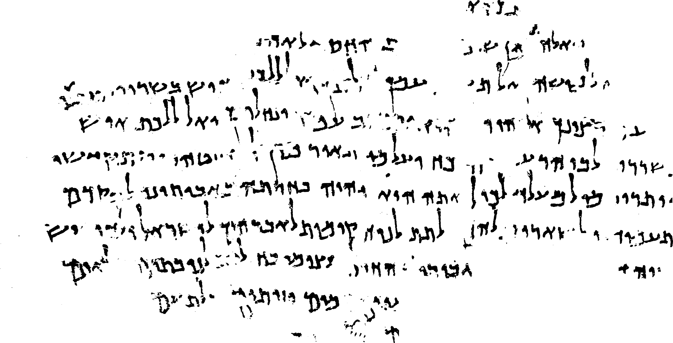
COMPUTATIONAL QUMRANIC PALEOGRAPHY
Berat Kurar-Barakat and Nachum Dershowitz
Images courtesy
Israel Antiquities Authority
photographer Shai Halevi
Notes:
Welcome, everyone. My name is Berat and I am a postdoctoral researcher at Tel Aviv University.
Our work title is "Computational Qumranic Paleography," a project that I've been working on alongside my advisor, Professor Nachum Dershowitz.
It is focusing on the Dead Sea Scrolls with the goal of developing computational methods to enhance the paleographic analysis of these historically significant manuscripts.
So now, I am going to give a short presentation about our ongoing project and present our preliminary results.

Slide 2
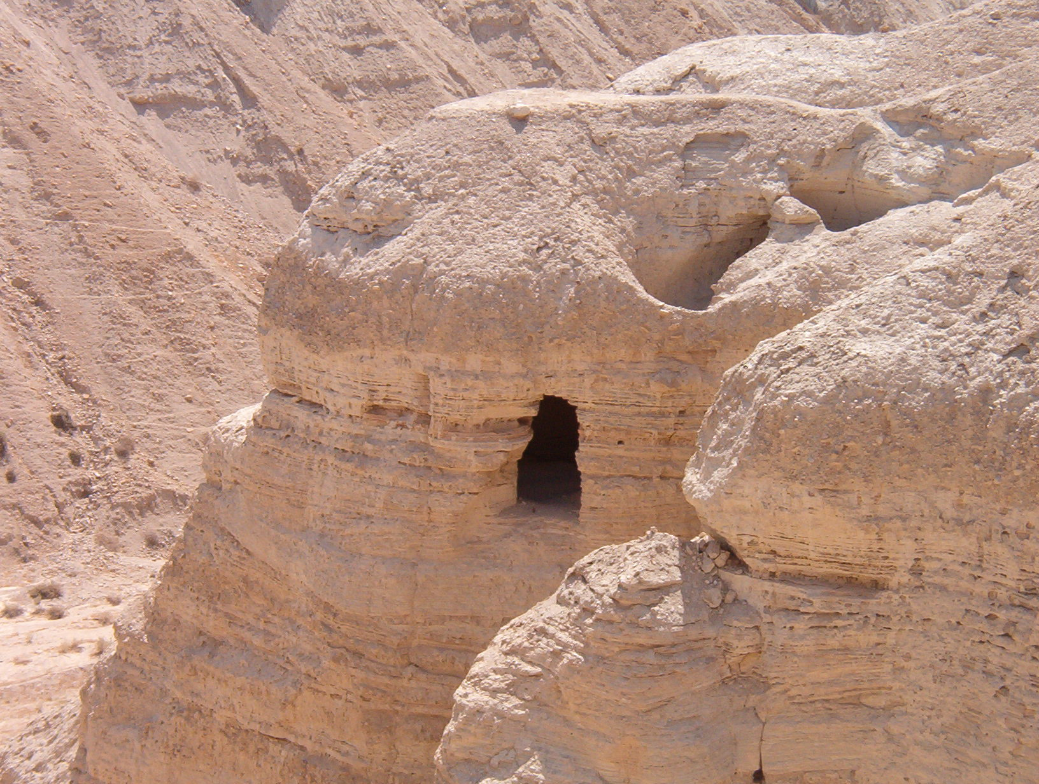
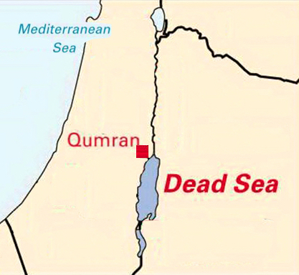
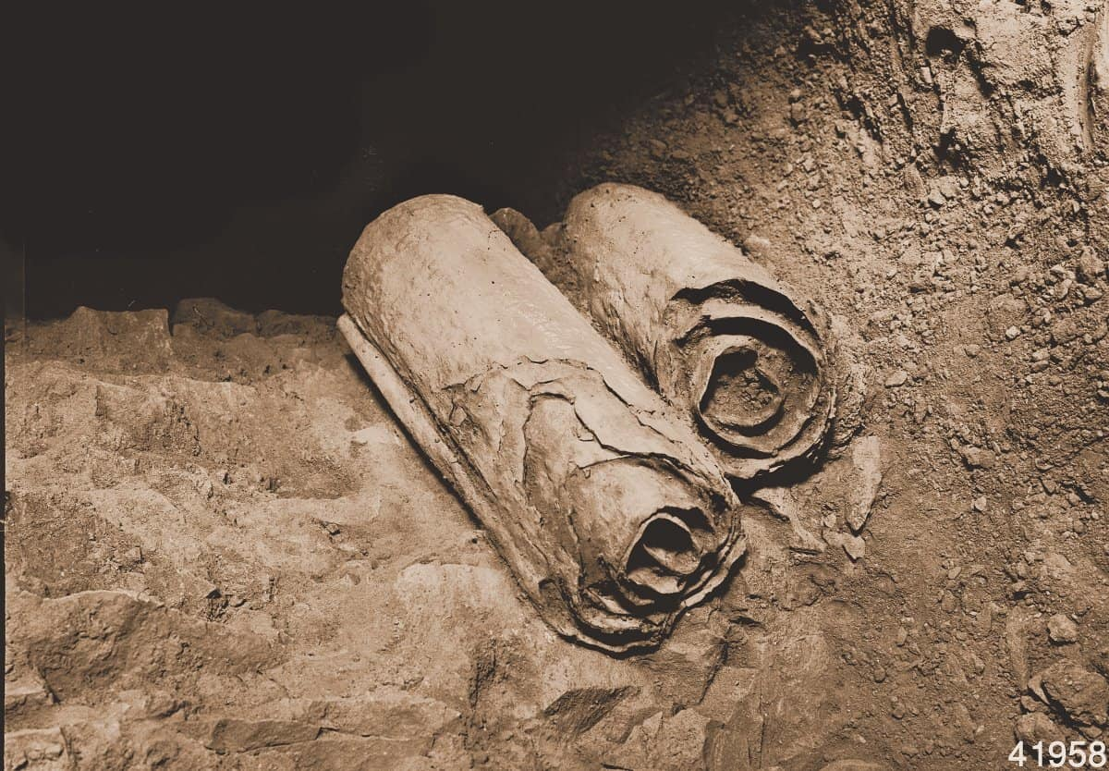
A Qumran cave
Dead Sea scrolls
Notes:
The Dead Sea Scrolls are ancient manuscripts that are about 2,000 years old.
They were one of the greatest archaeological discoveries of the 20th century.
The scrolls were discovered over a period of 10 years, between 1946 and 1956, in the Qumran Caves on the northwestern shore of the Dead Sea.

Slide 3
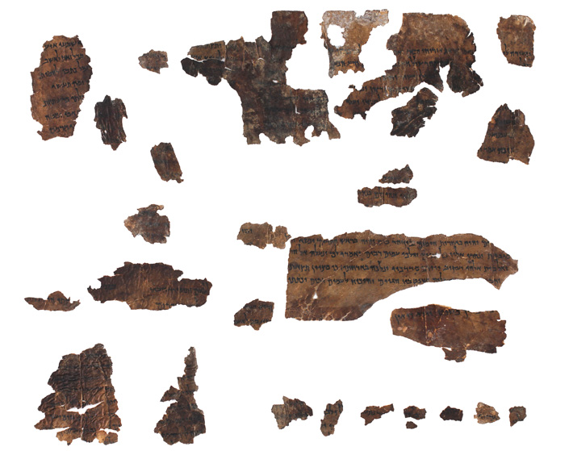
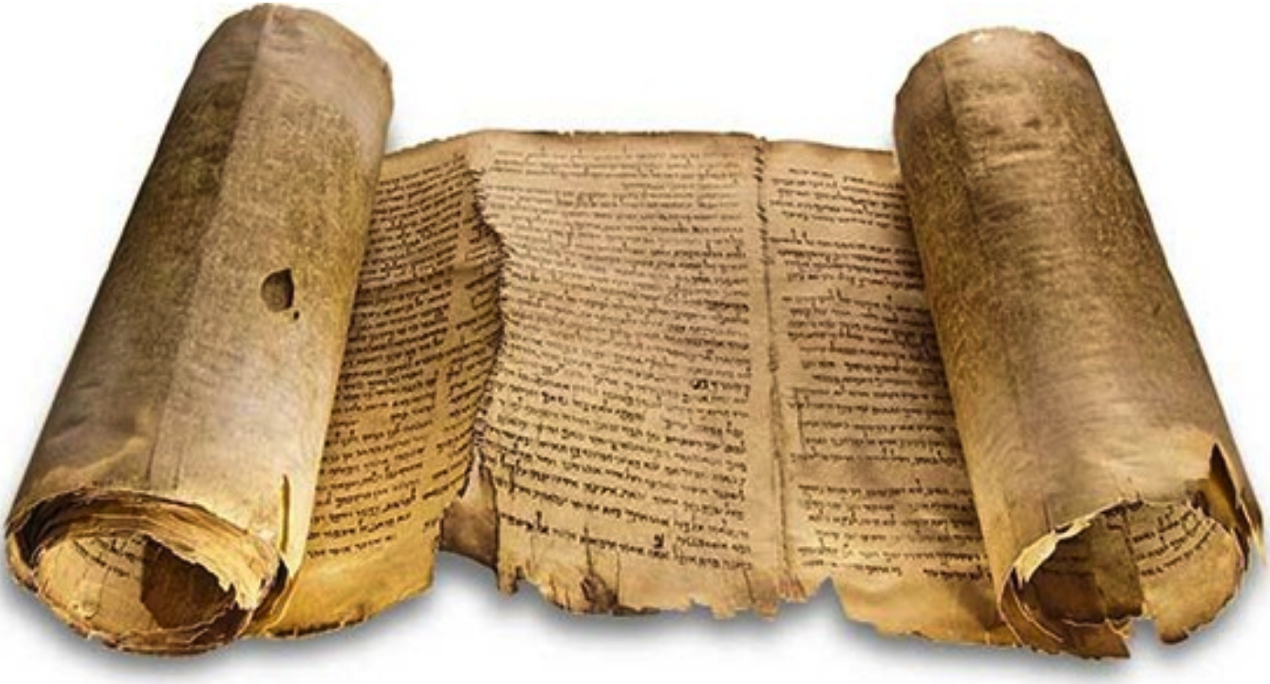
Great Isaiah Scroll
734 cm
Isaiah fragments
Notes:
The scrolls include around 950 different manuscripts.
Some of them are well preserved entire scrolls and others are fragmented due to natural causes or human interference.

Slide 4
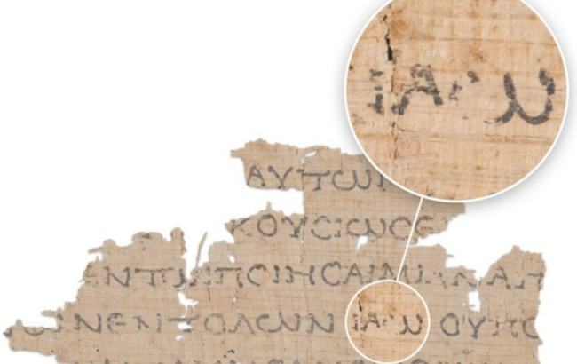
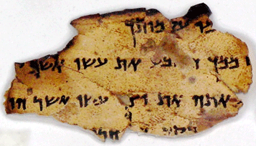
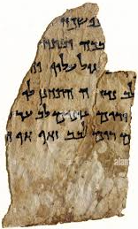
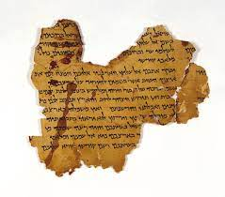
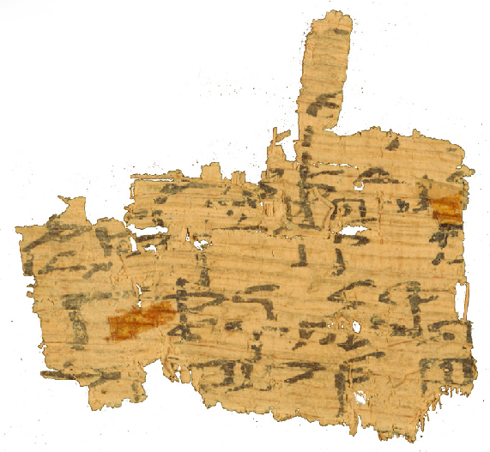
Black carbon-based ink
Parchment fragments
Papyrus
fragments
Notes:
The Qumran scrolls are mostly made of parchment, with a few of them are made of papyrus,
and they are written with black carbon-based ink.

Slide 5
Digitization of DSS
1200 mega pixel images
Full color images
Multi spectral images
Publicly available online
High resolution color and multispectral images
Notes:
Recently, the Israel Antiquities Authority digitized the Dead Sea Scrolls and made them publicly available online.
They provide high resolution full color images and multispectral images at a range between the blue band and the near infrared band.
This allows anyone to view and study the scrolls from anywhere in the world.
It also gives us the chance to develop computational tools for automating their analysis.

Slide 6
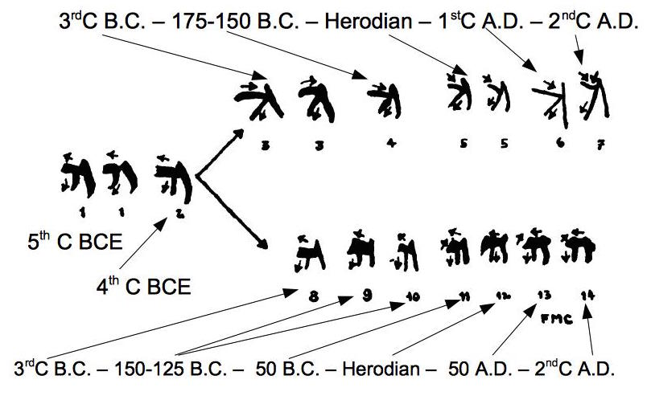
Paleographic analysis
Cross. “The Oldest Manuscripts from Qumran," Journal of Biblical Literature, 1955
For dating manuscripts
Estimate age of scrolls by comparing handwriting style with style of dated manuscripts
Chronologically aligned different scripts of the letter he
Notes:
Paleographic analysis of the Dead Sea Scrolls is essential for several tasks. I will mention only a few significant ones.
The first task is dating the manuscripts.
Paleographic analysis helps to estimate the age of the scrolls by comparing their handwriting style with the handwriting style of the other dated manuscripts.

Slide 7
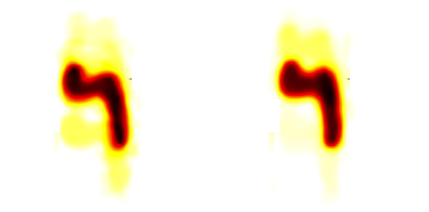
Paleographic analysis
Popović et al. “Artificial intelligence based writer identification generates new evidence for the unknown scribes of the Dead Sea Scrolls exemplified by the Great Isaiah Scroll (1QIsaa),” 2021
For identifying scribes
Identify different scribes who may have written various parts by comparing handwriting styles throughout scroll
First scribe
Second scribe
Different resh letters from the two halves of the Great Isaiah Scroll
Notes:
The second task is identifying the scribes.
Paleographic analysis helps to identify different scribes who may have written various parts of the scrolls by comparing the handwriting styles throughout the scroll.

Slide 8
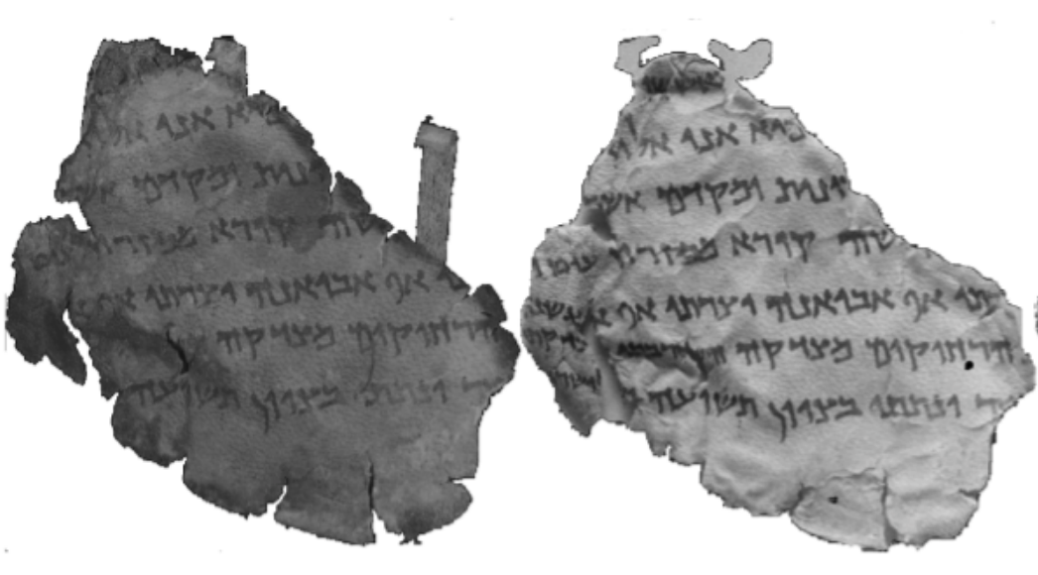
Paleographic analysis
Levi et al. “A Method for Segmentation, Matching and Alignment of Dead Sea Scrolls,” 2021
For matching new and old images
Match new and old images of a fragment by matching handwriting styles
New image
Old image
Matched old and new images of a fragment
Notes:
The third task is matching the new and the old images of a fragment.
Paleographic analysis helps to match the new and the old images of a fragment by matching their handwriting styles.

Slide 9
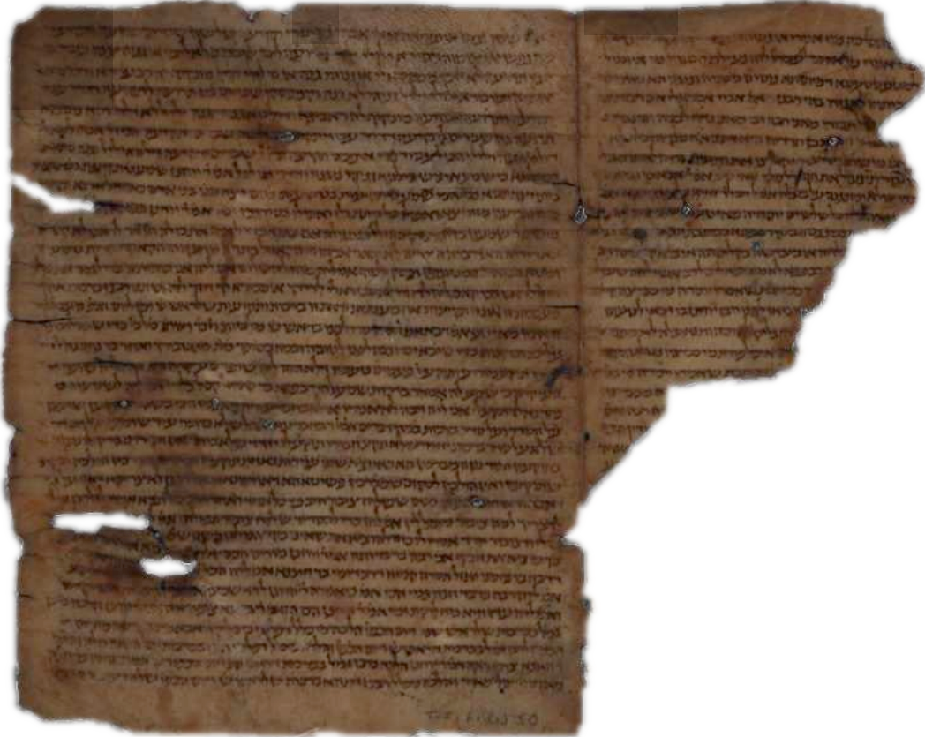
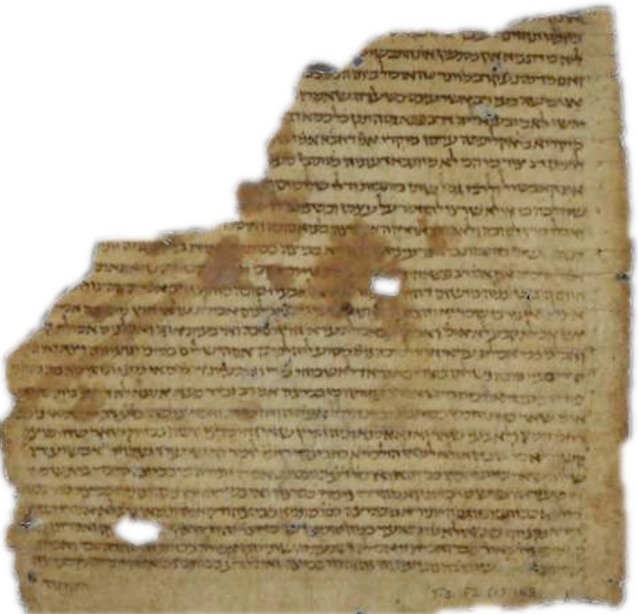
Paleographic analysis
Ben-Shalom et al. “Where is my Other Half?,” 2014
For pairing fragments of a scroll
Pair fragments by comparing their handwriting styles
Notes:
The fourth task is pairing the fragments of a scroll.
Paleographic analysis helps to pair the fragments of a scroll by comparing their handwriting styles.

Slide 10
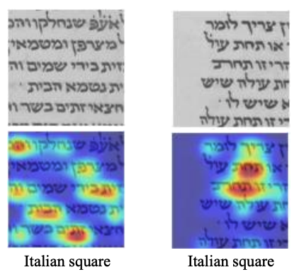
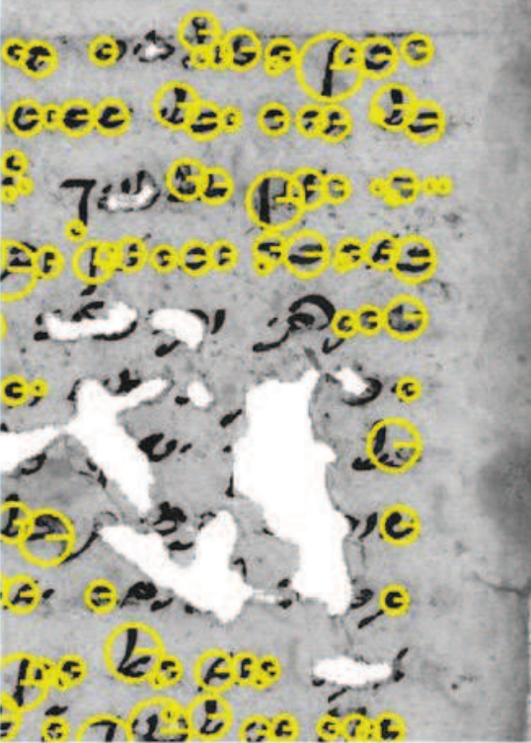
Previous works
Keypoint-based
Patch-based
Wolf et al. “Identifying Join Candidates in the Cairo Genizah,” 2010
Vasyutinsky et al. “Deep learning for paleographic analysis of medieval Hebrew manuscripts,” 2020
Notes:
Previous methods, such as using image patches,connected components, and keypoints, fail to focus on letter forms because neither document image patches nor whole document images consistently contain the same letters with the same occurrence frequency.
As a result, these methods tend to focus on high-level patterns that exist across all the letter strokes.
Hence, it is difficult to provide explainability for the letter similarities in their results.

Slide 11
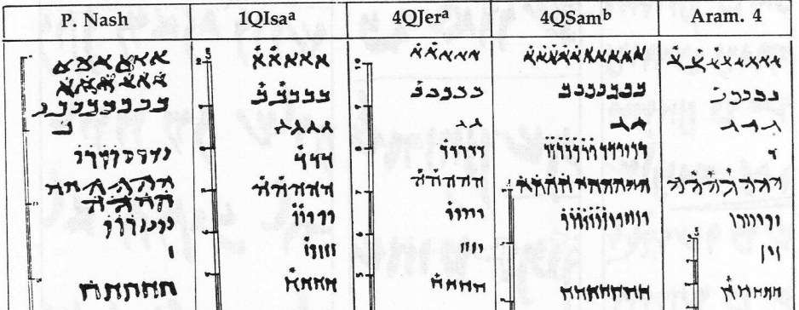
Letter-level paleography
Yardeni, “The palaeography of 4QJerª”,1990
Comparative chart of letter forms
Notes:
Hence, we aim to focus on recognized and segmented letters to achieve precise paleographical analysis.

Slide 12
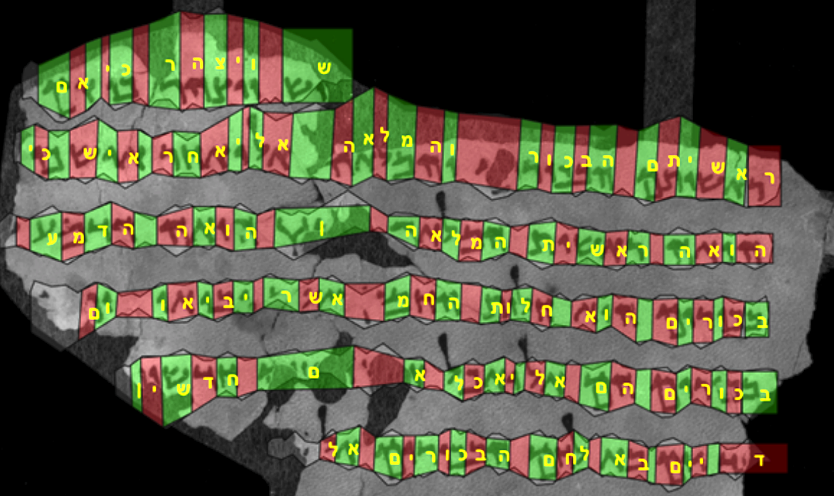
Letter detection and recognition
Ben Ezra et al. “Transcription Alignment for Highly Fragmentary Historical Manuscripts,” 2020
Notes:
We already have a method for detecting and recognizing letters by training a sequential OCR model using transcriptions.
However, the main issue is that the letter detections are not precise.
They often include parts of neighboring letters or miss some parts of the detected letters.

Slide 13
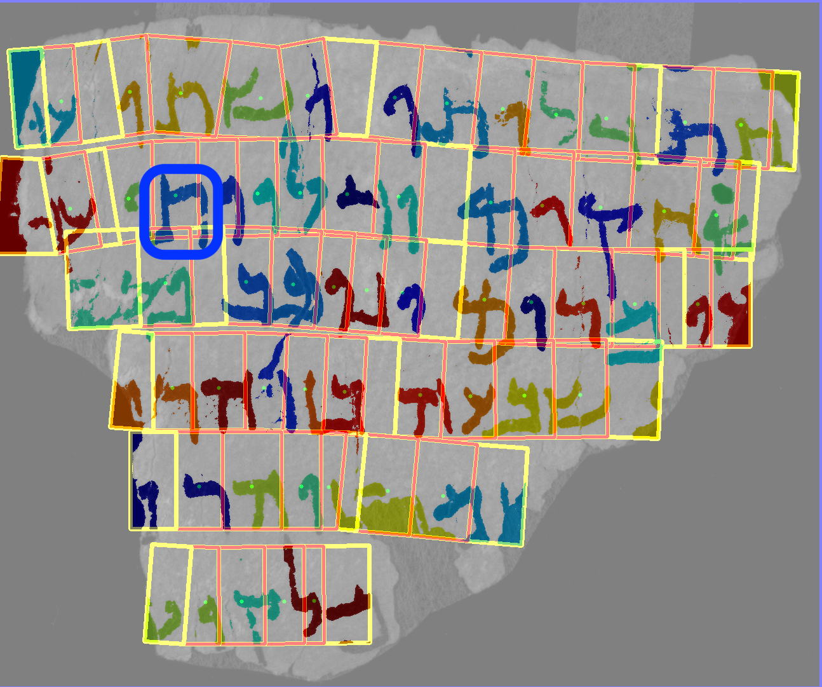
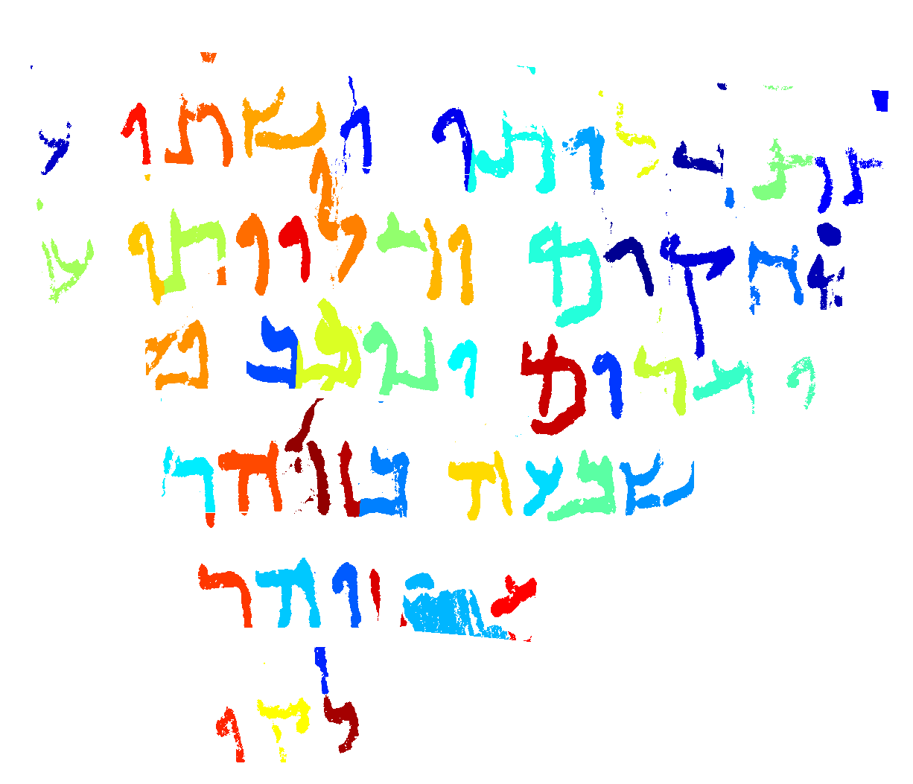
Letter detection to letter segmentation
Brown-DeVost et al. “Automatically linking Dead Sea Scroll transcriptions to fragment images: Towards the letter level,” 2022
Energy
Minimization
Detected and
recognized letters
Segmented and
recognized letters
Notes:
We used energy minimization to convert the rough letter detections into accurate letter segmentations.
However, this introduced a new issue with binarization artifacts.

Slide 14
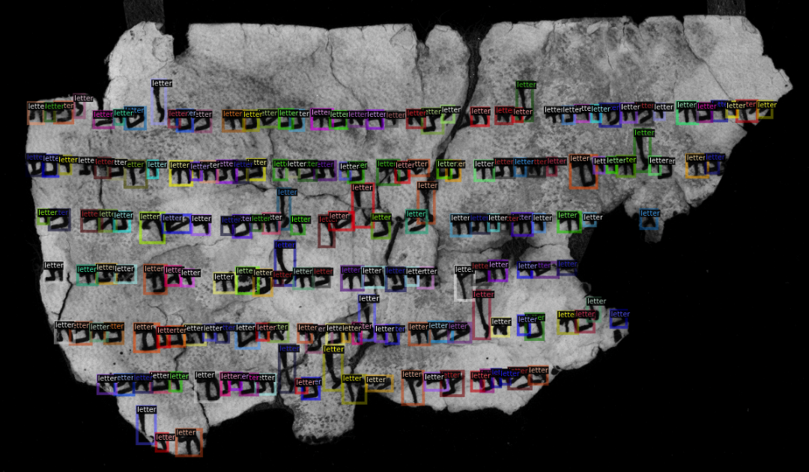
Letter detection using Faster-RCNN
Notes:
To eliminate binarization artifacts, we initially used Faster-RCNN to make a precise letter detection, but the expert annotation process was extremely slow.
As a result, we decided not to pursue this approach further.

Slide 15
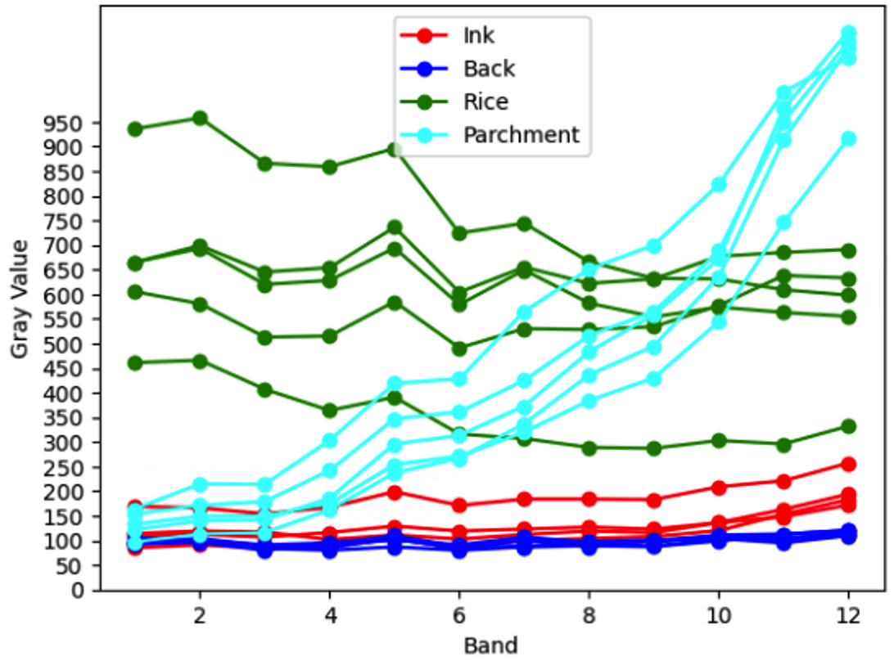
Clustering multispectral trends
Gray value trend of pixels across multispectral bands
Notes:
Next, we clustered the pixels based on their multispectral trends,
but this approach was not very successful in discriminating the ink from the black background.

Slide 16
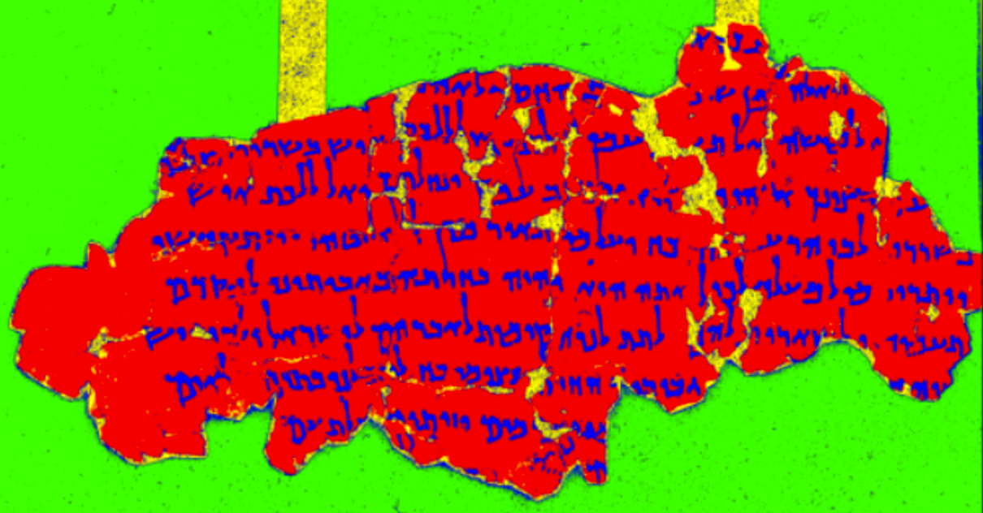
Clustering multispectral trends
Gray value trend of pixels across multispectral bands
Notes:
Next, we clustered the pixels based on their multispectral trends,
but this approach was not very successful in discriminating the ink from the black background.

Slide 17
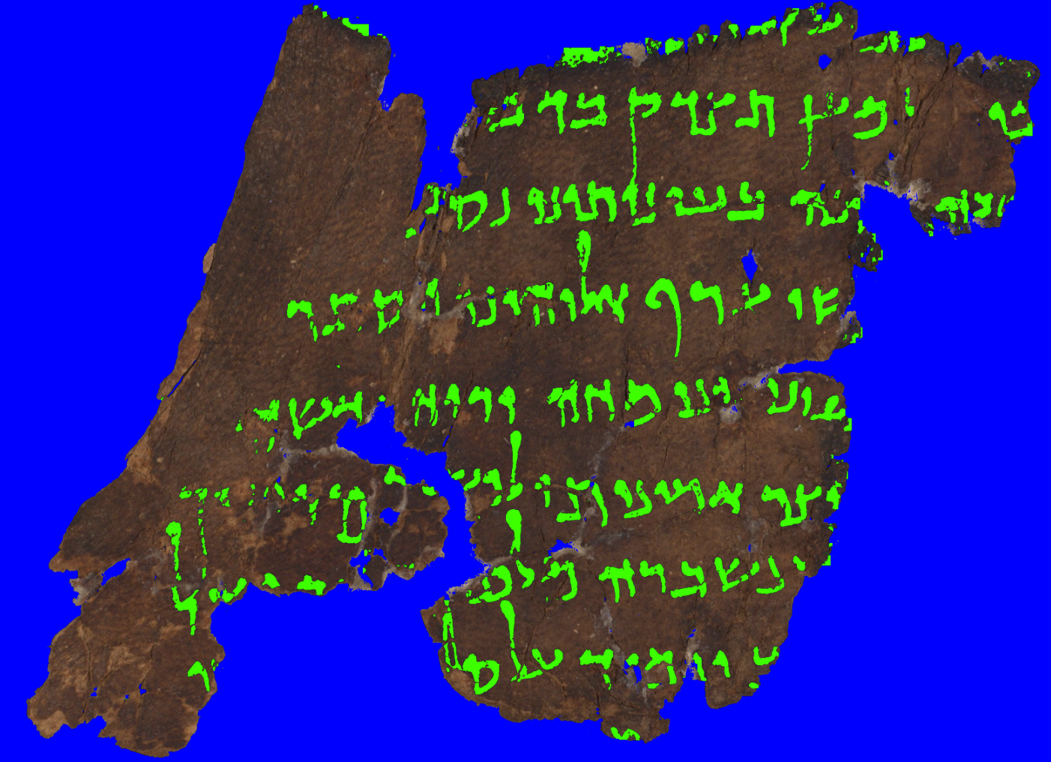
Multispectral thresholding with energy minimization (MSEM)
Notes:
Finally, we achieved satisfactory results using multispectral thresholding with energy minimization.
It can segment not only the ink but also the parchment, going beyond what we originally aimed.

Slide 18
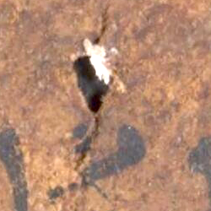
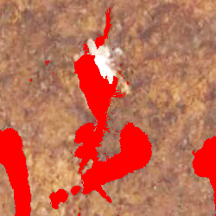
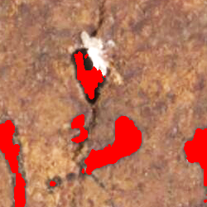
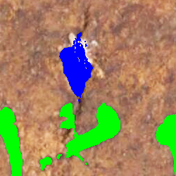
Multispectral thresholding with energy minimization (MSEM)
Input
Otsu
GrabCut
MSEM
Notes:
It can differentiate between the ink and the holes, unlike the Otsu and GrabCut methods.

Slide 19
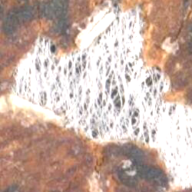
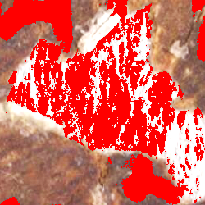
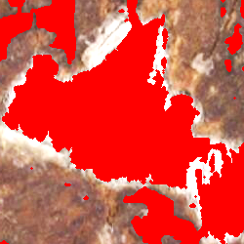
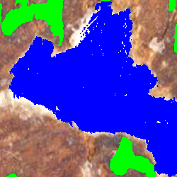
Multispectral thresholding with energy minimization (MSEM)
Input
Otsu
GrabCut
MSEM
Notes:
It can also discriminate between the ink and the rice paper, which the Otsu and GrabCut methods fail to segment.

Slide 20
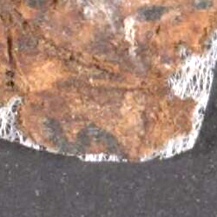
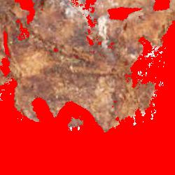
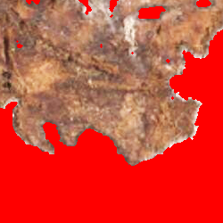
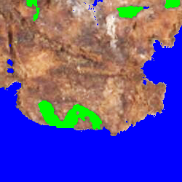
Multispectral thresholding with energy minimization (MSEM)
Input
Otsu
GrabCut
MSEM
Notes:
It can discriminate between the ink and the background as well, whereas the Otsu and GrabCut methods tend to lose the letters at the background edges of the parchment.

Slide 21
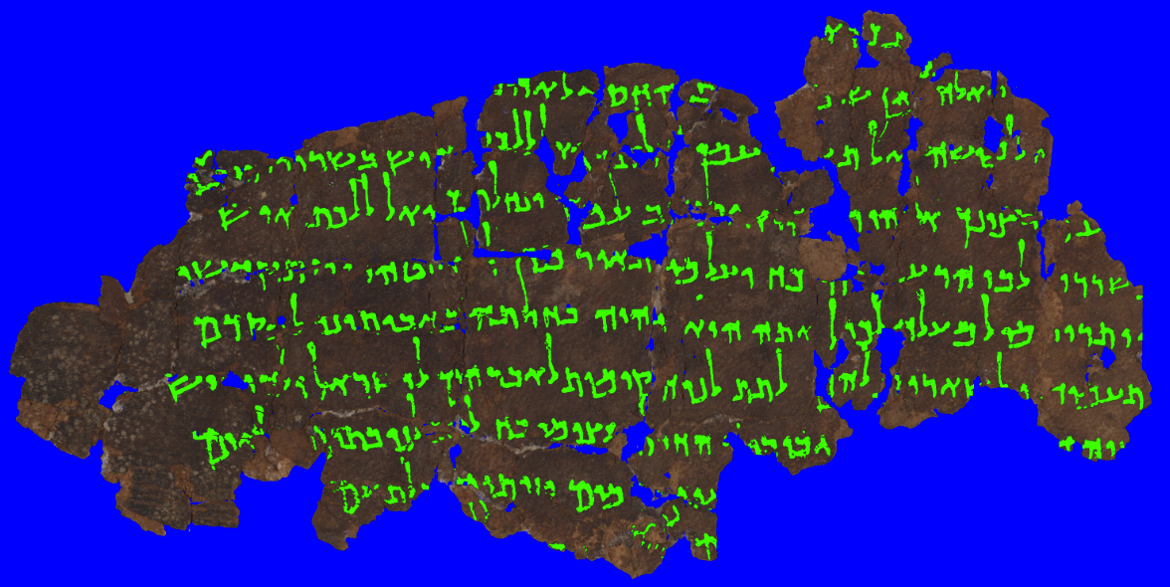
Multispectral thresholding with energy minimization (MSEM)
Notes:
And here are some additional results of ink and parchment segmentation obtained using multispectral thresholding with energy minimization.
This is an example of a parchment with quite amount of script interlaced with numerous holes among them.

Slide 22
Multispectral thresholding with energy minimization (MSEM)
Notes:
The multispectral thresholding with energy minimization method exhaustively segments each of the pixels in an IAA image, assigning each pixel to one class only. It does not rely on morphological or edge detection operations and makes no assumptions about component size. Thus, the segmentation of a part of an image is consistent with its segmentation as part of the entire image.

Slide 23
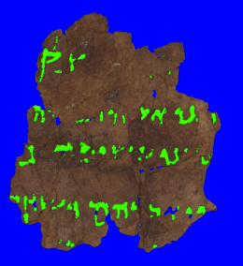
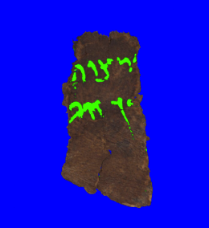
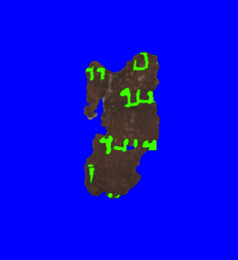
Multispectral thresholding with energy minimization (MSEM)
Notes:
These are examples of parchments with degraded ink and darkened parchment

Slide 24
More results on ink and parchment segmentation using MSEM
Notes:
Thank you for your time and attention. I look forward to any questions or feedback you may have.

